Slide 1
CSNHS 26-27 HACKATHON
Pathfolio
A high school experience tracker
Capture the details now. Use them when applications begin.
WORKING JAVA DEMO
Student view + counselor overview + resume export
Notes:
Challenge source: Hackathon -3 Building Your High School Portfolio (1).pdf, supplied by the user.

Slide 2
The memory gap
Students complete meaningful work, but the evidence gets scattered across four years.
The result
By senior year, names, dates, hours, and impact are easy to forget.
Incomplete applications
Missing service hours
Generic resume descriptions
College applications and scholarship forms ask for specific details. Students often rebuild those details from old messages, calendars, and memory.
Pathfolio fixes the problem while the experience is still fresh.
02
Notes:
Problem statement is based on page 2 of the supplied hackathon brief.

Slide 3
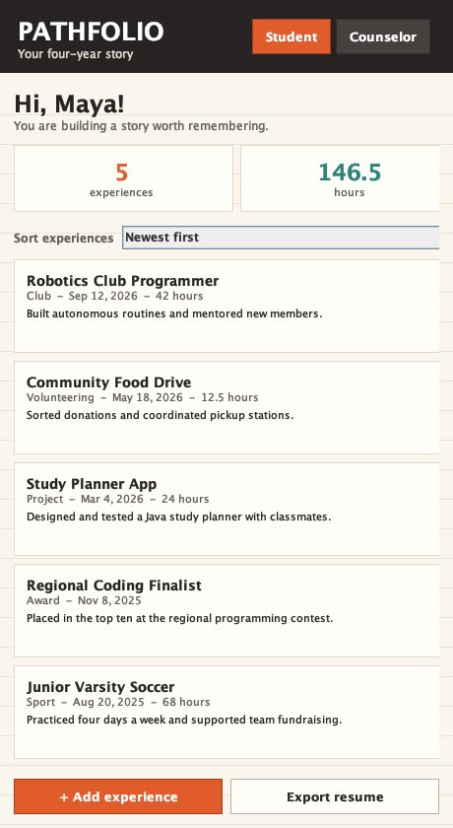
Student experience
A phone-sized workspace turns activities into a sortable four-year record.
Record an experience
Add the title, category, date, hours, and a short description.
Choose the order
Sort the full portfolio by newest, oldest, or activity category.
Reuse the work
Automatic hour totals stay visible, and the app exports organized resume text.
03
Notes:
Screenshot generated from the included Pathfolio Java application. Requirements source: supplied brief, pages 3 and 4.

Slide 4
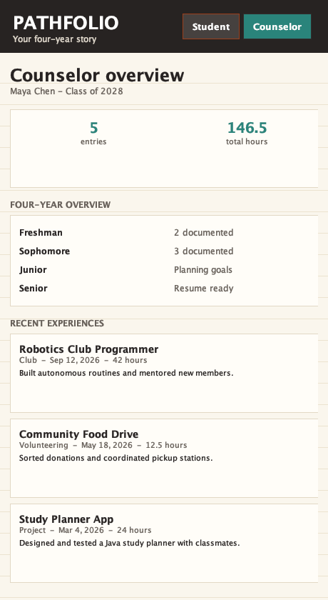
Counselor experience
Counselors can read the portfolio and see how it develops across high school.
Four-year overview
The year-by-year summary makes missing periods easy to notice.
Automatic hour total
The dashboard adds activity hours and shows the total at a glance.
Recent experiences
Counselors can read the latest titles, dates, hours, and descriptions.
04
Notes:
Screenshot generated from the included Pathfolio Java application. Counselor interaction is required by page 3 of the supplied brief.

Slide 5
Core application flow
Each new experience updates the hour total and joins the sortable portfolio.
Student adds
experience
App validates
required fields
App adds entry
and totals hours
Counselor views
four-year overview
Student sorts
or exports
If validation fails, the form stays open and highlights the missing or invalid field.
New entries remain available for the current app session.
05
Notes:
The flowchart documents the implemented Java application logic. Flowchart and core logic are required by pages 3 and 4 of the supplied brief.

Slide 6
Sorting and hour-total logic
Comparators change the record order, while aggregation calculates the hours.
Computer science concepts
INPUT sortMode
results = all experiences
IF sortMode is NEWEST
SORT results by date descending
ELSE IF sortMode is OLDEST
SORT results by date ascending
ELSE
SORT results by category
totalHours = SUM each experience's hours
DISPLAY results and totalHours
Data model
Each experience is one structured record with a category, date, hours, and description.
Algorithms
Comparators order the records. Aggregation adds the hours from every experience.
06
Notes:
Pseudocode reflects PortfolioService.sorted and PortfolioService.totalHours in the included Java source. The CS concept requirement appears on page 3 of the supplied brief.

Slide 7
A focused prototype
The simplified app keeps only the requested enhancements and the required user views.
Working prototype
Implementation
Add experiences during the current session
Sort by newest, oldest, or category
Calculate total hours automatically
Export resume-ready text
Show a four-year counselor overview
Standard Java Swing interface
In-memory demo records
No external libraries
Runs from a single JAR
Student and counselor views
Pathfolio gives every experience a place before the details disappear.
07
Notes:
Implementation details are drawn from the included Java source. The solution stays within the brief's high-school-level feasibility requirement.

