Slide 1
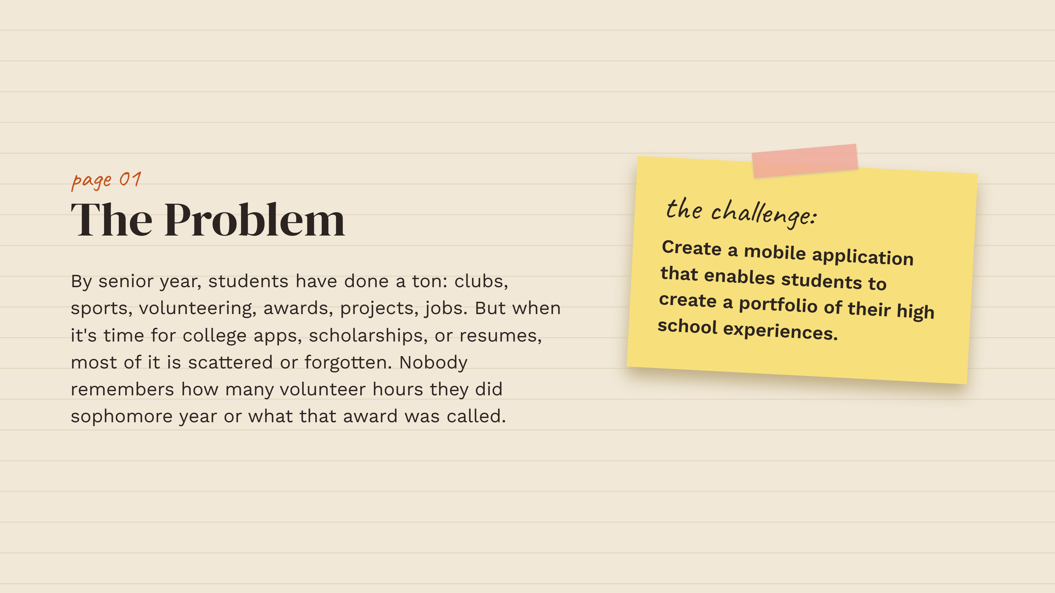
CSNHS 26-27 HACKATHON
Pathfolio
A high school experience tracker
Capture the details now. Use them when applications begin.
WORKING JAVA DEMO
Student view + counselor review + resume export
Notes:
Challenge source: Hackathon -3 Building Your High School Portfolio (1).pdf, supplied by the user.

Slide 2
The memory gap
Students complete meaningful work, but the evidence gets scattered across four years.
The result
By senior year, names, dates, hours, and impact are easy to forget.
Incomplete applications
Unverified service hours
Generic resume descriptions
College applications and scholarship forms ask for specific details. Students often rebuild those details from old messages, calendars, and memory.
Pathfolio fixes the problem while the experience is still fresh.
02
Notes:
Problem statement is based on page 2 of the supplied hackathon brief.

Slide 3
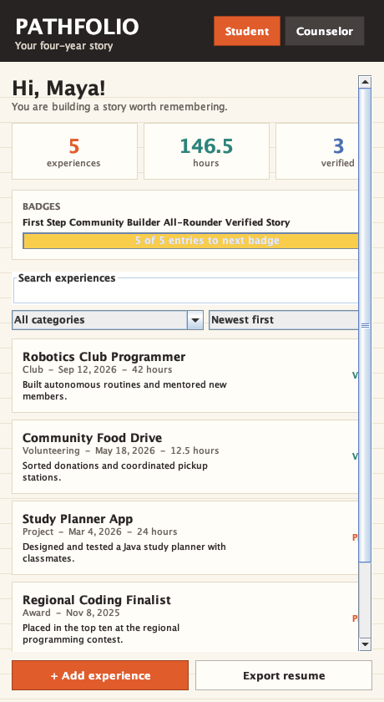
Student experience
A phone-sized workspace turns activities into a searchable four-year record.
Record an experience
Add the title, category, date, hours, and a short description.
Find the right story
Search descriptions, filter by activity type, or sort by date and category.
Reuse the work
Track progress with badges, then export organized resume text when it is needed.
03
Notes:
Screenshot generated from the included Pathfolio Java application. Requirements source: supplied brief, pages 3 and 4.

Slide 4
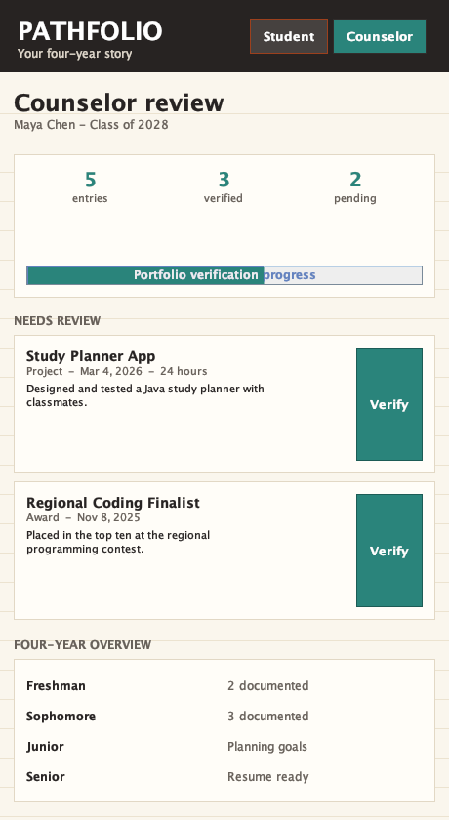
Counselor experience
Counselors review claims early instead of reconstructing a record during senior year.
Review queue
Pending activities appear in one list with dates, hours, and student descriptions.
One-click verification
A verified label tells students which entries are ready for official applications.
Four-year overview
The timeline makes missing years visible before they become an application problem.
04
Notes:
Screenshot generated from the included Pathfolio Java application. Counselor interaction is required by page 3 of the supplied brief.

Slide 5
Core application flow
Each saved experience becomes searchable, reviewable, and ready for reuse.
Student adds
experience
App validates
required fields
App saves and
updates totals
Counselor
verifies entry
Student exports
resume text
If validation fails, the form stays open and highlights the missing or invalid field.
All records remain on the student computer in the prototype.
05
Notes:
The flowchart documents the implemented Java application logic. Flowchart and core logic are required by pages 3 and 4 of the supplied brief.

Slide 6
Search, filter, and sort logic
A single pipeline transforms the saved list into the view the student requested.
Computer science concepts
INPUT query, selectedType, sortMode
results = all experiences
FILTER results where
title or description contains query
and type matches selectedType
SORT results by date or category
DISPLAY results
Data model
Each experience is one structured record with a category, date, hours, description, and verification status.
Algorithms
Predicate filters remove nonmatches. Comparators order the remaining records. Aggregation calculates total hours and badge progress.
06
Notes:
Pseudocode reflects PortfolioService.find in the included Java source. The CS concept requirement appears on page 3 of the supplied brief.

Slide 7
Realistic now, expandable later
The prototype works with standard Java and keeps the school rollout path simple.
Working prototype
School rollout
Add experiences and keep them between sessions
Search, filter, and sort the portfolio
Track hours, badges, and verification
Export resume-ready text
Move local records to a school database
Use student and counselor sign-in
Attach evidence when a school requires it
Generate formatted PDF resumes
Pathfolio gives every experience a place before the details disappear.
07
Notes:
Implementation details are drawn from the included Java source. The solution stays within the brief's high-school-level feasibility requirement.

