Slide 1
Time Series Data Mining Review
Author: Sun Zhao
Email:zixiaojindao@gmail.com

Slide 2
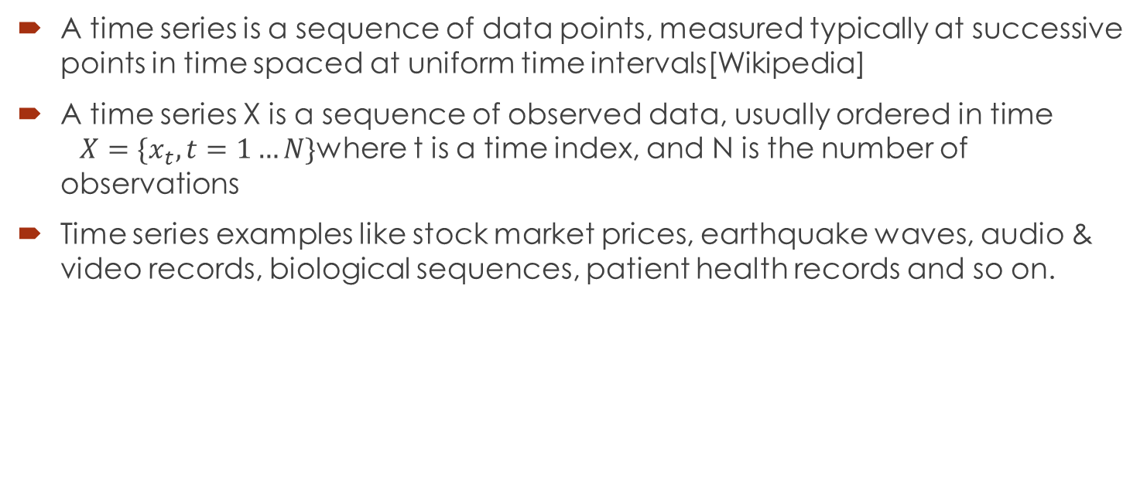
Time Series Definition
A time series is a sequence of data points, measured typically at successive points in time spaced at uniform time intervals[Wikipedia]
A time series X is a sequence of observed data, usually ordered in time $X=\{x_{t},t=1…N\}$where t is a time index, and N is the number of observations
Time series examples like stock market prices, earthquake waves, audio & video records, biological sequences, patient health records and so on.

Slide 3
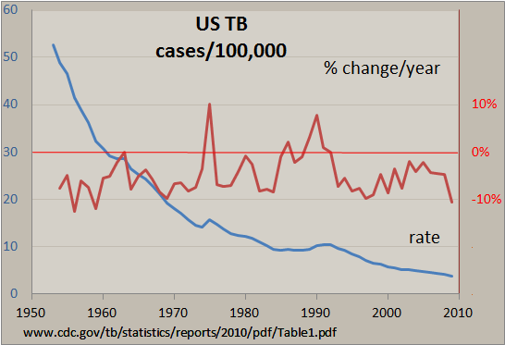
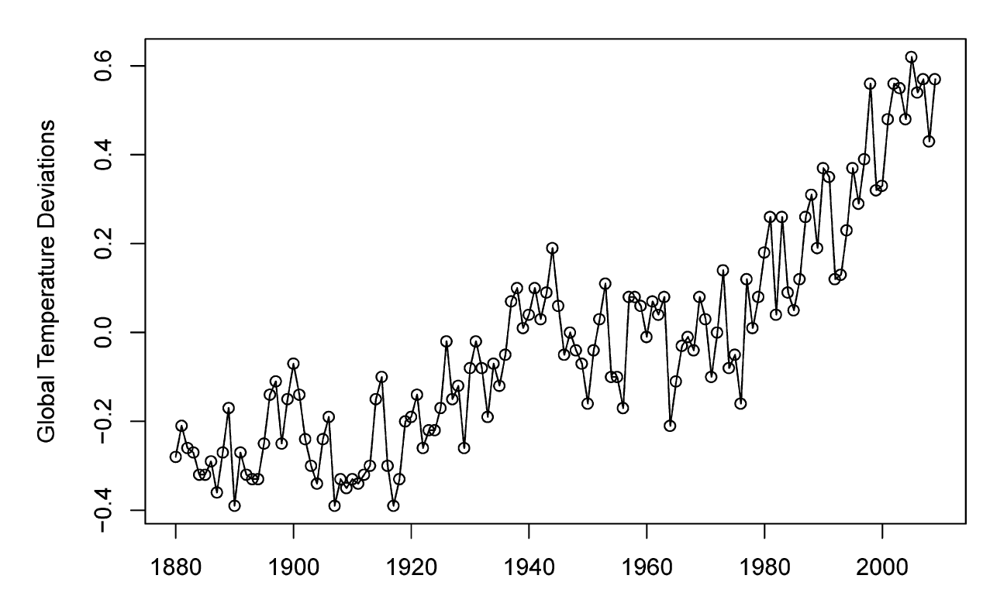
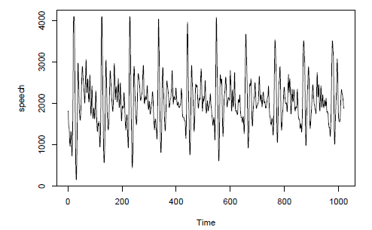
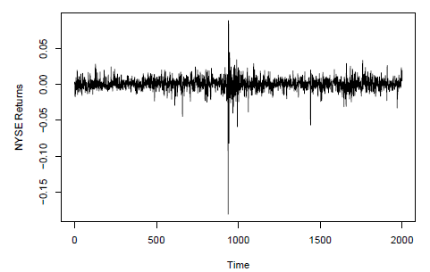
Time Series Visualization Examples

Slide 4
Time Series Data Mining(TSDM)
Query by content
Clustering
Classification
Segmentation
Prediction
Regression

Slide 5
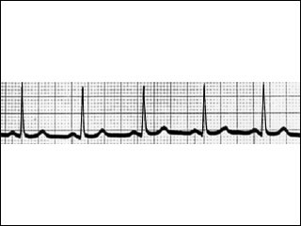
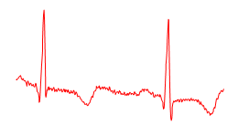
Query by Content
Given a query time series Q, and some similarity/ dissimilarity measure D(Q,C), find the nearest matching time series in database DB.
Motivating applications: keyword-based search in handwritten doc-
uments, DNA and protein matching, query-by-humming.
Full Sequence Matching
Subsequence Matching

Slide 6
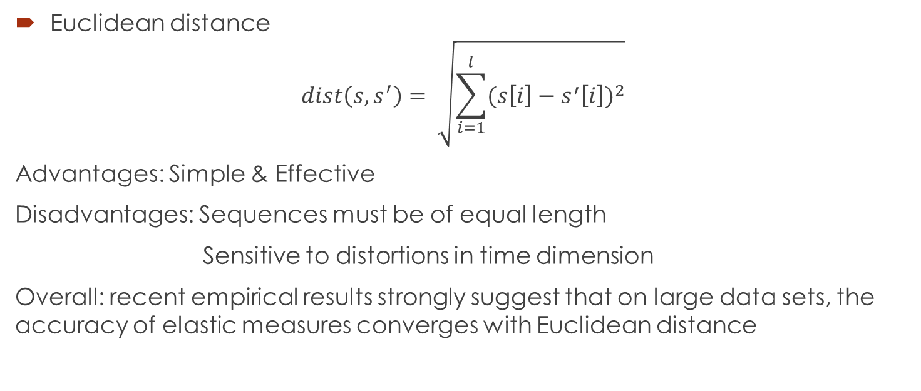
Full Sequence Matching
Euclidean distance
$$dist\left(s,s^{′}\right)= \sqrt{\sum_{i=1}^{l}{{(s\left[i\right]−s^{′}\left[i\right])}^{2}}}$$
Advantages: Simple & Effective
Disadvantages: Sequences must be of equal length
Sensitive to distortions in time dimension
Overall: recent empirical results strongly suggest that on large data sets, the accuracy of elastic measures converges with Euclidean distance

Slide 7
Full Sequence Matching
Dynamic Time Warping(DTW) algorithm[Kruskal and Liberman 1983]
int DTWDistance(s: array [1..n], t: array [1..m])
{
DTW := array [0..n, 0..m]
for i := 1 to m
DTW[0, i] := infinity
for i := 1 to n DTW[i, 0] := infinity
DTW[0, 0] := 0
for i := 1 to n
for j := 1 to m
cost:= d(s[i], t[j])
DTW[i, j] := cost + minimum(DTW[i-1, j ], // insertion
DTW[i , j-1], // deletion
DTW[i-1, j-1]) // match
return DTW[n, m]
}

Slide 8
Subsequence Matching
concatenating all data base sequence into one long one X.
Offline step:
Compute F(X, j) for all j.
Online steps, given a query Q:
Embedding step:
Compute F(Q).
Filter step:
Compare F(Q) to all F(X, j).
Select p best matches → p candidate endpoints.
Refine step:
Use DTW to evaluate each candidate endpoint.
Q:
TCTAGGGCA
…ACTTAGCTGTAGTCGTTCTATGGCATATGCATGCCATG…

Slide 9
Clustering
Find natural groupings of the time series in database DB under some similarity/dissimilarity measure D(Q,C)
Three time series clustering approaches:
raw-data-based
feature-based
model-based
General clustering methods
K-means, c-means
Hierarchical clustering
Neural networks
Similarity/distance measures
L p distance
Pearson’s correlation
Short time series distance
Dynamic time warping distance
Kullback–Liebler distance
Probability-based distance

Slide 10
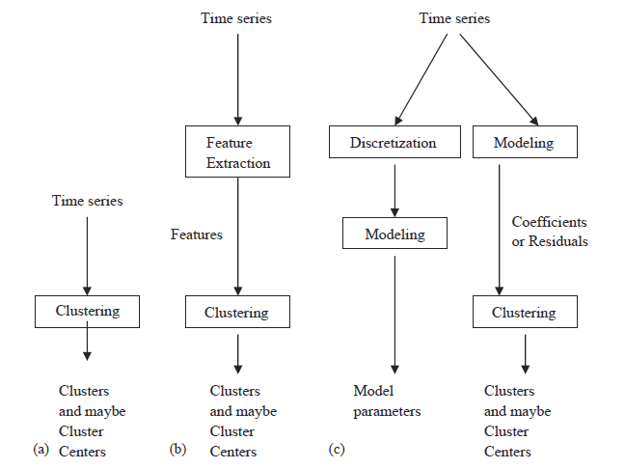
Clustering
Find natural groupings of the time series in database DB under some similarity/dissimilarity measure D(Q,C)
Three time series clustering approaches:
raw-data-based
feature-based
model-based
General clustering methods
K-means, c-means
Hierarchical clustering
Neural networks
Similarity/distance measures
L p distance
Pearson’s correlation
Short time series distance
Dynamic time warping distance
Kullback–Liebler distance
Probability-based distance

Slide 11
Classification
Given an unlabeled time series Q, assign it to one of two or more predefined classes
Three time series clustering approaches:
feature-based
sequence distance based
model-based

Slide 12
Feature Based Classification
Discrete symbolic:
k-gram based
pattern-based (define pattern criterion)
feature mining
Real value:
Time series shapelets
wavelet decomposition
Classifier:
Naive Bayes
SVM
Neural networks

Slide 13
Sequence Distance Based Classification
Similarity measure
Euclidean distance
DTW/Fast DTW
Alignment based distances for symbolic sequences
Global alignment: Needleman-Wunsch Algorithm
Local alignment: Smith-Waterman Algorithm, BLAST, BLAT
Classifiers:
KNN
SVM with particular kenels

Slide 14
Model Based Classification
Assumption: sequences in a class are generated by an underlying model M. Given a class of sequences, M models the probability distribution of the sequences in the class.
General process
Training step: Learn parameters for model M
classification step: Assign a new sequence to the class with the highest likelihood.
Generative models:
Naive Bayes
k-order Markov
Profile HMM

Slide 15
Segmentation
Given a time series Q containing n data points, construct a model Q’, from K piecewise segments (K<<n) such that Q’ closely approximates Q

Slide 16
Prediction
Find unusual subsequences(events) of the time series in TSDB under to some similarity/dissimilarity measure D(Q,C).

Slide 17
Regression
Given a query time series t, prediction the next certain number of data points of t.

