Slide 1
Time Series Data Mining Review
Author: Sun Zhao
Email:zixiaojindao@gmail.com

Slide 2
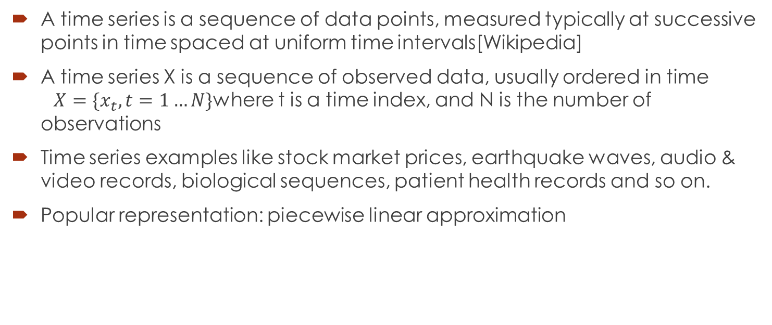
Time Series Definition
A time series is a sequence of data points, measured typically at successive points in time spaced at uniform time intervals[Wikipedia]
A time series X is a sequence of observed data, usually ordered in time $X=\{x_{t},t=1…N\}$where t is a time index, and N is the number of observations
Time series examples like stock market prices, earthquake waves, audio & video records, biological sequences, patient health records and so on.
Popular representation: piecewise linear approximation

Slide 3
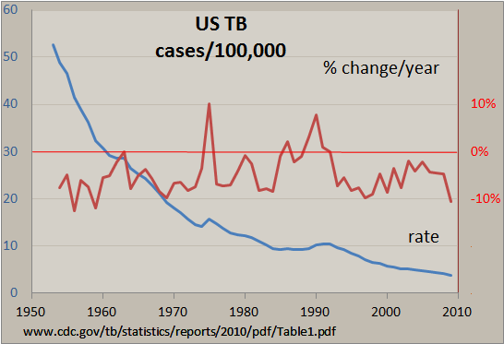
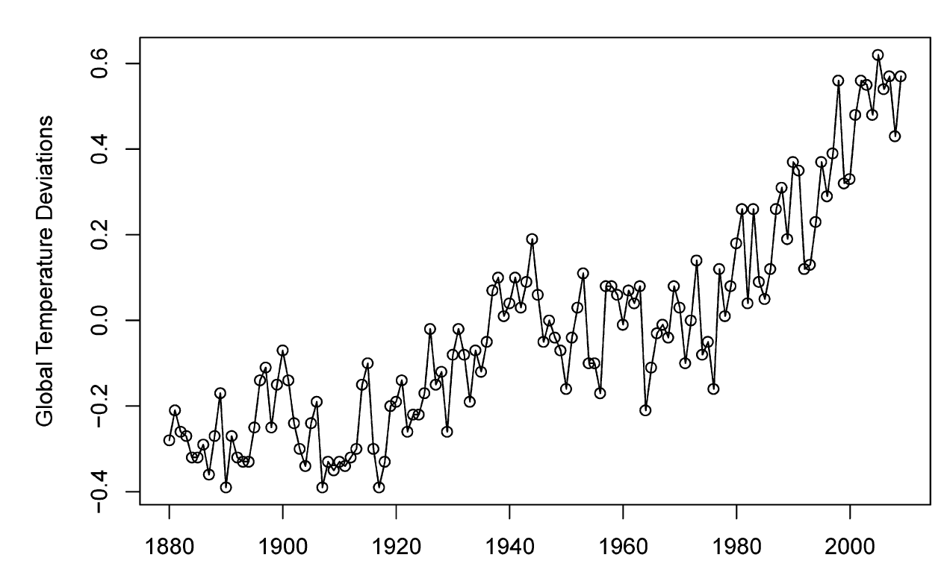
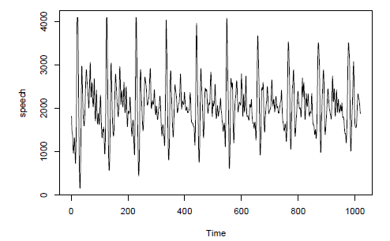
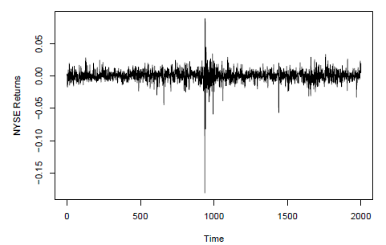
Time Series Visualization Examples

Slide 4
Time Series Data Mining(TSDM)
Segmentation
Forecasting
Query by content
Prediction
Clustering
Classification

Slide 5
Segmentation
Given a time series T, produce the best representation using only K segments.
Given a time series T, produce the best representation such that the maximum error for any segment does not exceed some user-specified threshold, max error.
Given a time series T, produce the best representation such that the combined error of all segments is less than some user-specified threshold, total max error.

Slide 6
Segmentation Basic Approaches
Sliding Windows: A segment is grown until it exceeds some error bound. The process repeats with the next data point not included in the newly approximated segment.
Top-Down: The time series is recursively partitioned until some stopping criteria is met.
Bottom-Up: Starting from the finest possible approximation, segments are merged until some stopping criteria is met.

Slide 7
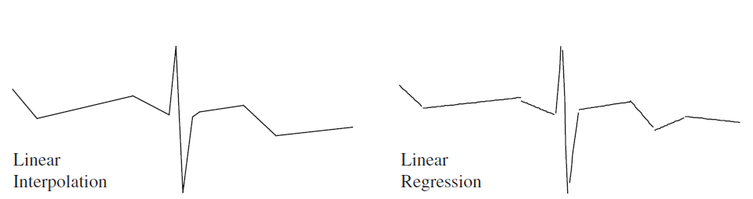

Create Segments
Linear Interpolation: Here the approximating line for the subsequence T[a : b] is simply the line connecting $t_{a}$ and $t_{b}$. This can be obtained in constant time.
Linear Regression: Here the approximating line for the subsequence T[a : b] is taken to be the best fitting line in the least squares sense [Shatkay (1995)]. This can be obtained in time linear in the length of segment.

Slide 8
Sliding Window
Algorithm Seg_TS = Sliding_Window(T, max error)
anchor = 1;
while not finished segmenting time series
i = 2;
while calculate_error(T[anchor: anchor + i ]) < max_error
i = i + 1;
end;
Seg_TS = concat(Seg TS, create_segment(T[anchor: anchor
+ (i - 1)]);anchor = anchor + i;
end;

Slide 9
Top-Down Segmentation
Algorithm SegTS = TopDown(T, max_error) best_so_far = inf; for i = 2 to length(T) - 2 // Find the best splitting point. improvement_in_approximation = improvement_splitting_here(T, i); if improvement_in_approximation < best_so_far breakpoint = i; best_so_far = improvement_in_approximation; end; end; // Recursively split the left segment if necessary. if calculate_error(T[1:breakpoint]) > max_error SegTS = TopDown(T[1:breakpoint]); end; // Recursively split the right segment if necessary. if calculate_error(T[breakpoint + 1:length(T)]) > max_error SegTS = TopDown(T[breakpoint + 1:length(T)]); end;

Slide 10
Bottom-up Segmentation
Algorithm SegTS = BottomUp(T, max_error)
for i = 1 : 2 : length(T) // Create initial fine approximation.
SegTS = concat(SegTS, create_segment(T[i: i + 1 ]));
end;
for i = 1 : length(SegTS) - 1 // Find merging costs.
merge_cost(i) = calculate_error([merge(SegTS(i), SegTS(i + 1))]);
end;
while min(merge_cost) < max error // While not finished.
p = min(merge_cost); // Find ‘‘cheapest’’ pair to merge.
SegTS(p) = merge(SegTS(p), SegTS(p + 1)); // Merge them.
delete(SegTS(p + 1)); // Update records.
merge_cost(p) = calculate_error(merge(SegTS(p), SegTS(p + 1)));
merge_cost(p - 1) = calculate_error(merge(SegTS(p - 1), SegTS(p)));
end;

Slide 11
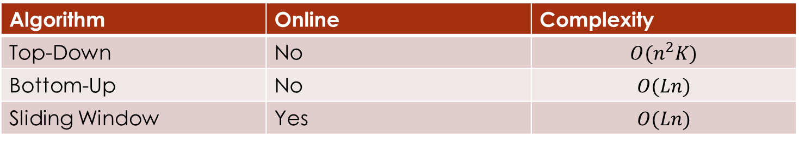
Comparison
Algorithm | Online | Complexity
Top-Down | No | $$O(n^{2}K)$$
Bottom-Up | No | $$O(Ln)$$
Sliding Window | Yes | $$O(Ln)$$
L=n/K

Slide 12
Forecasting
Given a query time series t, forecast the next certain number of data points of t.
Subjective
subjective basis using judgement, intuition, commercial knowledge and any
other relevant information
Univariate
based on a model fitted only to present and past observations of a given
time series
Multivariate
depend at least partly on values of one or more additional series

Slide 13
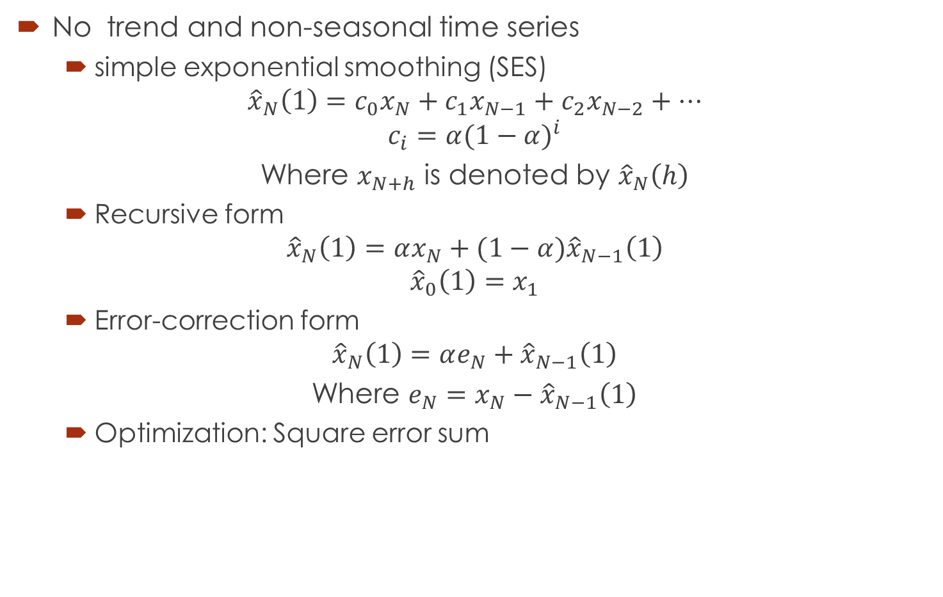
Univariate Forecasting
No trend and non-seasonal time series
simple exponential smoothing (SES)
$${\hat{x}}_{N}\left(1\right)=c_{0}x_{N}+c_{1}x_{N−1}+c_{2}x_{N−2}+…$$
$$c_{i}=α{(1−α)}^{i}$$
Where $x_{N+h}$ is denoted by ${\hat{x}}_{N}\left(h\right)$
Recursive form
$${\hat{x}}_{N}\left(1\right)=αx_{N}+(1−α){\hat{x}}_{N−1}\left(1\right)$$
$${\hat{x}}_{0}\left(1\right)=x_{1}$$
Error-correction form
$${\hat{x}}_{N}\left(1\right)=αe_{N}+{\hat{x}}_{N−1}\left(1\right)$$
Where $e_{N}=x_{N}−{\hat{x}}_{N−1}\left(1\right)$
Optimization: Square error sum

Slide 14

Univariate Forecasting
Trend and non-seasonal time series
Holt forecasting procedure
$$L_{t}=αx_{t}+\left(1−α\right){(L}_{t−1}+T_{t−1})$$
$$T_{t}=γ\left(L_{t}−L_{t−1}\right)+\left(1−γ\right)T_{t−1}$$
$${\hat{x}}_{t}\left(h\right)=(L_{t}+hT_{t})$$

Slide 15

Univariate Forecasting
Trend and seasonal time series
Holt winner forecasting procedure
$$L_{t}=α\left(\frac{x_{t}}{I_{t−12}}\right)+(1−α)(L_{t−1}+T_{t−1})$$
$$T_{t}=γ\left(L_{t}−L_{t−1}\right)+\left(1−γ\right)T_{t−1}$$
$$I_{t}=δ\left(\frac{x_{t}}{L_{t}}\right)+\left(1−δ\right)I_{t−12}$$
$${\hat{x}}_{t}\left(h\right)=\left(L_{t}+hT_{t}\right)I_{t−12+h}$$

Slide 16
Univariate Forecasting
Box-Jenkins procedure
To be reviewed

Slide 17
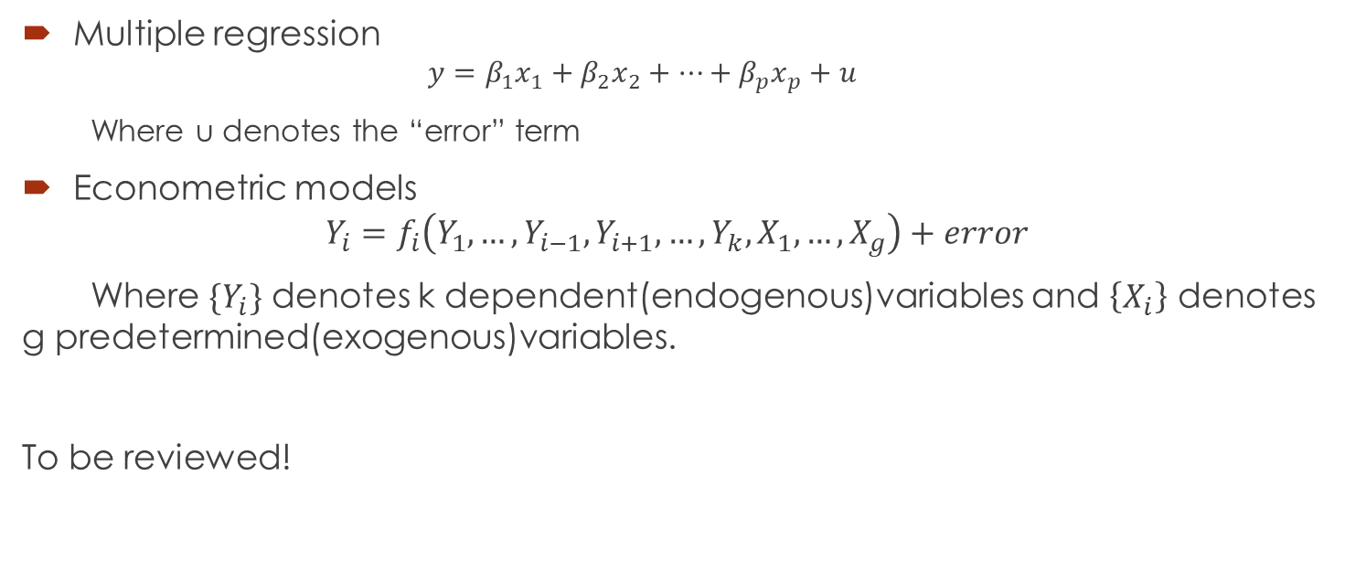
Multivariate Forecasting
Multiple regression
$$y=β_{1}x_{1}+β_{2}x_{2}+…+β_{p}x_{p}+u$$
Where u denotes the “error” term
Econometric models
$$Y_{i}=f_{i}\left(Y_{1},…,Y_{i−1},Y_{i+1},…,Y_{k},X_{1},…,X_{g}\right)+error$$
Where $\{Y_{i}\}$ denotes k dependent(endogenous)variables and $\left\{X_{i}\right\}$ denotes g predetermined(exogenous)variables.
To be reviewed!

Slide 18
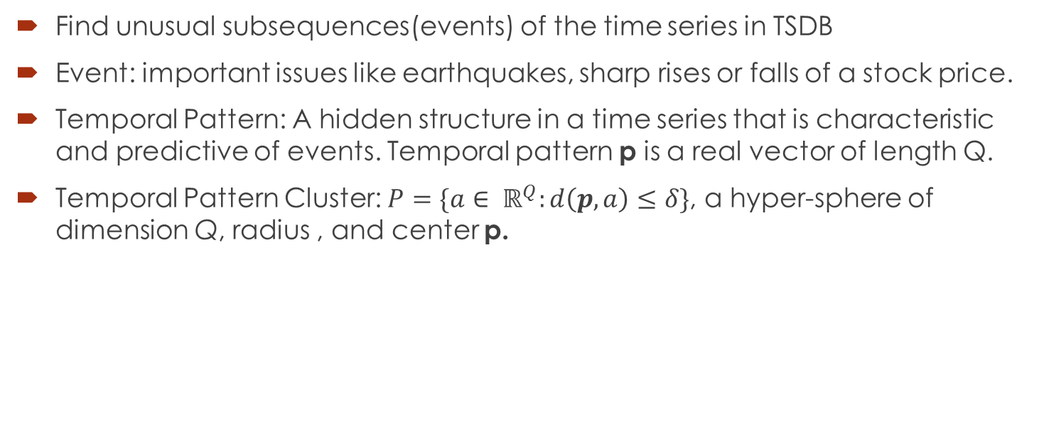
Prediction
Find unusual subsequences(events) of the time series in TSDB
Event: important issues like earthquakes, sharp rises or falls of a stock price.
Temporal Pattern: A hidden structure in a time series that is characteristic and predictive of events. Temporal pattern p is a real vector of length Q.
Temporal Pattern Cluster: $P=\{a∈ ℝ^{Q}:d\left(p,a\right)≤δ\}$, a hyper-sphere of dimension Q, radius , and center p.

Slide 19
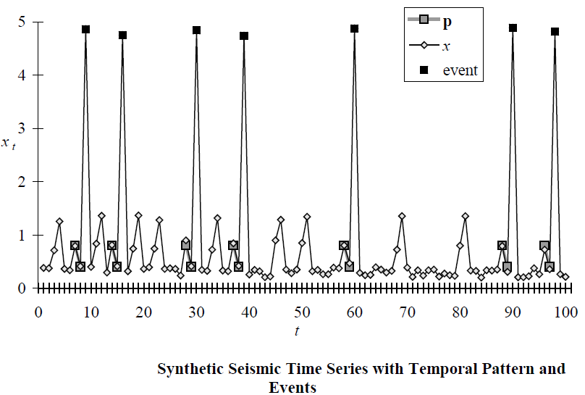

Prediction
Find unusual subsequences(events) of the time series in TSDB under to some similarity/dissimilarity measure D(Q,C).
Event: important issues like earthquakes, sharp rises or falls of a stock price
Temporal Pattern: A hidden structure in a time series that is characteristic and predictive of events. Temporal pattern p is a real vector of length Q.
Temporal Pattern Cluster: $P=\{a∈ ℝ^{Q}:d\left(p,a\right)≤δ\}$, a hyper-sphere of dimension Q, radius , and center p

Slide 20
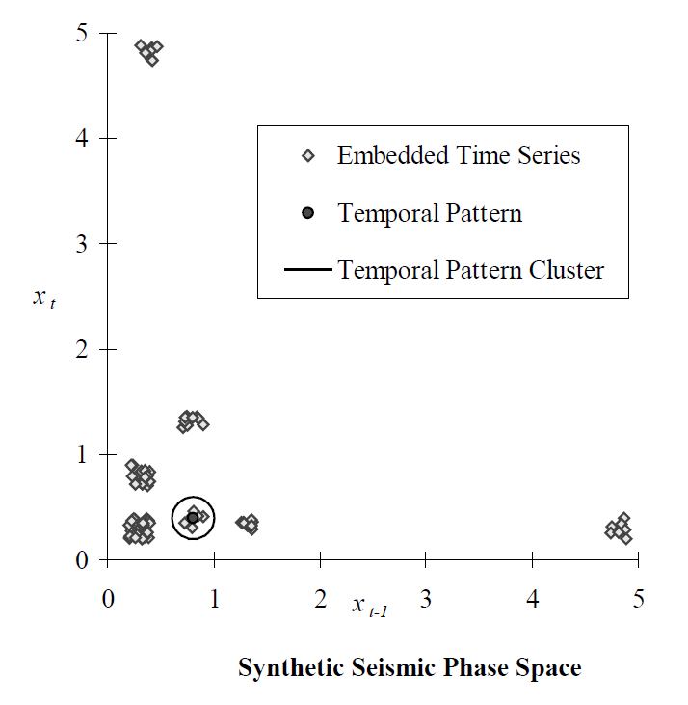

Time Delay Embedding
Time-Delay Embedding: $x_{t}=(x_{t−\left(Q−1\right)τ},…,x_{t−2τ},x_{t−τ}, x_{t})$

Slide 21
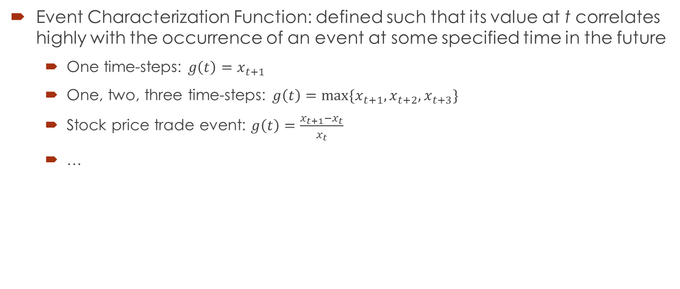
Event Characterization
Event Characterization Function: defined such that its value at t correlates highly with the occurrence of an event at some specified time in the future
One time-steps: $g\left(t\right)=x_{t+1}$
One, two, three time-steps: $g\left(t\right)=max⁡\{x_{t+1}, x_{t+2}, x_{t+3}\}$
Stock price trade event: $g\left(t\right)=\frac{x_{t+1}−x_{t}}{x_{t}}$
…

Slide 22
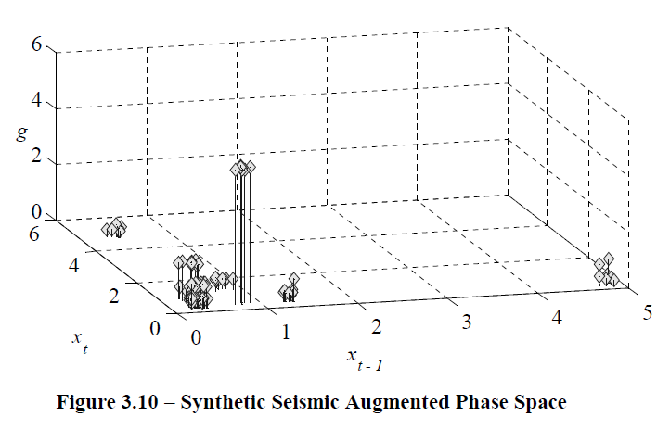

Augmented Embedding
Augmented Embedding: $<x_{t}, g\left(t\right)>∈ℝ^{Q+1}$

Slide 23

Object Function&Optimization
$$Λ=\left\{t:t=\left(Q−1\right)τ+1,…,N\right\}$$
$$M=\left\{t:x_{t}∈P, t∈Λ\right\}$$
$$\tilde{M}=\left\{t:x_{t}∉P\right\}$$
$$μ_{M}=\frac{1}{|M|}\sum_{t∈M}{g(t)}$$
$$σ_{M}^{2}=\frac{1}{|M|}\sum_{t∈M}{{(g\left(t\right)−μ_{M}^{})}^{2}}$$
Objection function: T test
$$f\left(P\right)=\frac{μ_{M}−μ_{\tilde{M}}}{\sqrt{\frac{σ_{M}^{2}}{|M|}+\frac{σ_{\tilde{M}}^{2}}{|\tilde{M|}}}}$$
Optimization: Genetic Algorithm

Slide 24
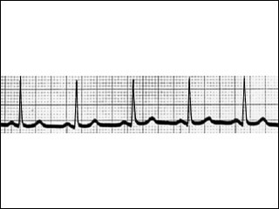
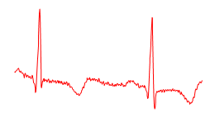
Query by Content
Given a query time series Q, and some similarity/ dissimilarity measure D(Q,C), find the nearest matching time series in database DB.
Motivating applications: keyword-based search in handwritten doc-
uments, DNA and protein matching, query-by-humming.
Full Sequence Matching
Subsequence Matching

Slide 25
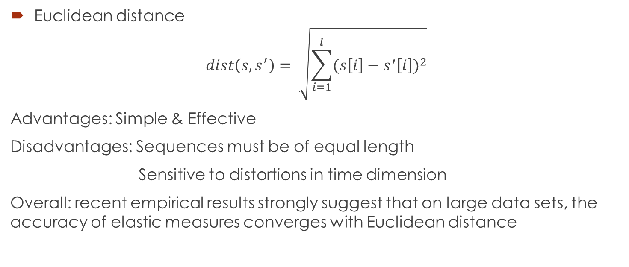
Full Sequence Matching
Euclidean distance
$$dist\left(s,s^{′}\right)= \sqrt{\sum_{i=1}^{l}{{(s\left[i\right]−s^{′}\left[i\right])}^{2}}}$$
Advantages: Simple & Effective
Disadvantages: Sequences must be of equal length
Sensitive to distortions in time dimension
Overall: recent empirical results strongly suggest that on large data sets, the accuracy of elastic measures converges with Euclidean distance

Slide 26
Full Sequence Matching
Dynamic Time Warping(DTW) algorithm[Kruskal and Liberman 1983]
int DTWDistance(s: array [1..n], t: array [1..m])
{
DTW := array [0..n, 0..m]
for i := 1 to m
DTW[0, i] := infinity
for i := 1 to n
DTW[i, 0] := infinity
DTW[0, 0] := 0
for i := 1 to n
for j := 1 to m
cost:= d(s[i], t[j])
DTW[i, j] := cost + minimum(DTW[i-1, j ], // insertion
DTW[i , j-1], // deletion
DTW[i-1, j-1]) // match
return DTW[n, m]
}

Slide 27
Subsequence Matching
concatenating all data base sequence into one long one X？
Q:
TCTAGGGCA
…ACTTAGCTGTAGTCGTTCTATGGCATATGCATGCCATG…

Slide 28
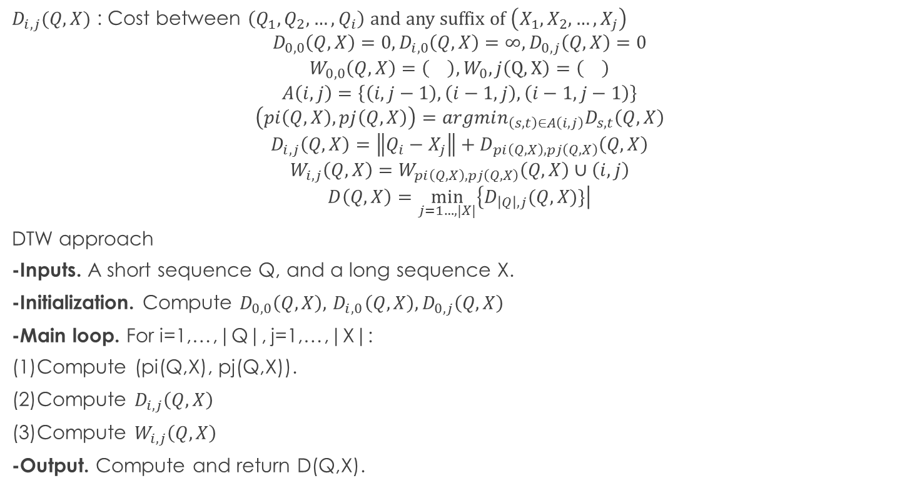
Subsequence Matching
$D_{i,j}(Q,X)$ : Cost between $\left(Q_{1},Q_{2},…,Q_{i}\right)$ and any suffix of $\left(X_{1}, X_{2},…,X_{j}\right)$
$$D_{0,0}\left(Q,X\right)=0, D_{i,0}\left(Q,X\right)=∞, D_{0,j}\left(Q, X\right)=0$$
$$W_{0,0}\left(Q,X\right)=\left(\right), W_{0},j\left(Q,X\right)=\left(\right)$$
$$A\left(i,j\right)=\left\{\left(i,j−1\right),\left(i−1,j\right),\left(i−1,j−1\right)\right\}$$
$$\left(pi\left(Q,X\right),pj\left(Q,X\right)\right)=argmin_{\left(s,t\right)∈A\left(i,j\right)}D_{s,t}\left(Q,X\right)$$
$$D_{i,j}\left(Q,X\right)=\left\|Q_{i}−X_{j}\right\|+D_{pi\left(Q,X\right),pj\left(Q,X\right)}\left(Q,X\right)$$
$$W_{i,j}\left(Q,X\right)=W_{pi\left(Q,X\right),pj\left(Q,X\right)}\left(Q,X\right)∪\left(i,j\right)$$
$$D\left(Q,X\right)=\min_{j=1…,|X|}\left\{D_{\left|Q\right|,j}(Q,X)\}\right|$$
DTW approach
-Inputs. A short sequence Q, and a long sequence X.
-Initialization. Compute $D_{0,0}\left(Q,X\right),{ D}_{i,0}\left(Q,X\right), D_{0,j}\left(Q, X\right)$
-Main loop. For i=1,…,|Q|, j=1,…,|X|:
(1)Compute (pi(Q,X), pj(Q,X)).
(2)Compute $D_{i,j}\left(Q,X\right)$
(3)Compute $W_{i,j}\left(Q,X\right)$
-Output. Compute and return D(Q,X).
O(|Q||X|)

Slide 29
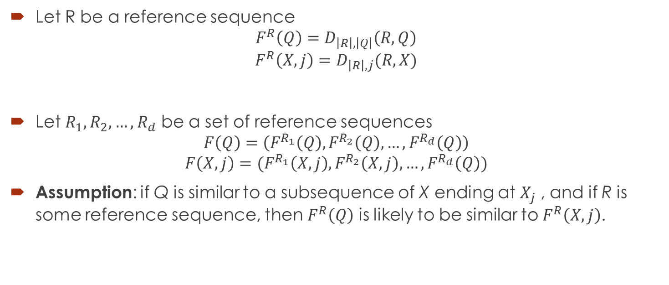
Subsequence Matching
Let R be a reference sequence
$$F^{R}\left(Q\right)=D_{\left|R\right|,\left|Q\right|}\left(R,Q\right)$$
$$F^{R}\left(X,j\right)=D_{\left|R\right|,j}(R,X)$$
Let $R_{1},R_{2},…,R_{d}$ be a set of reference sequences
$$F\left(Q\right)=\left(F^{R_{1}}\left(Q\right), F^{R_{2}}\left(Q\right),…,F^{R_{d}}\left(Q\right)\right)$$
$$F\left(X,j\right)=(F^{R_{1}}\left(X,j\right),F^{R_{2}}\left(X,j\right),…,F^{R_{d}}\left(Q\right))$$
Assumption: if Q is similar to a subsequence of X ending at $X_{j}$ , and if R is some reference sequence, then $F^{R}\left(Q\right)$ is likely to be similar to $F^{R}\left(X,j\right)$.

Slide 30
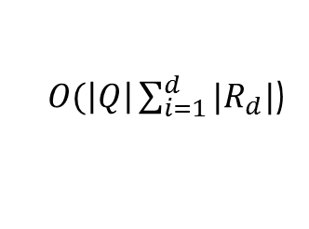
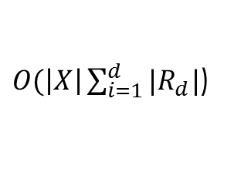
Subsequence Matching
Offline step:
Compute F(X, j) for all j.
Online steps, given a query Q:
Embedding step:
Compute F(Q).
Filter step:
Compare F(Q) to all F(X, j).
Select p best matches → p candidate endpoints.
Refine step:
Use DTW to evaluate each candidate endpoint.
$O(\left|X\right|\sum_{i=1}^{d}{|R_{d}|}$)
$O(\left|Q\right|\sum_{i=1}^{d}{|R_{d}|}$)

Slide 31
Subsequence Matching
Optimization
Filter step: sampling values of Distance(F(Q), F(X,j)) for all j
Refine step: Max length limited to 2|Q|
Reference sequences selection
Details omitted

Slide 32
Clustering
Find natural groupings of the time series in database DB under some similarity/dissimilarity measure D(Q,C).
Three time series clustering approaches:
raw-data-based
feature-based
model-based
General clustering methods
K-means, c-means
Hierarchical clustering
Neural networks
Similarity/distance measures
L p distance
Pearson’s correlation
Short time series distance
Dynamic time warping distance
Kullback–Liebler distance
Probability-based distance

Slide 33
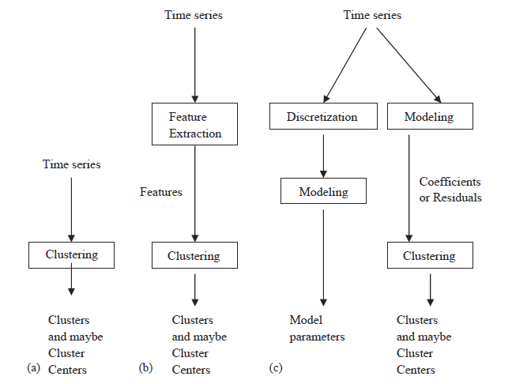
Clustering
Find natural groupings of the time series in database DB under some similarity/dissimilarity measure D(Q,C)
Three time series clustering approaches:
raw-data-based
feature-based
model-based
General clustering methods
K-means, c-means
Hierarchical clustering
Neural networks
Similarity/distance measures
L p distance
Pearson’s correlation
Short time series distance
Dynamic time warping distance
Kullback–Liebler distance
Probability-based distance

Slide 34
Classification
Given an unlabeled time series Q, assign it to one of two or more predefined classes
Three time series clustering approaches:
feature-based
sequence distance based
model-based

Slide 35
Feature Based Classification
Discrete symbolic:
k-gram based
pattern-based (define pattern criterion)
feature mining
Real value:
Time series shapelets
wavelet decomposition
Classifier:
Naive Bayes
SVM
Neural networks

Slide 36
Sequence Distance Based Classification
Similarity measure
Euclidean distance
DTW/Fast DTW
Alignment based distances for symbolic sequences
Global alignment: Needleman-Wunsch Algorithm
Local alignment: Smith-Waterman Algorithm, BLAST, BLAT
Classifiers:
KNN
SVM with particular kenels

Slide 37
Model Based Classification
Assumption: sequences in a class are generated by an underlying model M. Given a class of sequences, M models the probability distribution of the sequences in the class.
General process
Training step: Learn parameters for model M
classification step: Assign a new sequence to the class with the highest likelihood.
Generative models:
Naive Bayes
k-order Markov
Profile HMM

Slide 38
Sequence Analysis
Subsequence Matching
Frequent subsequence mining
Sequence Prediction
Bioinformatics Sequence Analysis
DNA sequence alignment
Motif discovery
Sequence classification

Slide 39
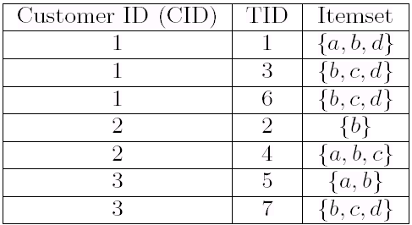
Frequent subsequence mining
Sequence
representation
S= ({a}, {b, c}) is a sequence
The support of S is Sup_{D}(S)
Frequent sequential pattern:
Sup_{D}(S) >= Min Support
Sup_{D}(S) = Sup_{D} ({a}, {b, c} ) = 2

Slide 40
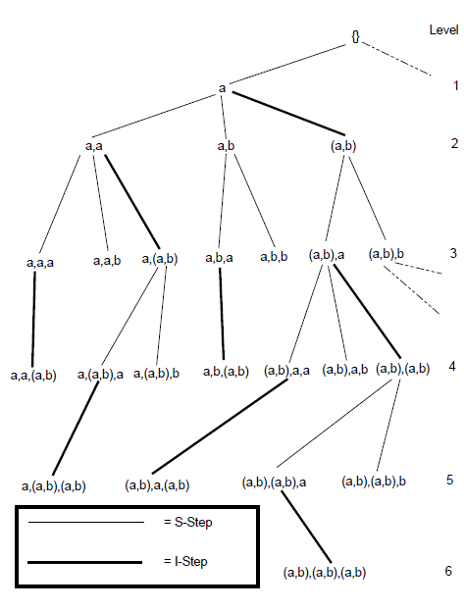
Sequence Tree
S = ({a, b, c}, {a, b})
Sequence-extended sequence
S’=({a,b,c},{a,b},{d})
Item-extended sequence
S’=({a,b,c},{a,b,d}

Slide 41
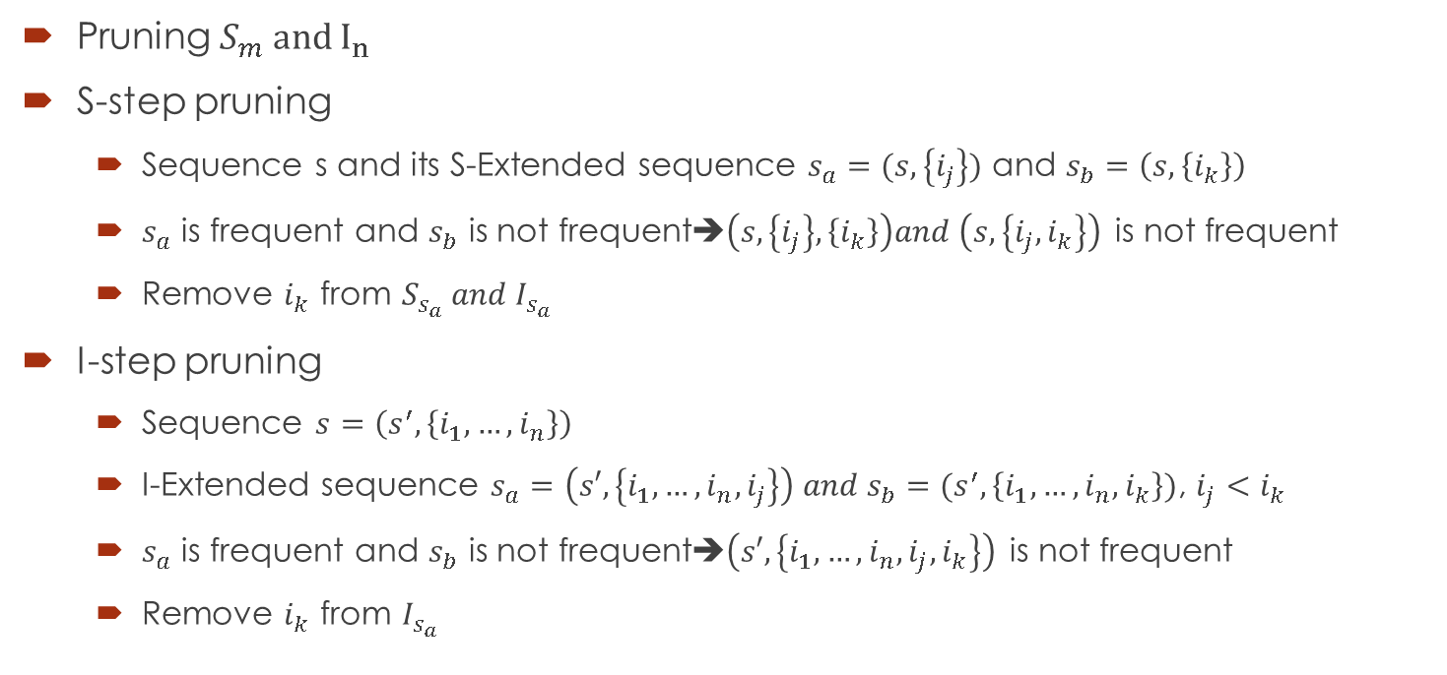
Frequent subsequence mining
Pruning $S_{m} and I_{n}$
S-step pruning
Sequence s and its S-Extended sequence $s_{a}=(s,\left\{i_{j}\right\})$ and $s_{b}=\left(s,\left\{i_{k}\right\}\right)$
$s_{a}$ is frequent and $s_{b}$ is not frequent➔$\left(s,\left\{i_{j}\right\},\left\{i_{k}\right\}\right)and \left(s,\left\{i_{j}, i_{k}\right\}\right)$ is not frequent
Remove $i_{k}$ from $S_{s_{a}} and I_{s_{a}}$
I-step pruning
Sequence $s=\left(s^{′},\left\{i_{1},…,i_{n}\right\}\right)$
I-Extended sequence $s_{a}=\left(s′,\left\{i_{1},…,i_{n},i_{j}\right\}\right) and s_{b}=(s^{′},\left\{i_{1},…,i_{n},i_{k}\right\})$, $i_{j}<i_{k}$
$s_{a}$ is frequent and $s_{b}$ is not frequent➔$\left(s′,\left\{i_{1},…,i_{n},i_{j},i_{k}\right\}\right)$ is not frequent
Remove $i_{k}$ from $I_{s_{a}}$

Slide 42
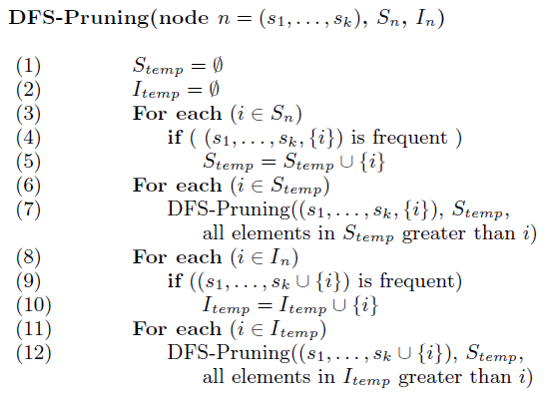
DFS-Pruning Algorithm
DFS-Pruning Algorithm

Slide 43
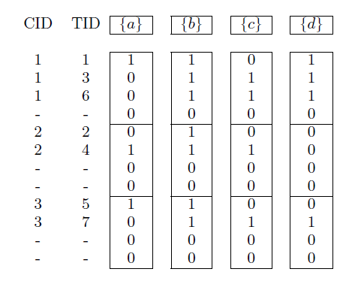

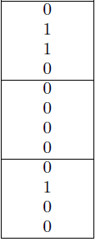
How to count frequency？
Sequence bitmap, last item set indicator

Slide 44
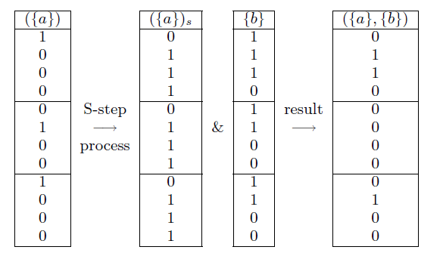
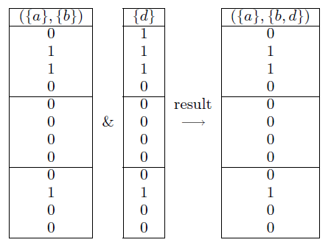
Bitmap Counting
S-Process I-Process

Slide 45
Mining Data Streams
Process of extracting knowledge structures from continuous, rapid data records.
Computer network traffic, phone conversations, ATM transactions, web searches, and sensor data.
One pass constrain.
Temporal evolution, historical data may be updated.

Slide 46
Theoretical Foundations
Data-based techniques(summarize data set)
Sampling
Load shedding
Sketching
Aggregation
Task-based techniques(address computational challenges)
Approximation algorithms
Sliding Window
Algorithm Output Granularity

Slide 47
Sampling
Reservoir sampling
array R[k]; // result
integer i, j;
// fill the reservoir array
for each i in 1 to k do
R[i] := S[i]
done;
// replace elements with gradually decreasing probability
for each i in k+1 to length(S) do
j := random(1, i); // important: inclusive range
if j <= k then
R[j] := S[i]
fi
Done
Drawbacks: can not adapted to fluctuating data rates

Slide 48
Load Shedding
Determine when to shed load
Determine where to she load
Determine how much load to shed
Drawbacks: drop potential patterns

Slide 49
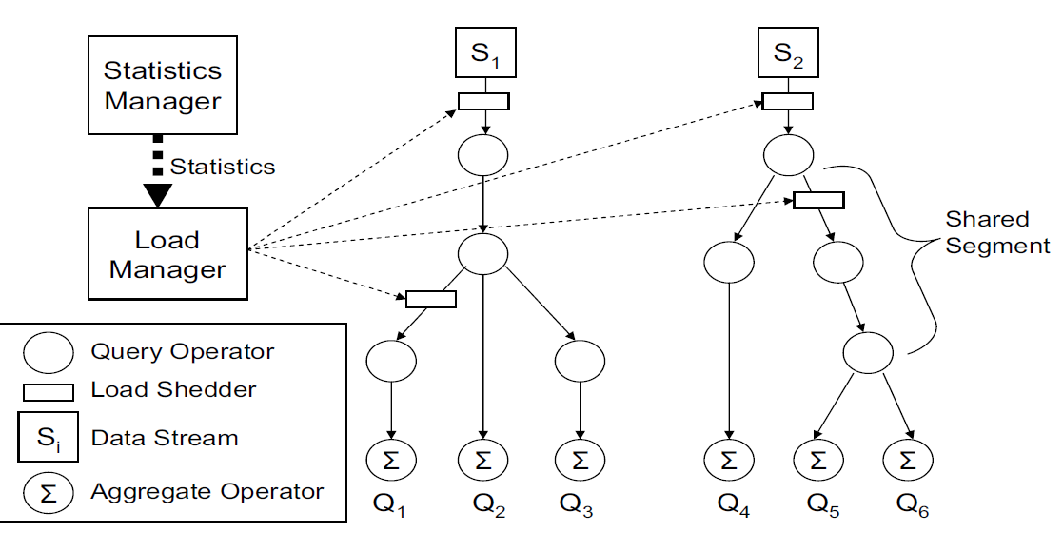
Load Shedding
Determine when to shed load
Determine where to she load
Determine how much load to shed
Drawbacks: drop potential patterns

Slide 50
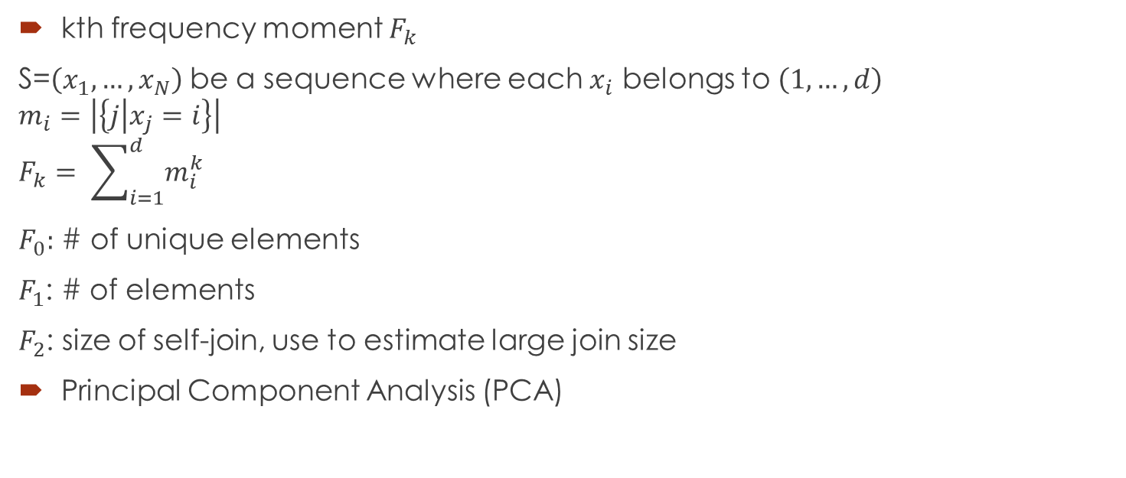
Sketching
kth frequency moment $F_{k}$
S=$\left(x_{1},…,x_{N}\right)$ be a sequence where each $x_{i}$ belongs to $\left(1,…,d\right)$
$$m_{i}=\left|\left\{j | x_{j}=i\right\}\right|$$
$$F_{k}= \sum_{i=1}^{d}{m_{i}^{k}}$$
$F_{0}:$ # of unique elements
$F_{1}$: # of elements
$F_{2}$: size of self-join, use to estimate large join size
Principal Component Analysis (PCA)

Slide 51
Synopsis Data Structures & Aggregation
Synopsis Data Structures
Wavelet analysis
Histograms
Quantiles
frequency moments
Aggregation
Means
Variances
Other statistical aggregated data

Slide 52
Pros & Cons
Data-Based:
Techniques | Definitions | Pros | Cons
Sampling | Choosing a data subset for analysis | Error Bounds Guaranteed | Poor for anomaly detection
Load Shedding | Ignoring a chunk of data | Efficient for queries | Very poor for anomaly detection
Sketching | Random projection on feature set | Extremely Efficient | May ignore Relevant features
Synopsis Structure | Quick Transformation | Analysis Task Independent | Not sufficient for very fast stream
Aggregation | Compiling summary statistics | Analysis Task Independent | May ignore Relevant features

Slide 53
Pros & Cons
Task-Based:
Techniques | Definitions | Pros | Cons
Approximation Algorithms | Algorithms with Error Bounds | Efficient | Resource adaptivity with data rates not always possible
Sliding Window | Analyzing most recent streams | General | Ignores part of stream
Algorithm Output Granularity | Highly Resource aware technique with memory and fluctuating data rates | General | Cost overhead of resource aware component

Slide 54
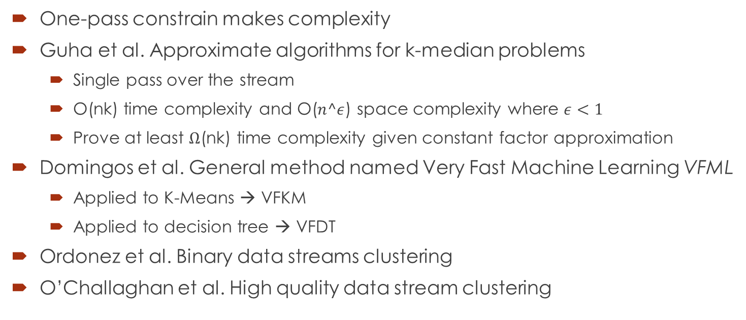
Data Stream Clustering
One-pass constrain makes complexity
Guha et al. Approximate algorithms for k-median problems
Single pass over the stream
O(nk) time complexity and O($n^ε$) space complexity where $ε<1$
Prove at least $Ω$(nk) time complexity given constant factor approximation
Domingos et al. General method named Very Fast Machine Learning VFML
Applied to K-Means → VFKM
Applied to decision tree → VFDT
Ordonez et al. Binary data streams clustering
O’Challaghan et al. High quality data stream clustering

Slide 55
Data Stream Classification
High speed nature of data streams : The rate of building a classification model should be higher than the data rate
Bounded memory requirements: load shedding, sampling, aggregation, and creating data synopsis
Concept Drifting: Models become stale and less relevant over time. Ensemble based classification for voting a best prediction
Challenges in Distributed Applications: Large mounts mining result sent to users in a limited bandwidth environments. Addressed by DFT methods
Modeling change of mining results over time: Users are interested in modeling changes over a temporal basis

Slide 56
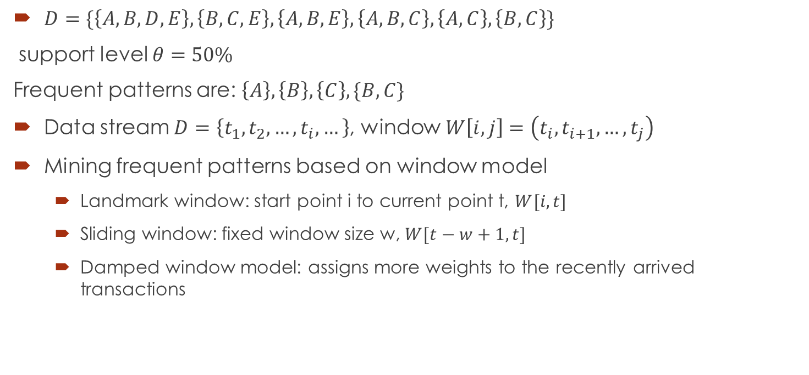
Data Stream Frequent pattern Mining
$D=\{\left\{A,B,D,E\right\}, \left\{B,C,E\right\}, \left\{A, B, E\right\}, \left\{A, B, C\right\}, \left\{A, C\right\}, \left\{B, C\right\}\}$
support level $θ=50\%$
Frequent patterns are: $\left\{A\right\}, \left\{B\right\}, \left\{C\right\}, \{B,C\}$
Data stream $D=\left\{t_{1}, t_{2},…,t_{i},…\right\}$, window $W\left[i,j\right]=\left(t_{i},t_{i+1},…, t_{j}\right)$
Mining frequent patterns based on window model
Landmark window: start point i to current point t, $W[i,t]$
Sliding window: fixed window size w, $W[t−w+1, t]$
Damped window model: assigns more weights to the recently arrived transactions

