Slide 1
Automating Billing Policy Updates with GenAI
Cotiviti - Automating Billing Policy Updated with AI
Dhruv Donga | Cotiviti Intern Assessment

Slide 2
Problem Statement
Scale : Cotiviti works with more than 200 healthcare payers and health systems
Gap : When CMS or Payer updates billing policy, Cotiviti needs to read both version, identify the changes and rewrite internal rules assess the downstream claim impact
Volume : Which is time-consuming and must be performed for thousands of documents annually.
Its need to done for thousands of documents annually

Slide 3
Relevant Trends
Reliable Extraction : LLMs can now extract rules from policy language reliably
Using Rag has shown good results in medical guideline interpretation
With model citing the exact source sentences, which makes its output verifiable
LLM can handle growing policy volume
Solution : Our solution validates this policies using Large Language Model to make it faster, less error-prone

Slide 4
Opportunities
AI pipeline that reads a new policy PDF, compares it to the prior version and produces structured changes with summary that analyst’s can work with, updates the workflow from days to hours.
We propose demo with three main function.
1. Extraction : Parse raw policy PDFs into structured, actionable rules
2. Verification : Compares old and new policy iterations to create a clear change report
3. Regression Audit : Evaluates synthetic test claims against the new rules to validate downstream operational impact

Slide 5
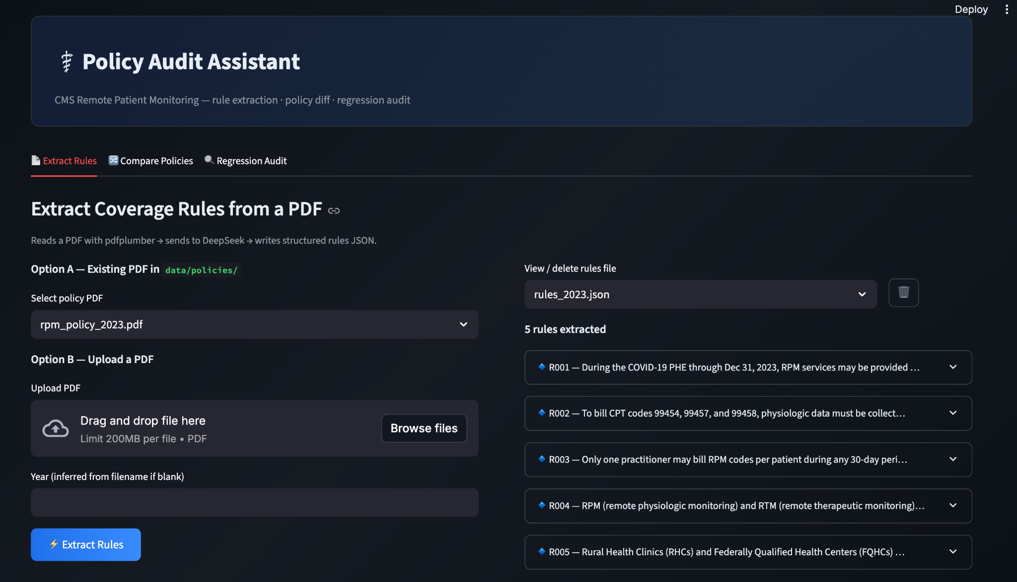
Demo

Slide 6
Technology
Stack :Our demo utilizes direct JSON extractions and the OpenRouter API for focused speed-to-value testing
Enterprise Transition : To scale across cotiviti’s catalog of payer-provider contrats, we transition to LlamaIndex
Implementing a vector database allows the system to partition full policy documents into searchable semantic chunks, drastically lowering token consumption and accelerating retrieval times.

Slide 7
Conclusion
The bottleneck in healthcare content management is not that billing process are complex its that converting policy updates into working rules is still a complex process.
Automating the ingestion and comparison cycles allows cotiviti to scale operational efficiency without inflating overhead costs.

