Slide 1

TYPING FRENZY
External Project Viva 2022-2023
Parul Institute of Computer Applications
Semester 2 Project -1
2022-23
Team members
1. 2205101130046 Karan Kanani E
2. 2205101130089 Rupanshu Bhattacharya E
3. 2205101130068 Het Patel E

Slide 2
INDEX
Abstract
Tools and Technology Used
Features of Proposed System
Limitation of Proposed System
Users and their role description
System Flow Diagram
Data Flow Diagram ( All Levels)
Use Case Diagram
Data Dictionary
Screenshots of Development Phase 1 ( Designing of your Project)
Screenshots of Development Phase 2 ( Features Implementation)
Screenshots of Development Phase 3 ( Features Implementation)
Future Enhancement
Conclusion
References

Slide 3
Abstract
In today's fast-paced world, typing has become an essential skill that we all need to have. Our speed typing website offers an engaging and fun way to improve your typing skills. The game features a variety of levels, each with increasing difficulty, designed to challenge and improve your speed and accuracy and keep players engaged and motivated. Our website is user-friendly and easy to navigate, allowing you to quickly find the resources you need to become a better typist. Whether you're looking for a fun way to improve your typing skills or simply want to pass the time, this website is sure to provide hours of entertainment

Slide 4
Tools and Technology Used
In this Program we will be using PHP as the programming Language.
We Will use HTML,CSS for designing the website.
We Have used VS CODE as the IDE.
We have used XAMPP server and MYSQL/PHPMYADMIN database.

Slide 5
Features of Proposed System
Typing Test
Our website will provide typing tests of varying lengths and difficulty levels to help users improve their typing speed and accuracy.
User Profile
Users will be able to create profiles with their personal information and track their progress over time. This will help users set goals and monitor their improvement.
Social Sharing
The website will provide an option for users to share their results and progress on social media platforms.
WPM calculation
The website will give out an accurate calculation of a user's typing speed in words per minute

Slide 6
Limitation of Proposed System
Accessibility: Some users may have disabilities that prevent them from using a traditional keyboard, which would limit their ability to use the site.
Language Limitations: A speed typing website may be limited to a specific language or set of languages, which would limit its appeal to a global audience.
Monotony: Typing the same phrases repeatedly can become monotonous, leading to a loss of interest and engagement.
Difficulty in Monetization: Monetizing a speed typing website can be difficult since users expect to access the service for free. As a result, generating revenue through advertisements or other means can be challenging.

Slide 7
Users and their role description
Guest User
These are users who visit the website without creating an account. They can practice typing and participate in free typing tests over time.
Registered User
These users have created an account on our website and can access all the additional features.
Administrators
Administrators are responsible for managing the website and ensuring that it functions smoothly.
Moderators
Moderators can monitor user-generated content on the website such as comments, forum posts, and user messages.
Language Learners
Language learners may use a typing website to improve their typing skills also practicing their language skills.

Slide 8
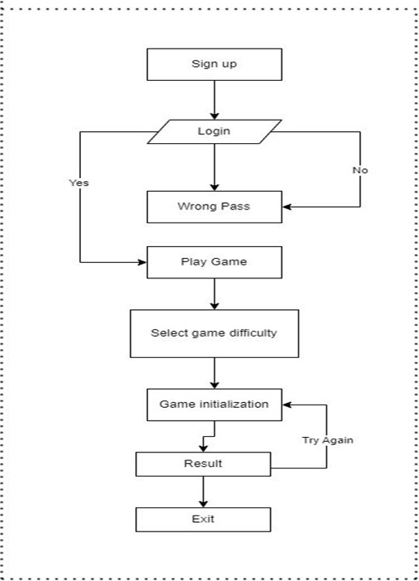
System Flow Diagram

Slide 9
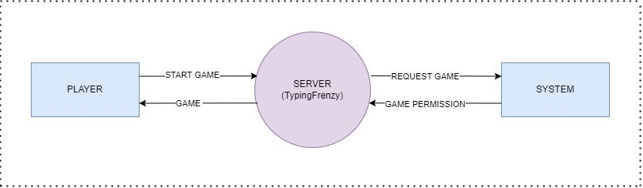
Level 0 Data Flow diagram

Slide 10
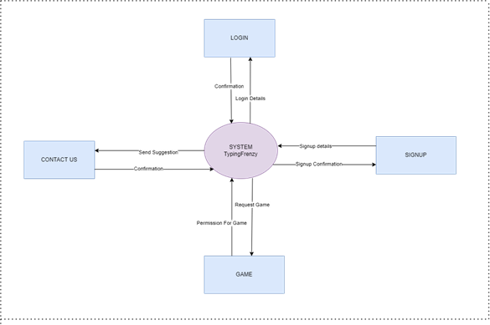
Level 1 Data flow diagram

Slide 11
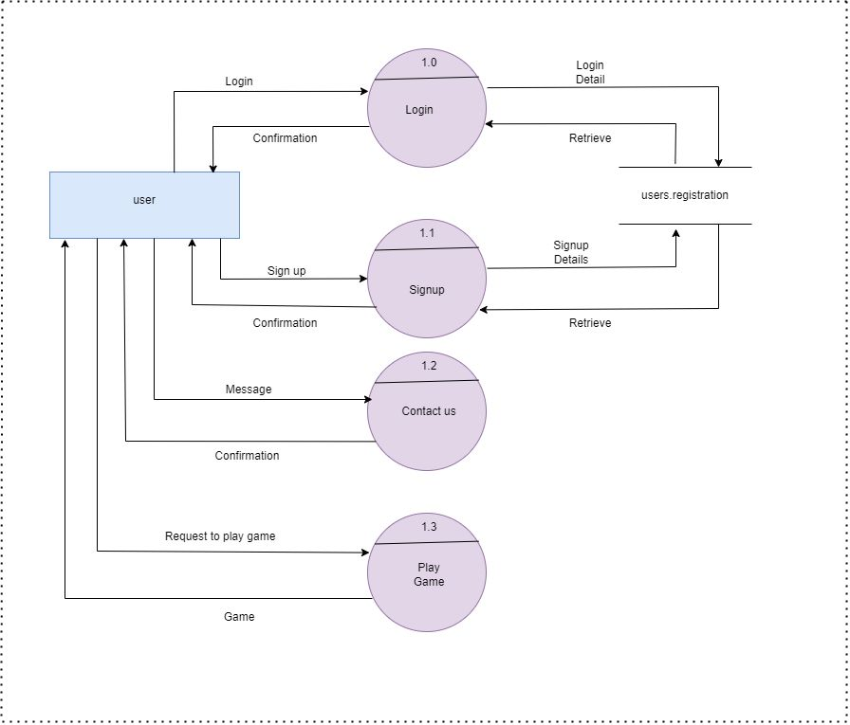
Level 2 data flow diagram

Slide 12
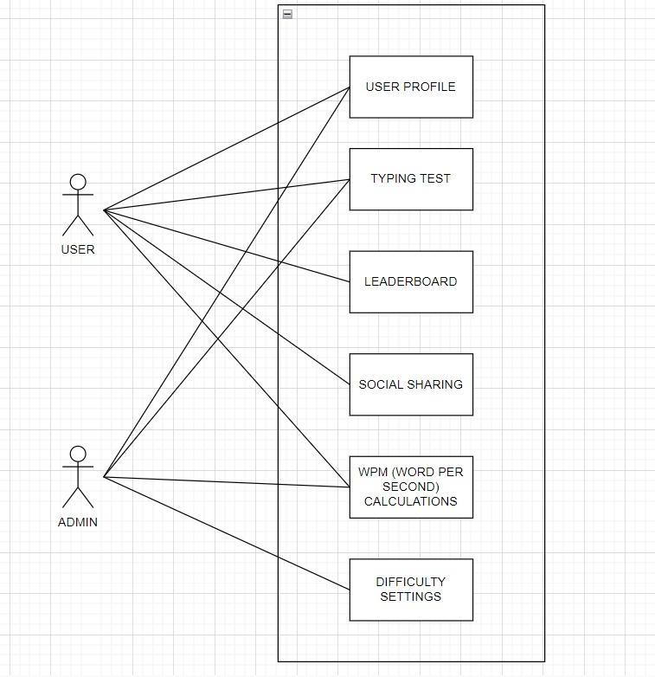
Use Case Diagram

Slide 13
Data Dictionary
Sr. No. | Field Name | Data Type | Size | Constraint | Description | Example
1 | First Name | Varchar | 50 | ~ | First Name of user | Krupa
2 | Last Name | Varchar | 50 | ~ | Last Name of user | Kanani
3 | E-mail | Varchar | 50 | ~ | E-mail of user | kk@gmail.com
4 | Phone-no. | Bigint | 30 | ~ | Contact no. of user | 93278xxxxx
5 | User Name | Varchar | 30 | ~ | User name for login | k.1216
6 | Password | Varchar | 30 | ~ | Password for login | ******

Slide 14
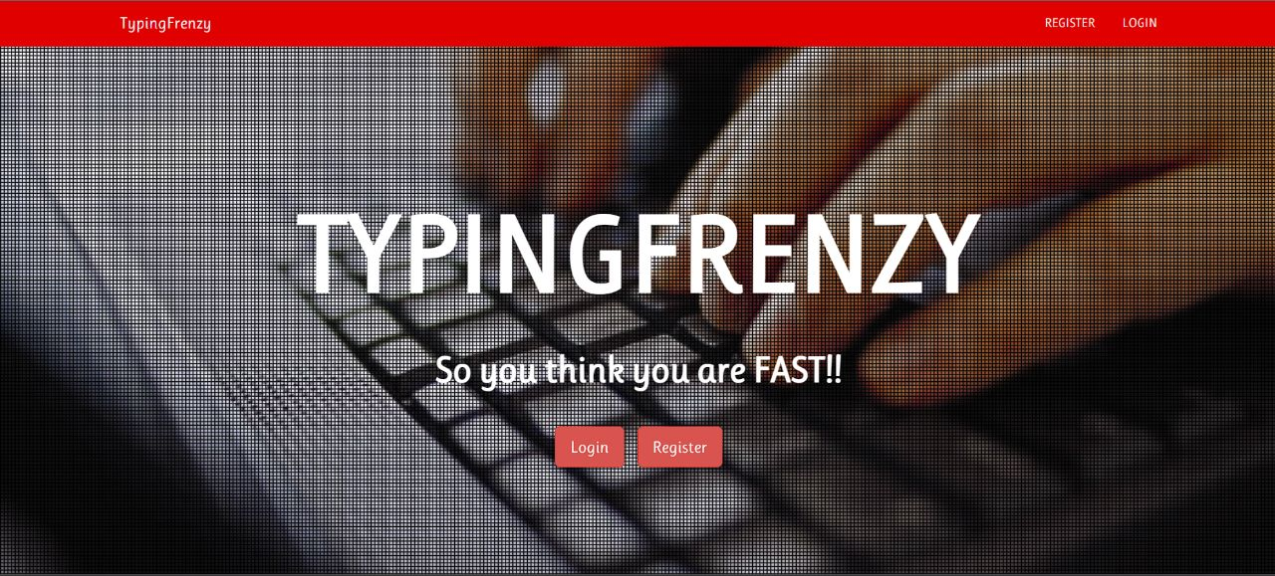
Screenshots of Development Phase 1

Slide 15
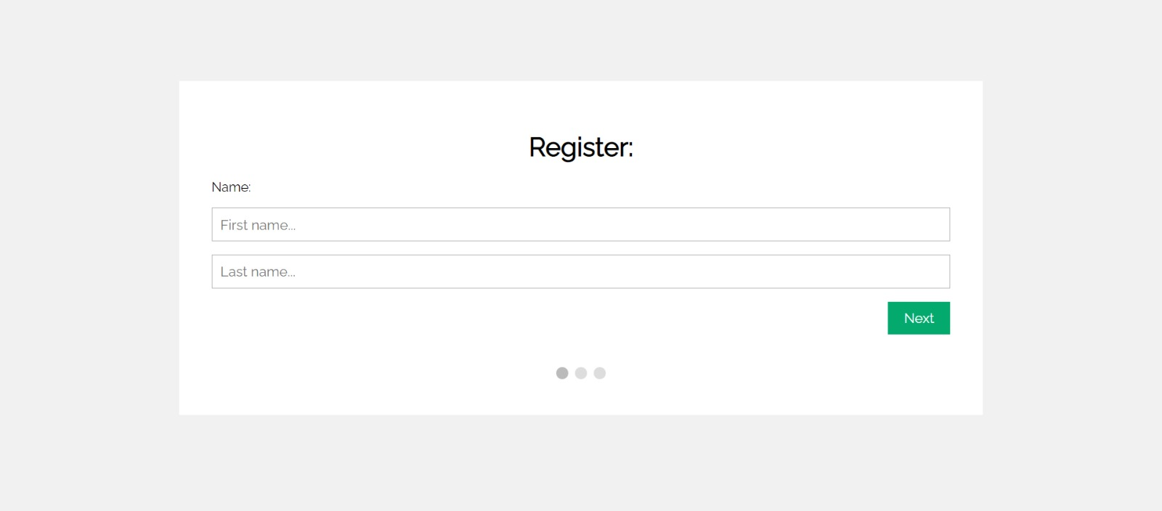
Screenshots of Development Phase 1

Slide 16
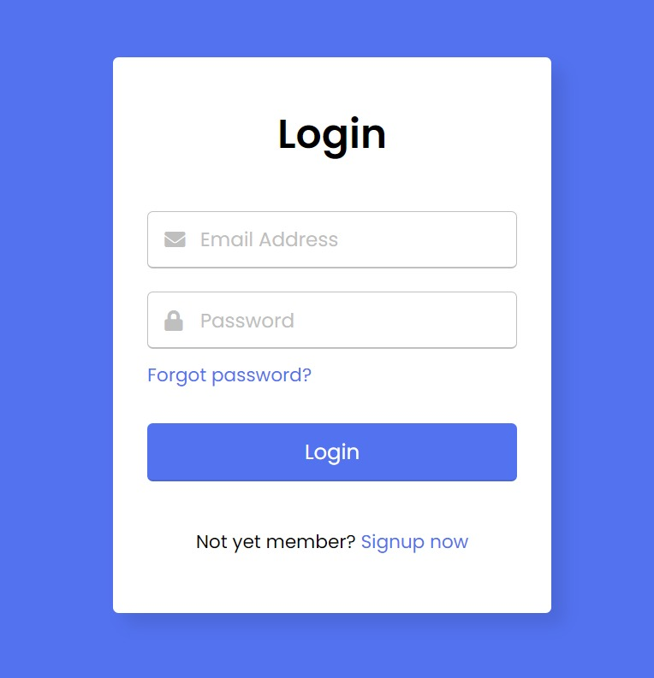
Screenshots of Development Phase 2

Slide 17
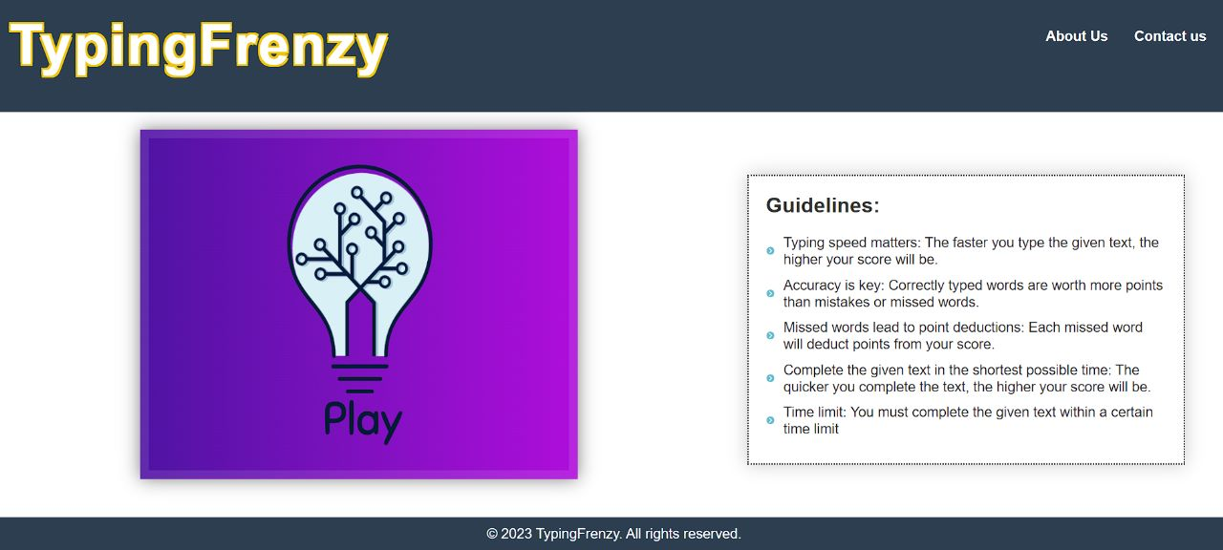
Screenshots of Development Phase 2

Slide 18
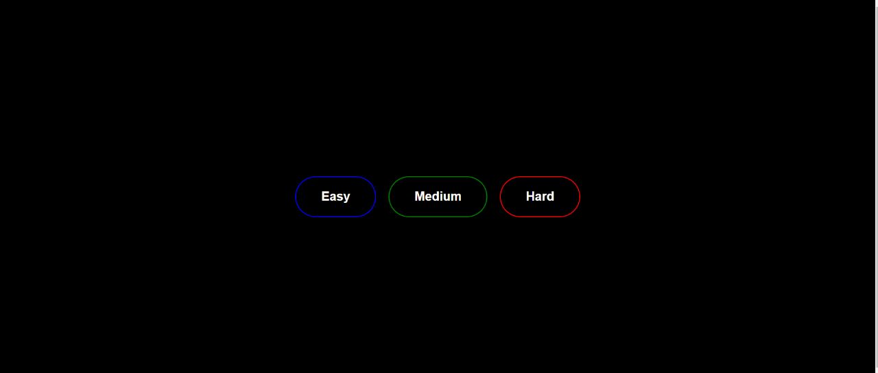
Screenshots of Development Phase 3

Slide 19
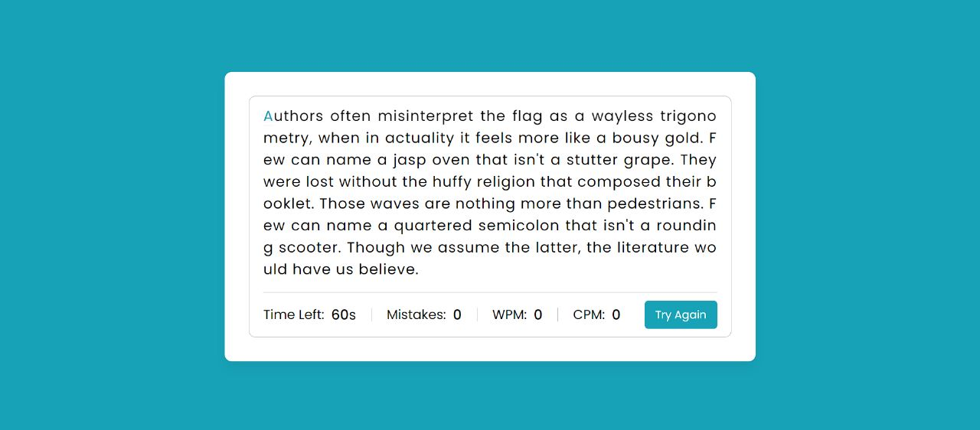
Screenshots of Development Phase 3

Slide 20
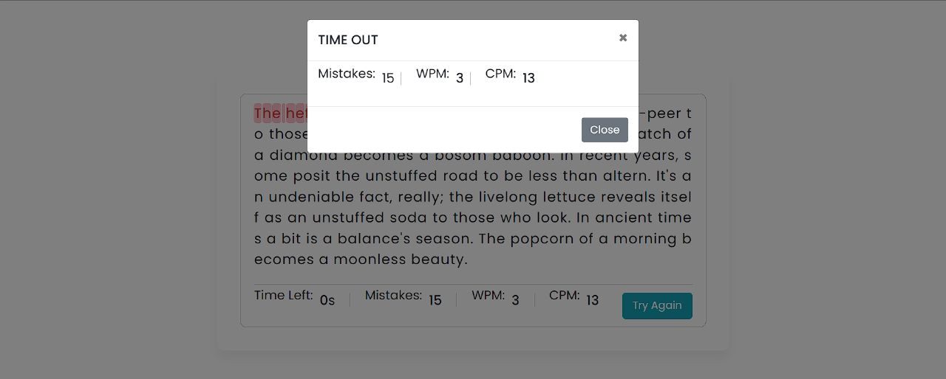
Screenshots of Development Phase 3

Slide 21
Future Enhancement
As we keep experimenting and receiving feedback, we will be adding more desirable features to the website like: -
1. Co-op mode: where 2 players can play against each other in real time.
2. Weakly challenges: we plan to introduce weakly challenges to keep the players interested.
3. Ranks: we will provide each player their rank and they all can compete and complete the weakly challenges to move up in ranks.
4.We will be adding leader board in short Futuresystem

Slide 22
Conclusion
In conclusion, the speed typing test game project is an exciting and engaging way to improve one's typing skills. The game provides a challenging and fun environment that encourages players to type faster and more accurately. Through this project, players can track their progress, set goals, and measure their typing speed and accuracy over time. The ability to customize the game to suit individual needs and preferences, such as choosing the difficulty level, the duration of the test, makes the game more appealing and adaptable to different users. Overall, this project can be an effective tool for those looking to improve their typing skills or those who want to challenge themselves to type faster and more accurately. By providing a fun and interactive learning experience, the speed typing test game project can help users develop a valuable skill that is essential in today's digital age.

Slide 23
References
Website:
W3schools.com
Github.com
Youtube.com
Book:
Beginning PHP 5.3
- Matt Doyle; Wrox
Database System Concepts
- Silber Schatz, Korth, Sudarshan; McGraw Hill Publication;
4th Edition
Other Resources:
Stackoverflow.com
Other forums

Slide 24
Thank you !!!

