Slide 1
presentation
Project A
Team name: Sun Knight
Team leader: Yang Chenyu
Team member: Han Bing

Slide 2
Our GUI
Main
In main frame, we use raddiobutton and entries to input the basis data.
Result
We use canvas to show the figures and the output data.
Menu
We add menu to control this program and give information about it.

Slide 3
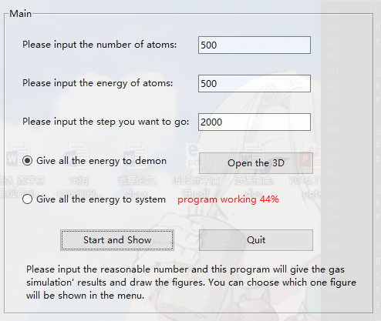
Main
In this you can input the basis data.
When you input the illegal data, and it will give you tips to let you change.
It will also show the progress bar when it’s working.

Slide 4
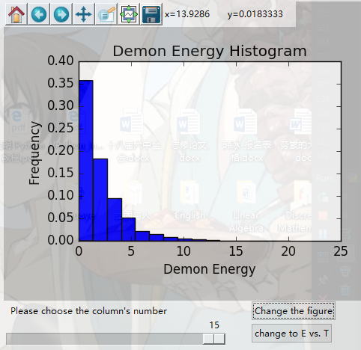
result
We have the functional bar to control figures.
We add scale to adjust the figure’s columns.
We also output the results into a text to make you know more about stimulation.

Slide 5
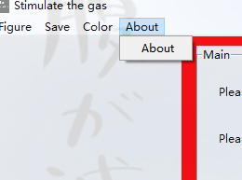
Menu
By menu, you can choose to hide some figures
Save figures and data for research
Change the background
Know more about our team

Slide 6
Some special points

Slide 7
Progress bar
We add the progress bar so that we can see the program working progress when the program is calculating.

Slide 8
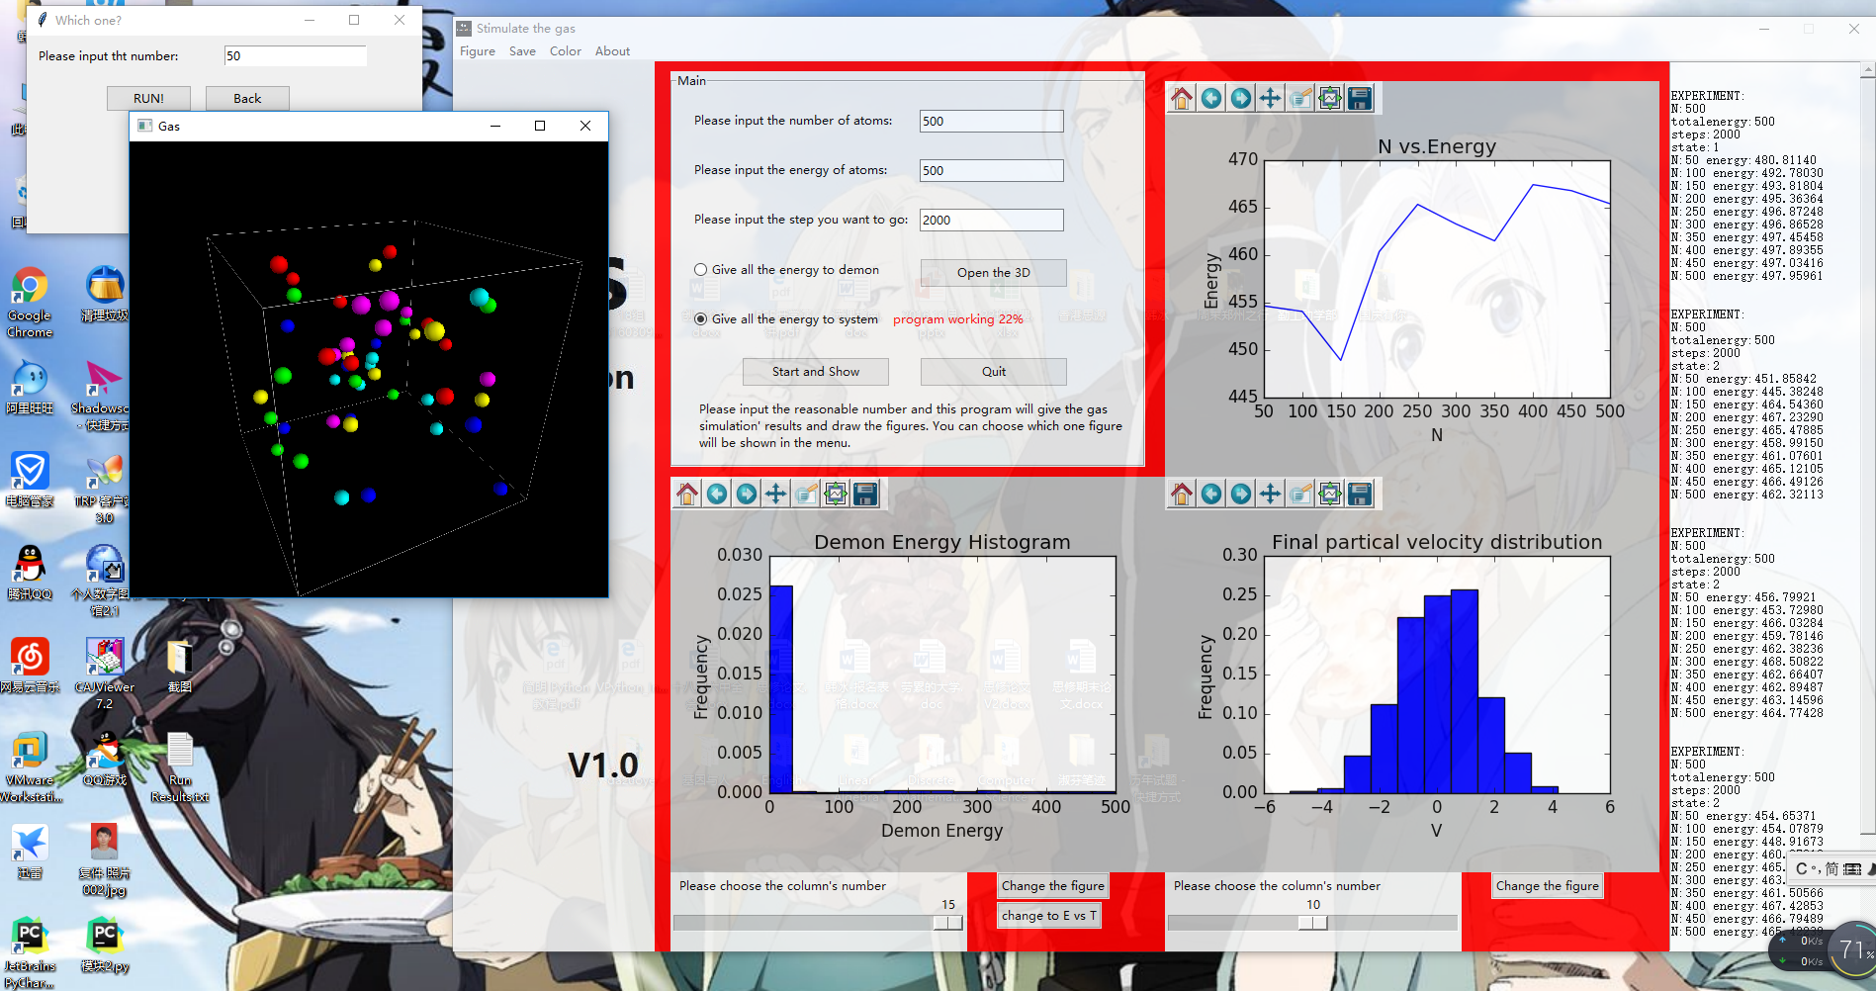
multithreading
We use multithreading to run this program so that we can do all things at the same time.

Slide 9
About 3d stimulation
Vpython
We two make a 3D stimulation by different algorithm.
1.Predict in advance and show
2.Detect the collision, and show

Slide 10
algorithm Principle
critical point
N
N
Critical point
N
N
N
Frame N

Slide 11
Algorithm principle

Slide 12
algorithm advantages and disadvantages
Can deal with larger number of particles
Can simulate with high accuracy
But the collision per time is much fewer

Slide 13
Algorithm consist two threads one class
Change time
Refresh location
Check collision
Calculate velocity
Save data
Calculate current position
Draw
Get data
Data base

Slide 14
Collision check algorithm
1.Consider one direction

Slide 15
Collision check algorithm
2. Sort the particles according to the time of the intersection in that direction
3. Check one by one by solving functions to find out whether the collision will happen

Slide 16
3D Algorithm
3D
Divide
collision
Run
This algorithm is detecting the particles’ position and calculate the collision.

Slide 17
algorithm advantages and disadvantages
More efficient(can stimulate many collision at the same time)
Less accuracy(maybe some particles will go through each other if speed is too fast)

Slide 18
Algorithm principle
N²
N²
N²
N²
N²
N²
N²

Slide 19
Divide
I check the particles’ coordinates, and divide the cube into nine parts.
Q:Why I differ from others, nine parts rather than eight.
A:I think the particles in the boundary may be collided but we don’t compute it.

Slide 20
collision
For all the particles in every parts, we compare the x-coordinate, if close then compare y and z.
For all the particles closed, if L<2r, then run the collision program and change their velocities.

Slide 21
Run
X = Vt
Change the coordinates of the particles.
Show the frames.

Slide 22
How I decrease the calculate
Divide into nine parts
Compare x, y , z one by one

Slide 23
Thanks for your watching
By: Yang Chenyu
Han Bing

