Slide 1
Adaptive Signal Processing
Shanghai Jiao Tong University
SEIEE
Homework

Slide 2
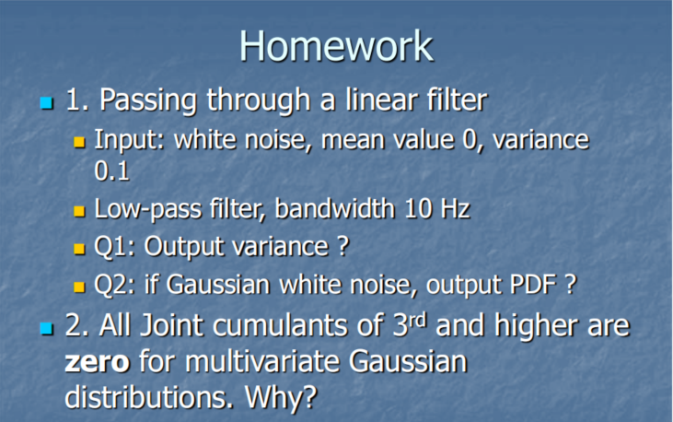

Slide 3
Home Work
Q1：Assume 𝑢(t) represents the input white noise, ℎ(t) is the lowpass filter with bandwidth 10Hz, 𝑦(t) = 𝑢(t) *ℎ(t) is the output.
Then
Because 𝑢(t) is the white noise with mean value 0 , so:

Slide 4
According to Parseval theorem:
Because ℎ(𝑡) is a low-pass filter:
So:

Slide 5
Q2：According to Q1, because :
and 𝑢(t) is gaussian-distributed, for any time moment 𝑡 , the sum of several gaussian variables is still a gaussian variable( ℎ(𝜏𝑘) and 𝜏 could be seen as two factors for constant time t). Thus, 𝑦(𝑡) is a gaussian-distributed variable, too. In Q1, we have calculated the mean value and the variance of 𝑦(t) , which are 0 and 1，so the PDF of 𝑦(t) is :

Slide 6
Assignment 2:
Assume one n dimension Gaussian vector:
The mean value vector is:
And the covariance matrix is:

Slide 7
where
Joint probability density function is
Joint eigenfunction of is:
where

Slide 8
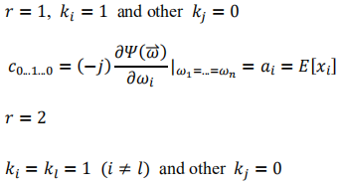
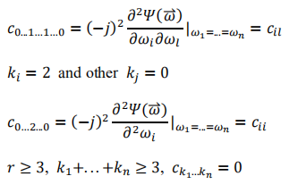
The second eigenfunction of
For high order cumulant

