Slide 1
Tap input vector
Q1：correlation matrix of
Q2: tap weight of Wiener filter when the desired response is uncorrelated with
where

Slide 2
Q3: tap weight of Wiener filter, when
Q4: tap weight of Wiener filter, when
prescribed delay

Slide 3
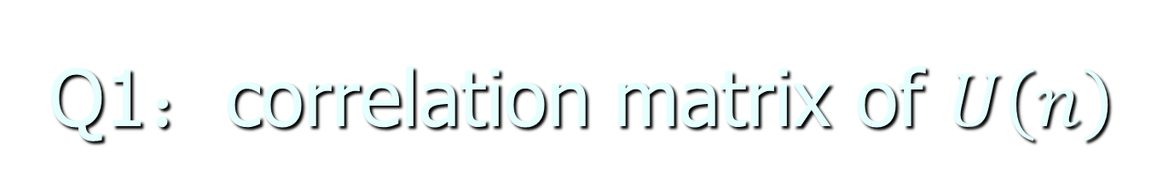
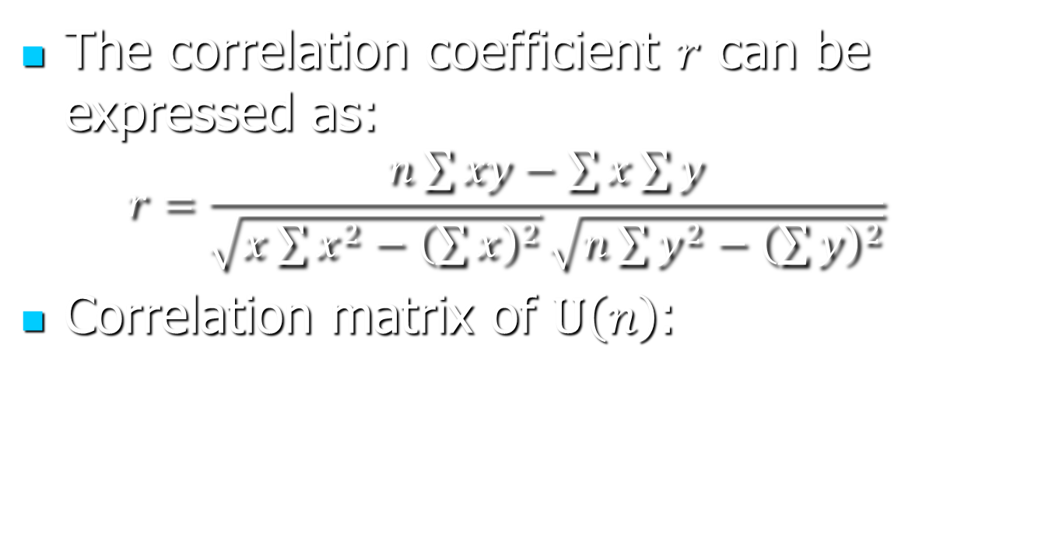


Slide 4
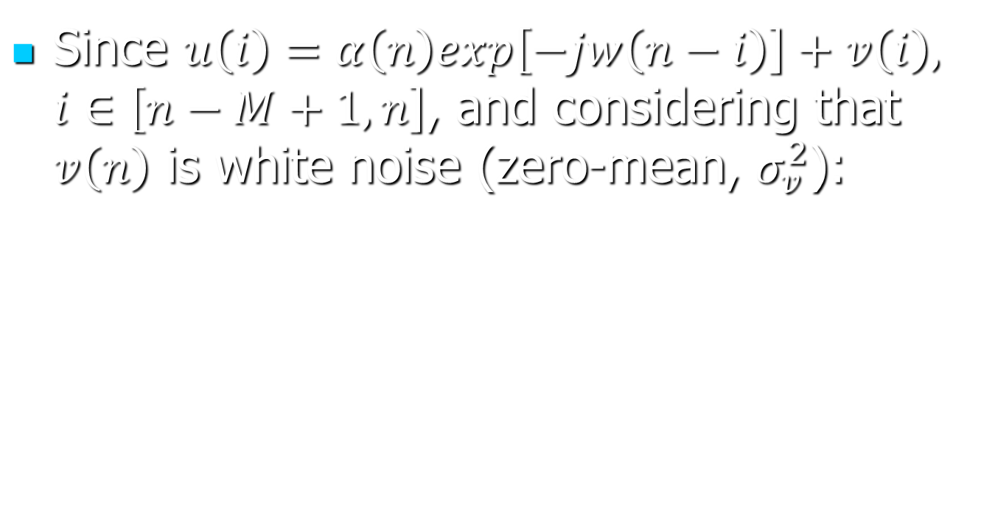




Slide 5

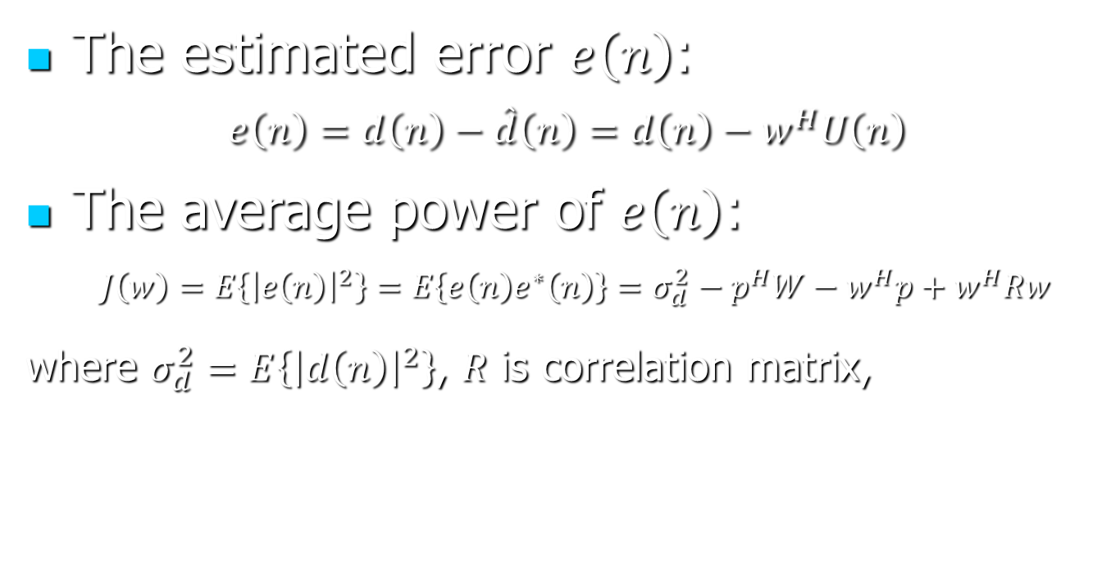


Slide 6
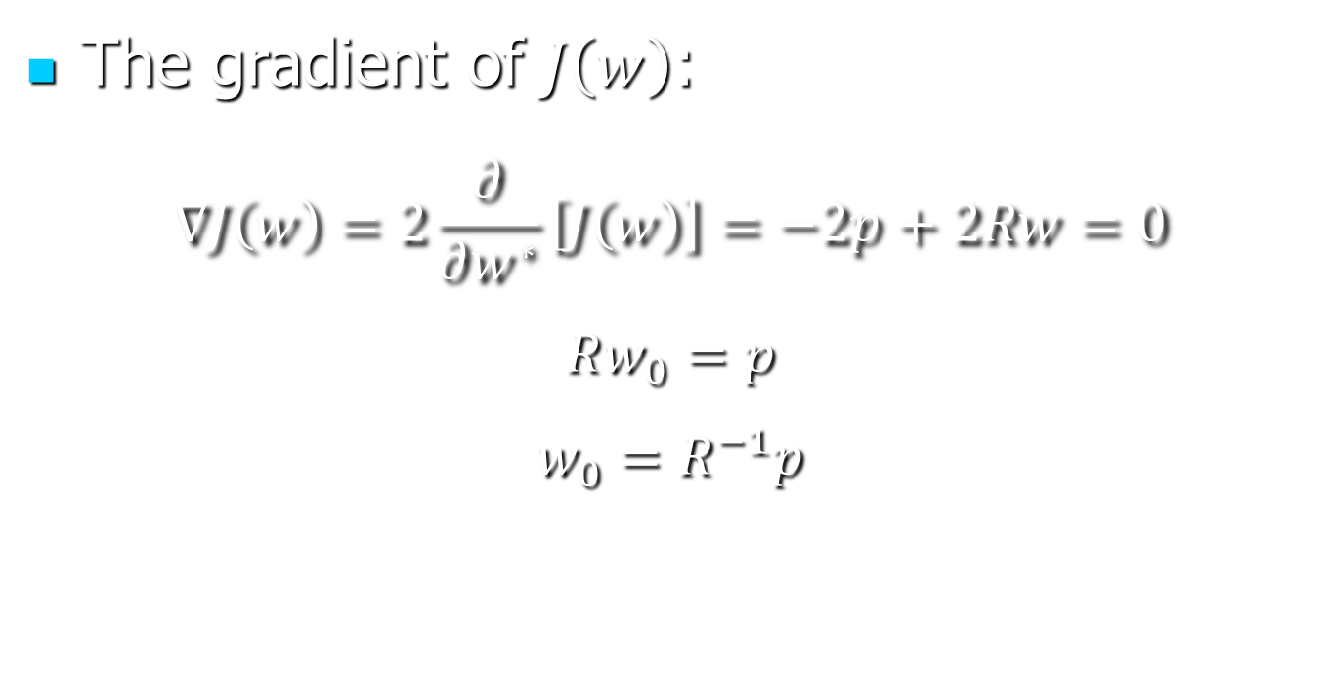

Slide 7
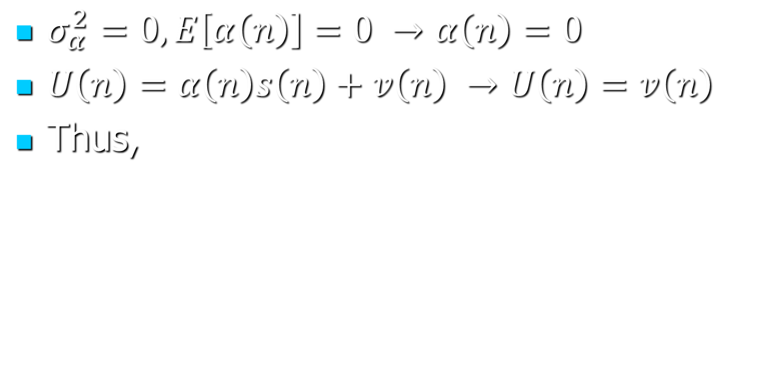
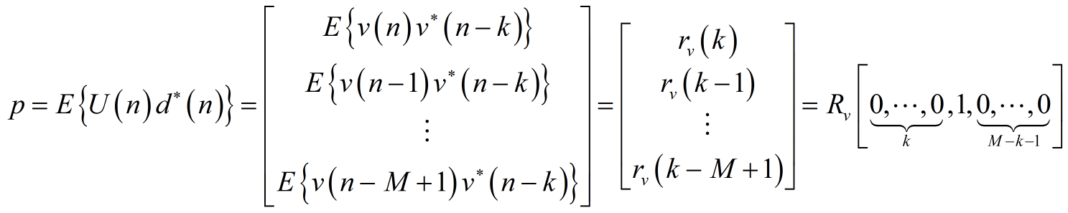
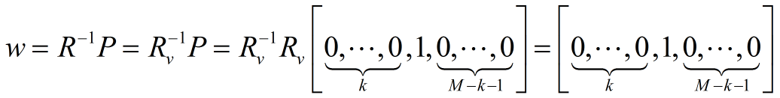
Q3: tap weight of Wiener filter, when

Slide 8


Q4: tap weight of Wiener filter, when
prescribed delay
Where
Thus

Slide 9
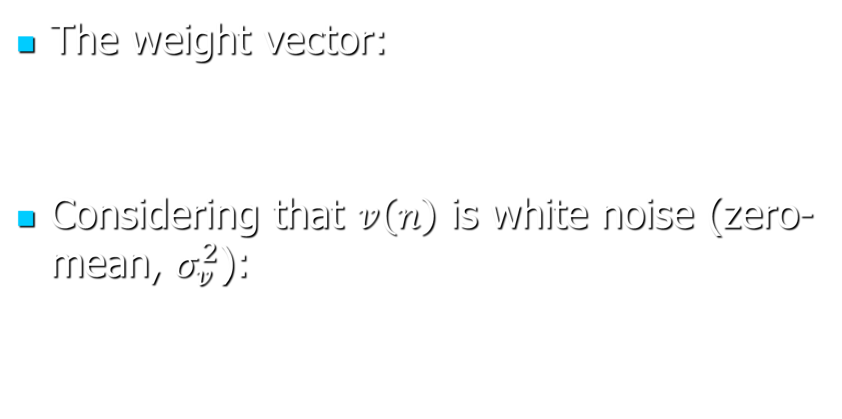



Q4: tap weight of Wiener filter, when
prescribed delay

