Slide 1
Adaptive Signal Processing
Shanghai Jiao Tong University
SEIEE
Homework

Slide 2
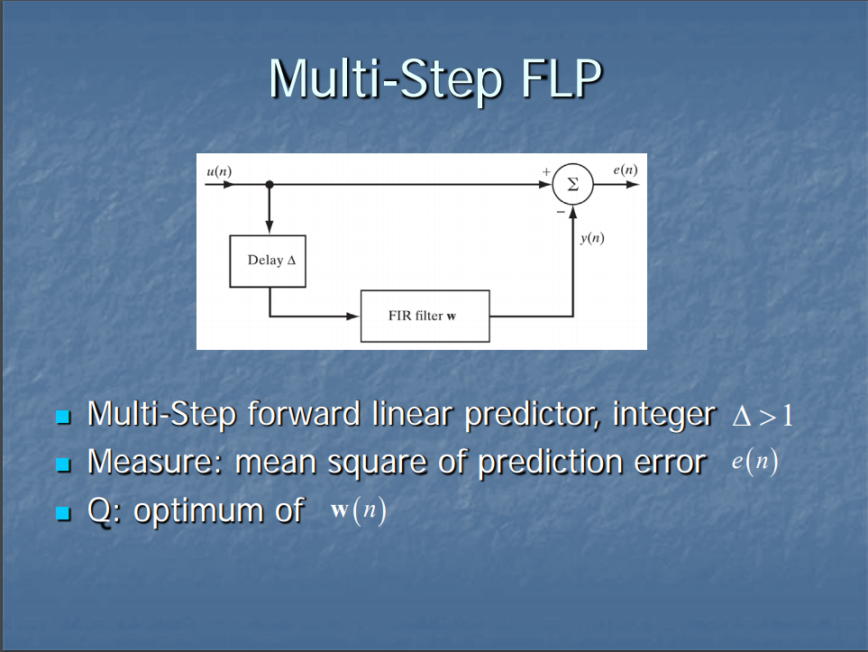
Homework 4

Slide 3
Homework 4
The estimation error is
Where
The mean square value of the estimation error is

Slide 4
We now note the following:

Slide 5
We may thus rewritten Eq.(1) as
The optimum value of the weight vector is
Where is the inverse of the correlation matrix .

