Slide 1
Adaptive Signal Processing
Shanghai Jiao Tong University
SEIEE
Homework

Slide 2
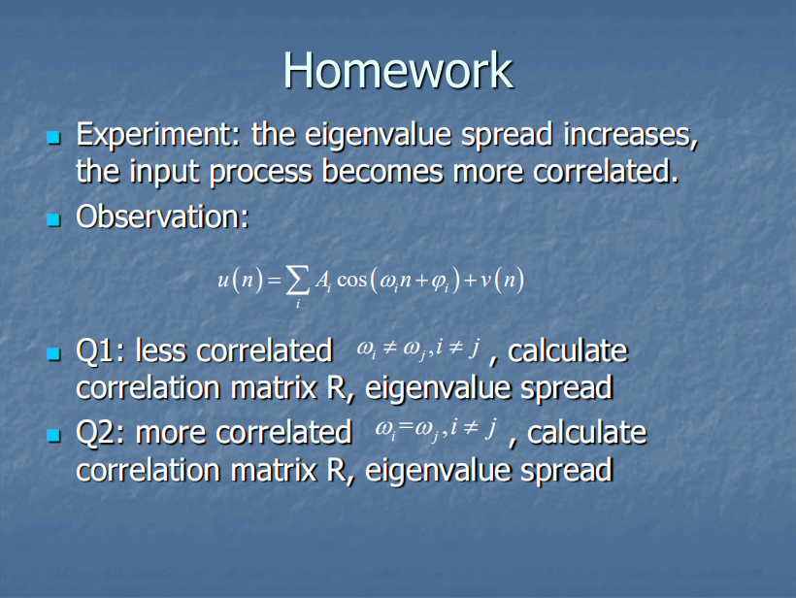

Slide 3
Home Work
Assume that denotes white noise
When

Slide 4
Home Work
Assume M= 2, the eigenvalues of are as follow

Slide 5
Home Work
When
Assume 𝑀 = 2, the two eigenvalues of 𝑹 are

Slide 6
Hence, the eigenvalue spread equals
Obviously
Hence, the eigenvalue spread increases, the input process becomes more correlated.

