Slide 1
Adaptive Signal Processing
Shanghai Jiao Tong University
SEIEE
Homework

Slide 2
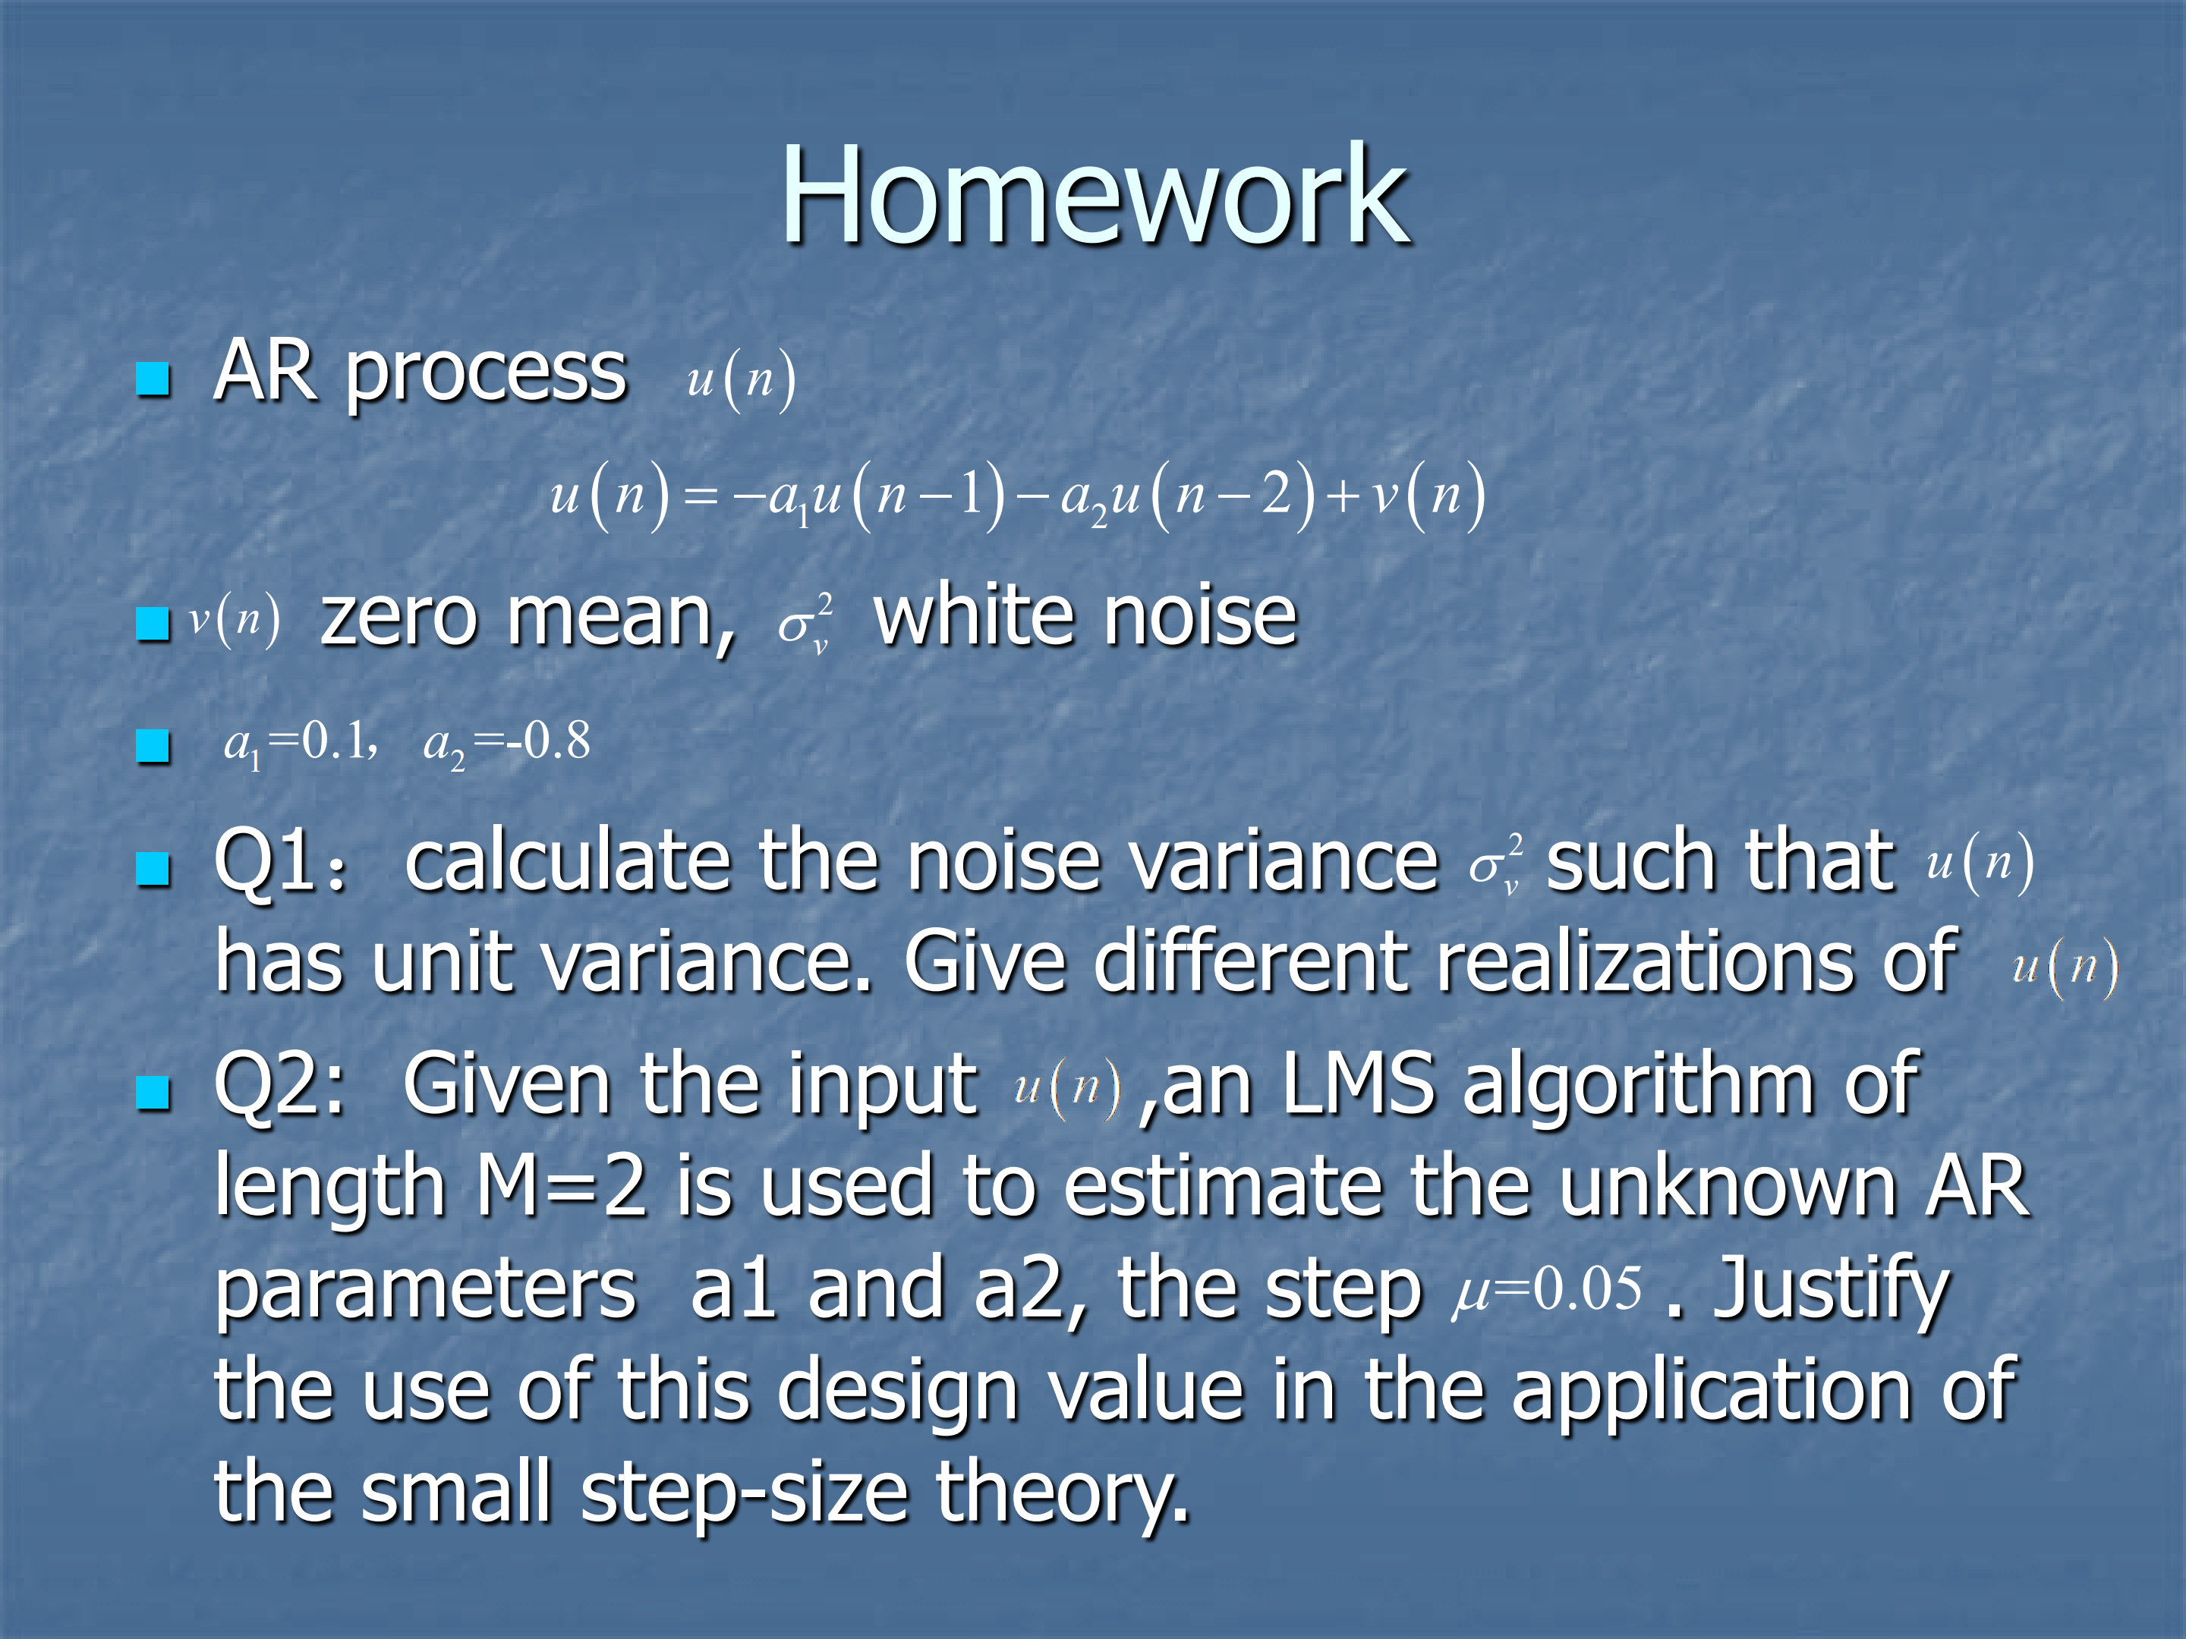

Slide 3
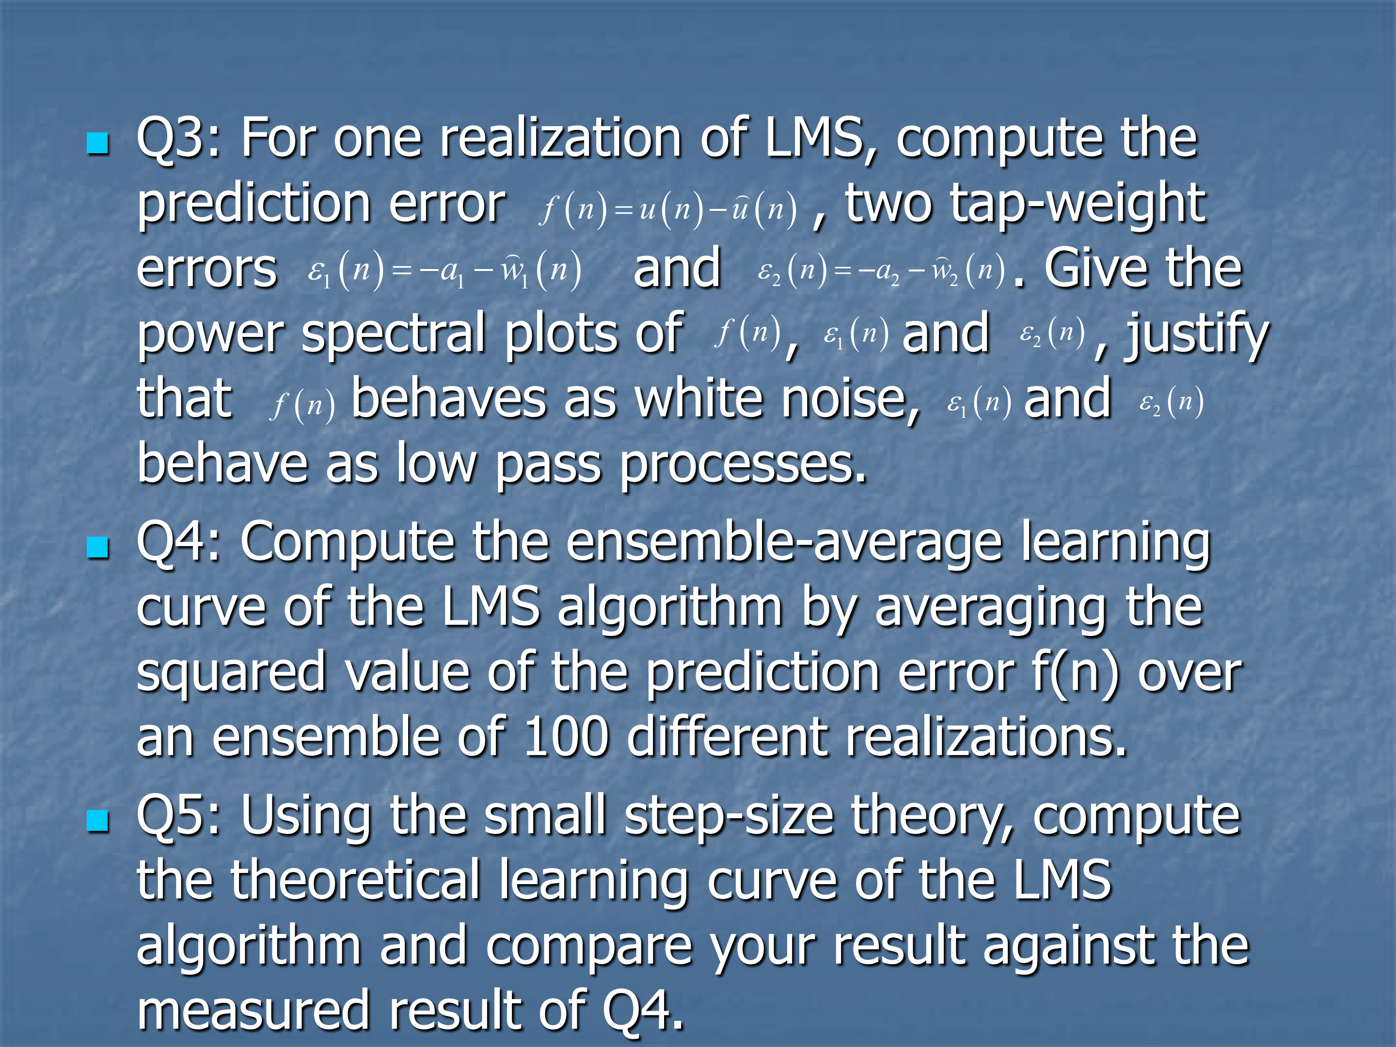

Slide 4
Home Work
Q1: The characteristic equation:
Two roots of the equation are calculated as follows:
So the AR process u(n) is an asymptotically stationary process

Slide 5
Home Work
Use Yule-Walker equations to find the relationship between and

Slide 6
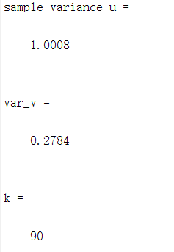
Home Work
From the equations above,we can get

Slide 7
Home Work
Q2:Use LMS to calculate a1 and a2
We use this method to iteratively figure out the value of a1 and a2.

Slide 8
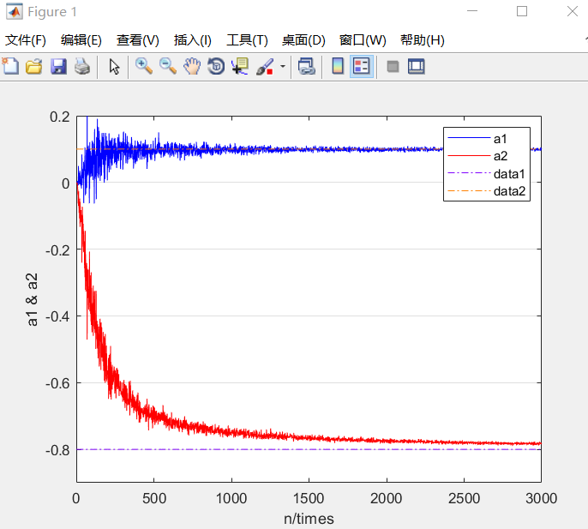
Home Work
Result

Slide 9
Home Work
And from Q1, we can get
we can get eigenvalues of R,
So
we have
Here, meets the requirement of small step theory.

Slide 10
Home Work
Q3
Because

Slide 11
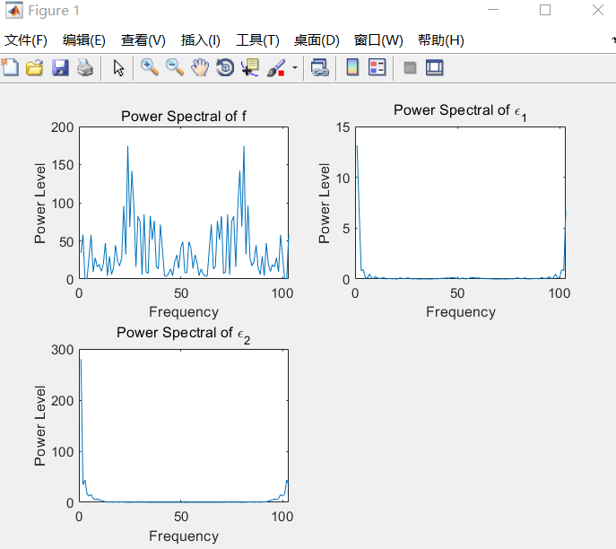
Home Work
Matlab

Slide 12
Home Work
Q4&Q5：From Q3,we can get
In LMS prosess,accumulate squared error of estimation can be expressed as

Slide 13
Home Work
And theoretical cost function J can be expressed as

Slide 14
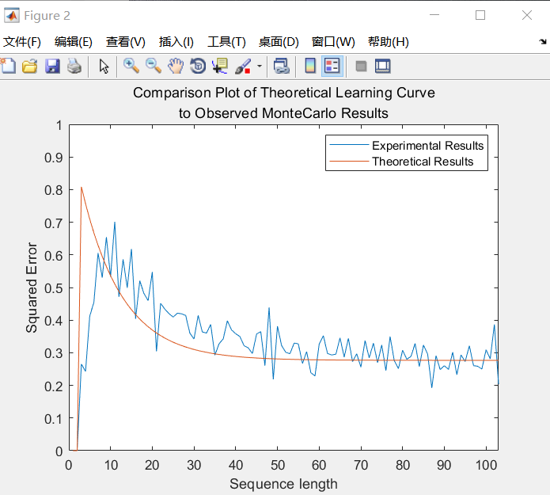
Home Work
Result of two cost functions

