Slide 1
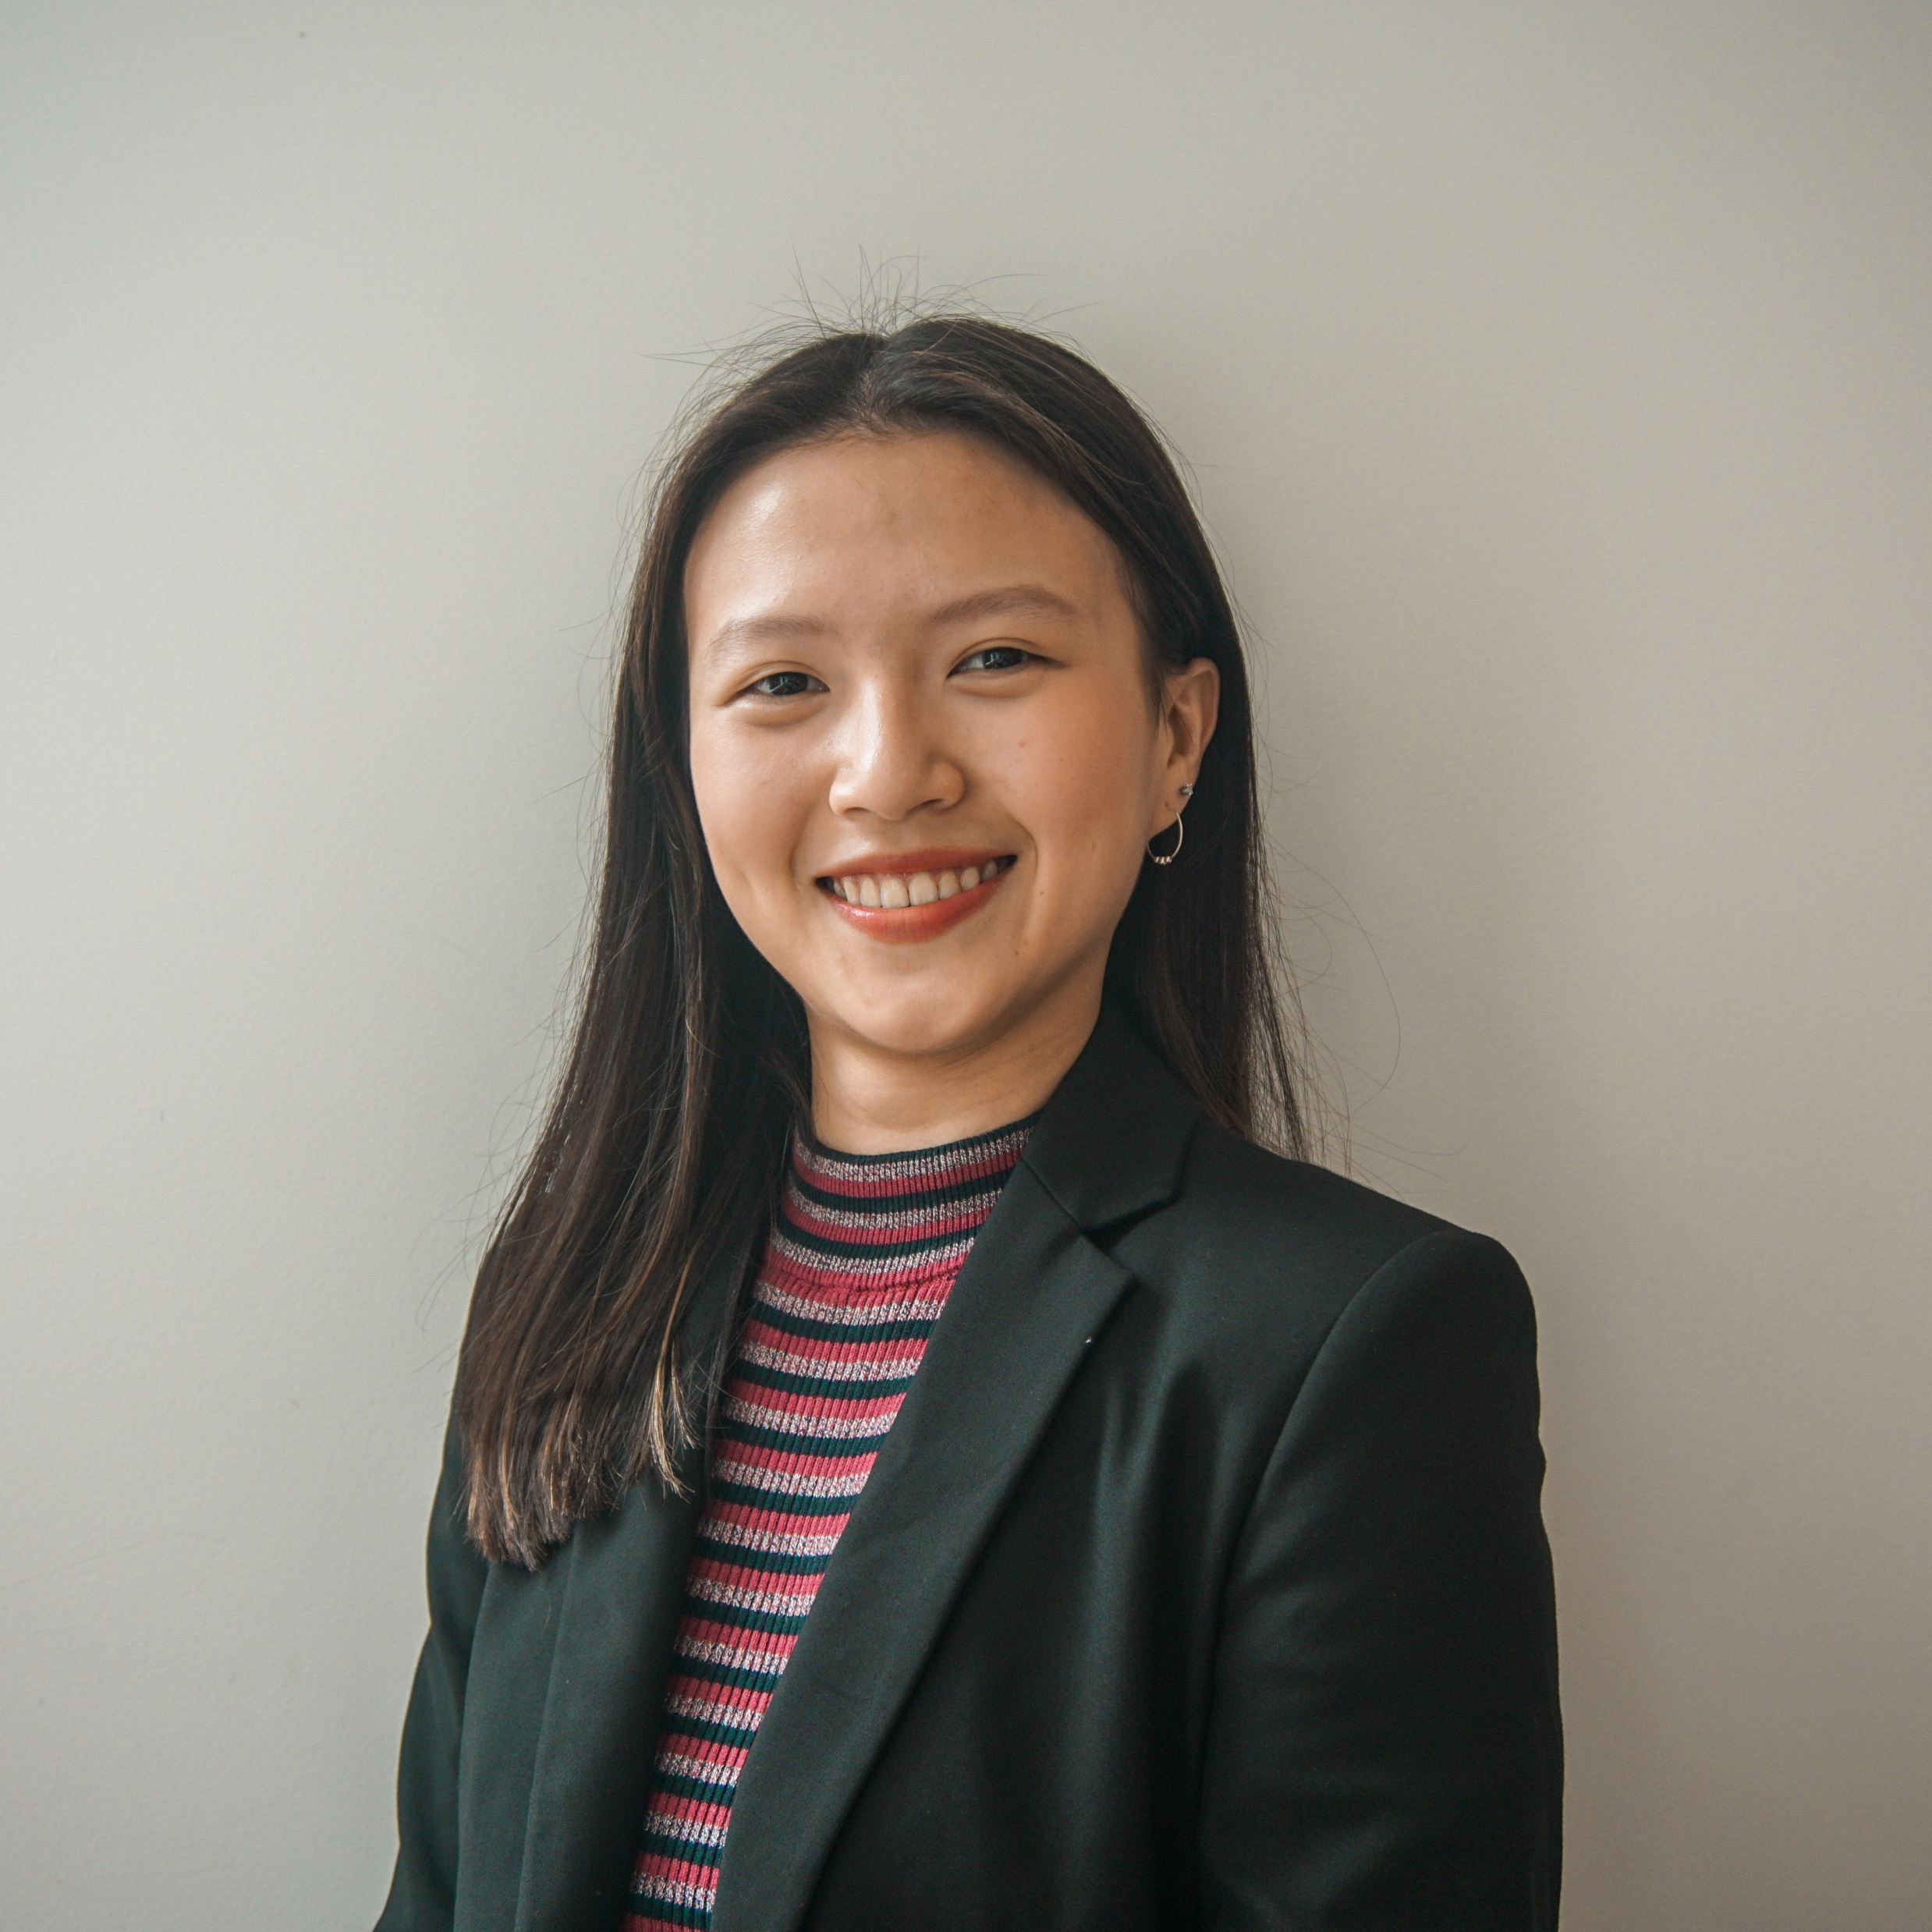
Title
Team Alexa
UNSW DataSoc x Atlassian: Datathon 2020
Kirsten Tai
Benjamin Smith
Brandon Zeng

Slide 2
Executive Summary
Executive Summary
XXX
XXX
XXX
CONSIDERATIONS
XXXX
OBJECTIVE
XXXX
XXXX
STRATEGY
XX
XX
XX
XX
XX
XX
IMPACT

Slide 3
Example slide
THIS IS A TAKEAWAY

Slide 4
This is a 3 point slide
1
2
3
XX
XX
XX

Slide 5

This is a 3 point slide leading into one takeaway
1
First point
2
Second point
Summarises to this point
3
Third point

Slide 6
Any strategy needs to remain aligned with your core mission.
Regardless of impact, the revenues
need to be better at Atlassian

