Slide 1
Genomic Query Challenge
14 November 2019 – David Nix
Platform for querying billions of molecular data points from millions of participants to enable:
Clinical trial matching
Genetic Counselor query of classified variants and related individuals
Patient cohort construction and comparison - Illumina Cohort Analyzer
Genomic analysis and data integration
Works with mixed data types that produce genomic coordinate associated features:
DNASeq – WGS, WES, clinical testing, ctDNA – SNV/ INDEL, CNV, Translocations, Rearrangements
MethylSeq/ ATACSeq/ ChIPSeq – epigenetic marks
RNASeq – bulk/ single cell transcriptomics, gene fusions
Works with mixed genome builds and different species
Works with or links to original data sources
Works in minutes vs hours
Works via scalable micro services vs a single ”Big App”
First challenge – how handle range query problem?

Slide 2
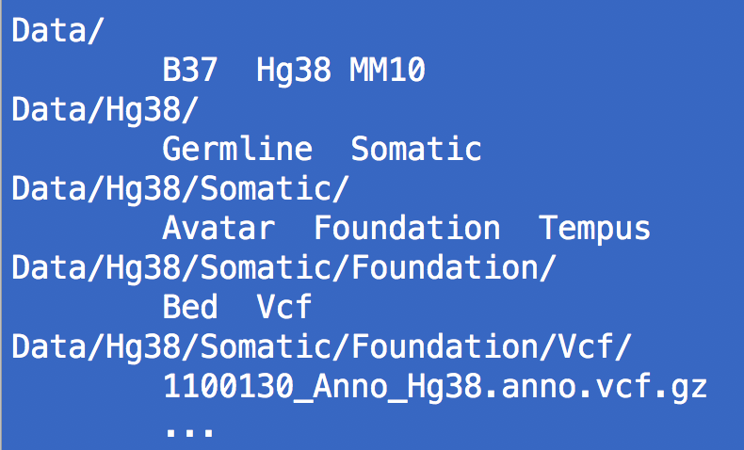
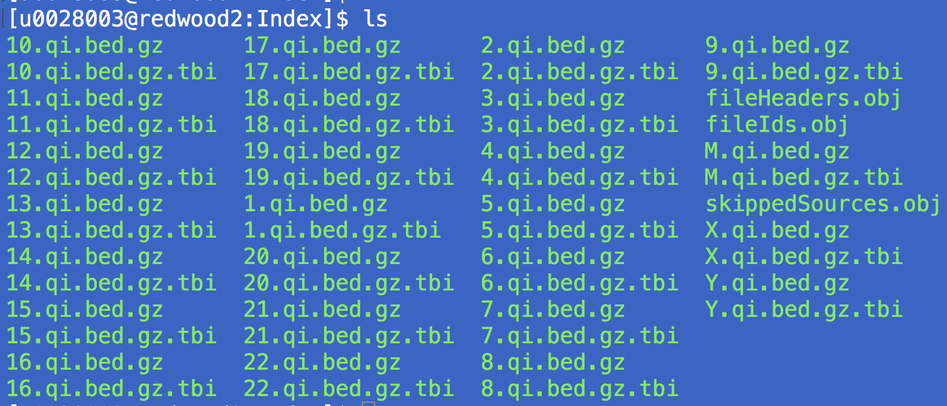
Installing the Genomic Query API
GitHub: https://github.com/HuntsmanCancerInstitute/Query
Running Instance: http://hci-clingen1.hci.utah.edu:8080/Query/search?fetchOptions=true
Step 1 – Structure your genomic data file system.
File paths regex expressions are used to filter results.
Step 2 – Create a master chromosome position index that maps genomic elements to particular regions in the genome.
Walk every row in bgzip compressed, tabix indexed genomic data files (e.g. vcf, bed, maf, gvcf, custom, etc)
Multi threaded, 3hrs per 500M records. USeq QueryIndexer app.
Build and species agnostic
Step 3 – Launch the RESTful web app QueryAPI service
Java Jersy JAX framework w/ extensive JUnit tests for every API call
Loads index either in memory (RAM intensive) or registers the master tabix index files
Uses key tokens to limit access to particular datasets, fetchKey service with digest authentication

Slide 3
How Genomic Query API Functions
First search is a genomic coordinate range query on the master index.
Find me what intersects with ROI, e.g. KRAS, TERT promoter, within Lynch syndrome genes
Pulls pointers to data files that intersect via Interval Tree or a tabix master index search
Use regular expressions to filter the returned files, e.g. Only vcf.gz and Hg38 and Somatic
Second search, fetches the actual data from specific files (if needed):
For each intersecting file, use tabix to fetch the intersecting records
Use regular expressions to filter the data rows returned from each file, e.g. Pathogenic, BRAF, V600E
Advantages:
Species and genome build agnostic – b37, hg19, hg38, mm10, etc.
Works with any data that can be bgzipped and tabix indexed (vcf, bed, maf, gvcf, custom, etc.)
Original data source is retained and queried, no parsing or extraction.
Faster than standard SQL and NoSQL databases
Both web API and direct file system queries
No RFP
Disadvantages:
File path based regexes are limited and brittle
Needs development, integration with a relational db, externalization of annotations, server farm
Needs benchmarking against GORdb, Golden Helix Variant Warehouse, Oracle Omics Db, ?

Slide 4
An Example Genomic Query
# Fetch Options
http://hci-clingen1.hci.utah.edu:8080/Query/search?fetchOptions=true
# Fetch Key
http://hci-clingen1.hci.utah.edu:8080/Query/fetchKey
user: QueryAll
pw: xxxxx
yaxUbj1xAhSSxE4m+Deu1Q==:p9786ElrjmPV0RJtogKNUrpWh0Tiro5C3wVlYsIgBiM=
# Encode Key for URLs, https://www.url-encode-decode.com/
yaxUbj1xAhSSxE4m%2BDeu1Q%3D%3D%3Ap9786ElrjmPV0RJtogKNUrpWh0Tiro5C3wVlYsIgBiM%3D
# Basic search for KRAS records - 3959
http://hci-clingen1.hci.utah.edu:8080/Query/search?
key= yaxUbj1xAhSSxE4m%2BDeu1Q%3D%3D%3Ap9786ElrjmPV0RJtogKNUrpWh0Tiro5C3wVlYsIgBiM%3D&
bed=chr12:25,204,509-25,252,252
5161 vcf and bed files with 523,166,813 records – small -> 5B in next 3yrs.

Slide 5
An Example Genomic Query
# Basic search for KRAS VCF files - 1382
http://hci-clingen1.hci.utah.edu:8080/Query/search?
key= yaxUbj1xAhSSxE4m%2BDeu1Q%3D%3D%3Ap9786ElrjmPV0RJtogKNUrpWh0Tiro5C3wVlYsIgBiM%3D&
bed=chr12:25,204,509-25,252,252&
regExAll=.vcf.gz
# Basic search for KRAS VCF records, Somatic - 786
http://hci-clingen1.hci.utah.edu:8080/Query/search?
key= yaxUbj1xAhSSxE4m%2BDeu1Q%3D%3D%3Ap9786ElrjmPV0RJtogKNUrpWh0Tiro5C3wVlYsIgBiM%3D&
bed=chr12:25,204,509-25,252,252&
regExAll=.vcf.gz;Somatic
# Basic search for KRAS VCF records, Somatic, High or Moderate impact – 311 vcf records
http://hci-clingen1.hci.utah.edu:8080/Query/search?
key= yaxUbj1xAhSSxE4m%2BDeu1Q%3D%3D%3Ap9786ElrjmPV0RJtogKNUrpWh0Tiro5C3wVlYsIgBiM%3D&
bed=chr12:25,204,509-25,252,252&
regExAll=.vcf.gz;Somatic&
regExAllData=KRAS&
regExOneData=HIGH;MODERATE&
fetchData=true

Slide 6
Genomic Query API - App
*****************************************************************************************************************************************************
** VCF Call Frequency: June 2019 **
*****************************************************************************************************************************************************
Calculates a vcf call frequency for each variant when pointed at a genomic Query service (https://github.com/HuntsmanCancerInstitute/Query) or the Data and Index directories the service is accessing. CallFreq's are calculated by first counting the number of exact vcf matches present and dividing it by the number of intersecting bed files. Use this to flag variants with high call rates that are potential false positives. Some are not, e.g. BRAF V600E occurs in 58% of cancers with a BRAF mutation. So treate the call freq as an annotation requiring context level interpretation. Use the file filter to limit which files are included in the call freq calculations. Only file paths containing the file filter will be included. Be sure to place both the sample vcf and associated callable region bed files in the same Query index folder path as defined by -f.
Required Options:
-v Full path to a file or directory containing xxx.vcf(.gz/.zip OK) file(s)
-s Directory to save the annotated vcf files
-f Query service file filter, e.g. /B37/Somatic/Avatar/
-c Config txt file containing two tab delimited columns with host, queryUrl, realm,
userName, password, and (optionally) fileFilter and or maxCallFreq. 'chmod 600'
the file! e.g.:
host hci-clingen1.hci.utah.edu
queryUrl http://hci-clingen1.hci.utah.edu:8080/Query/
realm QueryAPI
userName FColins
password g0QueryAP1
-i (Alternative to -c), provide a path to the Index directory generated by the USeq QueryIndexer app.
-d (Alternative to -c), provide a path to the Data directory used in creating the Index.
Options:
-m Maximum call freq, defaults to 1, before appending 'CallFreq' to the FILTER field.
-x Remove failing max call freq records, not recommended.
-b Minimum bed call count before applying a max call freq filter, defaults to 8.
-e Print verbose debugging output.
Example: java -jar pathToUSeq/Apps/VCFCallFrequency -v Vcf/ -s CFVcfs -f
/B37/Somatic/Avatar/ -m 0.05 -c vcfCFConfig.txt
*****************************************************************************************************************************************************

