Slide 1

_VOLVA
RUMOR DEFENDER
謠言止於「機」智者
SPRING 2022
CPS3601 FINAL PROJECT

Slide 2
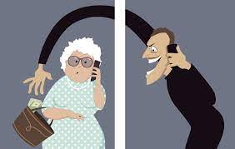
According to China’s 7th national census (2020), the population aged 60 and over has exceeded 260 million.
China’s total Internet users reached 989 million, accounting for 1/5 of the global Internet users, of which 11.2% are aged 60 and over.
81% of the old people think they can distinguish the Internet information, but only 60% of the elderly will use the website, mobile app to identify true and false.

Slide 3

Project Content
Main Procedure
python real-time dynamic crawl to acquire the current screen information
Match these messages with the rumor information database trained algorithm
Send a warning message or prompt to help the old people to judge the information

Slide 4

Future Expectations
The dividends brought by scientific and technological development should benefit all citizens, and those 18% elderly should not be excluded. Only by actively establishing the thinking of serving the elderly population can the development of technology achieve the goal of "universal benefit" for all citizens

Slide 5

Problem
Need To Be
Solved
Implement dynamic crawl the current web page
Ignore the blue v content of microblog
Implement UI stitching
Condition triggering
\\ 2020 © Creative - VOLVA
5

Slide 6




_VOLVA
01.
Problem Encountered
In Our Project
It’s hard to achieve on mobile
Ma Mingyang (Frank)
02.
Crawler Problem

Slide 7


Slide 8
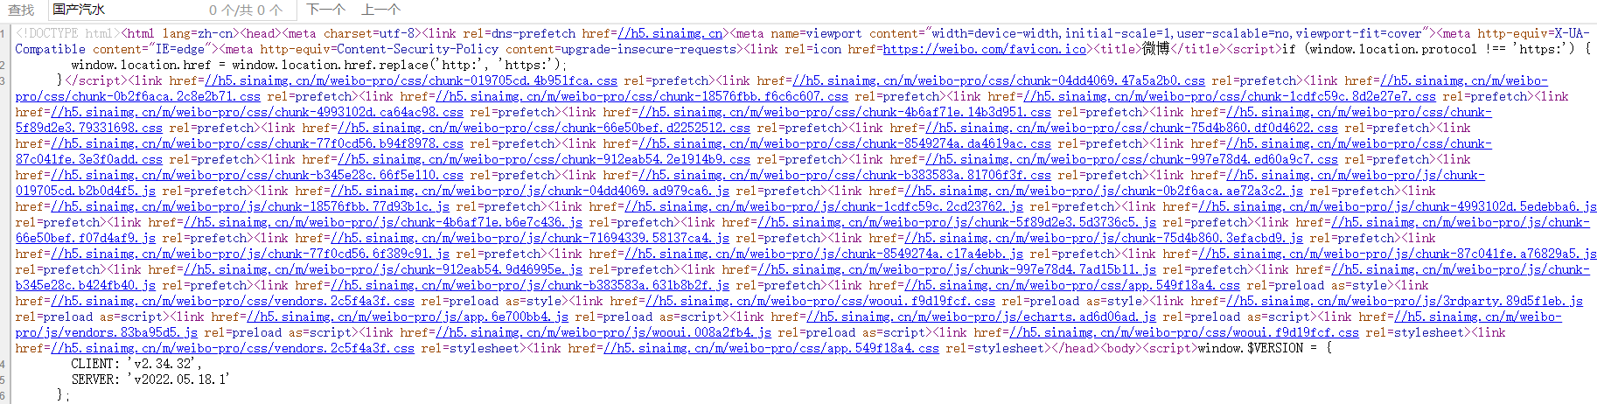
There is the information we need in the webpage, but not in the source code, or the developer hides the content we need

Slide 9
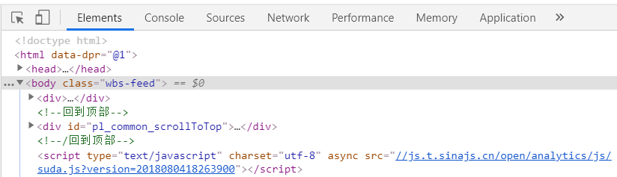
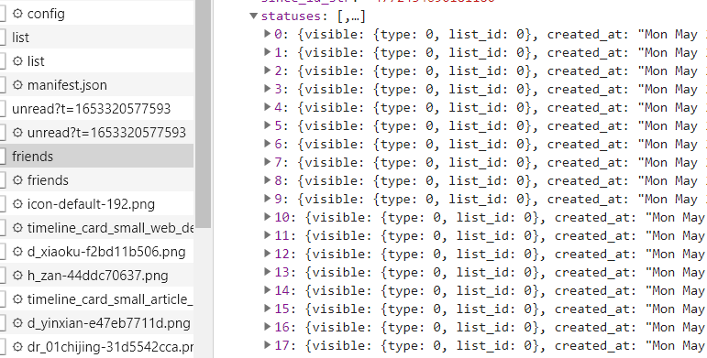

Slide 10
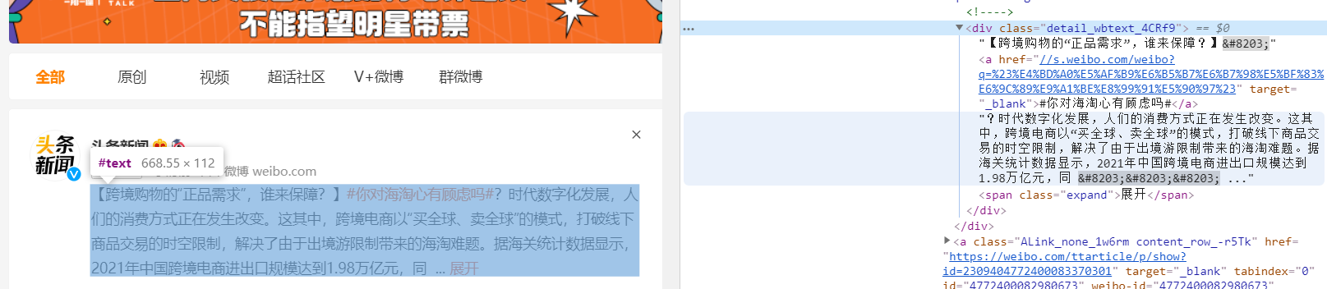
All Weibo content is under the class="detail_wbtext_4CRf9" tag

Slide 11

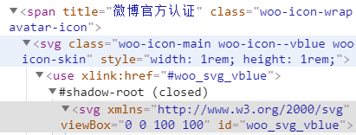
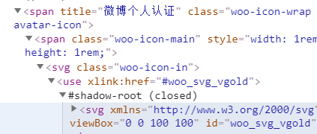
Rumor-like texts posted on official account

Slide 12
Rumor Classification Model
Xiao, Qianyi (Jason)

Slide 13
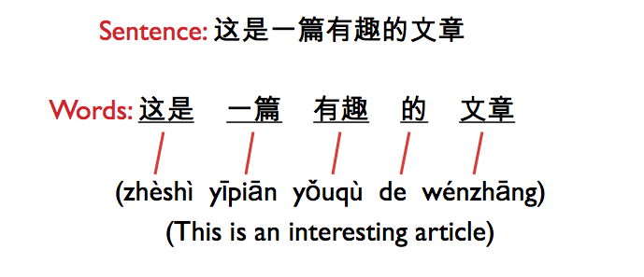
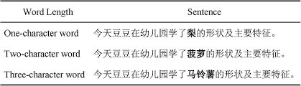
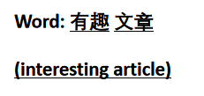
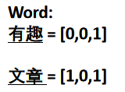
Chinese NLP
Word Segementation
Stopwords Removing
Word2Vec

Slide 14
Trained classifier +
5000 words vector +
Naive Bayes (87% accuracy)
Model choice
Most frequent 5000 words vector
Weibo Word Vector
Overfitting and slow
LSTM 97% accuracy

Slide 15
Beautiful Soup
01
Strong anti-scraping mechanism
Weibo Text Extraction
02
Selenium
Human simulated browser automation
03
JS Code
Realize Window switch

Slide 16
CONCERNING THE FRONTEND
UI/UX Design
Wang Junfeng (Claire)
01
Design Strategy
UI for Senior Citizens
02
Development Process
Framework choice & implement details

Slide 17
The Five Dimensions of Interaction Design
1D
Word
The more choices a user has, the longer it takes to decide. A user must weigh more options, which can lead to confusion.
Having many choices is not a good when it comes to interacting with digital products.
Many e-commerce stores apply Hick’s law to segment choices and categories products for easier searching, clicking, and buying.
Hick’s Law
2D
Visual Factors
3D
Physical and Space
4D
Time
5D
Behaviour

Slide 18

Simplicity

Slide 19
PYQT 5
Drag and drop functionality for implementing visual elements
Add code to visual elements
Cross-platform support
Easy install with pip.
PySide6
Newly released 2020
Offers more overall in terms of widgets and looks
Same Origin with PYQT
Python GUI Frameworks
Tkinter
Especially suitable for developing desktop apps
Pre-installed in recent python3
Offers a vast collection of widgets
WxPython
Kivy
Open source, Cross platform
Supports both Python 2.7 and 3
Simple to use
Not a part of the pre-installed Python on MacOS
Cross-platform, open-source Python library (based on Python and Cython)
Designed for rapid development of apps with complex UIs, like multi-touch apps

Slide 20
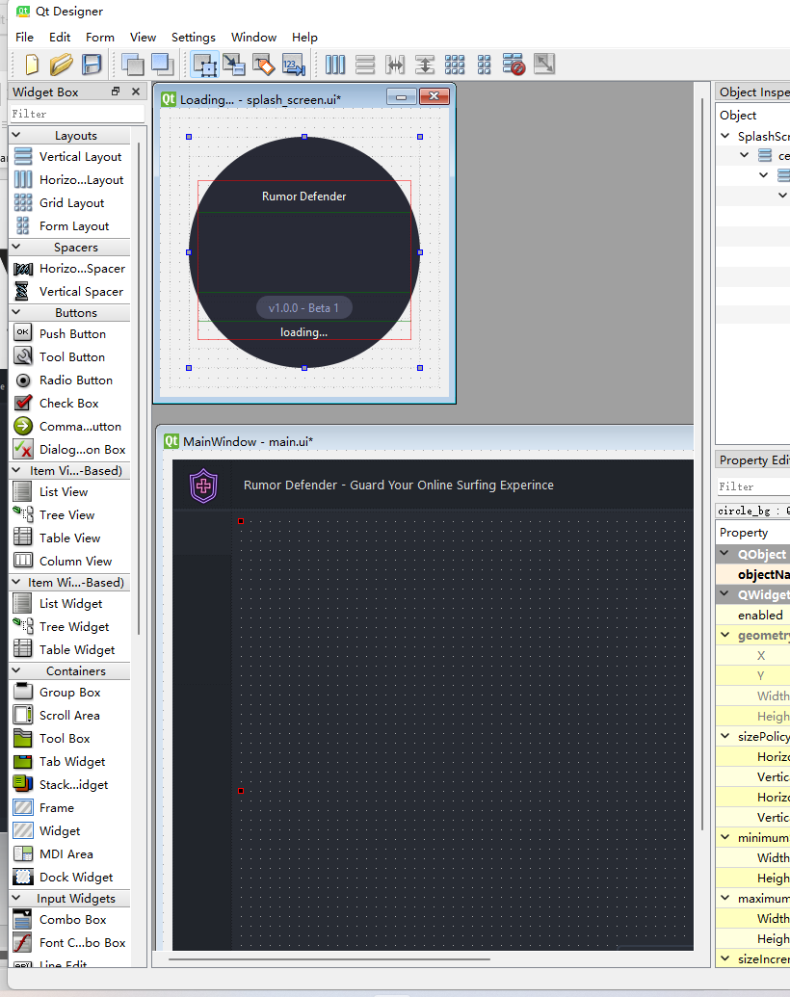
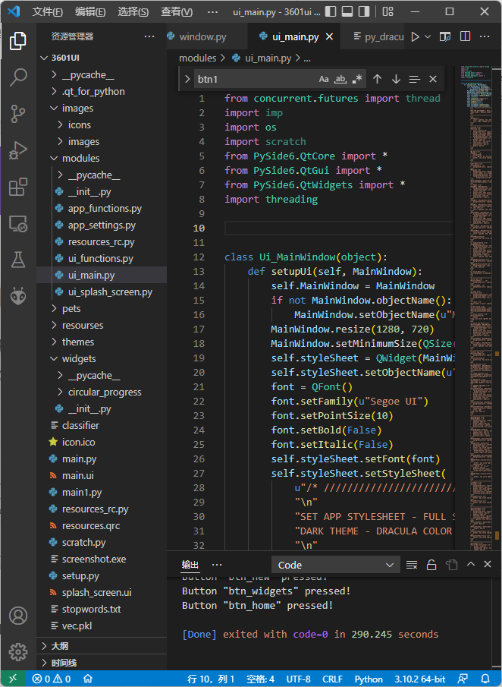
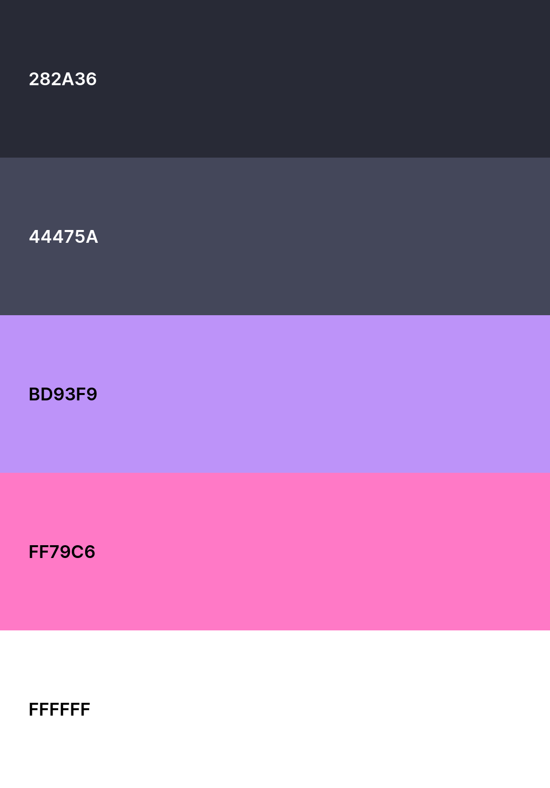
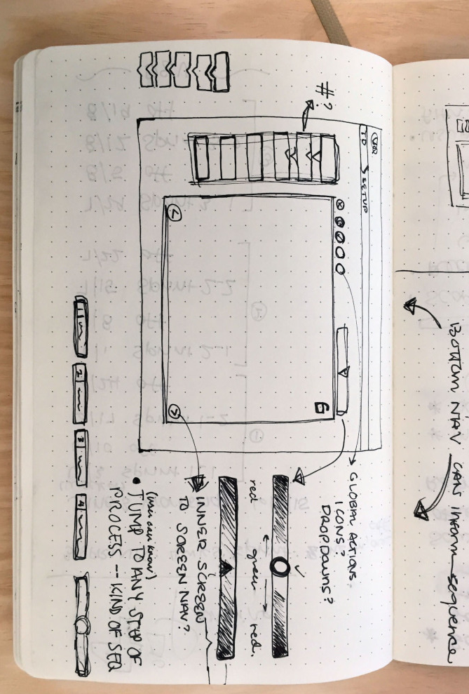
DESIGN PROCEDURE
01.
02.
03.
04.
Choose Theme Color Combination
Sketch
Design Windows In Qt Designer
Coding

Slide 21
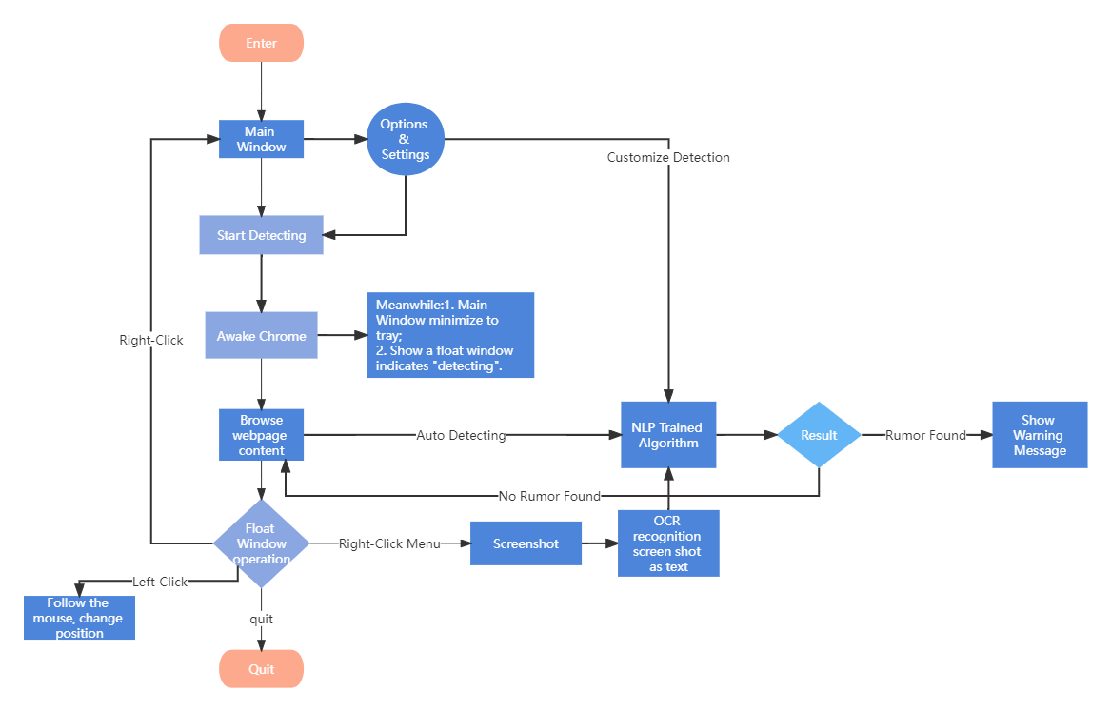

Stitching UI with the Backend Logic

Slide 22
Future Work
Enable OCR
Support general webpage content, not only Weibo
Detect history, language settings, custome detection, etc.
Develop mobile APP

Slide 23

Thank You
FOR YOUR ATTENTION

