Slide 1
Delay Optimization for AR Service using MEC Federation System
Huong Mai Do
Department of Information Communication Convergence
Soongsil University
Prof. Myungsik Yoo
School of Electronic Engineering
Soongsil University

Slide 2
Table of contents
Introduction
Proposed system model
Problem formulation
Methodology
Experiment and Results
Conclusion

Slide 3

Introduction
AR service using MEC
Open issues
Contributions

Slide 4
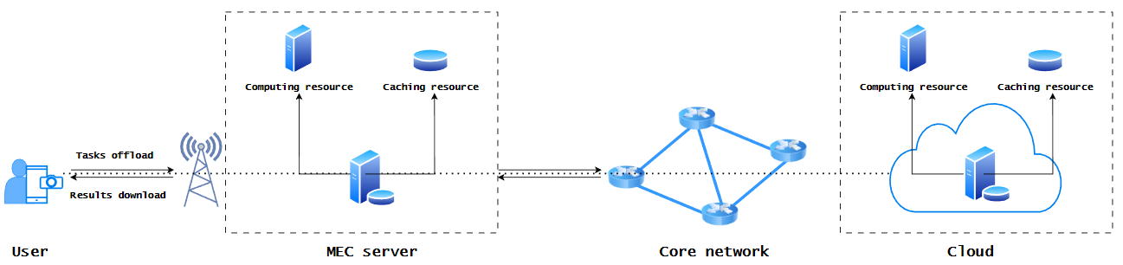
1.1 AR Video streaming in MEC
What is AR (Augmented Reality) video streaming?
Augmented reality (AR) is an interactive experience that combines the real world and computer-generated content (including visual, auditory, haptic, somatosensory, olfactory).
AR video streaming: using AR to enhance the experience of users when watching video.

Slide 5
1.2 Issue
Network architecture – System model
Dedicated MEC system has limited in resource sharing and task offloading options.
The tasks can not handle by local server will be sent to cloud server, make the congressing in back bone network.

Slide 6
1.3 Contributions
Proposed a system model of AR-based MEC federation using multi-hop wired connection
Formulate a minimize delay problem for AR services
Transfer the minimize problem to an MDP problem and solve it by a DRL - DDPG algorithm

Slide 7
2. Proposed system model
AR sub-tasks dependencies model
AR-based MEC federation system

Slide 8
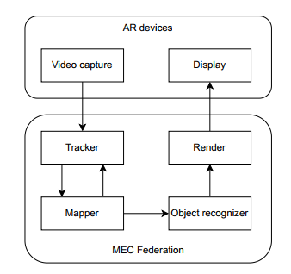
2.1 AR sub-tasks dependencies model
Video capture: capture the real world frames & generate the sub-task request.
Tracker: tracks the position of the users.
Mapper: builds a digital environment model of the real word (video frames).
Object recognizer: identifies known objects (existing objects) in the video frames.
Render: builds the frames attached AR contents.
Display: shows the frames attached AR to clients.
AR sub-tasks model
Notes:
Assume that the controller give decision immediate and don’t waste any time.

Slide 9
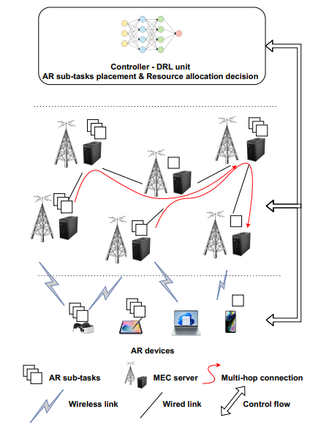
2. Proposed system model
Multiple AR devices of clients generate AR sub-tasks.
The MEC federation includes multiple MEC servers, each MEC server can communicate with AR devices by the base stations, and connect to each others by multi-hop wired connection.
The controller get all system information and decides where the sub-tasks will be executed, how resources allocation.
AR-based MEC federation system
Notes:
Assume that the controller give decision immediate and don’t waste any time.

Slide 10
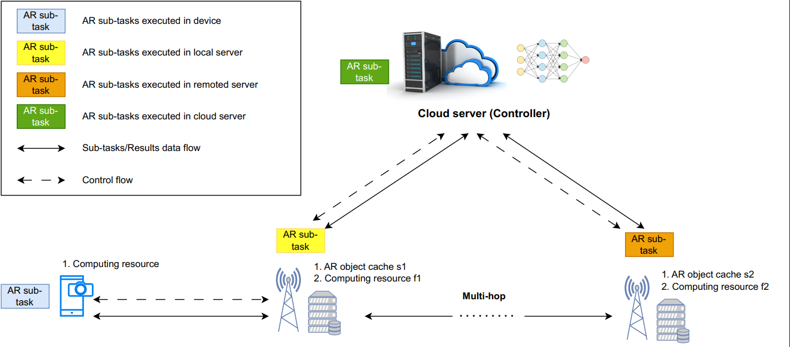
2. Proposed system model
Work flow
Notes:
Assume that the controller give decision immediate and don’t waste any time.

Slide 11
3. Problem statement
Task model
Communication model
Computation model
Queueing model
Problem formulation

Slide 12
3. Problem formulation
Objective: minimize average end-to-end delay of AR services of all users.
Including:
Communication delay: wired & wireless
Computation delay
Queueing delay

Slide 13
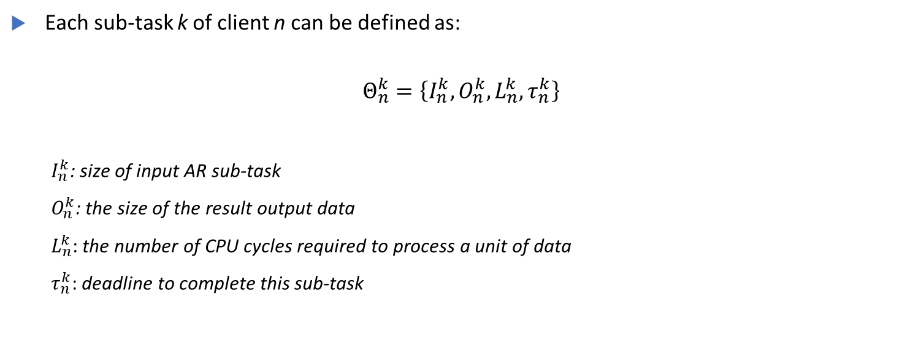
3.1 Task model
Each sub-task k of client n can be defined as:
$$Θ_{n}^{k}=\left\{I_{n}^{k},O_{n}^{k},L_{n}^{k},τ_{n}^{k}\right\}$$
$I_{n}^{k}$: size of input AR sub-task
$O_{n}^{k}$: the size of the result output data
$L_{n}^{k}$: the number of CPU cycles required to process a unit of data
$τ_{n}^{k}$: deadline to complete this sub-task

Slide 14
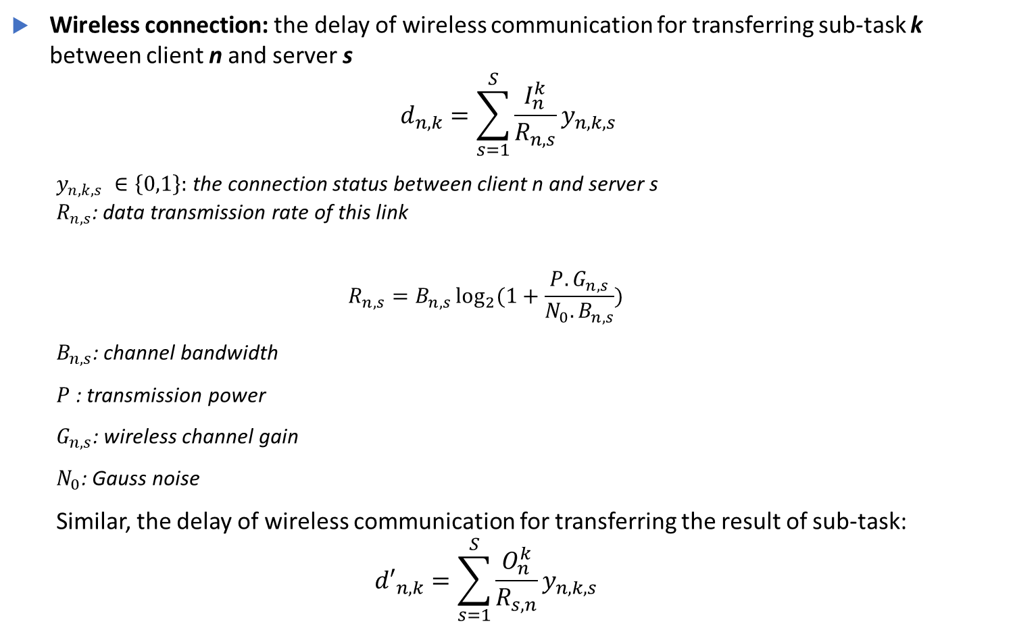
3.2 Communication model
Wireless connection: the delay of wireless communication for transferring sub-task k between client n and server s
$$d_{n,k}=\sum_{s=1}^{S}{\frac{I_{n}^{k}}{R_{n,s}}}y_{n,k,s}$$
$y_{n,k,s} ∈\left\{0,1\right\}:$the connection status between client n and server s $R_{n,s}$: data transmission rate of this link
$$R_{n,s}=B_{n,s}\log_{2}{(1+\frac{P.G_{n,s}}{N_{0}.B_{n,s}})}$$
$B_{n,s}$: channel bandwidth
$P$: transmission power
$G_{n,s}$: wireless channel gain
$N_{0}$: Gauss noise
Similar, the delay of wireless communication for transferring the result of sub-task:
$${d′}_{n,k}=\sum_{s=1}^{S}{\frac{O_{n}^{k}}{R_{s,n}}}y_{n,k,s}$$

Slide 15
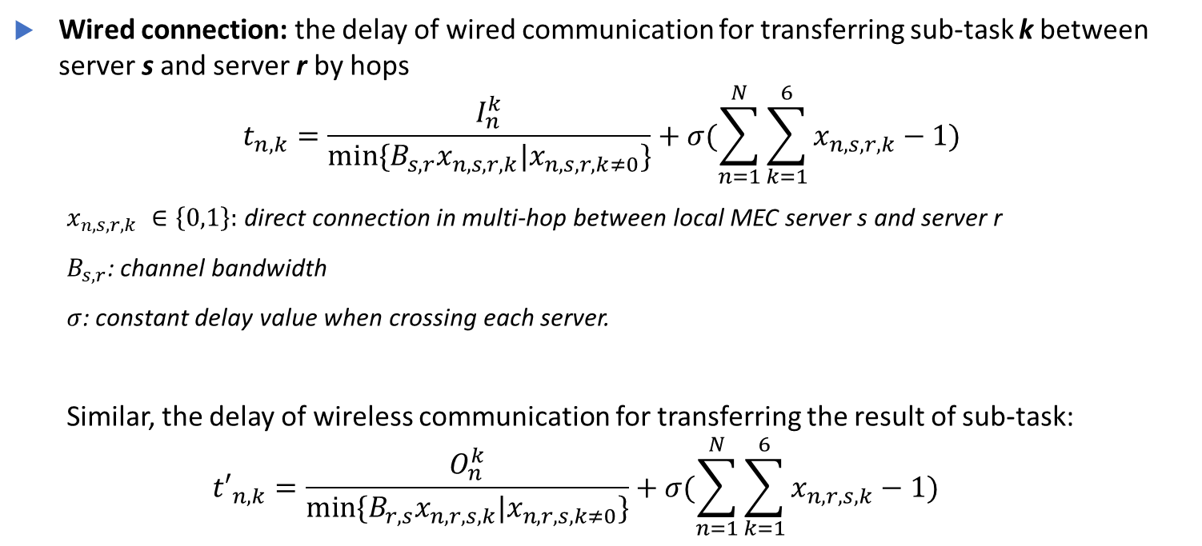
3.2 Communication model
Wired connection: the delay of wired communication for transferring sub-task k between server s and server r by hops
$$t_{n,k}=\frac{I_{n}^{k}}{min⁡\{B_{s,r}x_{n,s,r,k}|x_{n,s,r,k≠0}\}}+σ(\sum_{n=1}^{N}{\sum_{k=1}^{6}{x_{n,s,r,k}−1)}}$$
$x_{n,s,r,k} ∈\left\{0,1\right\}:$direct connection in multi-hop between local MEC server s and server r
$B_{s,r}$: channel bandwidth
$σ$: constant delay value when crossing each server.
Similar, the delay of wireless communication for transferring the result of sub-task:
$${t′}_{n,k}=\frac{O_{n}^{k}}{min⁡\{B_{r,s}x_{n,r,s,k}|x_{n,r,s,k≠0}\}}+σ(\sum_{n=1}^{N}{\sum_{k=1}^{6}{x_{n,r,s,k}−1)}}$$

Slide 16
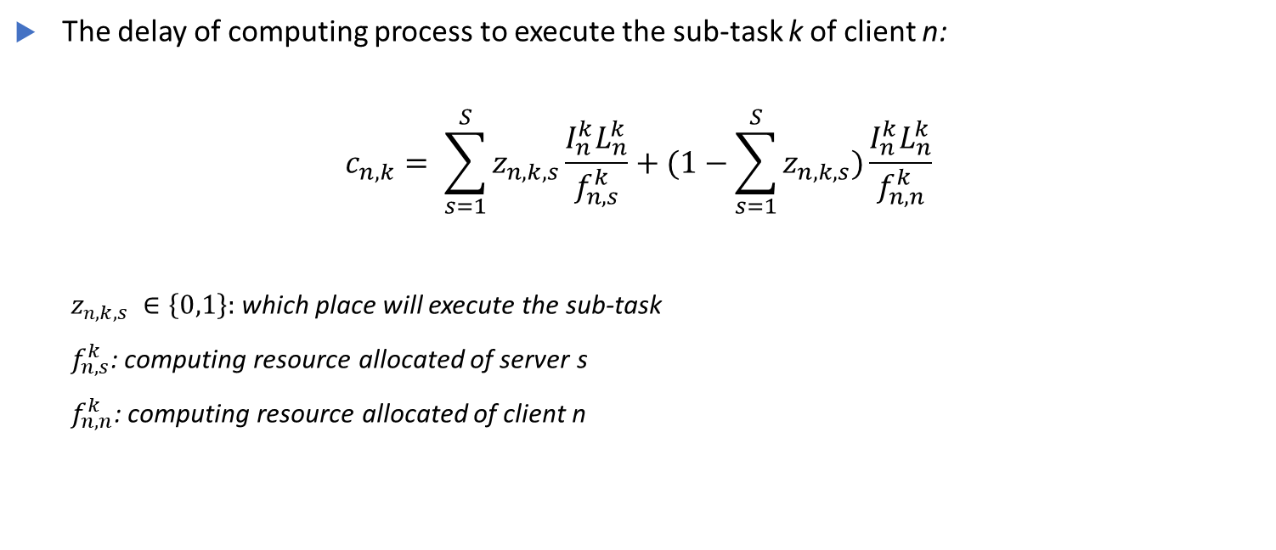
3.3 Computation model
The delay of computing process to execute the sub-task k of client n:
$$c_{n,k}= \sum_{s=1}^{S}{z_{n,k,s}\frac{I_{n}^{k}L_{n}^{k}}{f_{n,s}^{k}}}+(1−\sum_{s=1}^{S}{z_{n,k,s})\frac{I_{n}^{k}L_{n}^{k}}{f_{n,n}^{k}}}$$
$z_{n,k,s} ∈\left\{0,1\right\}:$which place will execute the sub-task
$f_{n,s}^{k}$: computing resource allocated of server s
$f_{n,n}^{k}$: computing resource allocated of client n

Slide 17
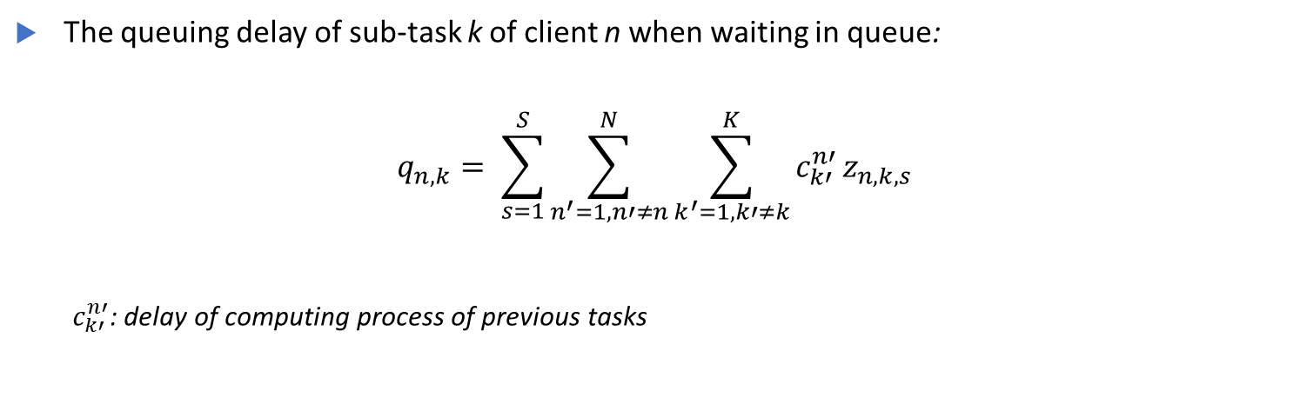
3.4 Queueing model
The queuing delay of sub-task k of client n when waiting in queue:
$$q_{n,k}= \sum_{s=1}^{S}{{\sum_{n^{′}=1, n′≠n}^{N}{\sum_{k^{′}=1, k′≠k}^{K}{c_{k′}^{n′}}}z}_{n,k,s}}$$
$c_{k′}^{n′}$: delay of computing process of previous tasks

Slide 18
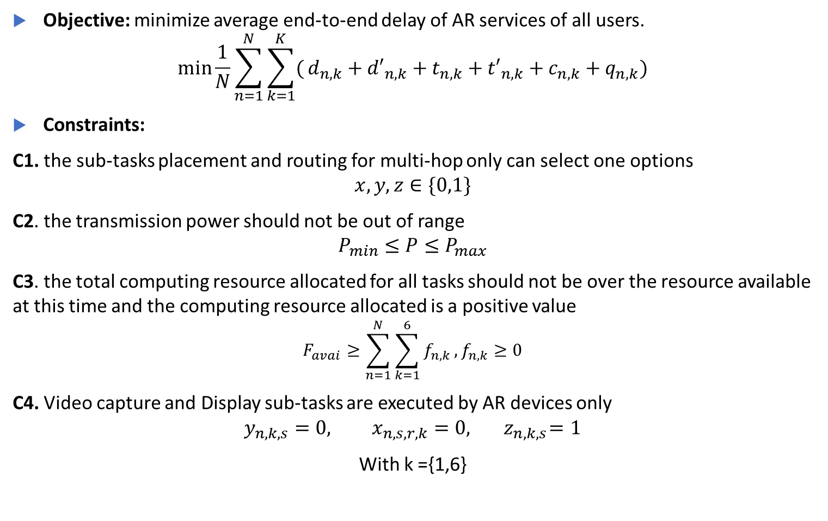
3.5 Problem formulation
Objective: minimize average end-to-end delay of AR services of all users.
$$\min{\frac{1}{N}}\sum_{n=1}^{N}{\sum_{k=1}^{K}{(}}d_{n,k}+{d′}_{n,k}+t_{n,k}+{t′}_{n,k}+c_{n,k}+q_{n,k})$$
Constraints:
C1. the sub-tasks placement and routing for multi-hop only can select one options
$$x,y,z∈\{0,1\}$$
C2. the transmission power should not be out of range
$$P_{min}≤P≤P_{max}$$
C3. the total computing resource allocated for all tasks should not be over the resource available at this time and the computing resource allocated is a positive value $$F_{avai}≥\sum_{n=1}^{N}{\sum_{k=1}^{6}{f_{n,k}}}, f_{n,k}≥0$$
C4. Video capture and Display sub-tasks are executed by AR devices only $$y_{n,k,s}=0, x_{n,s,r,k}=0,{ z}_{n,k,s}=1$$
With k ={1,6}

Slide 19
3. Methodology
Markov Decision Process (MDP)
DDPG framework

Slide 20
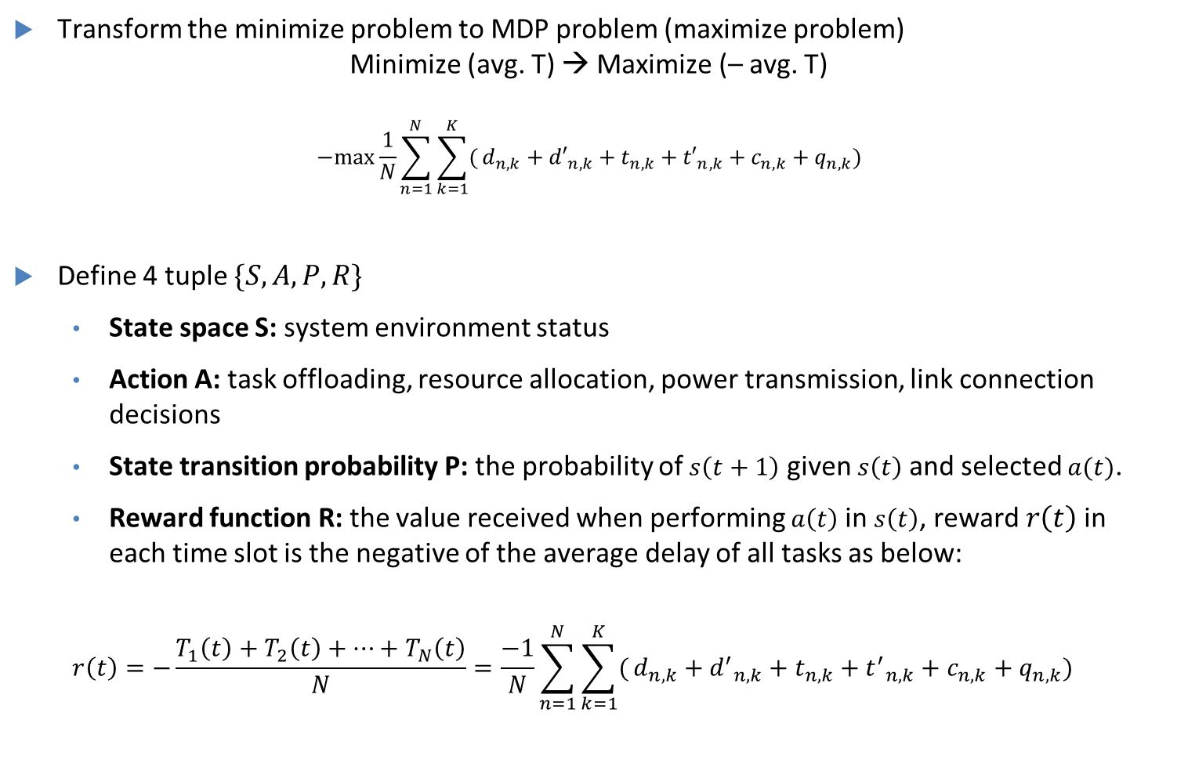
3.1 Markov Decision Process
Transform the minimize problem to MDP problem (maximize problem)
Minimize (avg. T) → Maximize (– avg. T)
$$−max{\frac{1}{N}}\sum_{n=1}^{N}{\sum_{k=1}^{K}{(}}d_{n,k}+{d′}_{n,k}+t_{n,k}+{t′}_{n,k}+c_{n,k}+q_{n,k})$$
Define 4 tuple $\{S,A,P,R\}$
State space S: system environment status
Action A: task offloading, resource allocation, power transmission, link connection decisions
State transition probability P: the probability of $s\left(t+1\right)$ given $s\left(t\right)$ and selected $a(t)$.
Reward function R: the value received when performing $a\left(t\right)$ in $s\left(t\right)$, reward $r\left(t\right)$ in each time slot is the negative of the average delay of all tasks as below:
$$r\left(t\right)=−\frac{T_{1}\left(t\right)+T_{2}\left(t\right)+…+T_{N}\left(t\right)}{N}=\frac{−1}{N}\sum_{n=1}^{N}{\sum_{k=1}^{K}{(}}d_{n,k}+{d^{′}}_{n,k}+t_{n,k}+{t^{′}}_{n,k}+c_{n,k}+q_{n,k})$$

Slide 21
3.2 DDPG framework
Our target: find the action that get the best long-term reward
Need to improve the policy.
Using DDPG, includes 3 phases:
Update critic network
Update actor network
Update target critic/actor network

Slide 22
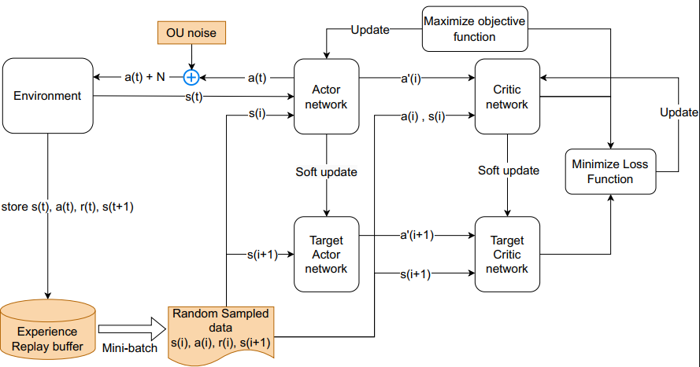
3.2 DDPG framework
Details:

Slide 23
4. Experiment and Results

Slide 24
6.1 Experiment & Results
We give first sub-tasks size (generates by uniform random), number of users and MEC servers as input.
The output will be efficient in offloading decision (including routing in multi-hops) and resource allocation for avg. delay optimization of AR services.
Parameters | Value
Number of clients | 5,10,15,20
Number of MEC servers | 4
CPU cycles per bit for each sub-tasks | 735
Tasks size (1st sub-task input) | [1, 10] MB
Bandwidth between client-MEC (up/down) | 20 MHz
Transmission rate between 2 MECs | 150Mbps
Power range | [5, 38] dBm
Computing resource capacity of device/edge | 5/ 25 GHz
Battery capacity of device | 1000J

Slide 25
6.2 Experiment & Results
System test cases:
Dedicated MEC
MEC collaboration (no multi-hop)
MEC federation (multi-hop)
Number of client adjust: 5, 10, 15, 20
Table 1. Avg. delay (ms) of AR services
Red color: violation of completion time constraints
Number of clients | Dedicated MEC | MEC collaboration (no multi-hop) | MEC federation (multi-hop)
5 | 11.36 | 5.64 | 2.37
10 | 23.68 | 11.73 | 5.50
15 | 39.91 | 19.84 | 7.22
20 | 48.95 | 25.44 | 10.02

Slide 26
4. Conclusion

Slide 27
8. Conclusion
We formulated an AR-based MEC federation system using multi-hop wired connection
We also find a strategy of AR sub-tasks offloading, multi-hop routing and resource allocation to minimize the avg. AR services delay and use the DDPG framework to solve optimize problem.
For the future direction, we want to apply more tight constraints that are close to reality and try to optimize both delay and quality of video frame to improve the AR services.

Slide 28


Slide 29
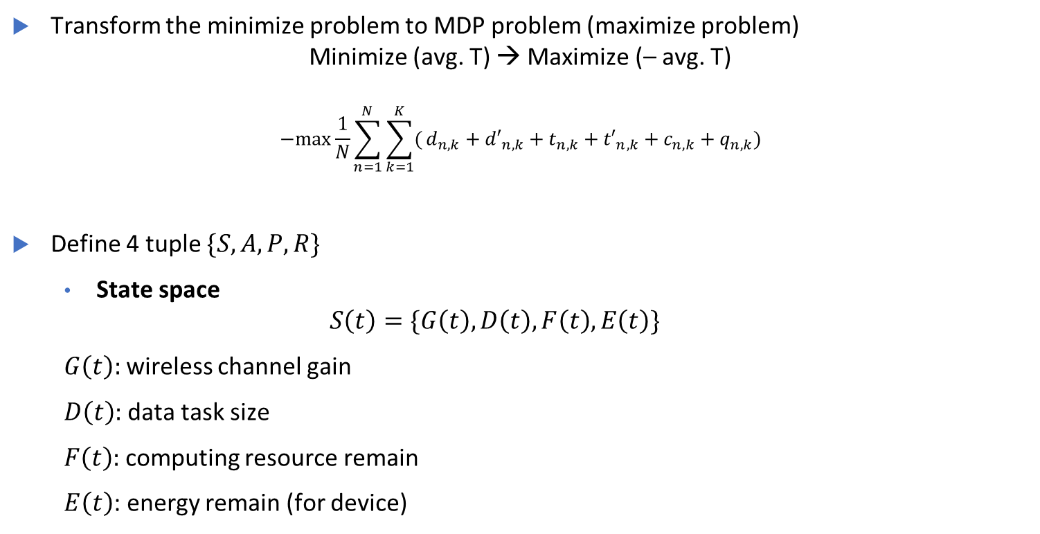
3.1 Markov Decision Process
Transform the minimize problem to MDP problem (maximize problem)
Minimize (avg. T) → Maximize (– avg. T)
$$−max{\frac{1}{N}}\sum_{n=1}^{N}{\sum_{k=1}^{K}{(}}d_{n,k}+{d′}_{n,k}+t_{n,k}+{t′}_{n,k}+c_{n,k}+q_{n,k})$$
Define 4 tuple $\{S,A,P,R\}$
State space
$$S\left(t\right)=\{G\left(t\right), D\left(t\right), F\left(t\right), E\left(t\right)\}$$
$G\left(t\right):$wireless channel gain
$D\left(t\right)$: data task size
$F\left(t\right)$: computing resource remain
$E\left(t\right)$: energy remain (for device)

Slide 30
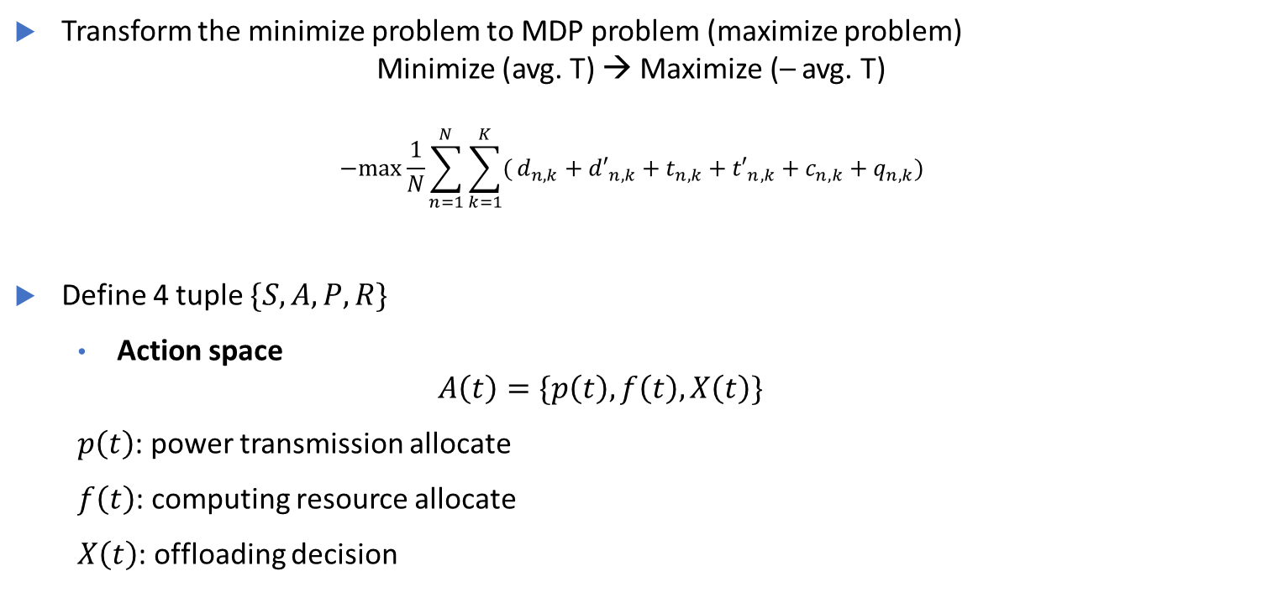
3.1 Markov Decision Process
Transform the minimize problem to MDP problem (maximize problem)
Minimize (avg. T) → Maximize (– avg. T)
$$−max{\frac{1}{N}}\sum_{n=1}^{N}{\sum_{k=1}^{K}{(}}d_{n,k}+{d′}_{n,k}+t_{n,k}+{t′}_{n,k}+c_{n,k}+q_{n,k})$$
Define 4 tuple $\{S,A,P,R\}$
Action space
$$A\left(t\right)=\{p\left(t\right), f\left(t\right), X\left(t\right)\}$$
$p\left(t\right)$: power transmission allocate
$f\left(t\right)$: computing resource allocate
$X\left(t\right)$: offloading decision

Slide 31
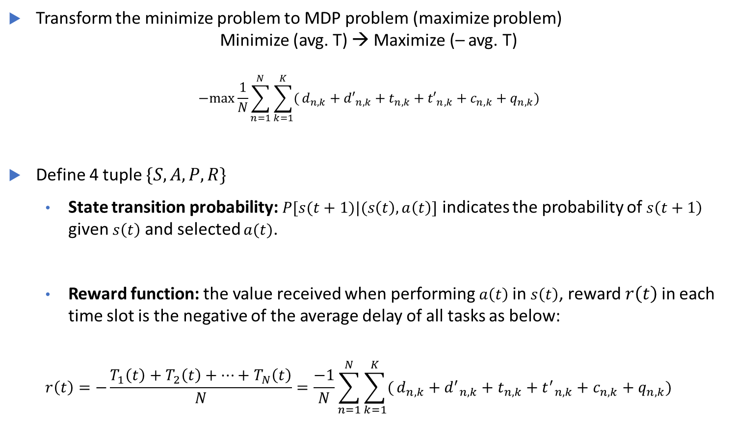
3.1 Markov Decision Process
Transform the minimize problem to MDP problem (maximize problem)
Minimize (avg. T) → Maximize (– avg. T)
$$−max{\frac{1}{N}}\sum_{n=1}^{N}{\sum_{k=1}^{K}{(}}d_{n,k}+{d′}_{n,k}+t_{n,k}+{t′}_{n,k}+c_{n,k}+q_{n,k})$$
Define 4 tuple $\{S,A,P,R\}$
State transition probability: $P[s(t+1)|(s\left(t\right), a\left(t\right)]$ indicates the probability of $s\left(t+1\right)$ given $s\left(t\right)$ and selected $a(t)$.
Reward function: the value received when performing $a\left(t\right)$ in $s\left(t\right)$, reward $r\left(t\right)$ in each time slot is the negative of the average delay of all tasks as below:
$$r\left(t\right)=−\frac{T_{1}\left(t\right)+T_{2}\left(t\right)+…+T_{N}\left(t\right)}{N}=\frac{−1}{N}\sum_{n=1}^{N}{\sum_{k=1}^{K}{(}}d_{n,k}+{d^{′}}_{n,k}+t_{n,k}+{t^{′}}_{n,k}+c_{n,k}+q_{n,k})$$

