Slide 1
Predicting Stock Movements Using News Data
Capstone 2 Project
Springboard Data Science Career Track
By: Ivy Huong Nguyen, Ph.D.

Slide 2
Outlines
Introduction, Data Description and Data Processing
Exploratory Data Analysis
Model Selection: Logistic Regression versus LightGBM
Conclusions

Slide 3
INTRODUCTION
This project is inspired by a Kaggle competition (https://www.kaggle.com/c/two-sigma-financial-news) hosted by Two Sigma, a company that is passionate about applying technology and data science to financial forecasts for over 17 years.
There are two datasets being used in this project:
  The news dataset
  The market dataset
Goal: Using features available in the news dataset to predict the target variable, returnsOpenNextMktres10 in the market dataset. Potentially we could also combine using the features available in the market dataset for the model selection as well.

Slide 4
EXPLORATORY DATA ANALYSIS
EDA on the market dataset
EDA on the news dataset

Slide 5
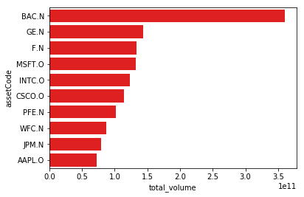
EDA of the Market Dataset
Bank of America corporation has the largest amount of trading in comparison to the others whereas Apple has the lowest amount in the list.

Slide 6
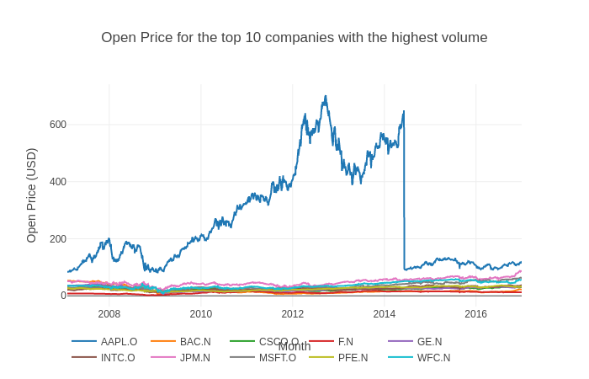
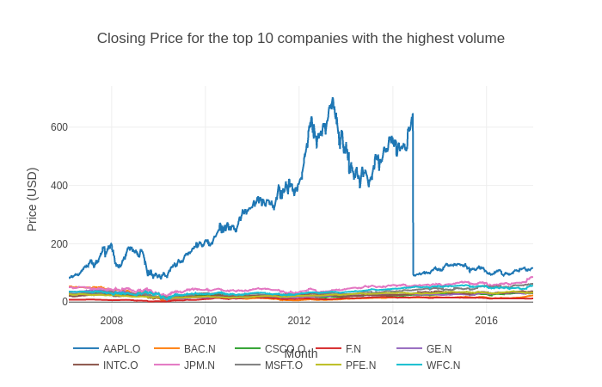
Close and open price of the top 10 Companies with the highest volume
It appears that there is a large gap in the close price and the open price of the APPL.O asset between May of 2014 and June of 2014.
After researching, this gap was found to match with the 7-for-1 split that Apple initiated on June 9 of 2014.

Slide 7
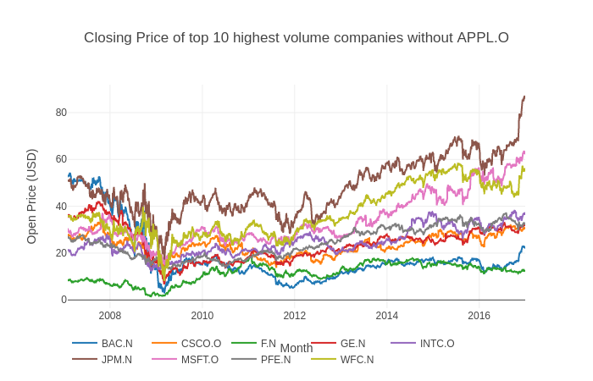
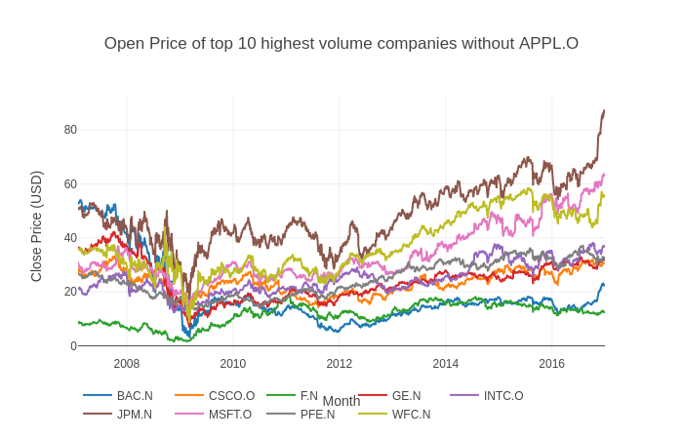
Excluding APPL.O
After excluding APPL.O, we can clearly see the collapse of Lehman Brothers during the year of 2008 in both close price and open graphs.
Another significant event that we can also point out in these graphs is towards the end of the year 2011, which marks the Black Monday of 2011 in the finance and investing industry.

Slide 8
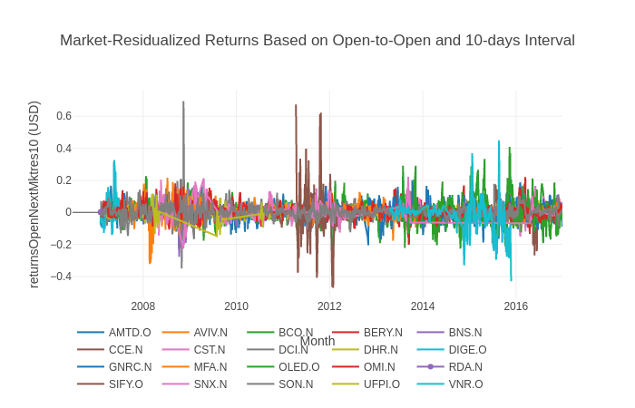
Target variable close-up for 20 random companies
The fluctuation of the market-residualized returns based on open-to-open price and within a 10-day interval of the 20 randomly selected assets is represented
We can somewhat see the collapse of the Lehman Brothers back in 2008 and the Black Monday of 2011 → looked at the price difference from open to close

Slide 9
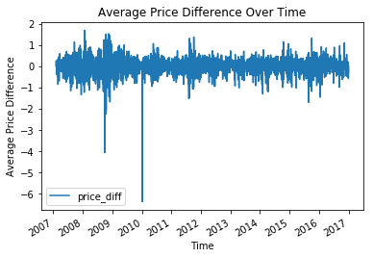
Feature engineering, data error elimination process
Noticed errors in the time-frame of the significant events via price difference graph
→ Sorted the price difference column that was generated earlier by taking the difference between the open and the close price.
noticed that the Towers Watson and Co has a huge price difference (almost $10,000 in difference) on the 4th of Jan in 2010
Fixed the errors by:
Took the ratio between the close stock price and the open stock price of the same day for each asset.
If the close price increases or decreases more than twice the open price then we classify that data point as an error and replace it with the median of the open price or the median of the close price.

Slide 10
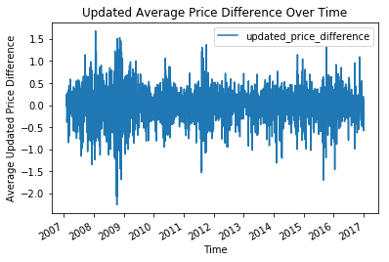
Updated average price difference Over Time of the randomly-selected 20 companies

Slide 11
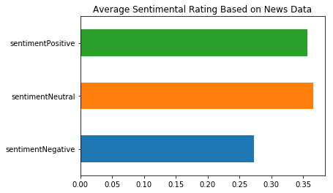
EDA of the News Dataset
a) Sentimental Rating

Slide 12
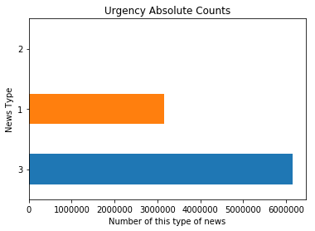
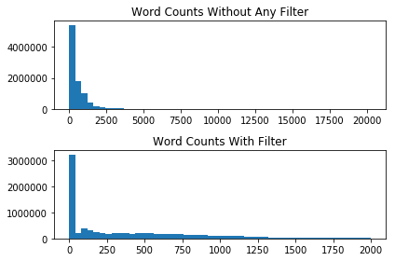
EDA of the News Dataset (cont.)
b) Urgency and word counts

Slide 13
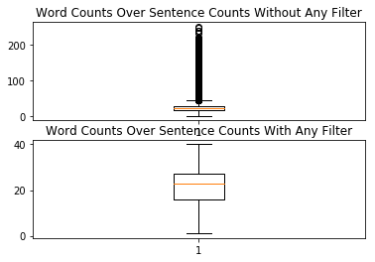
EDA of the News Dataset (cont.)

Slide 14
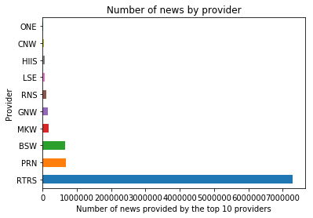
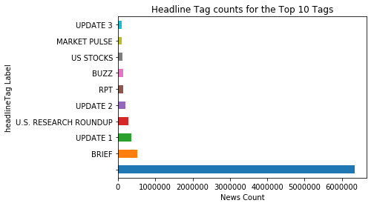
EDA of the News Dataset (cont.)
c) Providers and headline tags

Slide 15
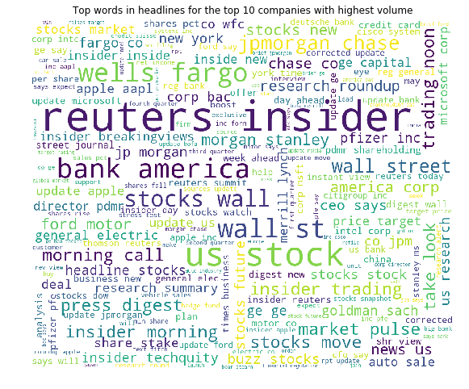
EDA of the News Dataset (cont.)
WordCloud generated image shows the impact of each word presented in the headlines of the top 10 companies that have highest trading volume

Slide 16
MODEL SELECTION
Comparing Model Performance
  Logistic regression model is the first choice when it comes to a binary classification problem → predict probability between 0 and 1
  Second choice is the lightGBM. LightGBM model is a relatively new but efficient model that is based on tree-based learning algorithm
    LightGBM is preferred as ‘light’ because of its high speed and its ability to handle large size dataset

Slide 17
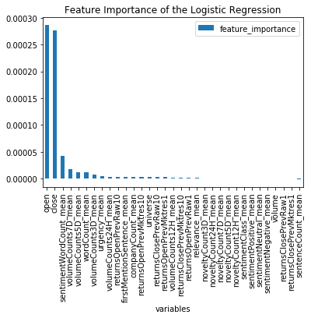
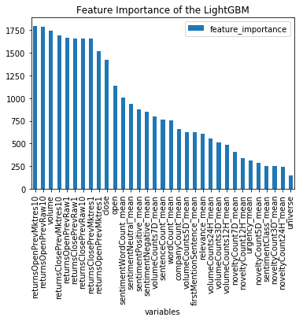
Feature Importance
The top three features that have the highest contribution to the logistic regression model are ‘open’, ‘close’, and ‘ sentimentWordCount-mean’.
The lightGBM model has a totally different distribution of the feature importance, in which the top three most important features are: returnsOpenPrevMktres10, returnsOpenPrevRaw10, and volume.

Slide 18
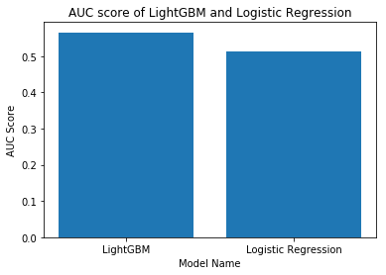
AUC Score Comparison
The Area Under the ROC Curve (AUC) score of the logistic regression is 51.41% whereas that of the lightGBM model is 56.62%

Slide 19
MODEL SELECTION
Tuning LightGBM Model: To further optimize the accuracy of the LightGBM model, we can vary the following features
  use large max_bin (slow down working process due to large dataset)
  use small learning_rate in addition to increasing the num_boost_round
  use large num_leaves (may cause overfitting)
  use bigger training dataset (not applicable in our case)
  try using 'dart' method
  or try using categorical features directly (already eliminated)

Slide 20
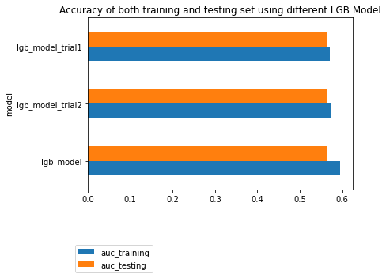
MODEL SELECTION

Slide 21
CONCLUSIONS
The prediction was made via the Kaggle kernel of this competition and was submitted; however the validation score is not available since this competition is still going.
Overall, the lightGBM model gives us a better AUC score in comparison to the logistic regression model → LightGBM is recommended for this dataset with further tuning to avoid overfitting and improving the AUC score.

