Slide 1

PORTABLE EXECUTABLE 32 FILE FORMAT

Slide 2
Nội dung
Basic Structure
DOS Header
PE Header
Import Table
Export Table
Section Table

Slide 3
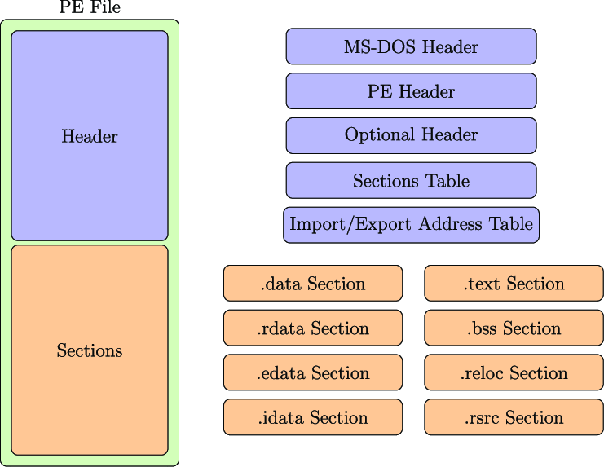
Basic Struture

Slide 4
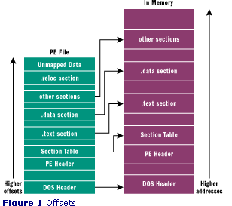
PE loader
tries to load the image at the preferred base address and maps the sections in memory.
goes through the section table and maps each section at the address calculated by adding the RVA of the section to the base address.
after mapping the sections in memory, the loader performs base relocations if the load address is not equal to the preferred base address in ImageBase.

Slide 5
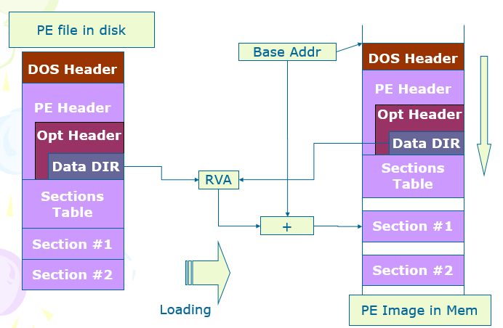
RVA
RVA – Relative Virtual Address
RVA points to the address in memory images, not the offset in file
PE Image Address = Base Address + RVA

Slide 6
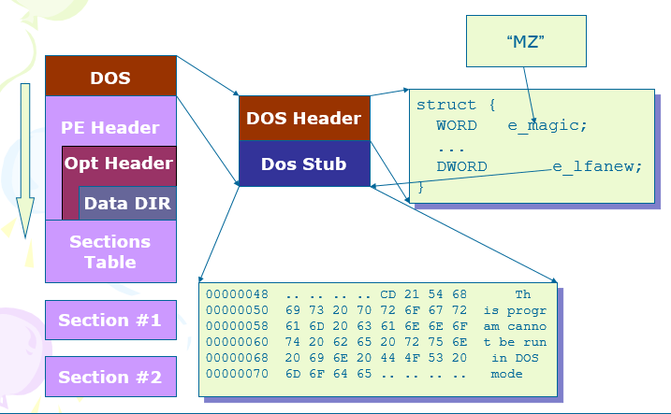
Dos Header

Slide 7
_IMAGE_DOS_HEADER
typedef struct _IMAGE_DOS_HEADER { // DOS .EXE header
WORD e_magic; // Magic number
WORD e_cblp; // Bytes on last page of file
WORD e_cp; // Pages in file
WORD e_crlc; // Relocations
WORD e_cparhdr; // Size of header in paragraphs
WORD e_minalloc; // Minimum extra paragraphs needed
WORD e_maxalloc; // Maximum extra paragraphs needed
WORD e_ss; // Initial (relative) SS value
WORD e_sp; // Initial SP value
WORD e_csum; // Checksum
WORD e_ip; // Initial IP value
WORD e_cs; // Initial (relative) CS value
WORD e_lfarlc; // File address of relocation table
WORD e_ovno; // Overlay number
WORD e_res[4]; // Reserved words
WORD e_oemid; // OEM identifier (for e_oeminfo)
WORD e_oeminfo; // OEM information; e_oemid specific
WORD e_res2[10]; // Reserved words
LONG e_lfanew; // File address of new exe header
} IMAGE_DOS_HEADER, *PIMAGE_DOS_HEADER;

Slide 8
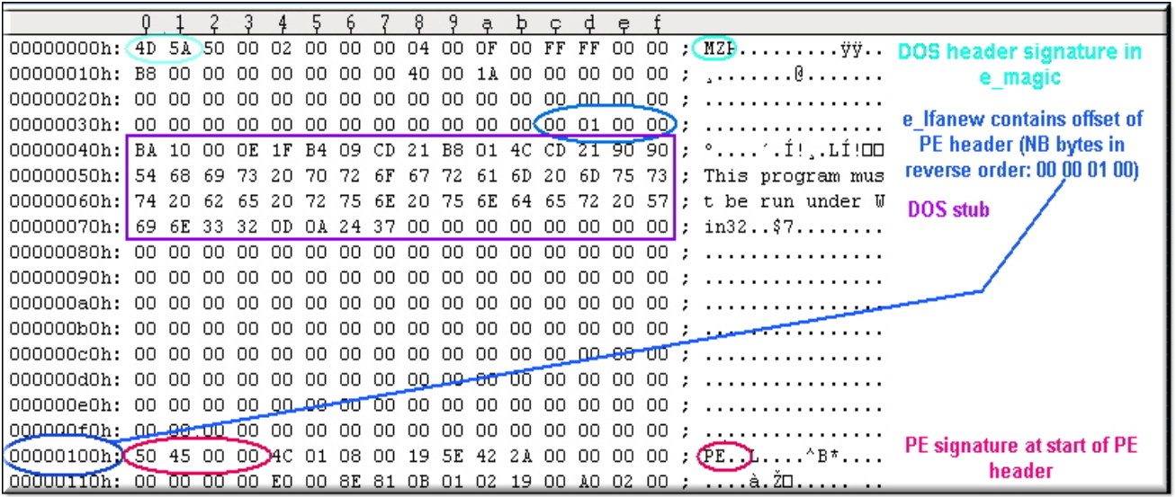

Slide 9
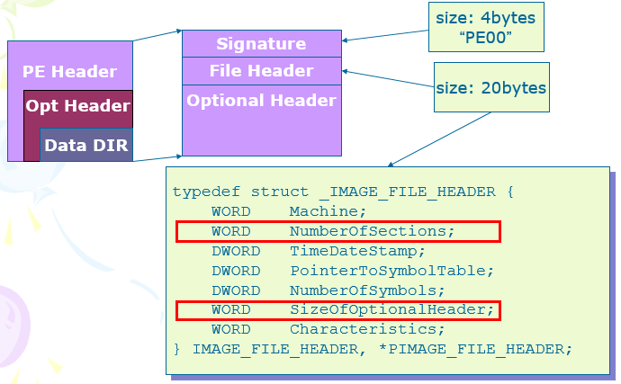
PE Header -- IMAGE_NT_HEADERS

Slide 10
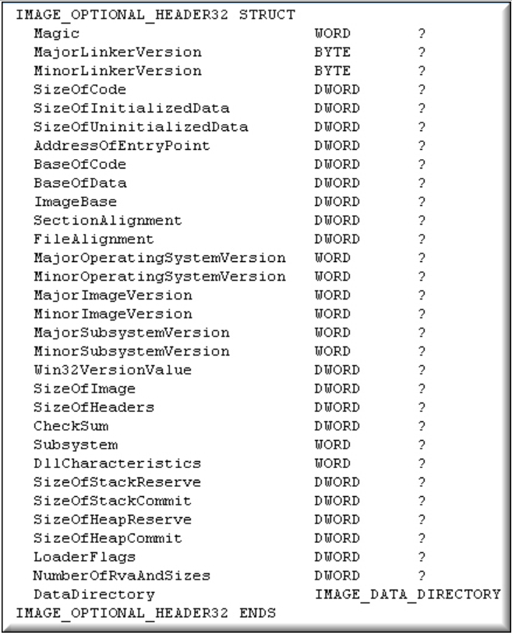
Optional Header
AddressOfEntryPoint
- Execution Entry (Note : RVA)
ImageBase
Alignment (Padding)
- SectionAlignment (Bigger)
- FileAlignment (Smaller)

Slide 11
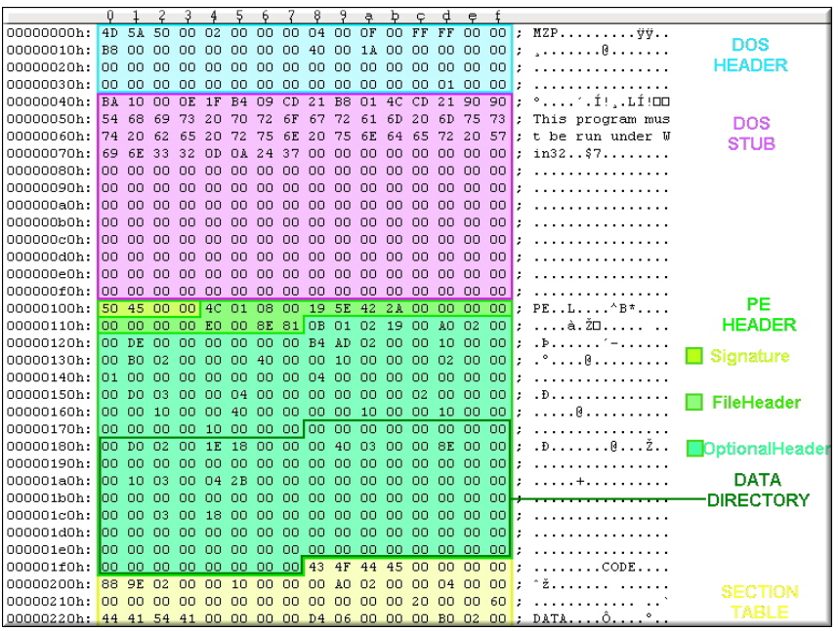

Slide 12
Data Directory
An Array with size 16 * 8
Note : RVA
IMAGE_DATA_DIRECTORY
DataDirectory[16];
typedef struct _IMAGE_DATA_DIRECTORY {
DWORD VirtualAddress;
DWORD Size;
} IMAGE_DATA_DIRECTORY;

Slide 13
Data Directory
0 : Export
1 : Import
2 : Resource
3 : Exception
4 : Security
5 : Base Relocation
6 : Debug
7 : Architecture
8 : Global PTR (unknown)
9 : TLS (Thread Local Storage)
10 : LOAD_CONFIG
11 : BOUND_IMPORT
12 : IAT
13 : DELAY_IMPORT
14 : COM_DESCRIPTOR
15 : 0x00000000, 0x00000000

Slide 14
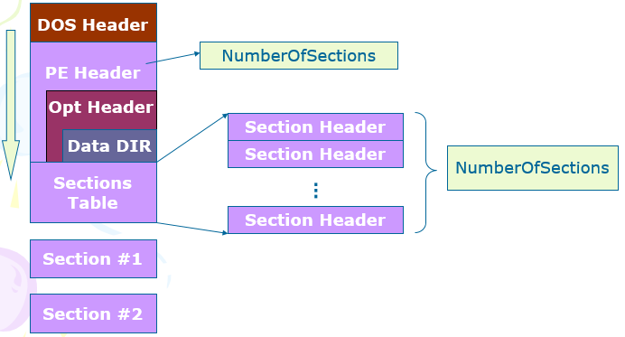
Section Table

Slide 15
Section Header
Name[8]
VirturalSize
VirtualAddress (RVA)
- Addr of section
SizeOfRawData
- Size of section in PE file
PointerToRawData
- Offset of section in PE file
Characteristics: flag
- Shared? Executable?
- Readable? Writable?
- Discardable?
typedef struct _IMAGE_SECTION_HEADER {
BYTE Name[8];
union {
DWORD PhysicalAddress;
DWORD VirtualSize;
} Misc;
DWORD VirtualAddress;
DWORD SizeOfRawData;
DWORD PointerToRawData;
DWORD PointerToRelocations;
DWORD PointerToLinenumbers;
WORD NumberOfRelocations;
WORD NumberOfLinenumbers;
DWORD Characteristics;
} IMAGE_SECTION_HEADER;

Slide 16
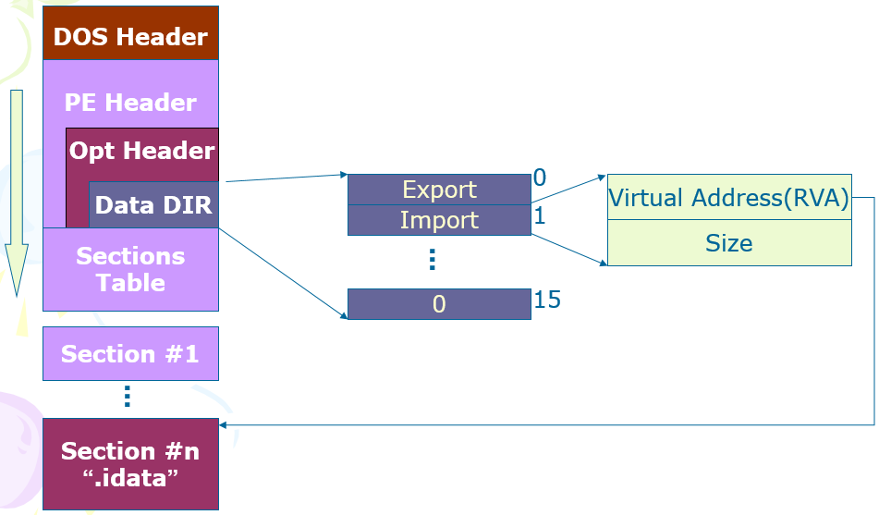
Import Directory
Từ đây tính ra offset của mảng cấu trúc IMAGE_IMPORT_DESCRIPTOR

Slide 17
DOS Header
typedef struct _IMAGE_IMPORT_DESCRIPTOR {
union {
DWORD Characteristics;
DWORD OriginalFirstThunk;
};
DWORD TimeDateStamp;
DWORD ForwarderChain;
DWORD Name;
DWORD FirstThunk; // RVA to IAT
} IMAGE_IMPORT_DESCRIPTOR;
PE Header
Opt Header
Data DIR
Sections
Table
Section #1
...
import desc 0
Section #n
“.idata”
import desc 1
...
0

Slide 18
Import Descriptor
import desc
OriginalFirstThunk
IMAGE_THUNK_DATA
IMAGE_THUNK_DATA
TimeDataStamp
IMAGE_THUNK_DATA
IMAGE_THUNK_DATA
ForwarderChain
IMAGE_THUNK_DATA
IMAGE_THUNK_DATA
Name
0000 0000
0000 0000
FirstThunk
“Kernel32.dll”
02F6
ExitProcess
0111
ReadFile
IMAGE_IMPORT_BY_NAME

Slide 19
PE Loader
Khi trình Loader nạp một File PE vào trong bộ nhớ, nó sẽ kiểm tra Import Table và nạp các file DLLs được yêu cầu vào không gian địa chỉ xử lý. Sau đó nó dạo qua mảng được trỏ bới FirtsThunk và thay thế IMAGE_THUNK_DATA bới những địa chỉ thực sự của các Import Functions ----> việc này trở thành Import Address Table

Slide 20
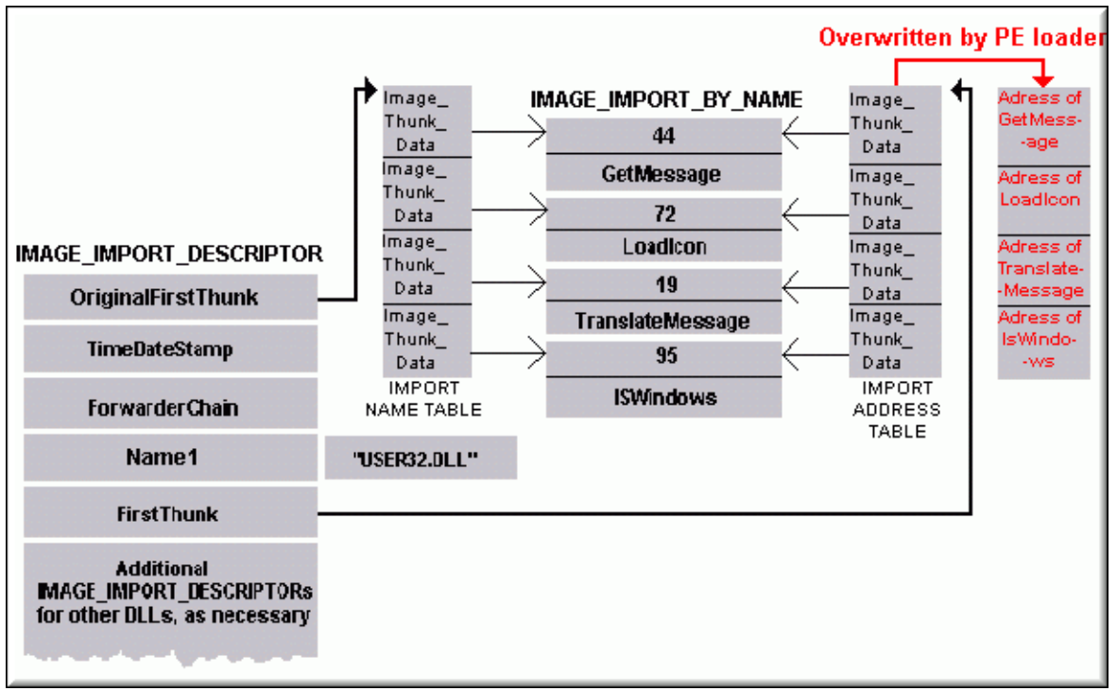

Slide 21
Export Directory
DOS Header
PE Header
Opt Header
0
Data DIR
Export
Virtual Address(RVA)
Import
1
Sections
Table
Size
...
0
15
Section #1
...
Section #n
“.edata”

Slide 22
DOS Header
typedef struct _IMAGE_EXPORT_DIRECTORY {
DWORD Characteristics;
DWORD TimeDateStamp;
WORD MajorVersion;
WORD MinorVersion;
DWORD Name; // RVA
DWORD Base;
DWORD NumberOfFunctions;
DWORD NumberOfNames;
DWORD AddressOfFunctions; // RVA
DWORD AddressOfNames; // RVA
DWORD AddressOfNameOrdinals; // RVA
} IMAGE_EXPORT_DIRECTORY;
PE Header
Opt Header
Data DIR
Sections
Table
Section #1
...
Export
Directory
Section #n
“.edata”
...

Slide 23
Export Directory
Name
“kernel32.dll”
Even filename is “kernel3.dll”
Base
Ordinal = Base + Index
NumberOfFunctions
NumberOfNames
<= NumberOfFunctions
Some functions have no name
AddressOfFunctions
RVA, point to an array of RVAs
AddressOfNames
AddressOfNameOrdinals
typedef struct _IMAGE_EXPORT_DIRECTORY {
DWORD Characteristics;
DWORD TimeDateStamp;
WORD MajorVersion;
WORD MinorVersion;
DWORD Name; // RVA
DWORD Base;
DWORD NumberOfFunctions;
DWORD NumberOfNames;
DWORD AddressOfFunctions; // RVA
DWORD AddressOfNames; // RVA
DWORD AddressOfNameOrdinals;// RVA
} IMAGE_EXPORT_DIRECTORY;

Slide 24
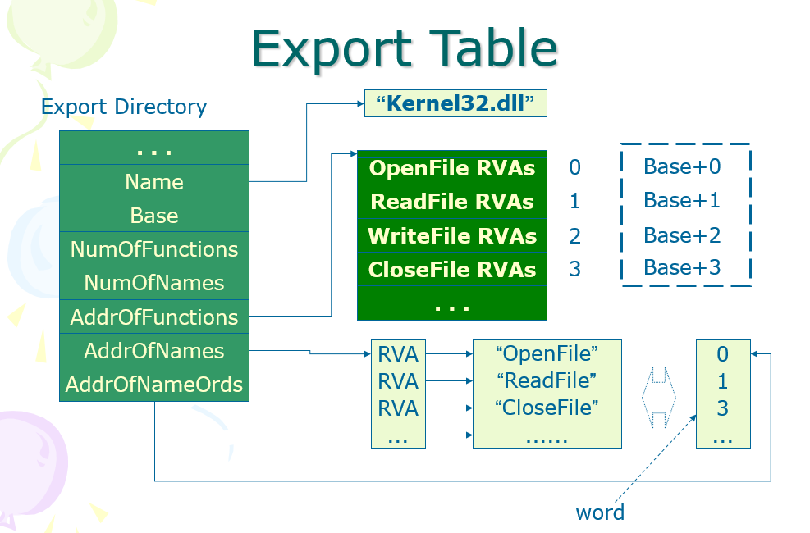

Slide 25
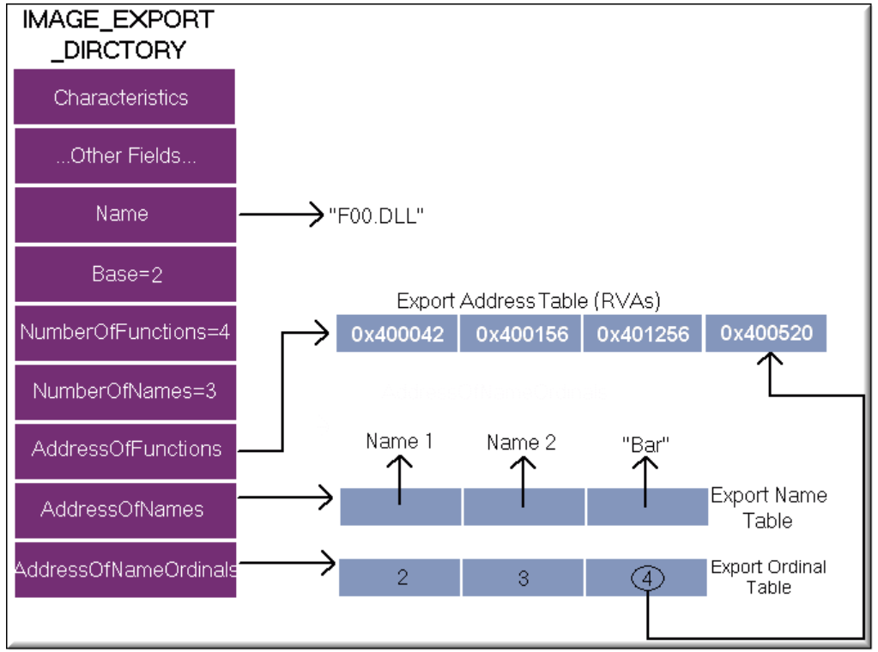
Export
Directory

Slide 26
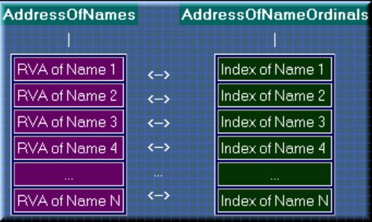

Slide 27


