Slide 1
VNBank-LOD
IT6390E SEMANTIC WEB · CAPSTONE PROJECT · GROUP 24
A five-star Linked Open Data application for the Vietnamese banking system
Đinh Thị Lan Hương · 20261261M
Vũ Đức Thành · 20261082M
Supervisor
Nguyễn Khắc Duy Ngọc · 20261206M
Dr. Đỗ Bá Lâm
Ngô Quang Minh · 20252084M
Hanoi University of Science and Technology · 10 Oct 2026
Notes:
Opening speaker: Đinh Thị Lan Hương. Good morning, professor and everyone. Group 24 presents VNBank-LOD, a Linked Open Data application for the Vietnamese banking system. The talk has four parts, one per member, and takes about ten minutes.

Slide 2
OUTLINE
PART 1 · about 2.5 min
PART 2 · about 2.5 min
Problem, scope and data
Ontology design and Protégé
Đinh Thị Lan Hương
Vũ Đức Thành
PART 3 · about 2.5 min
PART 4 · about 2.5 min
4-star RDF and 5-star linking
SPARQL, reasoning and evaluation
Nguyễn Khắc Duy Ngọc
Ngô Quang Minh
Notes:
Hương: The talk follows the five steps of the problem in four parts. I cover the problem, scope and data. Thành presents the ontology design. Ngọc presents the RDF conversion and linking. Minh presents the query interface, reasoning and evaluation.

Slide 3
From scattered information to five-star data
PART 1 · PROBLEM
Information about Vietnamese banks is scattered across bank websites, the State Bank of Vietnam and the stock exchanges, as HTML, PDF and spreadsheets.
1
On the web, open licence
2
Structured, machine-readable
3
Open format (CSV, Turtle)
These sources share no identifiers or schema, so machines cannot connect or query them. Our goal is to bring this data to five stars.
4
W3C standards: RDF, own URIs
5
Linked to Wikidata, DBpedia
Notes:
Hương: Public information about banks is only at one or two stars today. Even a simple question, such as which state-controlled banks were founded before 1991 and are headquartered in Hanoi, needs manual lookups across many pages. Tim Berners-Lee's five-star scheme is the yardstick we use throughout: on the right are the five levels and what we did at each.

Slide 4
30 banks (public data only)
PART 1 · SCOPE
Target | Planned | Achieved
Banks | 30 | 30
Bank types | 3 to 4 | 5
Linked banks | at least 10 | 24
Linked locations | all | 3/3
Source, collection date | every record | met
Stable internal URIs | yes | met
We weighed three options: basic information; adding deposit rates; adding branches and financial indicators.
We chose the first to fit the time available, and excluded internal data because one star requires an open licence.
Notes:
Hương: We set minimum targets before starting. The final result exceeds them for bank types and linked banks. There are only three locations (Vietnam, Hanoi, Ho Chi Minh City), because all 30 banks are headquartered in these two cities.

Slide 5
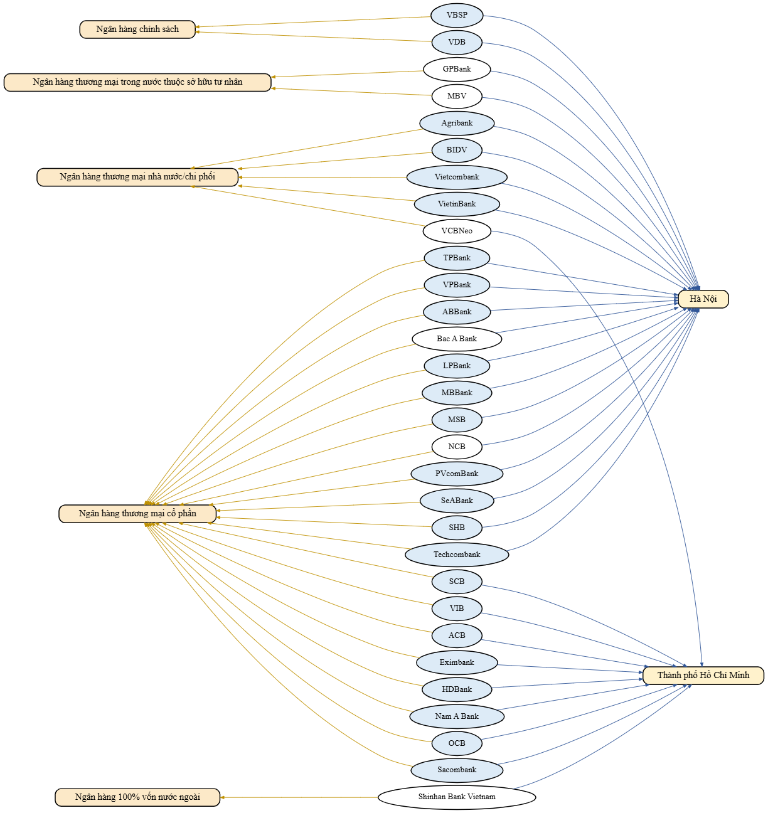
30 banks, every record sourced
PART 1 · DATA COLLECTION
30
5
banks
bank types
9
202
service groups
bank–service links
Source: Wikipedia's list of banks in Vietnam, checked against official websites. Headquarters follow the administrative boundaries in force from 1 July 2025.
Notes:
Hương: The data covers 30 banks of five types: policy banks, state-owned commercial banks, joint-stock commercial banks, domestic banks transferred under compulsory transfer, and wholly foreign-owned banks. The figure on the right is generated from the data file itself: each bank connects to its type on the left and its headquarters on the right; coloured banks have external links. Next, Thành will show how we modelled this data as an ontology.

Slide 6
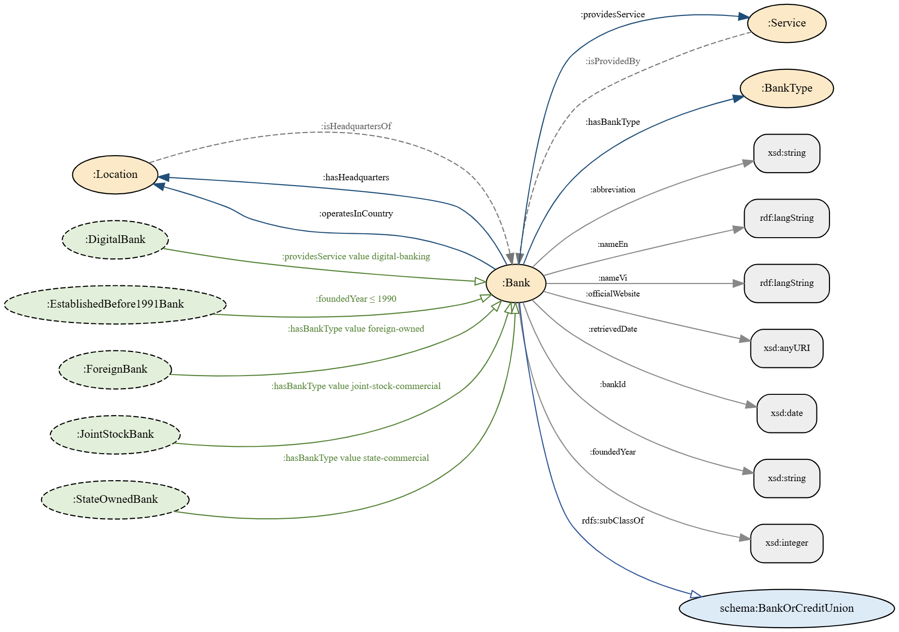
Four core classes, five defined classes
PART 2 · ONTOLOGY
Core classes
Bank, BankType, Location, Service. Types, locations and services are individuals.
Properties
6 object properties (2 inverse pairs) and 7 datatype properties typed with xsd.
Vocabulary reuse
Bank is a subclass of schema:BankOrCreditUnion.
Notes:
Thành: The ontology scope comes from six competency questions, for example which banks are state-owned, where they are headquartered and which services they provide. The figure on the left is generated from the Turtle file: orange nodes are core classes, green nodes are the five defined classes, grey boxes are datatypes. We model types, locations and services as individuals so new ones can be added without changing the schema.

Slide 7
Competency questions become inferred classes
PART 2 · OWL 2 AXIOMS
Restrictions on Bank
Defined classes (owl:equivalentClass)
Bank SubClassOf
hasBankType exactly 1 BankType,
hasHeadquarters exactly 1 Location,
bankId exactly 1 xsd:string,
providesService some Service,
schema:BankOrCreditUnion
Bank DisjointWith
BankType, Location, Service
StateOwnedBank ≡ Bank and
hasBankType value state-commercial
DigitalBank ≡ Bank and
providesService value digital-banking
EstablishedBefore1991Bank ≡ Bank and
foundedYear some xsd:integer[<= 1990]
+ JointStockBank, ForeignBank
The four hasValue classes fall within OWL 2 RL. EstablishedBefore1991Bank uses a datatype restriction, so it needs HermiT (OWL 2 DL).
Notes:
Thành: On the left are the restrictions on Bank: each bank has exactly one type, exactly one headquarters and exactly one identifier, and Bank is disjoint from the other classes. On the right are the five defined classes: their members are not asserted but computed by the reasoner. Note that the founded-before-1991 class uses a value-range restriction, which OWL RL cannot infer, so HermiT is required.

Slide 8
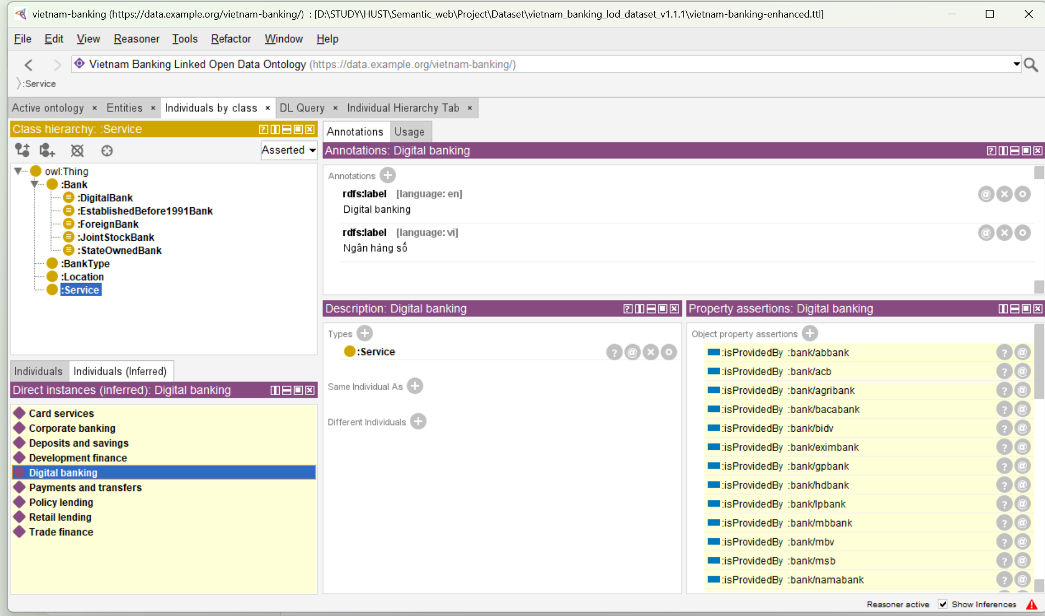
The reasoner classifies classes and infers inverses
PART 2 · PROTÉGÉ
Left: the five defined classes sit under :Bank.
Right: the Digital banking service carries isProvidedBy assertions inferred from owl:inverseOf, not entered by hand.
Notes:
Thành: This is Protégé after running the reasoner. The class tree on the left shows the five defined classes classified under Bank. The right pane shows the Digital banking service individual: the isProvidedBy rows have a yellow background, meaning the reasoner inferred them from the inverse of providesService; we did not assert them.

Slide 9
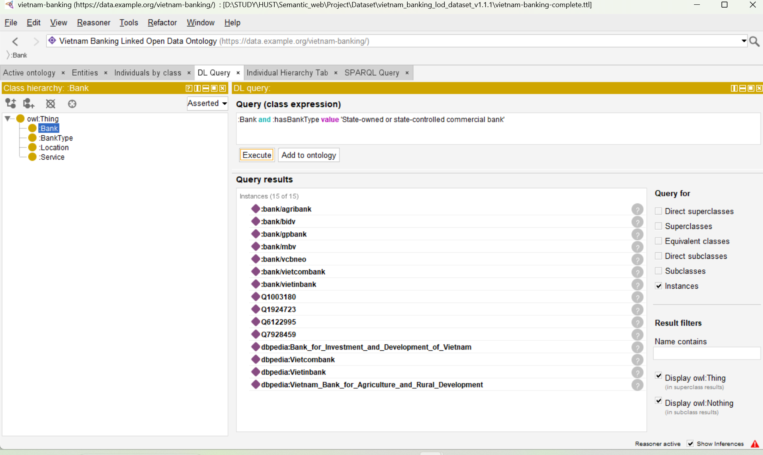
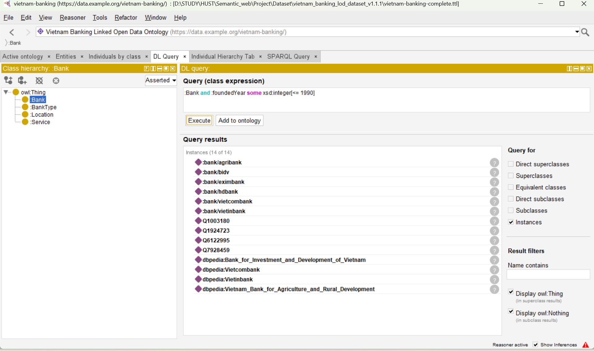
HermiT answers datatype restrictions
PART 2 · DL QUERIES WITH HERMIT
Bank and hasBankType value state-commercial
Bank and foundedYear some xsd:integer[<= 1990]: 6 banks
The lists include Wikidata and DBpedia IRIs because they are owl:sameAs the internal banks.
Notes:
Thành: Two DL queries in Protégé. The key one is on the right: HermiT answers the expression foundedYear less than or equal to 1990 with exactly six banks, which OWL RL in Python cannot do. The lists also contain Q-number and DBpedia IRIs because owl:sameAs makes them the same individual. Next, Ngọc presents the RDF data and linking.

Slide 10
Every bank is an RDF resource
PART 3 · FOUR STARS
bank:acb a :Bank ;
rdfs:label "Ngân hàng TMCP Á Châu"@vi ;
:bankId "ACB" ; :foundedYear 1993 ;
:hasBankType bt:joint-stock-commercial ;
:hasHeadquarters loc:ho-chi-minh-city ;
:providesService sv:digital-banking ;
schema:url <https://www.acb.com.vn/> ;
dcterms:source <…/List_of_banks_in_Vietnam> ;
owl:sameAs wd:Q727019,
dbr:Asia_Commercial_Bank .
1,067
RDF triples (Turtle)
Stable URIs: bank/{id}, bank-type/{id}, location/{id}, service/{id}.
IDs survive renaming: bank/lpbank.
Notes:
Ngọc: The tabular data is converted to Turtle with rdflib. This is a shortened description of ACB: bilingual labels, xsd datatypes, links to its type, headquarters, services and data source, and two owl:sameAs links. Every resource has its own stable URI; for example, LienVietPostBank was renamed LPBank but the URI is still bank/lpbank.

Slide 11
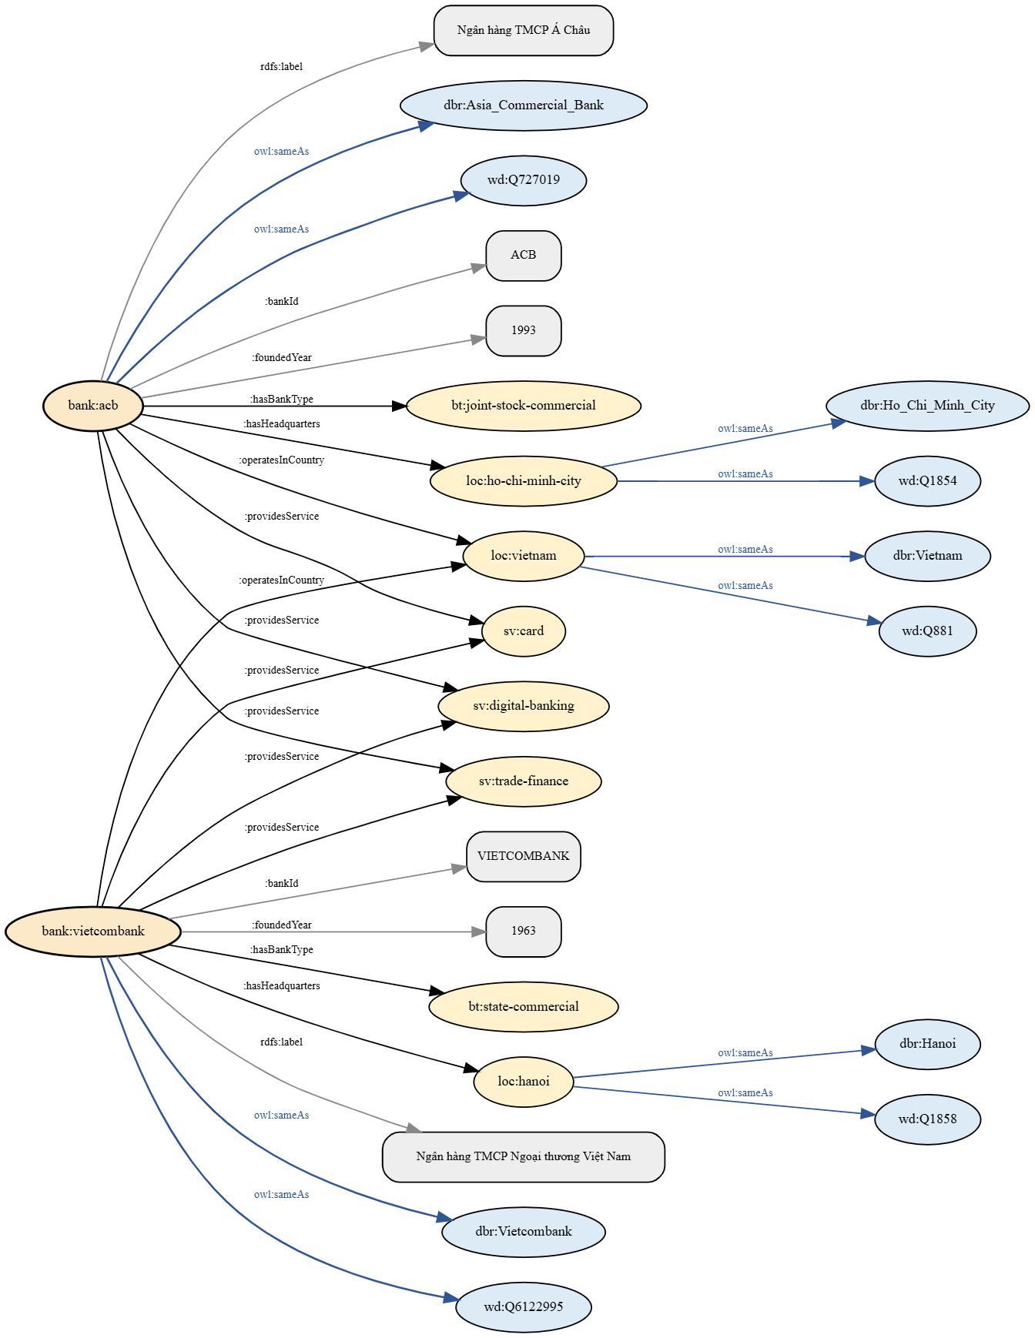
ACB and Vietcombank in the graph
PART 3 · KNOWLEDGE GRAPH
Orange: banks. Light yellow: types, headquarters, services. Blue: Wikidata and DBpedia resources.
Hanoi, Ho Chi Minh City and Vietnam are linked too, so the internal graph plugs straight into the LOD cloud.
Every edge in the figure is a triple in the data file.
Notes:
Ngọc: This figure is generated from the Turtle file, not drawn by hand. ACB and Vietcombank connect to their type, headquarters and services; the blue edges are owl:sameAs links to Wikidata and DBpedia. Locations are linked as well, so our data connects directly to the Linked Open Data cloud.

Slide 12
38 links, each with evidence
PART 3 · FIVE STARS
Entity | Method | Confidence | Count
Bank | Wikidata search, label match | medium | 18
Bank | Wikidata search (Eximbank) | low | 1
Bank | DBpedia page checked | high | 6
Bank | Wikidata IRI taken from DBpedia | high | 5
Bank | Wikipedia page title | medium | 2
Location | Wikidata and DBpedia | high | 6
24/30
banks with external links
3/3
locations linked
Notes:
Ngọc: We use owl:sameAs to link to Wikidata and DBpedia. Each link records its verification method, evidence URL and confidence in external_links.csv. High-confidence links were confirmed by opening the DBpedia page; medium ones are label matches on Wikidata. The two link sets are also declared as void:Linkset in the data file. Next, Minh presents the queries.

Slide 13
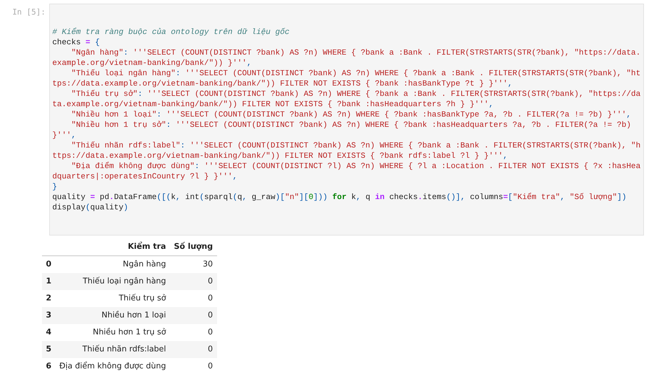
OWL RL adds 3,503 triples, no inconsistency
PART 4 · REASONING AND QUALITY CHECKS
1,067 → 4,570
triples before and after reasoning
Inferred | Count
StateOwnedBank | 5
JointStockBank | 20
DigitalBank | 28
isProvidedBy | 202
Quality-check cell in the notebook: zero violations.
Notes:
Minh: The notebook loads the Turtle file into two graphs: the raw graph and the graph after OWL RL reasoning. Reasoning adds 3,503 triples and no individual falls into owl:Nothing, so the data is consistent with the ontology. Before querying, the notebook runs checks derived from the axioms, such as banks without a type or unused locations; all return 0. These checks are needed because OWL makes the open-world assumption and does not flag missing values.

Slide 14
16 queries covering SPARQL 1.1
PART 4 · SPARQL INTERFACE
ID | Technique | Result
Q1 | SELECT, OPTIONAL, path | 30 rows
Q2 | Inferred class StateOwnedBank | 5 rows
Q3 | Internal IRI match | 20 rows
Q4 | Inferred class DigitalBank | 28 rows
Q5 | Numeric FILTER | 6 rows
Q6 | BIND, IF | 32 rows
Q7 | Inverse isProvidedBy | 28 rows
Q8 | Inverse isHeadquartersOf | 20 rows
ID | Technique | Result
Q9 | COUNT, GROUP BY | 5 rows
Q10 | ASK | true
Q11 | CONSTRUCT to schema.org | 280 triples
Q12 | FILTER NOT EXISTS | 6 rows
Q13 | UNION, BIND | 6 rows
Q14 | DESCRIBE | 27 triples
Q15 | SERVICE to Wikidata | live
Q16 | Free query in terminal | 2 rows
Notes:
Minh: The notebook has 16 queries covering the main SPARQL 1.1 query forms: SELECT, ASK, CONSTRUCT, DESCRIBE, grouping, UNION, negation and federated SERVICE queries. Q2, Q4, Q7 and Q8 rely on the reasoner's output. The sparql() function accepts free queries, which serves as the terminal query interface.

Slide 15
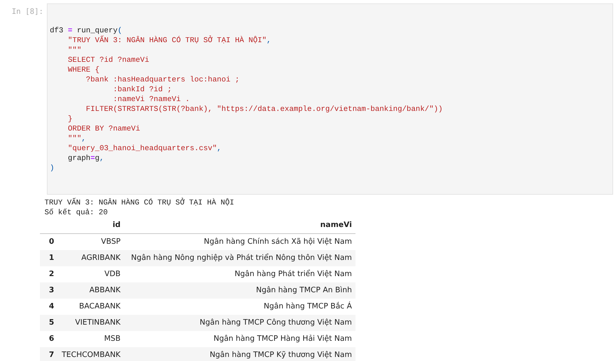
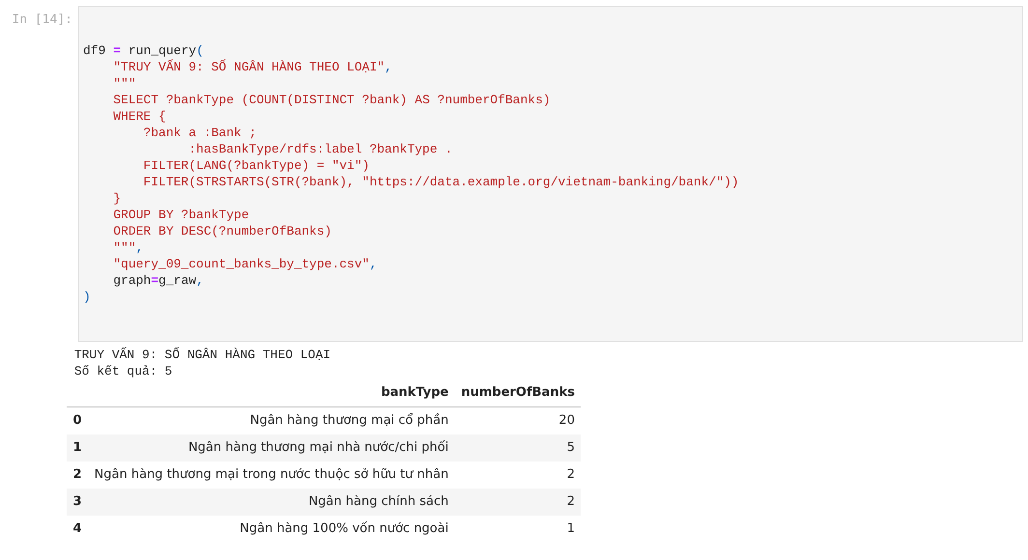
Hanoi headquarters and counts by bank type
PART 4 · ACTUAL RUN RESULTS
Q3: 20 banks, no owl:sameAs duplicates
Q9: 20 + 5 + 2 + 2 + 1 = 30 banks
Notes:
Minh: These are two executed notebook cells. Q3 matches Hanoi's internal IRI directly, so it returns exactly 20 banks; without this, each bank would repeat through three equivalent IRIs and the result would be 60 rows. Q9 uses COUNT and GROUP BY, and the total is exactly 30 banks.

Slide 16
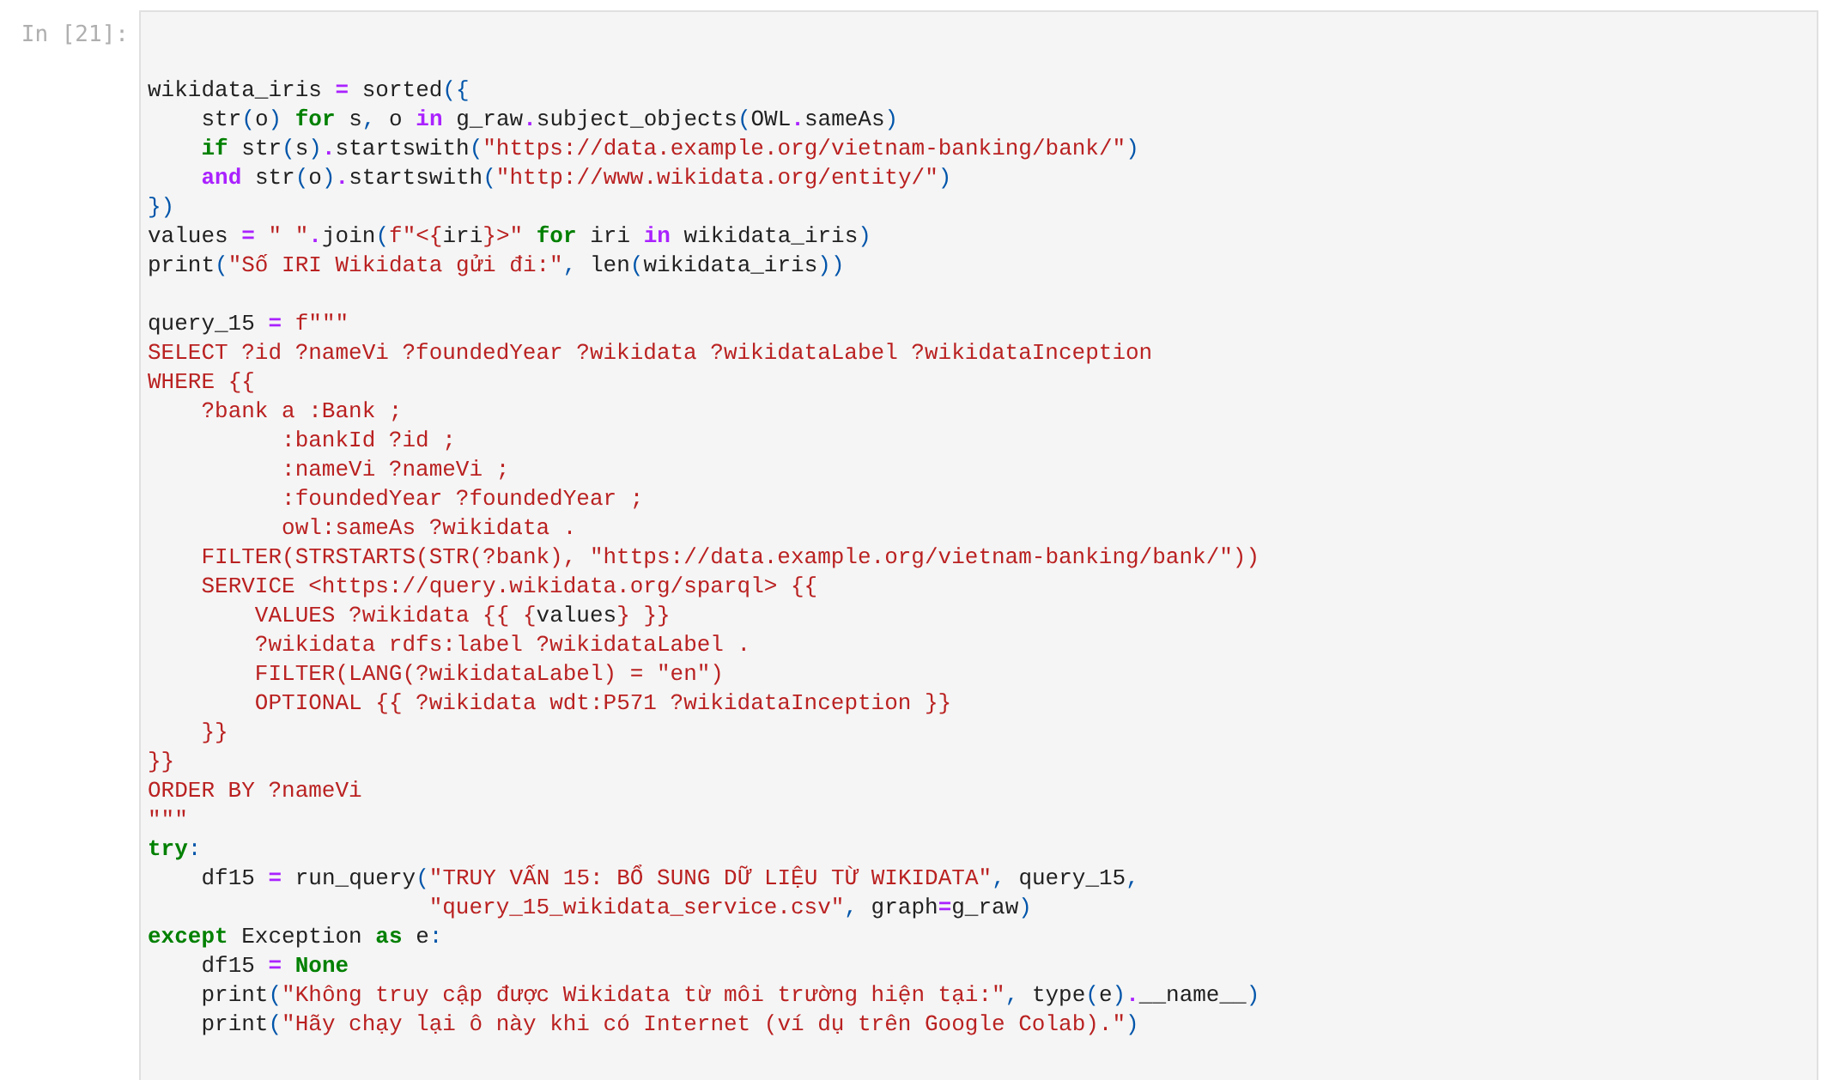
Links are used at query time
PART 4 · FEDERATED QUERY
Q15 sends the banks' 24 Wikidata IRIs to query.wikidata.org.
Wikidata returns English labels and inception dates (P571), shown next to our internal founding years.
This is working proof of the fifth star. The query ran successfully on Colab.
Notes:
Minh: This is the most important query for the fifth star. The notebook takes the linked Wikidata IRIs, sends them to the Wikidata endpoint with the SERVICE keyword, and gets back labels and inception dates. So the links do not just sit in the file; they are actually used to fetch external data. The query ran successfully on Google Colab.

Slide 17
Five stars, three limitations
PART 4 · EVALUATION
Linked Data best practice | Status
Dereferenceable URIs | partial
Outgoing RDF links | met
Well-known vocabularies | met
Dereferenceable own terms | not met
Mapping of own terms | partial
Provenance, licence, VoID | met
Alternative access methods | met
Limitations
Services assigned by bank type, not verified per bank.
19 Wikidata links are label matches only.
The example.org domain is not dereferenceable; no public endpoint yet.
Notes:
Minh: On the five-star scheme, the dataset reaches all five levels. Against the nine Linked Data best practices, we meet six, partly meet two and do not meet one. We also state three limitations: services are assigned by bank type, some Wikidata links are label matches only, and URIs are not dereferenceable because they use a placeholder domain.

Slide 18
Public data on 30 Vietnamese banks, published as five-star Linked Open Data
CONCLUSION
The OWL 2 ontology answers all six competency questions.
30 banks, 1,067 triples, 38 evidenced links.
Next: a Fuseki endpoint, SWIFT codes, stock tickers, FIBO.
Thank you!
Group 24 · Supervisor: Dr. Đỗ Bá Lâm
Notes:
Minh: In short, we brought public information on 30 Vietnamese banks up to five stars. The OWL 2 ontology answers all six competency questions, every external link carries evidence, and the notebook queries both our data and Wikidata. Future work is a Fuseki endpoint, more properties and links to FIBO. Thank you for listening.

