Slide 1
“Extended IBTrACS” catalogue

Slide 2
Motivation
IBTrACS is our best estimate of “observational truth” for tropical cyclones
However, in many cases, it does not capture the end (nor the very beginning) of the lifecycle
On the other hand, the entire lifecycle can be captured from (re)analyses, using objective cyclone trackers
But these trackers can have false alarms which never actually were tropical
So we combine all the available information by matching the IBTrACS tracks to the (re)analyses detected ones, in a dataset that contains most of the information we can gather from these datasets

Slide 3
How does it fit in Huracan’s catalogues plans?
NB: Suggested/provisional names
Extended IBTrACS
Tropical origin criterion: is in IBTrACS
"real" tracks: Obs+(re)analysis
Leo’s reanalysis CTO catalogues
Tropical origin criterion: Leo's
"Real" tracks: Reanalysis
Counterfactual events catalogue
Tropical origin criterion: IBTrACS or Leo's
forecasts/hindcasts alternative trajectories to initialized cyclones
Unseen events catalogue
Tropical origin criterion: Leo's
forecasts/hindcasts unseen (un-initialized) trajectories

Slide 4
1. Extended IBTrACS’ TRACKS
espECIALLY in the mid-latitudes

Slide 5
Method
IBTrACS
I use the North Atlantic subset, as is.
No filtering: all tracks, however short or weak or uncertain that are in IBTrACS will be in the dataset. But it is easy to filter afterwards.
(Re)analyses: Using available TRACK & SyCLoPS data
ERA20C: TRACK: 1901-2010
ERA5:
TRACK: 1940-2022
SyCLoPS: 1979-2022
JRA3Q: TRACK: 1948-2023
ECMWF-OP-AN (Operational analysis): 2006-2024 (NB: inhomogeneous resolution, increasing with time)
It is easy to add new datasets if the cyclone track have been detected already. Ideally, this tracking should include any cyclone track regardless of nature (i.e. no TC identfication criterion has been applied) as the IBTrACS matching will take care of identification. To provide added value, it is desirable that the tracking provides tracks that last for longer than they do in IBTrACS. If the point is to add more/better information to track over their recorded lifecycle, it is likely preferable to retrieve this information using IBTrACS tracks in the first place.

Slide 6
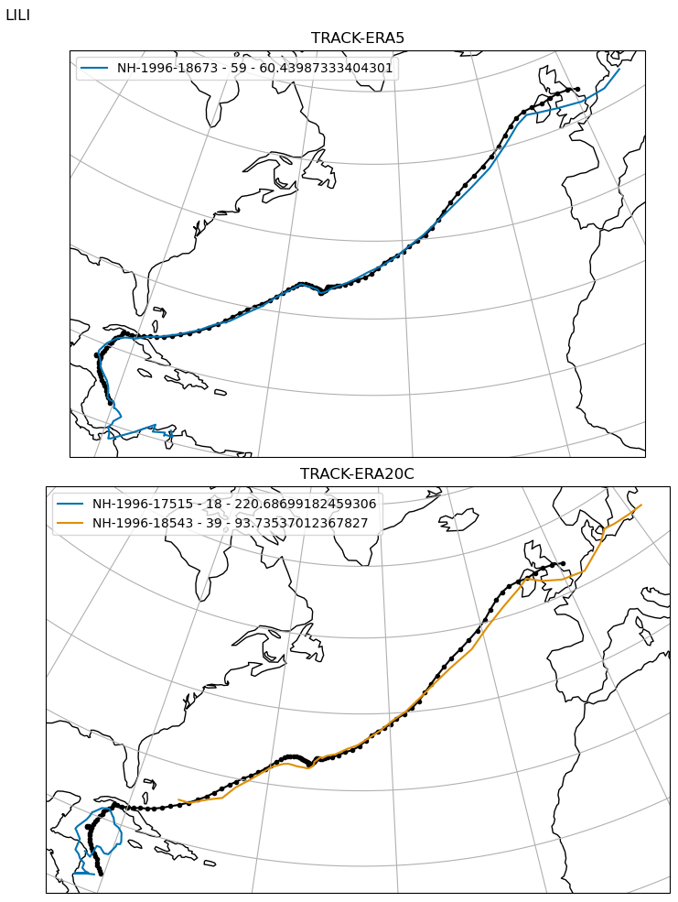
Matching
In ERA5 (TRACK), a matching track is found, with 59 matching time steps and a mean matching distance of 60km.
Following procedure from Bourdin et al. (2022), implemented in HuracanPy
Example Lili 1996
In ERA20C (TRACK), 2 matching tracks are found. They will be concatenated into one trajectory.

Slide 7
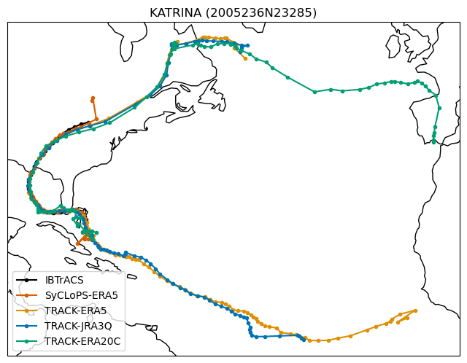
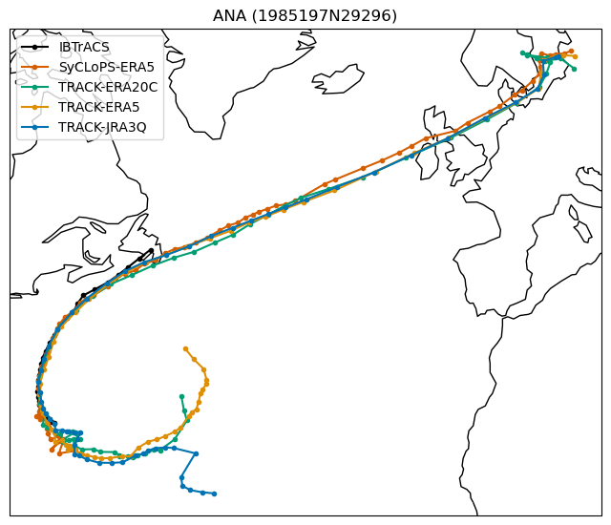
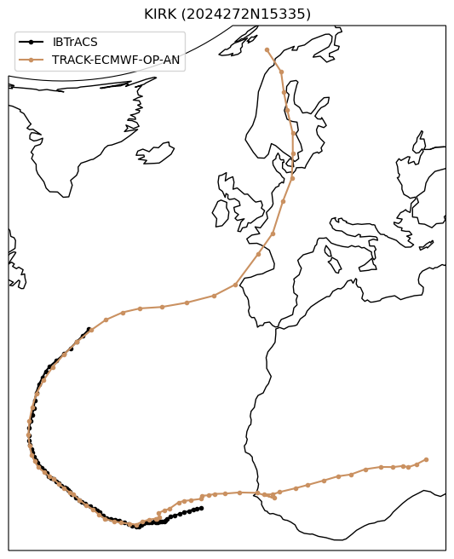
Gathering
For a given IBTrACS track, matching (re)analyses tracks are gathered
Side note: We observe that not only this approach help us prolong the tracks, it also provides a sense of (un)certainty when the different products agree (or not) on the extension of a track.

Slide 8
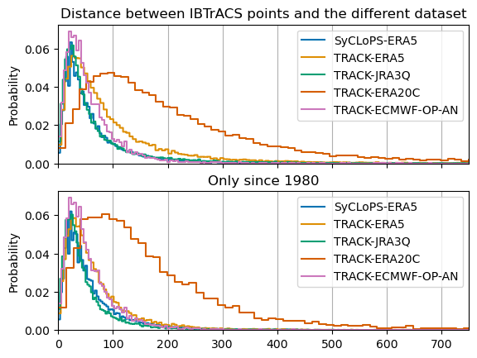
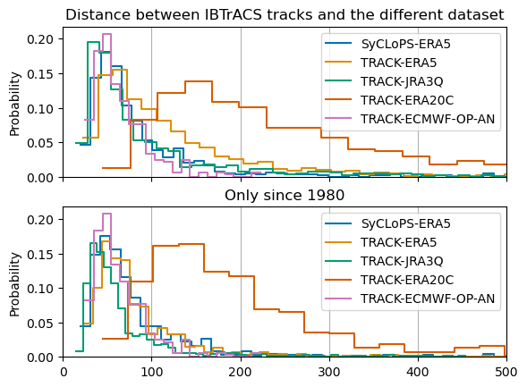
Validation
Visual validation of tracks
Matching distance is of the order of magnitude of the datasets’ grid size

Slide 9
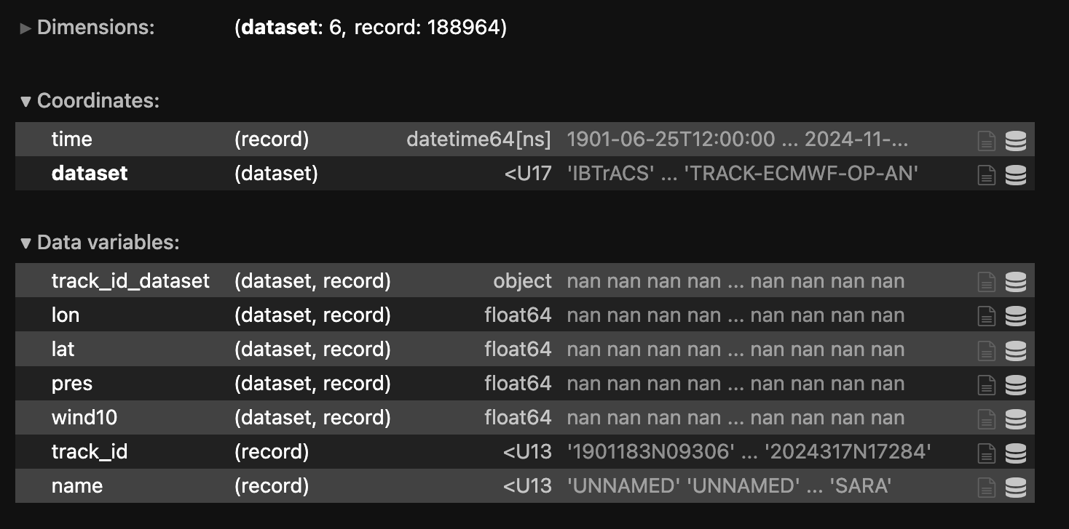
Minimal file
extended_ibtracs.nc
Usual record dimension x dataset dimension
track_id is IBTrACS track ID
Includes position in space and time + intensity (pressure & wind)
+ pres
+ wind10

Slide 10
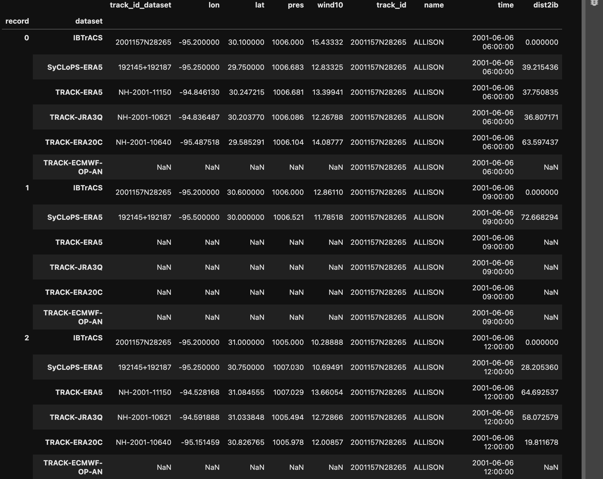
Example
1. Record represents time step in the track
Matching data
2. For a given record/time step, data is provided for each dataset that has a matching track at this time
No match with this dataset at this time
3. For matching points, longitude and latitude of the (re)analysis cyclone center (as defined by the tracker) is provided + intensity.
NB: Some products only provided 6-hourly data while IBTrACS is 3-hourly, hence there might be “gaps” for a given (re)analysis track.

Slide 11
Additions
Several additional attributes are provided:
CPS parameters (from ERA5 and JRA3Q)
Translation speed and direction
IBTrACS attributes (such as “nature”, “sshs”, etc.)
More can be added following the same template!
It is also possible to add maps from a NetCDF easily (see script on GitHub)

Slide 12
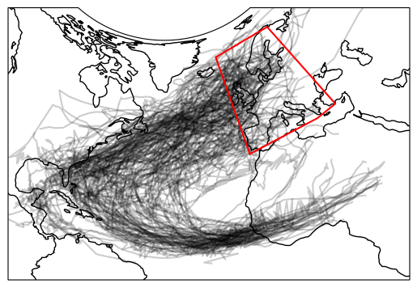
Subsetting
Using xarray/HuracanPy, the dataset is easy to subset:
For a specific track (use data.hrcn.sel_id from HuracanPy)
For a given period
For a given subset of data sources
For a specific intensity
For cyclones reaching a specific zone/country

Slide 13
GitHub
In Huracan-Project GitHub: https://github.com/Huracan-project/extended-ibtracs
Script to create minimal file
Scripts to add attributes
Scripts to visualize data
Script to add fields from e.g. reanalyses or observations

Slide 14
2. ASSOCIATING HAZARDS
Wind, Precipitation, Storm Surge

Slide 15
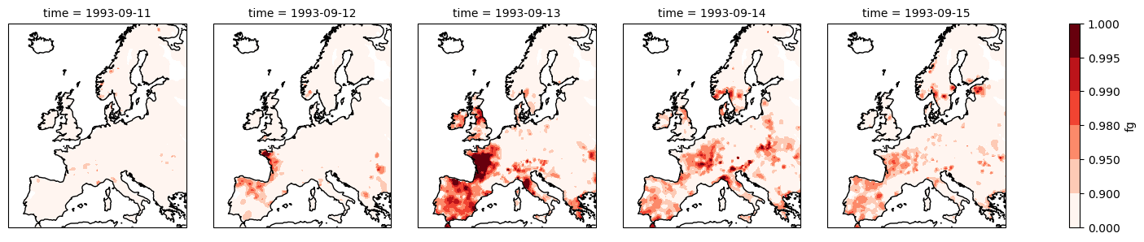
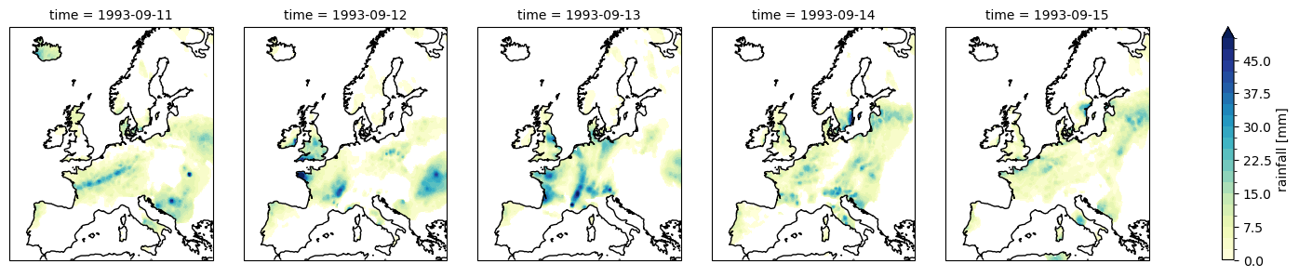
Done: Maps of WIND and Precip from E-Obs

Slide 16
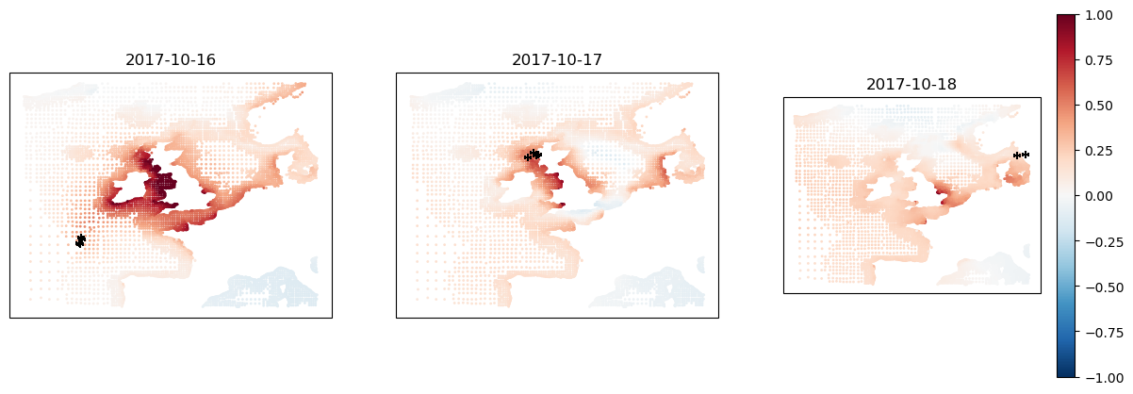
Soon
WiTRACK wind footprints
IMERG precip attributes
Storm surge observations

