Slide 1
Email Spam Classification (Project 2)
Celebal Technologies Summer Internship 2023
Name - Tusher Mondal
CSI-ID : CT-CSI23/DS0545
CSI-SUMMER-INTERNSHIP

Slide 2
Agenda
What is Spam ?
Statistics
Who Benefits from it?
Spam Filtering Techniques
Algorithm Flowchart
Experiments & Results
Conclusion
CSI-SUMMER-INTERNSHIP

Slide 3
What is Spam?
Spam → Unsolicited email
Emails that involves sending identical or nearly identical messages to thousands (or millions) of recipients.
Caution !
“SPAM - Spiced Ham ” is a popular American canned meat brand…☺
CSI-SUMMER-INTERNSHIP

Slide 4
Problem ☹
With a tiny investment, a spammer can send over 100,000 bulk emails per hour.
Junk mails waste storage and transmission bandwidth.
ISP’s investment → Cost we absorb as ISP’s customer
Spam is a problem because the cost is forced onto us, the recipient.
CSI-SUMMER-INTERNSHIP

Slide 5
Statistics
Email considered Spam | 40% of all email
Daily Spam emails sent | 12.4 billion
Daily Spam received per person | 6
Annual Spam received per person | 2,200
Spam cost to all non-corp. Internet users | $255 million
Spam cost to all U.S. Corporations in 2002 | $8.9 billion
Estimated Spam increase by 2007 | 63%
Users who reply to Spam email | 28%
Users who purchased from Spam email | 8%
Wasted corporate time per Spam email | 4-5 seconds
CSI-SUMMER-INTERNSHIP

Slide 6

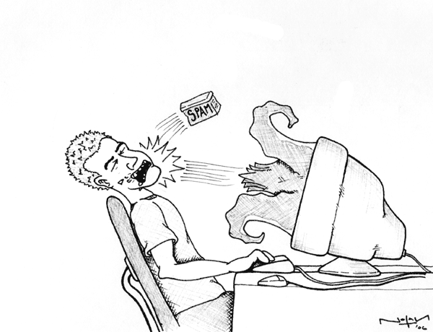


Who benefits from Spam?
Financial Firms e.g. Mortgage
Information about
interested customers
Recipient replies here
Lead Generators
(Gain 2% of
Loan value
per customer data)
Recipient
Spammers
(Share the profit
with Lead Generators)
CSI-SUMMER-INTERNSHIP

Slide 7
Filtering Techniques
CSI-SUMMER-INTERNSHIP

Slide 8
Spam Vs Ham
Care to be taken in any Spam filtering technique
“All the Spam could be allowed to pass thro; but, not even a single legitimate mail should be filtered.”
False Positive – Legitimate mail classified as spam.
Least false positive rate desired…
Caution : Check your junk folder before deleting
Don’t believe your Spam filter ☺
CSI-SUMMER-INTERNSHIP

Slide 9
Challenge-Response Filtering
Emails from unknown senders will receive an auto-reply message asking them to verify themselves
Senders “Challenged" to type in a word that is hidden within a graphic or a sound file
Mail is forwarded to receiver’s inbox, only after successful “response”
This technique almost filters all spam ☺. No spammer would be interested to take the extra effort to prove him / her self.
Commercial product “spamarrest”
Disadvantage
This technique is rude ☹
Sometimes senders don’t or forget to reply to the challenge
CSI-SUMMER-INTERNSHIP

Slide 10
Rule Based Filters
Rule based filters work based on some static rules to decide whether a mail is a spam or not.
Rules could be
      words and phrases
      lots of uppercase characters
      exclamation points
      special characters
      Web links
      HTML messages
      background colors
      crazy Subject lines etc.
CSI-SUMMER-INTERNSHIP

Slide 11
Rule Based Filters
Advantage
    Easy to implement
    No training required
Disadvantage
    Static rules too general
    Spammers find new ways to deceive the rules
CSI-SUMMER-INTERNSHIP

Slide 12
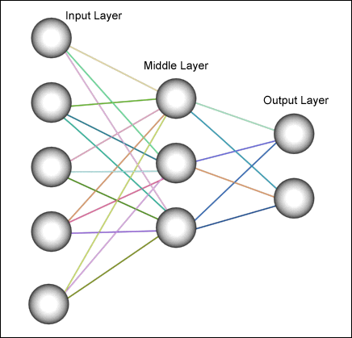
Neural Network for Training
Neural Network Structure
i
CSI-SUMMER-INTERNSHIP

Slide 13
Neural Networks for Training
Neural networks are used to train the spam filter (Rule-based or Bayesian) and itself is not a filter
Input → words or rules etc.
Trained over multiple samples of the user’s mails (both spam and ham)
Weights of the links are altered till the desired output is obtained.
CSI-SUMMER-INTERNSHIP

Slide 14
Supervised Learning
Supervised learning → Training with a “teacher” signal
Train the system till we get optimized unaltered weights for the edges.
Caution!
Take care not to over train the network.
CSI-SUMMER-INTERNSHIP

Slide 15
Combining Spam Filters
Goal → Combined filter aims to improve individual filters performance.
Combined Filter = Original Filter (OF) + Received Filter (RF)
Max gain → Received filter contains some feature sets not found in the original filter.
E.g.
Original Filter = {“Share Market”, “Higher Studies”}
Received filter = {“Share Market”, “Job Alerts”}
CSI-SUMMER-INTERNSHIP

Slide 16
Challenges
Decisions (Spam / Ham) made by both filters individually
Decisions agree → No Problem ☺
Disagreement → Due to difference of feature sets
    Challenges
      “How do we select the correct decision or filter?”
      “Who selects it?”
CSI-SUMMER-INTERNSHIP

Slide 17
Algorithm Flowchart
Training Phase
Final Verdict
CSI-SUMMER-INTERNSHIP

Slide 18
TF – IDF Similarity Measure
Commonly used in Information Retrieval applications.
More frequent words would be key to accurate classification of emails
FS predicted feature set is unique
“Query – Document” retrieval procedure.
      2 documents – Feature sets
      Query – Current email
CSI-SUMMER-INTERNSHIP

Slide 19
Experiments & Results
Testing Some Emails
CSI-SUMMER-INTERNSHIP

Slide 20
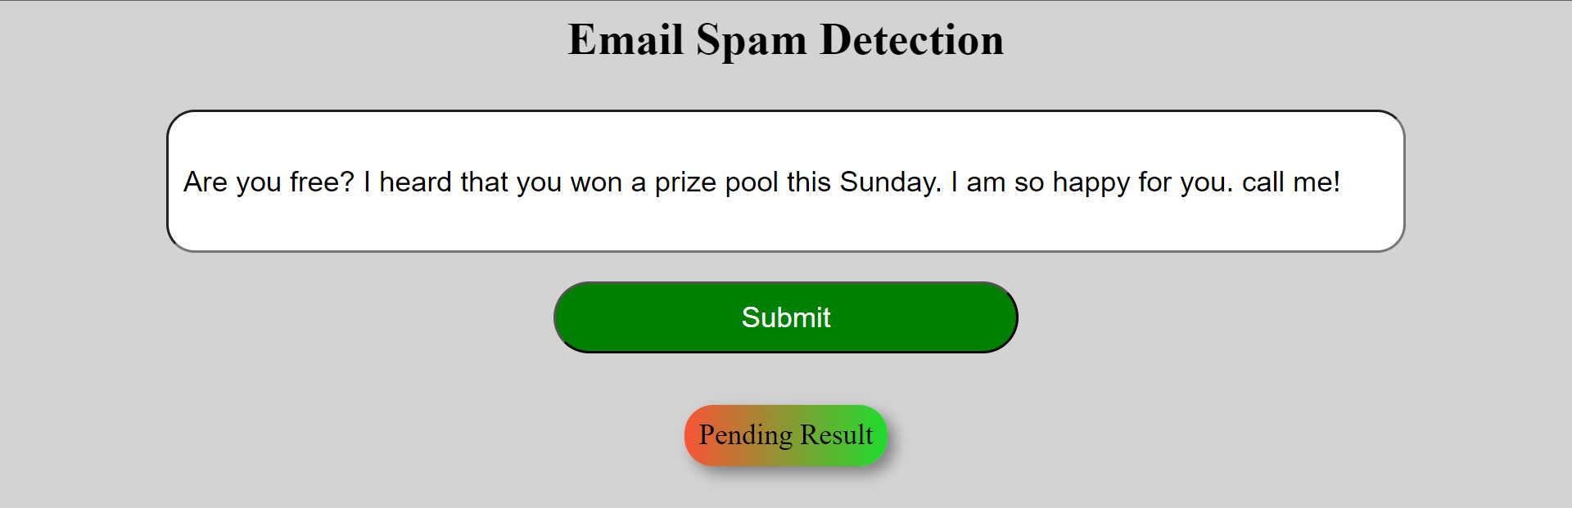
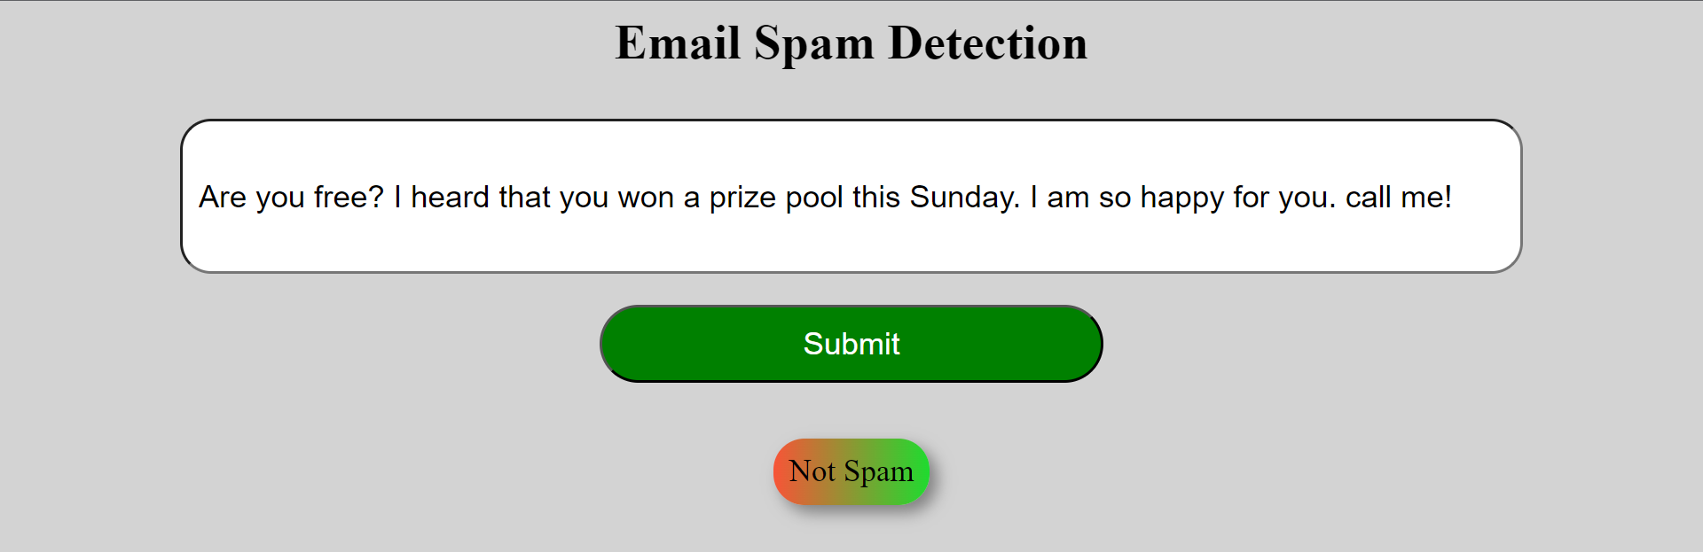
Test 1 Before Feeding
Test 1 After Feeding
CSI-SUMMER-INTERNSHIP

Slide 21
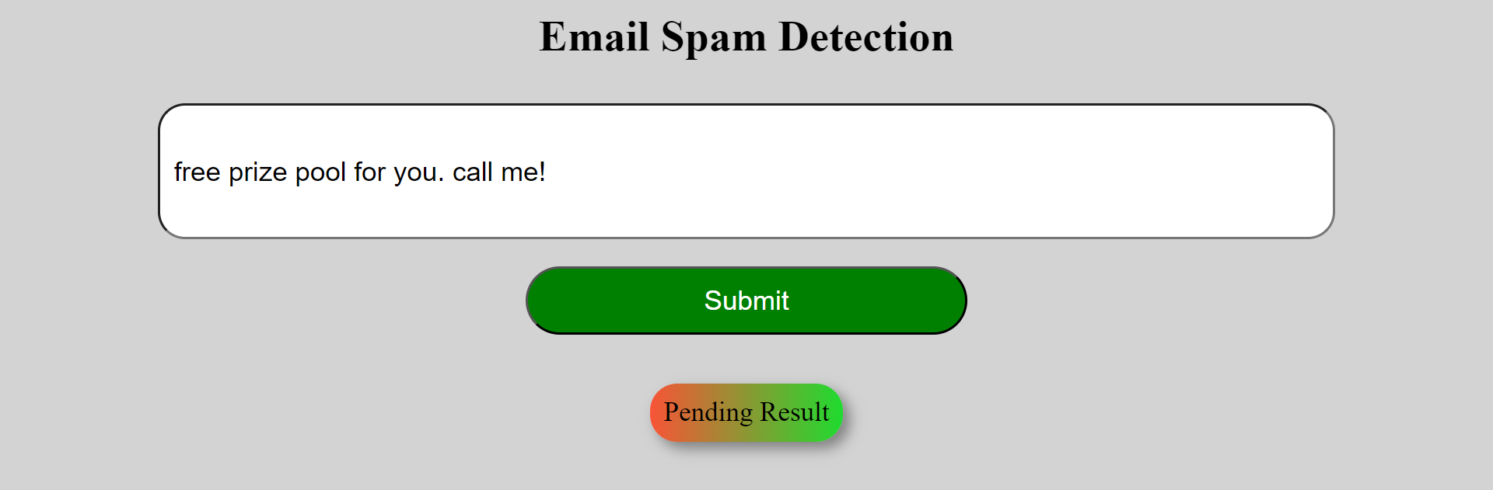
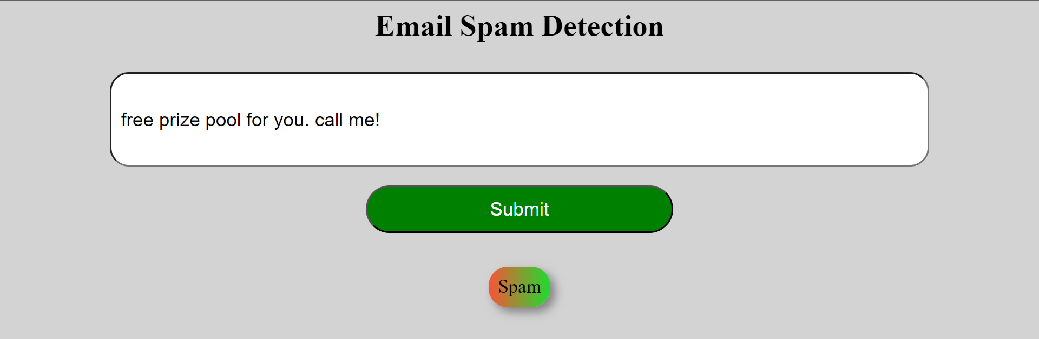
Test 2 Before Feeding
Test 2 After Feeding
CSI-SUMMER-INTERNSHIP

Slide 22
Conclusion
In this project, I applied machine learning techniques to detect spam emails from a large dataset. I used logistic regression as the main algorithm to classify the emails as spam or ham based on various features such as word frequency, punctuation, capitalization, and length. I evaluated the performance of the model using accuracy, precision, recall, and F1-score metrics. I also explored different ways to improve the model, such as feature selection, regularization, and cross-validation. I learned a lot about the principles and applications of machine learning in spam detection and gained valuable skills in data analysis and programming.
CSI-SUMMER-INTERNSHIP

Slide 23
Appendix
Added a GUI {https://github.com/Hurley2017/Email_Spam}
Added a COLAB {https://colab.research.google.com/drive/1inyQDNN9CBPAVnoMqxCPgItS0bEJeXpa?usp=sharing}
CSI-SUMMER-INTERNSHIP

Slide 24
Thank You ☺
CSI-SUMMER-INTERNSHIP

