Slide 1
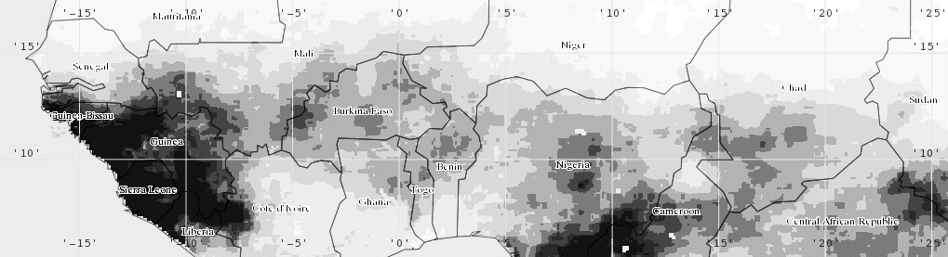
VIC CALIBRATION FOR HYDROLOGICAL EXTREME MONITORING
Kel Markert
NASA-SERVIR Mekong Regional Associate
University of Alabama in Huntsville | Earth System Science Center
8 March 2017

Slide 2
OUTLINE
VIC Variables to calibrate
Calibration methods
Land surface model calibration
Calibration best practices
Nyando basin model calibration
Calibration discussions

Slide 3
VARIABLES TO CALIBRATE
Five typical variables to calibrate for VIC
Other variables can be calibrated
Snow partitioning, Energy balance terms, Land surface parameterization
Typical calibration is mostly focused on soil variables (movement of water through soils)
Variable | units | Description | Typical Range
Ds | % | Fraction of Ds_{max} where non-linear baseflow occurs | >0 -1
Ds_{max} | mm・day⁻¹ | Maximum baseflow that can occur from the lowest soil layer | >0 - ~30
Ws | % | Fraction of maximum soil moisture where non-linear baseflow occurs | >0 - 1
b_{inf} | n/a | Shape parameter of the VIC curve | >0 – 0.4
Soil depths (for each layer) | m | Soil depth in meters for each soil layer | 0.1 – 1.5

Slide 4
VARIBLE CALIBRATION EFFECTS
With a higher value of Ds, the baseflow will be higher at lower water content in lowest soil layer
A higher value of Ws will raise the water content required for rapidly increasing, non-linear baseflow, which will tend to delay runoff peaks
A higher value of b_{inf} gives lower infiltration and yields higher surface runoff
Soil depth effects many model variables
For runoff considerations, thicker soil depths slow down (baseflow dominated) seasonal peak flows and increase the loss due to evapotranspiration

Slide 5
CALIBRATION METHODS
A focus of research is on more effective parameterization and calibration methods for hydrologic models
Manual calibrations
Very time consuming
May not provide the best parameters
Based on regional knowledge
Computer calibrations
Computationally intensive
Time consuming (no user involvement)
Very complex
Provides well calibrated parameters (depending on algorithm used)

Slide 6
CALIBRATION METHODS
Brute force calibrations
Random autostart complex
Initialization based on random combination of parameters
Uses best combination of parameters to start the simplex minimization algorithm to optimize
Genetic optimization
Based on the laws of natural selections
Initializes with random set of parameters and randomly chooses “parent” sets based on performance
Combines “parent” parameters to create “children”
Iterates for n number of generations

Slide 7
CALIBRATION METHODS
Multi-Objective Complex Evolution (MOCOM-UA)
Developed to calibrate models efficiently on multiple evaluation functions
Larger optimization populations produce a more complete picture of the Pareto set but also increase the number of simulations
Shuffled Complex Evolution (SCE-UA)
Most commonly used calibration algorithm for hydrologic applications
Designed to find the global optima
Starts several chains/complexes that evolve individually then shuffles parameters to make new complexes

Slide 8
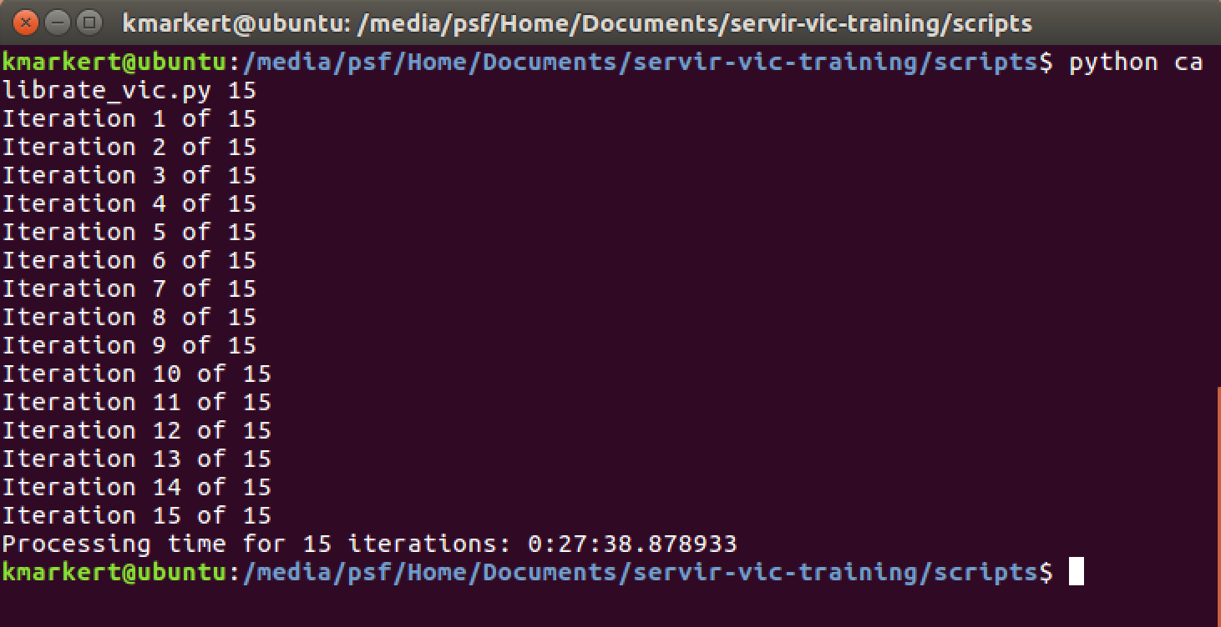
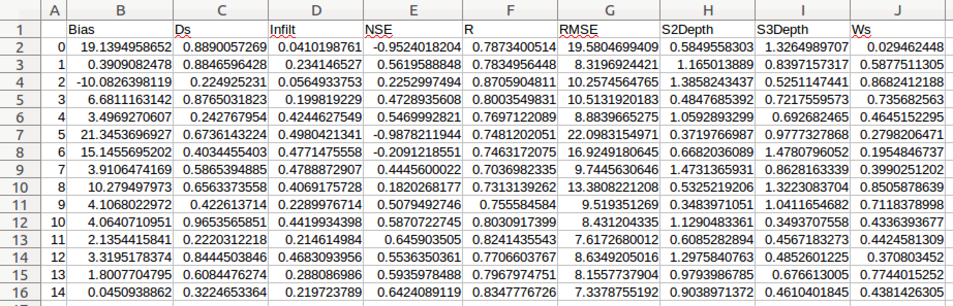
CALIBRATING NYANDO BASIN
We are going to perform a calibration on the Nyando basin model
Update the global parameter simulation time for 2005-2009
Navigate to the scripts folder in terminal
Run the command: $ python calibrate_vic.py 15
This executes a random parameter set estimation calibration for 15 iterations
A more robust calibration script is provided (calibrate_vic_sceua.py)
Requires more complex set-up and interpretation of results

Slide 9
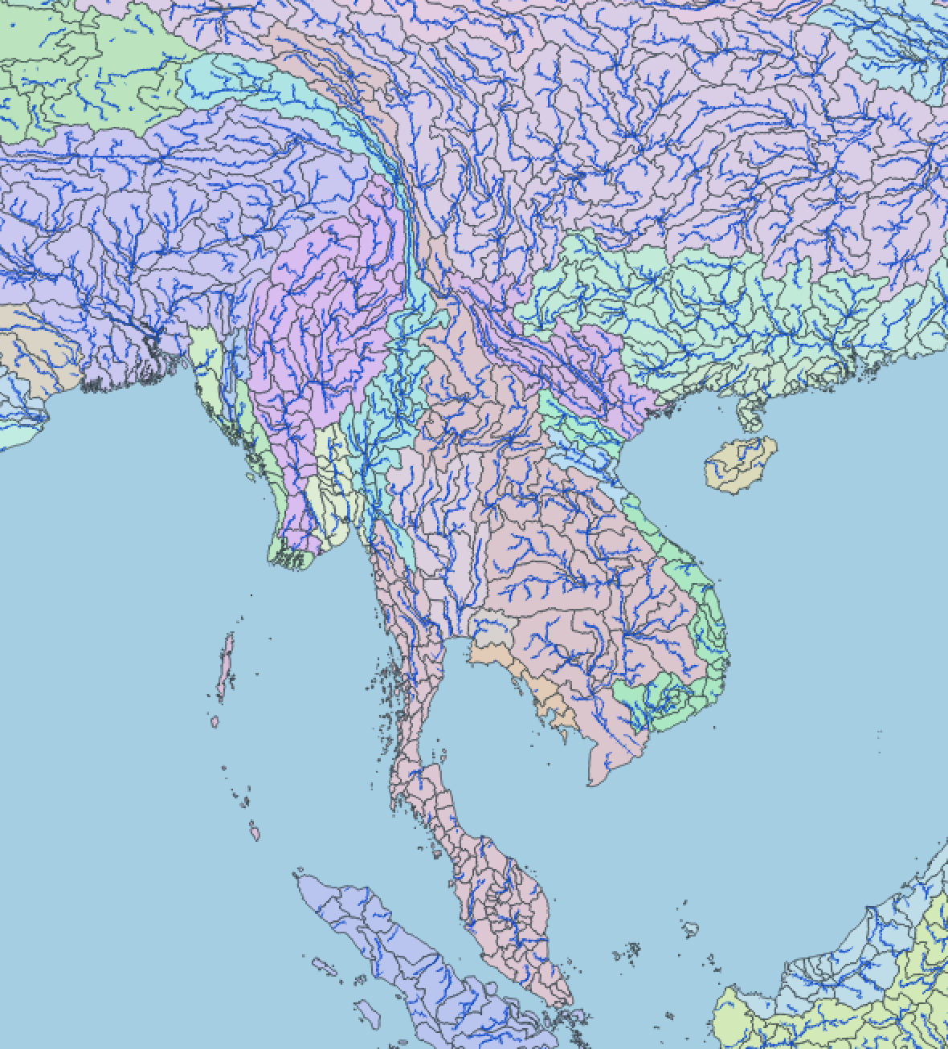
CALIBRATION BEST PRACTICES
Necessary to have an independent record for calibration and validation (or evaluation) of the hydrologic simulation
Typically save approximately half of observed time series for validation
Calibrate by sub-basin and combine for entire region
Common observation to use for calibration is streamflow
Can calibrate model using other observed parameters (soil moisture, ET, snow depth)
In situ measurements vs satellite observations

Slide 10
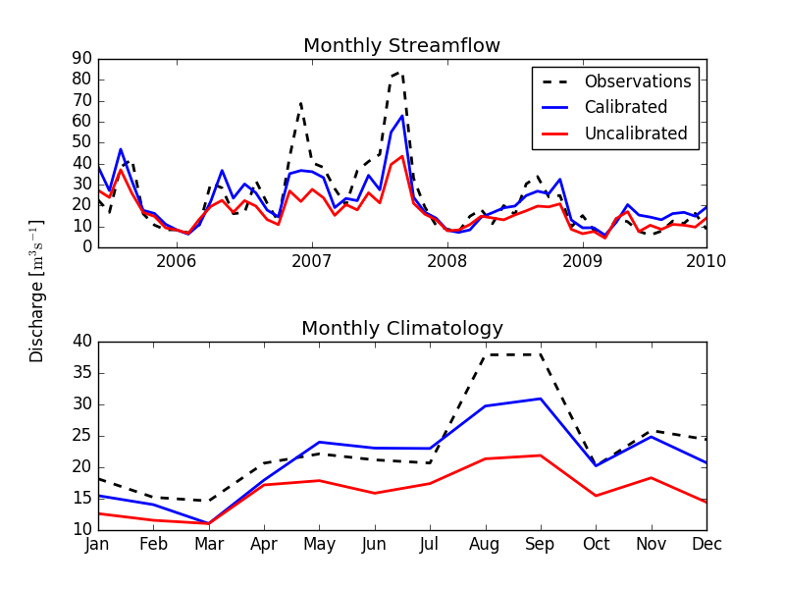
CALIBRATION FOR NYANDO BASIN
Used the SCE-UA algorithm
Parameter populations of 500 each running 55 simulations with one chain (12 hour runtime)
Uncalibrated NSE: 0.42
Calibrated NSE: 0.72
Bias: -1.11 m³·s⁻¹
RMSE: 6.80 m³·s⁻¹

Slide 11
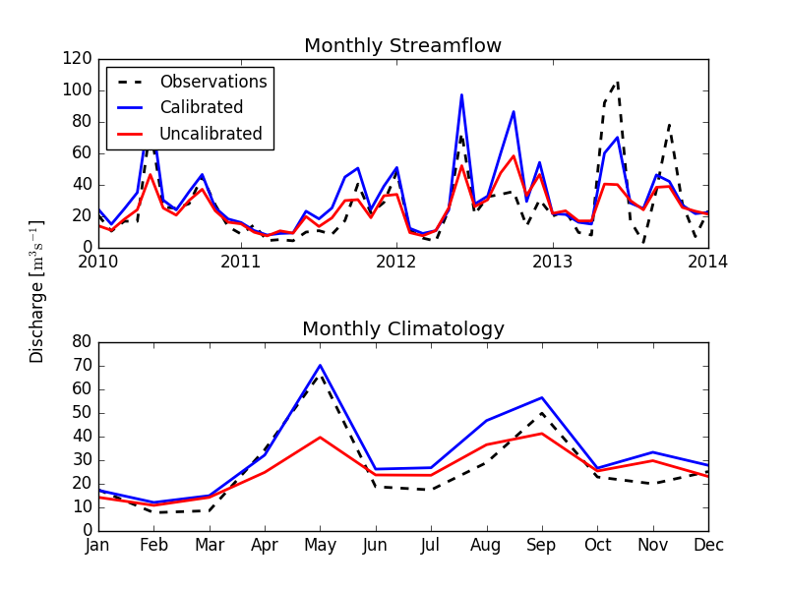
NYANDO BASIN MODEL VALIDATION
Model over/under estimates peak flow
Possible errors with input precipitation dataset fjkal
Uncalibrated NSE: 0.48
Calibrated NSE: 0.55
Bias: -6.07 m³·s⁻¹
RMSE: 10.89 m³·s⁻¹

Slide 12
EFFICIENT CALIBRATION TIPS
Grid cells with vegetation classes that cover less than 1-2 % of the grid cell can be removed
Should not be done when evaluating changes in streamflow as a function of change in vegetation
Only calibrate on wet pixels (grid cells that receive high precipitation and significantly contribute to streamflow)
Calibrate model using a large grid cell (~1°) and extract parameters to smaller grid for simulations
Significantly decreases calibration time
Calibrate using water balance mode

Slide 13
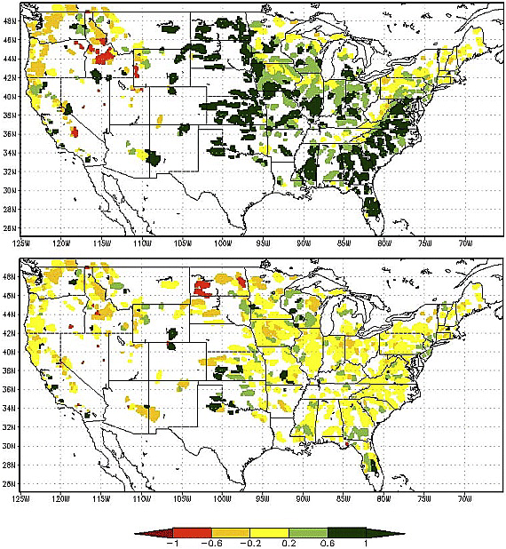
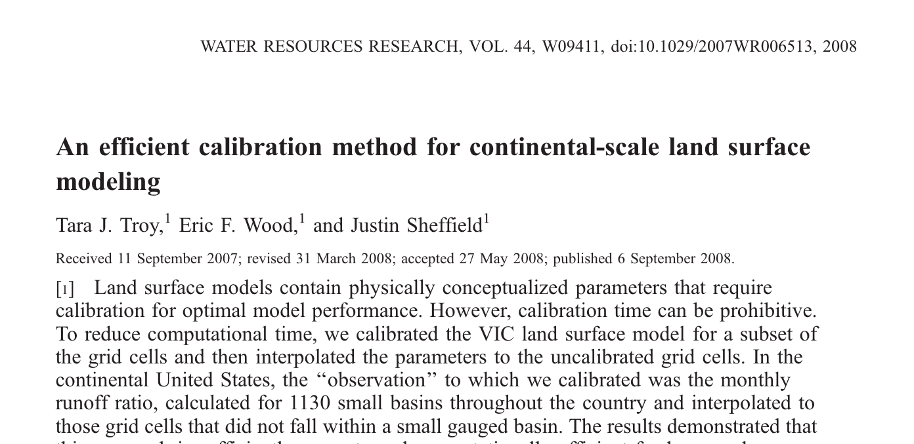
ADVANCED CALIBRATION METHODS
Spare grid calibration
Randomly selected calibration grid cells
Spatially interpolate calibrated factors
Based on monthly spatially homogeneous values (runoff ratio) at the pixel level
No need for long-term streamflow or routing model
Used to calibrate the NLDAS model
(Troy 2008, Open access article in Water Resources Research) Volume 44, Issue 9, W09411, 6 SEP 2008 DOI: 10.1029/2007WR006513 http://onlinelibrary.wiley.com/doi/10.1029/2007WR006513/full#wrcr11550-fig-0001

Slide 14
CALIBRATION CONSIDERATIONS
Calibration methods depends on the application of the model
Includes data used calibrated against (e.g. streamflow forecasting model should be calibrated against observed streamflow)
Calibrating against observed streamflow does not necessarily mean ET or snow depth may be calibrated
Calibration results and can be limited by input data quality
Calibration can only go as far as the model and data allows
Operational models should be calibrated regularly
Daily streamflow requires further calibration of the routing model parameters

Slide 15
THANK YOU
Kel Markert
kel.markert@nasa.gov

