Slide 1


Slide 2









Slide 4
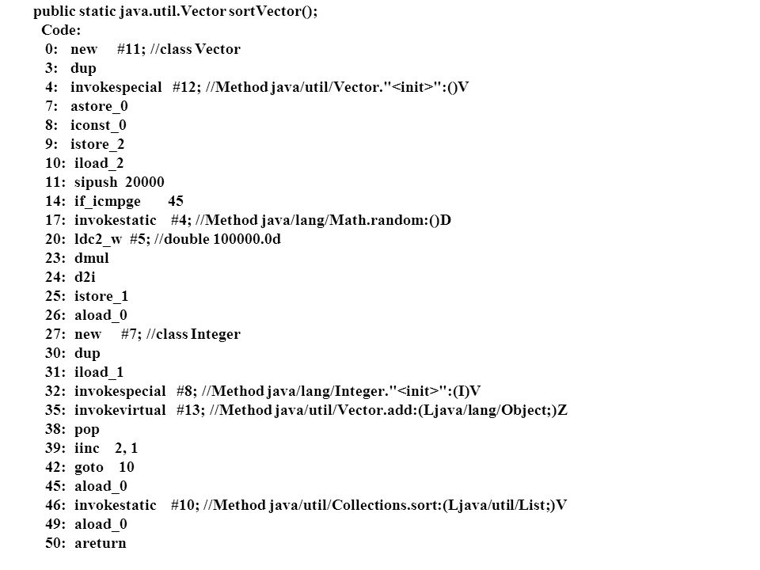




Slide 5
?

Slide 6
A propos des idiomes

Slide 7
List<Integer> numbers = Arrays.asList(7, 0, 60, 3, 6, 4, 30, 190);
Pour chaque nombre:
- Si le nombre est divisible par 3, alors le diviser par 3 et l’afficher

Slide 8
List<Integer> numbers = Arrays.asList(7, 0, 60, 3, 6, 4, 30, 190);
int i = 0; while (i < numbers.size()) { Integer number = numbers.get(i); if (number % 3 == 0) { System.out.println(number / 3); } i++; }
Pour chaque nombre:
- Si le nombre est divisible par 3, alors le diviser par 3 et l’afficher

Slide 9
List<Integer> numbers = Arrays.asList(7, 0, 60, 3, 6, 4, 30, 190);
int i = 0; while (i < numbers.size()) { Integer number = numbers.get(i); if (number % 3 == 0) { System.out.println(number / 3); } i++; }
Iterator<Integer> iterator = numbers.iterator(); while (iterator.hasNext()) { Integer number = iterator.next(); if (number % 3 == 0) { System.out.println(number / 3); } }
for (Iterator<Integer> iter = numbers.iterator(); iter.hasNext(); ) { Integer number = iter.next(); if (number % 3 == 0) { System.out.println(number / 3); } }
for (Integer number : numbers) { if (number % 3 == 0) { System.out.println(number / 3); } }
numbers.stream() .filter(number -> number % 3 == 0) .map(number -> number / 3) .forEach(System.out::println);

Slide 10
List<Integer> numbers = Arrays.asList(7, 0, 60, 3, 6, 4, 30, 190);
int i = 0; while (i < numbers.size()) { Integer number = numbers.get(i); if (number % 3 == 0) { System.out.println(number / 3); } i++; }
Iterator<Integer> iterator = numbers.iterator(); while (iterator.hasNext()) { Integer number = iterator.next(); if (number % 3 == 0) { System.out.println(number / 3); } }
for (Iterator<Integer> iter = numbers.iterator(); iter.hasNext(); ) { Integer number = iter.next(); if (number % 3 == 0) { System.out.println(number / 3); } }
for (Integer number : numbers) { if (number % 3 == 0) { System.out.println(number / 3); } }
numbers.stream() .filter(number -> number % 3 == 0) .map(number -> number / 3) .forEach(System.out::println);
?

Slide 11
List<Integer> numbers = Arrays.asList(7, 0, 60, 3, 6, 4, 30, 190);
int i = 0; while (i < numbers.size()) { Integer number = numbers.get(i); if (number % 3 == 0) { System.out.println(number / 3); } i++; }
for (Integer number : numbers) { if (number % 3 == 0) { System.out.println(number / 3); } }
numbers.stream() .filter(number -> number % 3 == 0) .map(number -> number / 3) .forEach(System.out::println);

Slide 13
public String getBdrLevel(KBdr bdr) { if (bdr == null
|| bdr.getBdrLevel() == null
|| bdr.getBdrLevel().getLevel() == null) { throw new IllegalArgumentException(); } return "Level: " + bdr.getBdrLevel().getLevel(); }
fun getBdrLevel(bdr: KBdr?): String = bdr?.bdrLevel?.level?.let { "Level: $it" }
?: throw IllegalArgumentException()

Slide 14
public String getBdrLevel(KBdr bdr) { if (bdr == null
|| bdr.getBdrLevel() == null
|| bdr.getBdrLevel().getLevel() == null) { throw new IllegalArgumentException(); } return "Level: " + bdr.getBdrLevel().getLevel(); }
fun getBdrLevel(bdr: KBdr?): String { if (bdr?.bdrLevel?.level != null) { return "Level: " + bdr?.bdrLevel?.level; } else { throw IllegalArgumentException() } }
fun getBdrLevel(bdr: KBdr?): String = bdr?.bdrLevel?.level?.let { "Level: $it" }
?: throw IllegalArgumentException()

