Slide 1


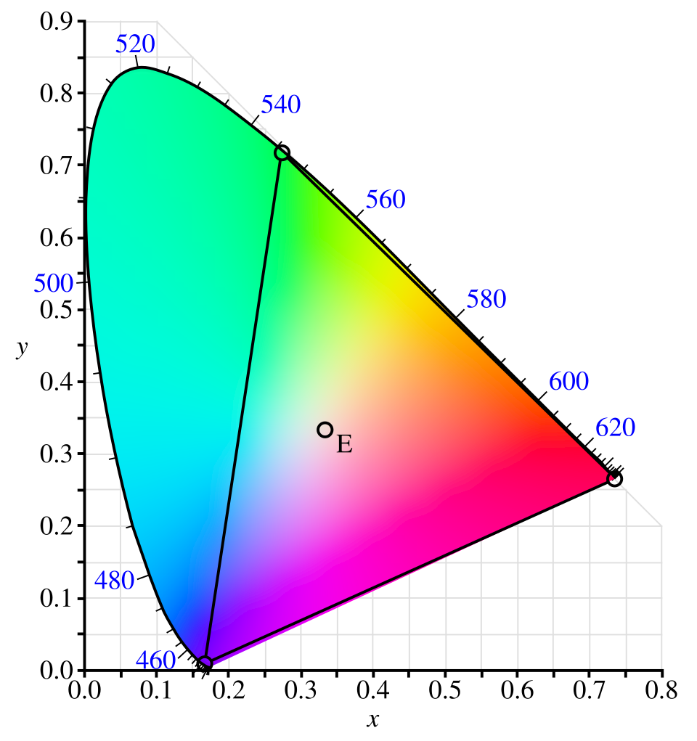
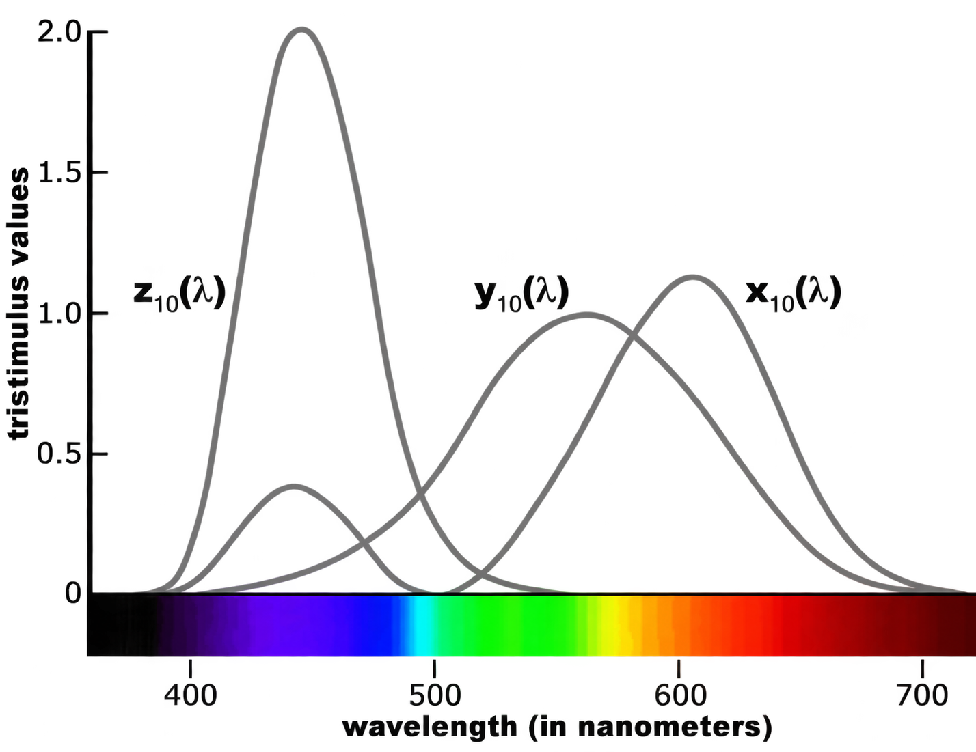





Color Imaging
HVAC
Computational Color Constancy
Cross-Camera Color Consistency
Tone Mapping
Multi-Spectral Singal Responses
Building Energy Simulation
Building Energy Audit
Fault and Diagnosis
HVAC System Control
HVAC System Automated Design

