Slide 1
FINAL PROJECT PRESENTATION
RT
RepairTrack
A secure, multi-tenant web platform connecting repair intake, workshop execution, inventory, billing, customer tracking and accountable administration.
Web-Based Repair Management System
APT 3065 Mid Sem Project
United States International University-Africa
August 2026
Presented by: Husain Kaka
Student ID: 666724
Supervisor: Prof. Patrick Wamuyu
Notes:
Introduce RepairTrack as a complete web information system for repair businesses. State the academic context and the central design goal: one reliable record from device intake to collection.
[Sources]
- RepairTrack repository source code and project documentation (local workspace, accessed 12 August 2026).

Slide 2
REPAIRTRACK WEB APPLICATION
Presentation roadmap
01
Problem context and project objectives
02
Users, requirements and system scope
03
Architecture, database and workflow design
04
Implemented web modules and interfaces
05
Security, validation and quality assurance
06
Deployment, limitations and future development
02
Notes:
Preview the presentation sequence. Emphasize that the presentation moves from the real operational problem to verified implementation evidence and deployment readiness.
[Sources]
- RepairTrack repository source code and project documentation (local workspace, accessed 12 August 2026).

Slide 3
REPAIRTRACK WEB APPLICATION
Repair operations fail when information is fragmented
Many workshops still coordinate repairs using paper job cards, spreadsheets, messaging threads and memory. The result is not merely inconvenience; it creates operational and financial risk.
THE CORE GAP
No single, authoritative repair record
Repair status is difficult to trace
Customers repeatedly request updates
Technician responsibility is unclear
Without a shared system of record, every handoff introduces ambiguity, from reception to diagnosis, stock consumption, payment and customer collection.
Parts usage and stock changes diverge
Invoices, payments and receipts become disconnected
03
Notes:
Frame the problem as information fragmentation across the repair lifecycle. Explain how this weakens traceability, customer trust, inventory accuracy and financial control.
[Sources]
- RepairTrack repository source code and project documentation (local workspace, accessed 12 August 2026).

Slide 4
REPAIRTRACK WEB APPLICATION
The project converts the repair lifecycle into one controlled workflow
GENERAL OBJECTIVE
Design and implement a secure web-based platform that manages repair businesses from intake to collection while maintaining role separation, tenant isolation and auditable records.
Specific objectives
Digitize customers, devices and repair tickets
Coordinate assignments, notes, parts and status
Generate invoices, receipts and payment records
Provide secure public and authenticated tracking
Produce operational reports and immutable audit evidence
04
Notes:
State the general objective, then connect each specific objective to a business risk identified on the previous slide.
[Sources]
- RepairTrack repository source code and project documentation (local workspace, accessed 12 August 2026).

Slide 5
REPAIRTRACK WEB APPLICATION
Four roles receive deliberately different views and permissions
SUPER ADMIN
BUSINESS ADMIN
Platform governance
Workshop control
Onboards businesses, controls tenant status, reviews aggregate platform health and system audit activity.
Manages customers, devices, technicians, repairs, stock, invoices, payments, reports and settings.
TECHNICIAN
CUSTOMER
Assigned execution
Transparent self-service
Works only on authorized jobs: accepts assignments, diagnoses, records notes/parts and advances valid statuses.
Views only owned repairs, invoices, receipts, payment state and customer-visible updates.
05
Notes:
Explain that role-based access is enforced by backend authorization and object ownership checks, not only by hiding menu items.
[Sources]
- RepairTrack repository source code and project documentation (local workspace, accessed 12 August 2026).

Slide 6
REPAIRTRACK WEB APPLICATION
A three-tier architecture separates interface, business logic and data
PRESENTATION
APPLICATION
PERSISTENCE
React + TypeScript
REST API
PostgreSQL
Vite | Material UI
React Query | Router
Express + TypeScript
Validation | RBAC | Services
Prisma ORM | 3NF schema
Transactions | Migrations
JWT access tokens and rotating refresh sessions secure every authenticated request.
06
Notes:
Walk through a request from the browser to the API and database. Explain why separation improves maintainability, security and testability.
[Sources]
- RepairTrack repository source code and project documentation (local workspace, accessed 12 August 2026).

Slide 7
REPAIRTRACK WEB APPLICATION
The data model preserves business ownership and repair history
26
56
Identity & tenancy
Repair operations
normalized tables
foreign keys
businesses | roles | users | sessions
settings | setup lock
customers | devices | repairs
status history | notes | assignments
Every tenant-owned operational record carries a business identifier; unique constraints and indexes protect identity, lookup and reporting paths.
Stock & billing
Assurance
inventory items | transactions | suppliers
repair parts | invoices | payments | receipts
notifications | audit logs
password resets | email verifications
07
Notes:
Describe the normalized model and its four logical domains. Highlight businessId as the central tenant-isolation key and status history/audit logs as append-only evidence.
[Sources]
- RepairTrack repository source code and project documentation (local workspace, accessed 12 August 2026).

Slide 8
REPAIRTRACK WEB APPLICATION
Ten controlled stages make every repair traceable
01
02
03
04
05
RECEIVED
DIAGNOSING
AWAITING
APPROVAL
WAITING FOR
PARTS
IN PROGRESS
06
07
08
09
10
TESTING
COMPLETED
READY FOR
COLLECTION
COLLECTED
CANCELLED
Each valid transition creates status history, audit evidence and, when enabled, a customer notification.
08
Notes:
Explain that the workflow is encoded as an allowed-transition map. Users cannot jump arbitrarily between states, which preserves process integrity.
[Sources]
- RepairTrack repository source code and project documentation (local workspace, accessed 12 August 2026).

Slide 9
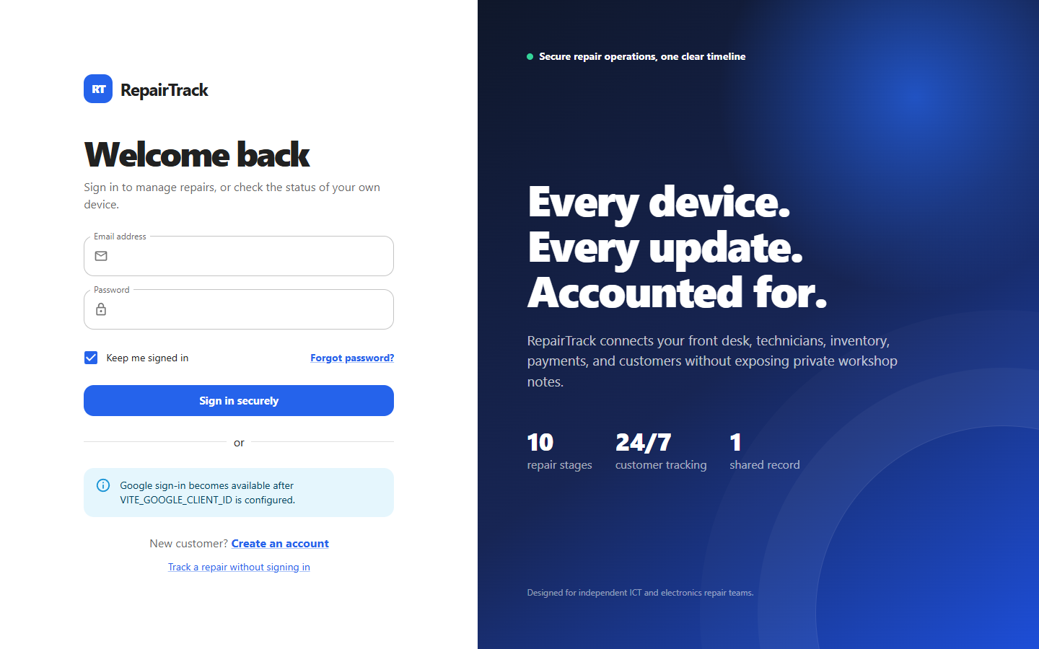
REPAIRTRACK WEB APPLICATION
Authentication begins with secure recovery and verification paths
The interface supports email login, customer registration, email verification, password recovery and Google sign-in after configuration.
Argon2id password hashing
Account lockout after repeated failures
Short-lived JWT access token
Rotating HttpOnly refresh cookie
No access token in localStorage
09
Notes:
Use the actual sign-in screen to explain the authentication journey. Mention that provider credentials are configured through environment variables rather than committed source.
[Sources]
- RepairTrack repository source code and project documentation (local workspace, accessed 12 August 2026).

Slide 10
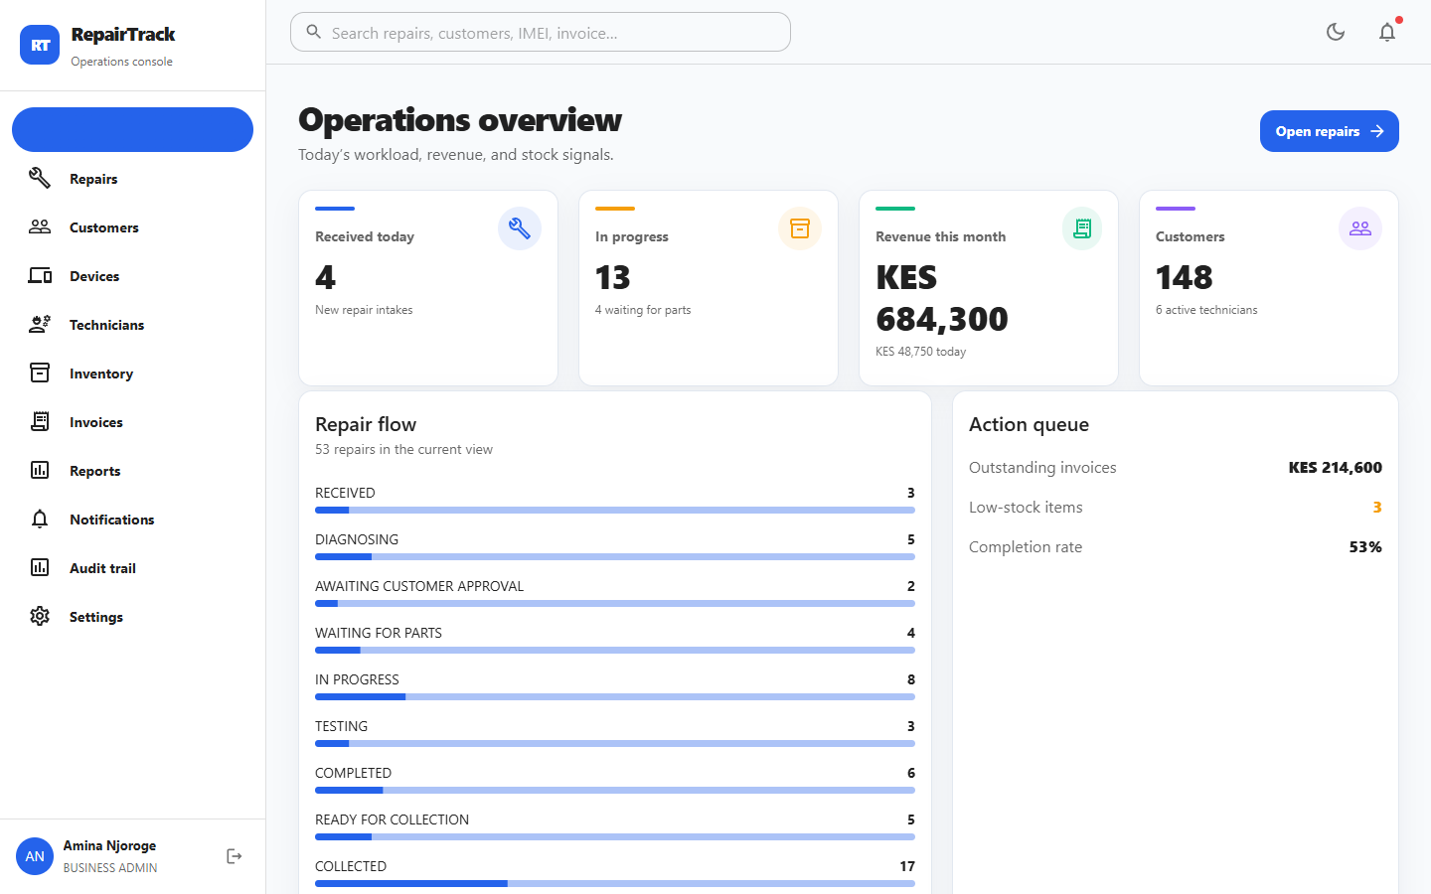
REPAIRTRACK WEB APPLICATION
The dashboard turns operational data into immediate action
At a glance
Repairs received today
Jobs in diagnosis or progress
Revenue today and this month
Customer and technician totals
Outstanding invoices and low stock
Repair-status completion signals
10
Notes:
Demonstrate how the dashboard supports daily decisions. Different roles receive different metrics; the super administrator receives aggregate tenant health without confidential repair detail.
[Sources]
- RepairTrack repository source code and project documentation (local workspace, accessed 12 August 2026).

Slide 11
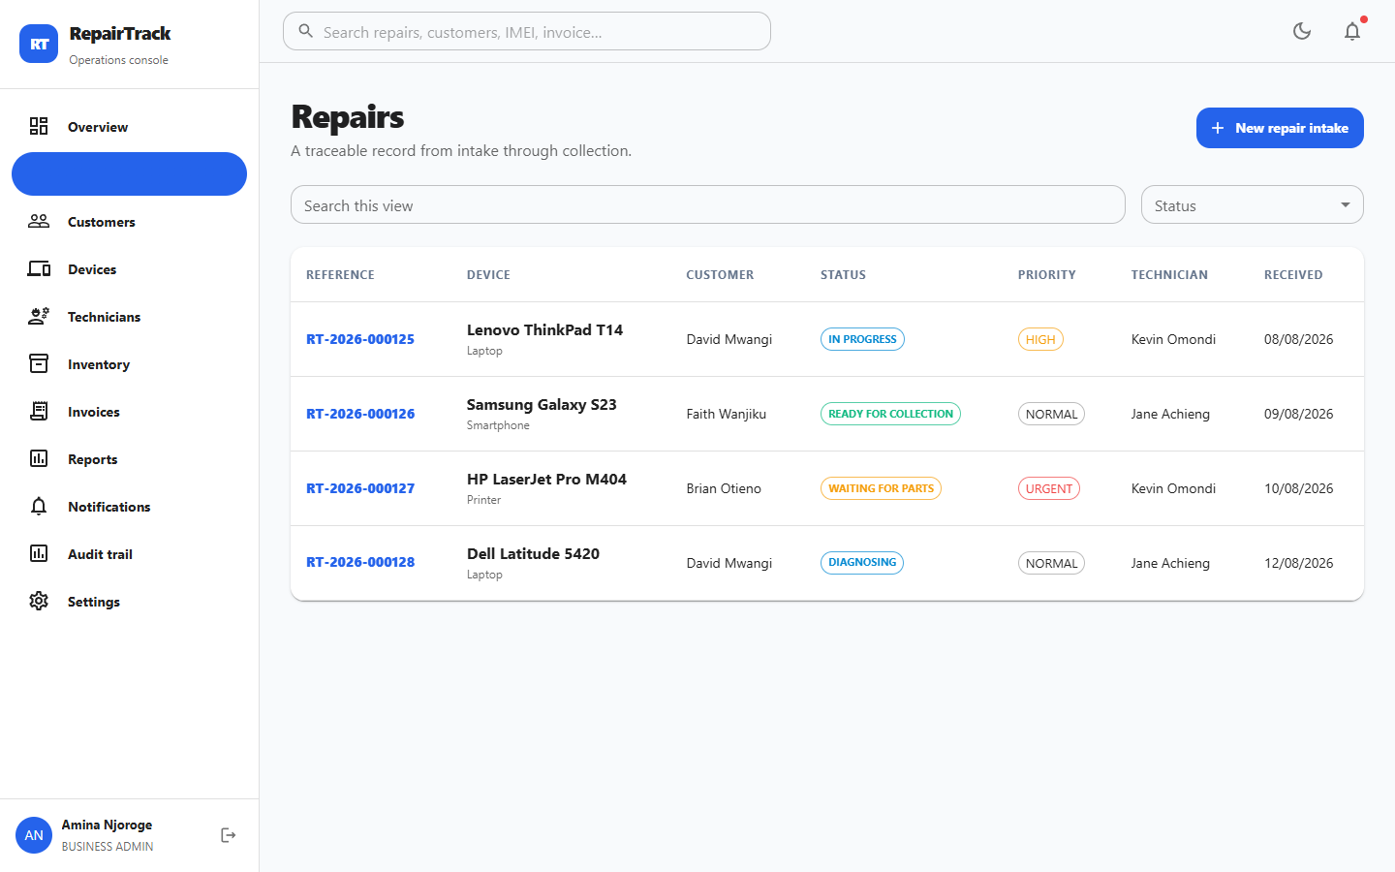
REPAIRTRACK WEB APPLICATION
Repair intake creates the system's central operational record
A repair ticket links customer, device, priority, assignment, estimated cost, due date, warranty context and separate internal/customer-visible notes.
Unique reference: RT-YYYY-NNNNNN
Secure random public tracking token
Search and status filtering
Assignment at intake or later
Audit event on creation
11
Notes:
Explain the intake fields and the uniqueness of both the internal reference and the separate public tracking token.
[Sources]
- RepairTrack repository source code and project documentation (local workspace, accessed 12 August 2026).

Slide 12
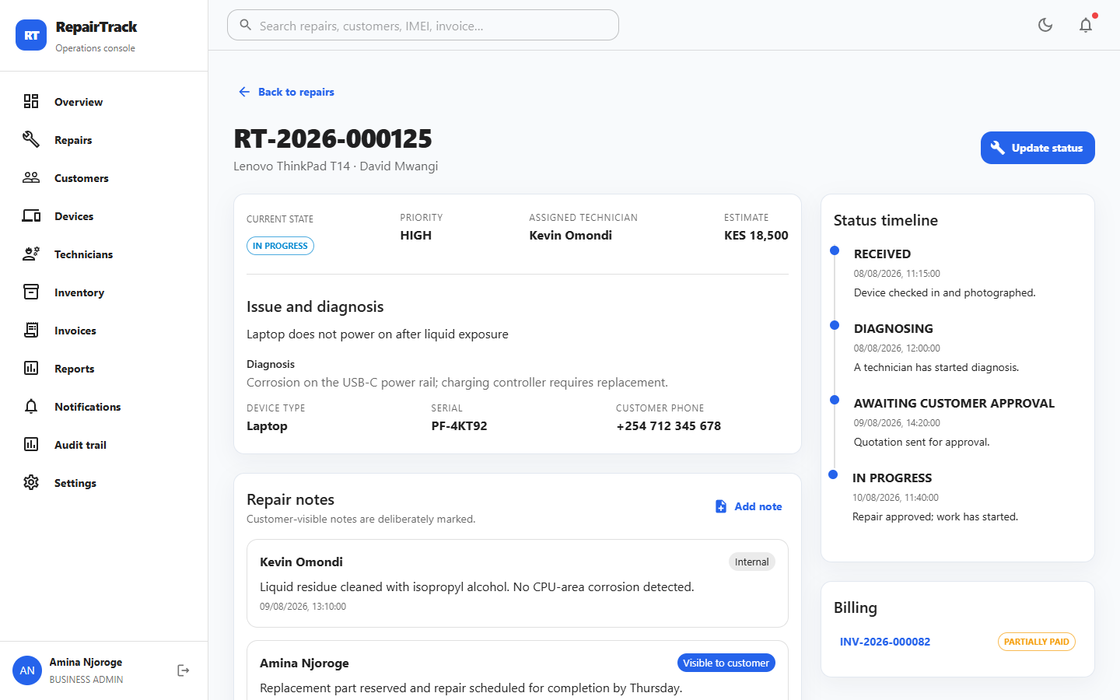
REPAIRTRACK WEB APPLICATION
One repair detail view coordinates diagnosis, parts, notes and billing
Technician assignment and acceptance
Diagnosis and cost recommendation
Internal versus customer-visible notes
Atomic parts consumption
Validated status advancement
Linked invoices and payment state
12
Notes:
Use the screen to show how a single record replaces disconnected job cards and messages. Point out visibility controls for notes and the status timeline.
[Sources]
- RepairTrack repository source code and project documentation (local workspace, accessed 12 August 2026).

Slide 13
REPAIRTRACK WEB APPLICATION
Customer and device records preserve service history
CUSTOMER PROFILE
Identity, contact details and relationship context
DEVICE RECORD
Serialized equipment linked to its owner
Duplicate prevention by business and contact fields
Type | brand | model
Alternative phone, address and service notes
Serial number | IMEI
Repair, invoice and payment history in context
Colour | storage | RAM
Accessories | physical condition
Reported fault | warranty | images
Device passcodes are deliberately excluded from the implemented schema to minimize sensitive data exposure.
13
Notes:
Explain the one-to-many relationship between customers and devices. Highlight data minimization: RepairTrack does not accept device passcodes in this implementation.
[Sources]
- RepairTrack repository source code and project documentation (local workspace, accessed 12 August 2026).

Slide 14
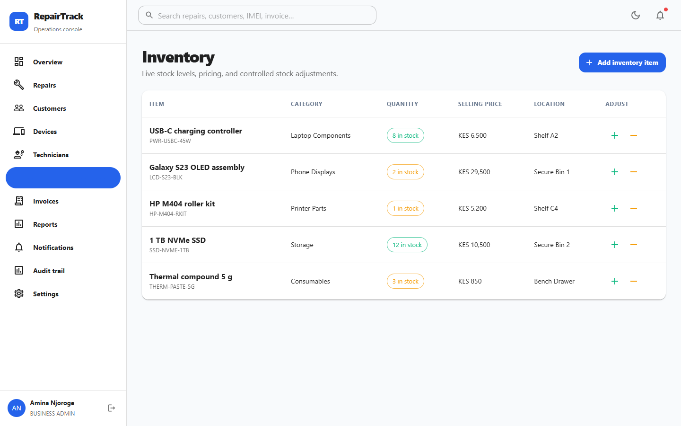
REPAIRTRACK WEB APPLICATION
Inventory movements stay synchronized with repair work
CONTROL LOGIC
SKU, barcode, category and supplier context
Purchase cost, selling price and location
Audited stock-in and stock-out history
Low-stock threshold alerts
Negative stock blocked by default
Repair part use reduces stock atomically
14
Notes:
Show the stock register and explain the transaction-based approach. Parts attached to a repair are consumed within a database transaction and use the recorded selling price for billing.
[Sources]
- RepairTrack repository source code and project documentation (local workspace, accessed 12 August 2026).

Slide 15
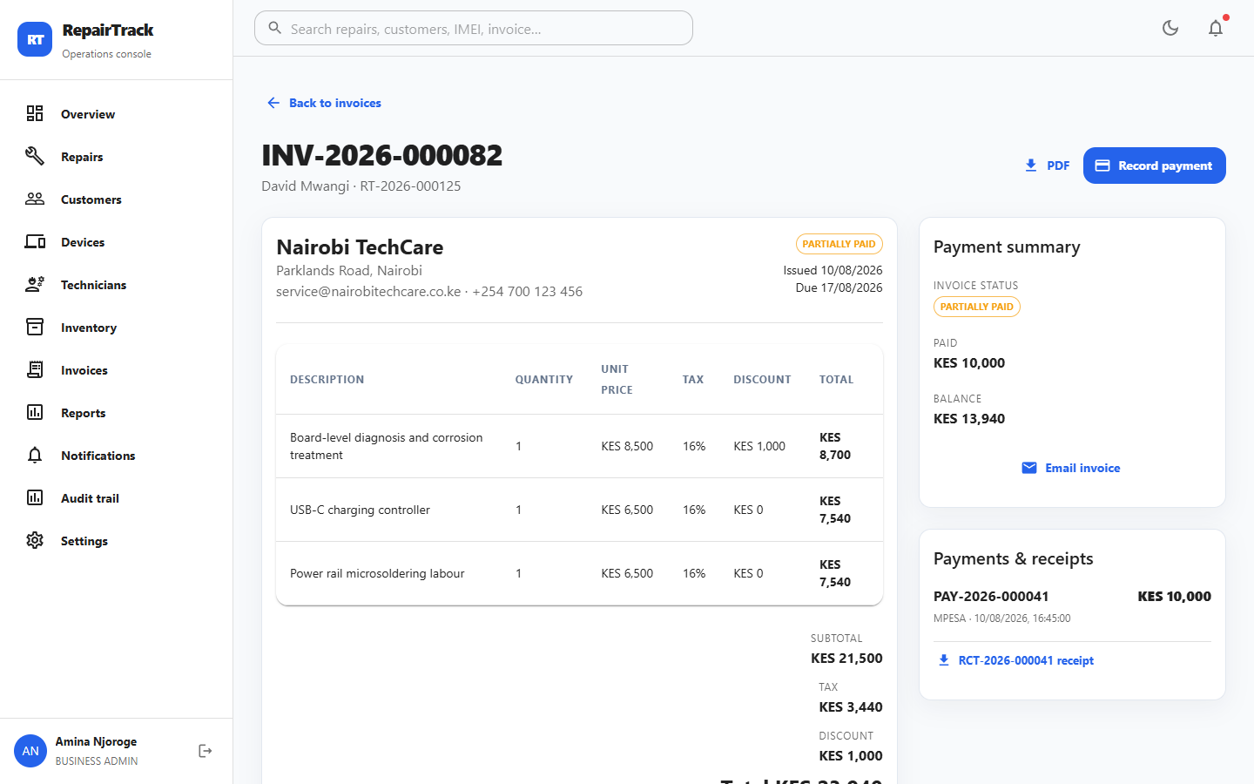
REPAIRTRACK WEB APPLICATION
Billing connects repair evidence to payment and receipt records
Draft, issued, partially paid, paid and cancelled states
Line-level quantity, tax and discount calculations
Full, partial and multiple payments
Cash, card, bank, M-Pesa and custom methods
PDF invoice and 58 mm / 80 mm / A4 receipts
Current repair status refreshed on receipt generation
15
Notes:
Discuss invoice calculation and serializable payment recording. Clarify that the M-Pesa boundary requires a verified transaction reference and does not fake provider confirmation.
[Sources]
- RepairTrack repository source code and project documentation (local workspace, accessed 12 August 2026).

Slide 16
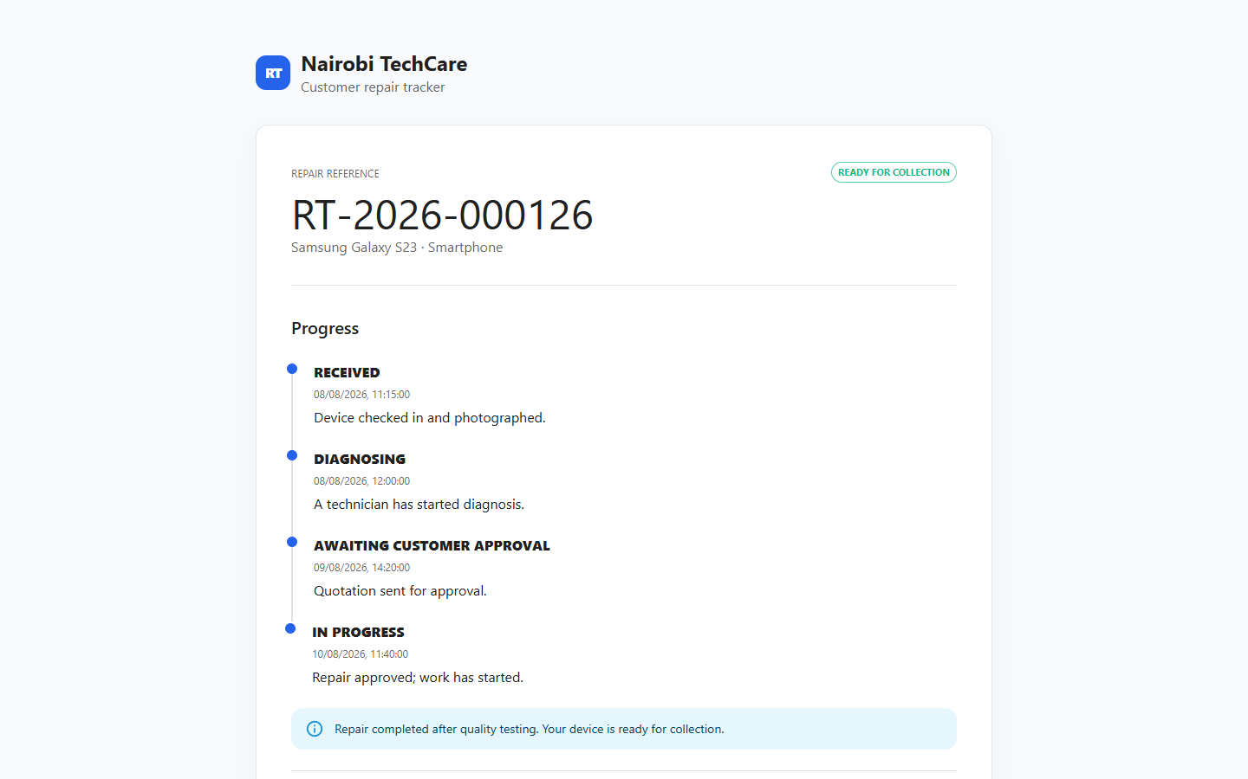
REPAIRTRACK WEB APPLICATION
Customers can track progress without exposing internal workshop data
A secure random tracking token powers the public page and QR link. Database identifiers, staff IDs, internal notes and security records are not exposed.
Repair reference and device identity
Current status and customer message
Estimated completion date
Status timeline
Invoice and payment state
Collection readiness
16
Notes:
Demonstrate the public tracking page. Explain that the token is random and revocable, while the projection contains only customer-safe fields.
[Sources]
- RepairTrack repository source code and project documentation (local workspace, accessed 12 August 2026).

Slide 17
REPAIRTRACK WEB APPLICATION
Event-driven notifications keep customers informed
STATUS EVENT
PREFERENCE CHECK
DELIVERY
EVIDENCE
A valid repair transition is committed.
Tenant settings decide enabled channels.
In-app and email delivery attempts are recorded.
Provider ID, sent time or failure state is retained.
Events include repair milestones, invoice issue and payment recording; provider credentials remain environment-managed.
17
Notes:
Describe the notification pipeline and how business preferences control in-app and email channels. Failed delivery does not silently disappear; it is recorded for operational follow-up.
[Sources]
- RepairTrack repository source code and project documentation (local workspace, accessed 12 August 2026).

Slide 18
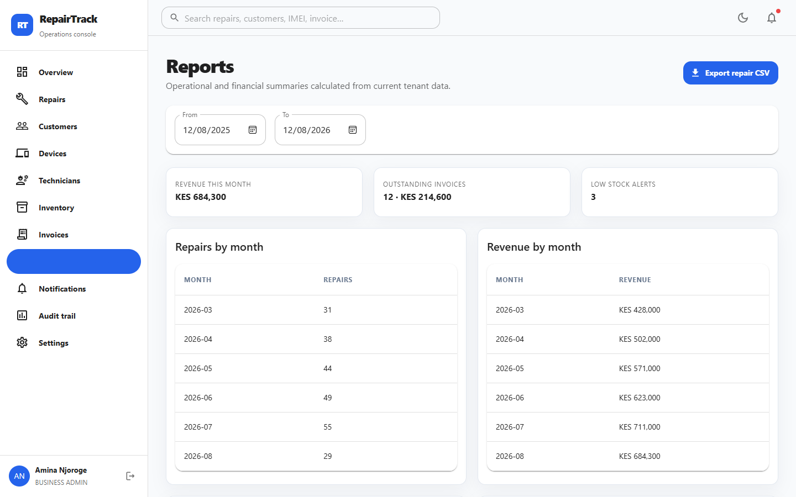
REPAIRTRACK WEB APPLICATION
Reports transform operational records into management evidence
Date-range repair trends
Status and device distribution
Technician workload and completion rate
Revenue and invoice balances
Payments by method
Low stock and most-used parts
CSV repair export
18
Notes:
Explain that all report queries are tenant-scoped. The screen supports date filters and CSV export, while the dashboard emphasizes immediate operational signals.
[Sources]
- RepairTrack repository source code and project documentation (local workspace, accessed 12 August 2026).

Slide 19
REPAIRTRACK WEB APPLICATION
Security is enforced through multiple independent control layers
01
02
03
04
05
AUTHENTICATION
AUTHORIZATION
API DEFENCE
DATA PROTECTION
ACCOUNTABILITY
Argon2id | verification | lockout
JWT access | rotating refresh
RBAC | business scope
object ownership | role routes
Zod validation | rate limits
secure headers | CORS | size limits
Prisma parameterization | encryption
soft deletion | secret isolation
Immutable audit events
IP, session, actor and metadata
The browser never becomes the security boundary; every sensitive backend query includes role, tenant and ownership conditions.
19
Notes:
Walk through defence in depth. Stress that client-side route guards improve usability but the backend independently enforces authorization and tenant isolation.
[Sources]
- RepairTrack repository source code and project documentation (local workspace, accessed 12 August 2026).

Slide 20
REPAIRTRACK WEB APPLICATION
The interface is responsive, accessible and consistent
DESIGN SYSTEM
Material UI components provide a consistent visual language across dashboards, tables, dialogs, forms and status indicators.
Desktop sidebar becomes a compact-viewport drawer
Responsive grids and scroll-safe tables
Light and dark display modes
Loading, empty, error and confirmation states
Keyboard-focused forms and skip-to-content link
Brand palette: #2563EB | #0F172A | #10B981 | #F59E0B | #EF4444
20
Notes:
Explain the responsive shell, reusable feedback states and theme system. Mention the deliberate code-splitting of route modules and server-state caching through React Query.
[Sources]
- RepairTrack repository source code and project documentation (local workspace, accessed 12 August 2026).

Slide 21
REPAIRTRACK WEB APPLICATION
Automated verification covers the web stack from types to security boundaries
18/18
5/5
0
1,092
Backend tests
Web tests
Lint/type errors
Modules transformed
Authentication, account state, security, workflow, invoice and payment rules
API retry contract and reusable interface components
Backend and web static checks completed cleanly
Successfully processed in the production Vite build
Production bundle: 273.35 kB application chunk (79.94 kB gzip) plus separated React, data and UI vendor chunks.
21
Notes:
Present only measured project results. Explain that the backend test suite includes unauthorized access, invalid and expired JWTs, standardized errors, password hashing, repair transitions and payment evidence.
[Sources]
- RepairTrack repository source code and project documentation (local workspace, accessed 12 August 2026).

Slide 22
REPAIRTRACK WEB APPLICATION
Validation was incremental and evidence-driven
STATIC
UNIT
INTEGRATION
ESLint and TypeScript
Business-rule tests
API security boundaries
BUILD
SCHEMA
AUDIT
Backend and Vite output
Prisma and migration SQL
Secrets, links and placeholders
Failures were corrected and the affected checks were rerun before the next development phase or commit.
22
Notes:
Explain the iterative quality process rather than only the final numbers. Mention that build, schema, security and documentation checks are included alongside tests.
[Sources]
- RepairTrack repository source code and project documentation (local workspace, accessed 12 August 2026).

Slide 23
REPAIRTRACK WEB APPLICATION
Deployment separates public delivery from protected services
STATIC WEB
API SERVICE
DATABASE
PROVIDERS
Vercel / Netlify
Render / Railway / VPS
Managed PostgreSQL
SMTP | Google OAuth
HTTPS assets + API URL
Node process + secrets
Backups + least privilege
Restricted credentials
Production requirements: HTTPS, managed secrets, database migration, backups, CORS allowlist, provider-domain verification and monitoring.
23
Notes:
Describe a practical deployment topology and the production controls that must accompany it. Explain that environment-specific providers are intentionally not hard-coded.
[Sources]
- RepairTrack repository source code and project documentation (local workspace, accessed 12 August 2026).

Slide 24
REPAIRTRACK WEB APPLICATION
Remaining work is concentrated in live infrastructure and advanced analysis
LIVE PROVIDERS
DATABASE EXECUTION
Google sign-in, SMTP delivery and M-Pesa require real project credentials and production callback testing.
The migration was schema-validated; a live fresh PostgreSQL application was not possible on the build machine.
ANALYTICS DEPTH
MEDIA STORAGE
Current reporting covers operational summaries; turnaround-time cohorts and forecasting are future enhancements.
The interface accepts approved HTTPS media URLs; a dedicated object-storage upload pipeline can be added.
PRODUCTION OPERATIONS
INTEGRATION EXTENSIONS
Monitoring, disaster-recovery drills, load testing and penetration testing belong in deployment hardening.
Future work may add supplier purchasing, calendar scheduling, richer PDF exports and verified payment webhooks.
24
Notes:
Distinguish implemented functionality from environment-dependent verification and future enhancements. This demonstrates honest project evaluation rather than overstating production readiness.
[Sources]
- RepairTrack repository source code and project documentation (local workspace, accessed 12 August 2026).

Slide 25
FINAL SYNTHESIS
RepairTrack delivers one accountable web record for the complete repair journey
The project demonstrates full-stack engineering through modular architecture, normalized data, role-based workflows, financial records, customer transparency, layered security, automated verification and deployment-ready documentation.
QUESTIONS
Thank you
Complete source, tests and manuals are included in the RepairTrack project repository.
Notes:
Close by returning to the original problem: fragmented repair information. Summarize how RepairTrack creates traceability, customer visibility and management control, then invite questions.
[Sources]
- RepairTrack repository source code and project documentation (local workspace, accessed 12 August 2026).

