Slide 1

Kickstarter Board Game Campaigns
Presented By:
Husain Mohamed Fardan
Talal Al-Jowder
Ammar

Slide 2
introduction
Kickstarter is a popular crowdfunding platform where creators pitch ideas and seek public support to fund their projects. In the competitive world of board game development, many creators turn to Kickstarter—but not all succeed. This project analyzes real Kickstarter data to understand what drives success in board game campaigns and to guide creators in launching more effective projects.

Slide 3
Problem Statement
Although Kickstarter offers a powerful platform for funding board games, many campaigns fail to reach their funding targets. With limited insights into what contributes to success, creators often set unrealistic funding goals, choose suboptimal launch times, or plan poorly timed campaign durations. This lack of data-driven guidance leads to missed opportunities and unmet creative potential.

Slide 4
Objectives
🧮 Examine how the requested funding amount affects campaign success rates.
📆 Identify whether certain months of the year are associated with higher success rates.
⏳ Determine the impact of campaign duration on the likelihood of success.

Slide 5
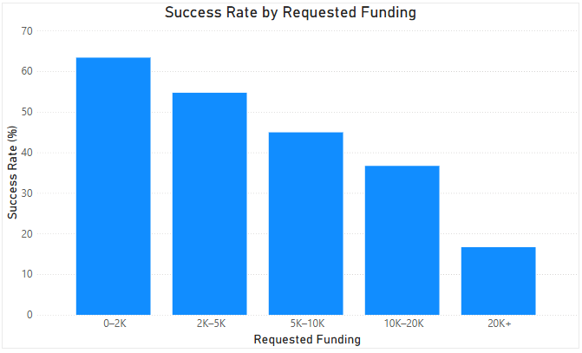

Slide 6
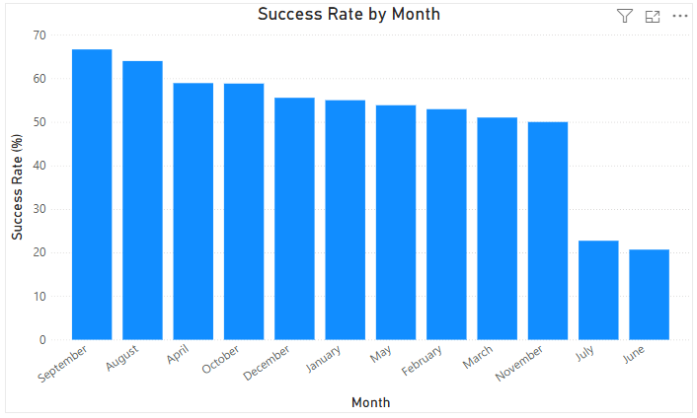

Slide 7
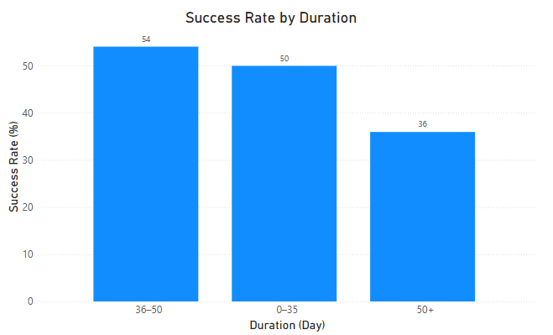

Slide 8
Limitations
📅 Outdated Campaigns: The dataset includes campaigns from earlier years (starting as far back as 2010), which may not reflect current Kickstarter trends or platform changes.
🎯 No Insight Into Campaign Quality: The dataset does not include details about project descriptions, visuals, video quality, or marketing strategy — all of which significantly impact campaign success.
📊 Unbalanced Categories: Some groupings (e.g., campaigns requesting high funding or lasting more than 60 days) have fewer observations, which can skew comparisons.

Slide 9
Recommendations
🎯 Set a Realistic Funding Target: Campaigns asking for less than $5,000 tend to have much higher success rates. Aim for a lean budget when possible.
📆 Choose the Right Launch Month: Launching in September or May August more favorable. Avoid months with lower overall success like June or July.
⏳ Keep the Campaign Duration Reasonable: Campaigns lasting 36–50 days had the highest success rates. Avoid overly short or excessively long durations.

Slide 10
Conclusion
Kickstarter offers board game creators a valuable platform — but success depends on more than just a good idea. By examining actual campaign data, this project uncovered key factors that impact success. Campaigns are more likely to succeed when they have a modest funding target, are launched during strategic months, and are timed within a 36-50 day window. Understanding these patterns empowers creators to launch smarter campaigns — increasing their chances of bringing their ideas to life.

Slide 11
THANK YOU

