Slide 1
Event Handling
Overview
Context Free Grammer

Slide 2
Event Handling
What is Grammer?
Set of rules which will be useful to generate meaningful sentence.

Slide 3
Event Handling
What is CFG?
Context-Free Grammar (CFG) is a formal system that provides a set of production rules to define the syntax of a language.
It consists of a collection of rules or productions that describe how symbols in a language can be combined to form valid strings.
Here's a thorough explanation of CFG, along with its relationship to compiler design

Slide 4

Event Handling
What is CFG?
Context free grammer is defned by four tuples:
G={V,T,P,S}
V:Set of varibles or non_terminal symbol.
These are placeholders for patterns of strings and can be replaced with other non-terminals or terminals.
They usually represent syntactic categories (e.g., expressions, statements).

Slide 5
Event Handling
What is CFG?
Context free grammer is defned by four tuples:
G={V,T,P,S}
V:Set of varibles or non_terminal symbol.
T: Set of Terminal Symbol
These are the actual symbols of the language that cannot be further decomposed. In programming languages, these might be keywords, operators, or identifiers.

Slide 6
Event Handling
What is CFG?
Context free grammer is defned by four tuples:
G={V,T,P,S}
V:Set of varibles or non_terminal symbol.
T: Set of Terminal Symbol
P: Set of production rules
alpha --> beta
alpha: Only one non terminal.
beta: combination of V and T (VUT)*

Slide 7
Event Handling
What is CFG?
Context free grammer is defned by four tuples:
G={V,T,P,S}
V:Set of varibles or non_terminal symbol.
T: Set of Terminal Symbol
P: Set of production rules
S: Start Symbol

Slide 8
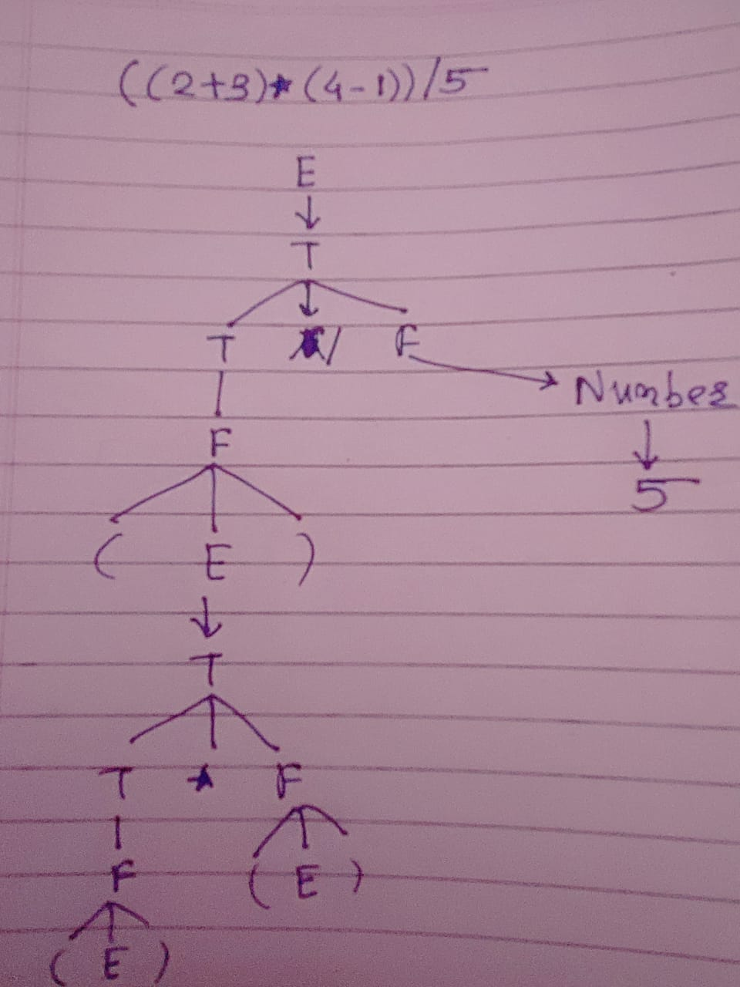
Event Handling
Example:
E → E+T
E →E-T
E→ T
T → T * F
T → T/F
T → F
F → (E)
F → Number

Slide 9
Event Handling
Example: 1) ((2+3)*(4-1)/5

Slide 10
Thank You

