Slide 1

Classification of Oil
Wells in the DSEATS Field Using Machine Learning
SPE DSEATS Africa Datathon 2025
Team Petromind
Name: Hussaini Ahmed
SPE Number: 5638753
SPE Section: SPE Abuja Section
School: Federal University of Technology, Minna (FUTMinna)
Name: Nunsi Shiaki
SPE Number: 5887756
SPE Section: SPE Lagos Section
School: Federal University of Technology, Akure (FUTA)
Name: Nasirdeen Shuaib
SPE Number: 5445518
SPE Section: SPE Abuja Section
School: Federal University of Technology, Minna (FUTMinna)
21/07/2025

Slide 2
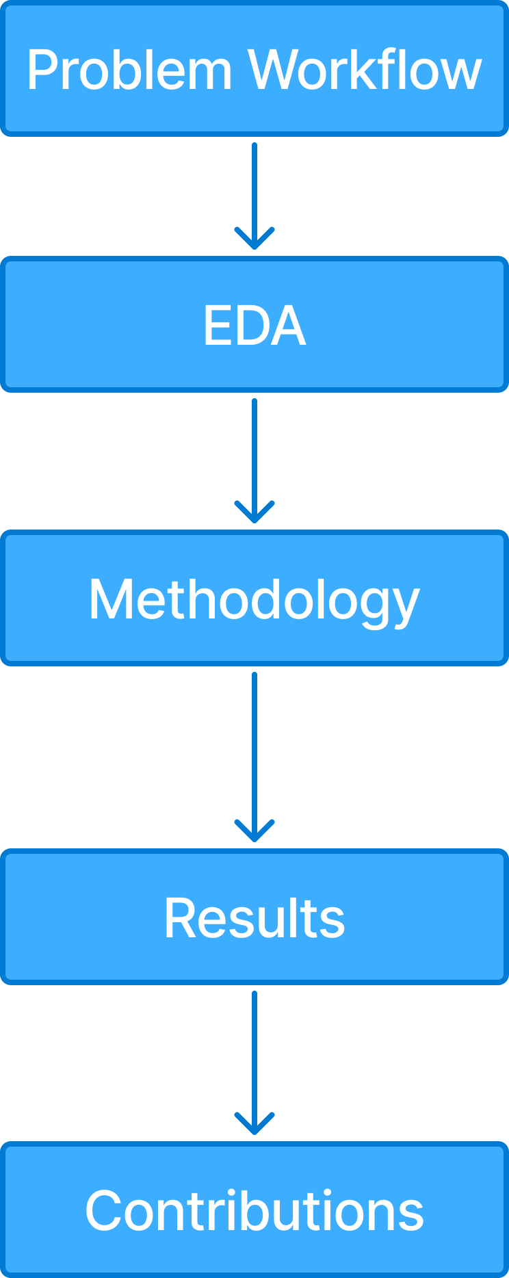
Outline
Workflow

Slide 3
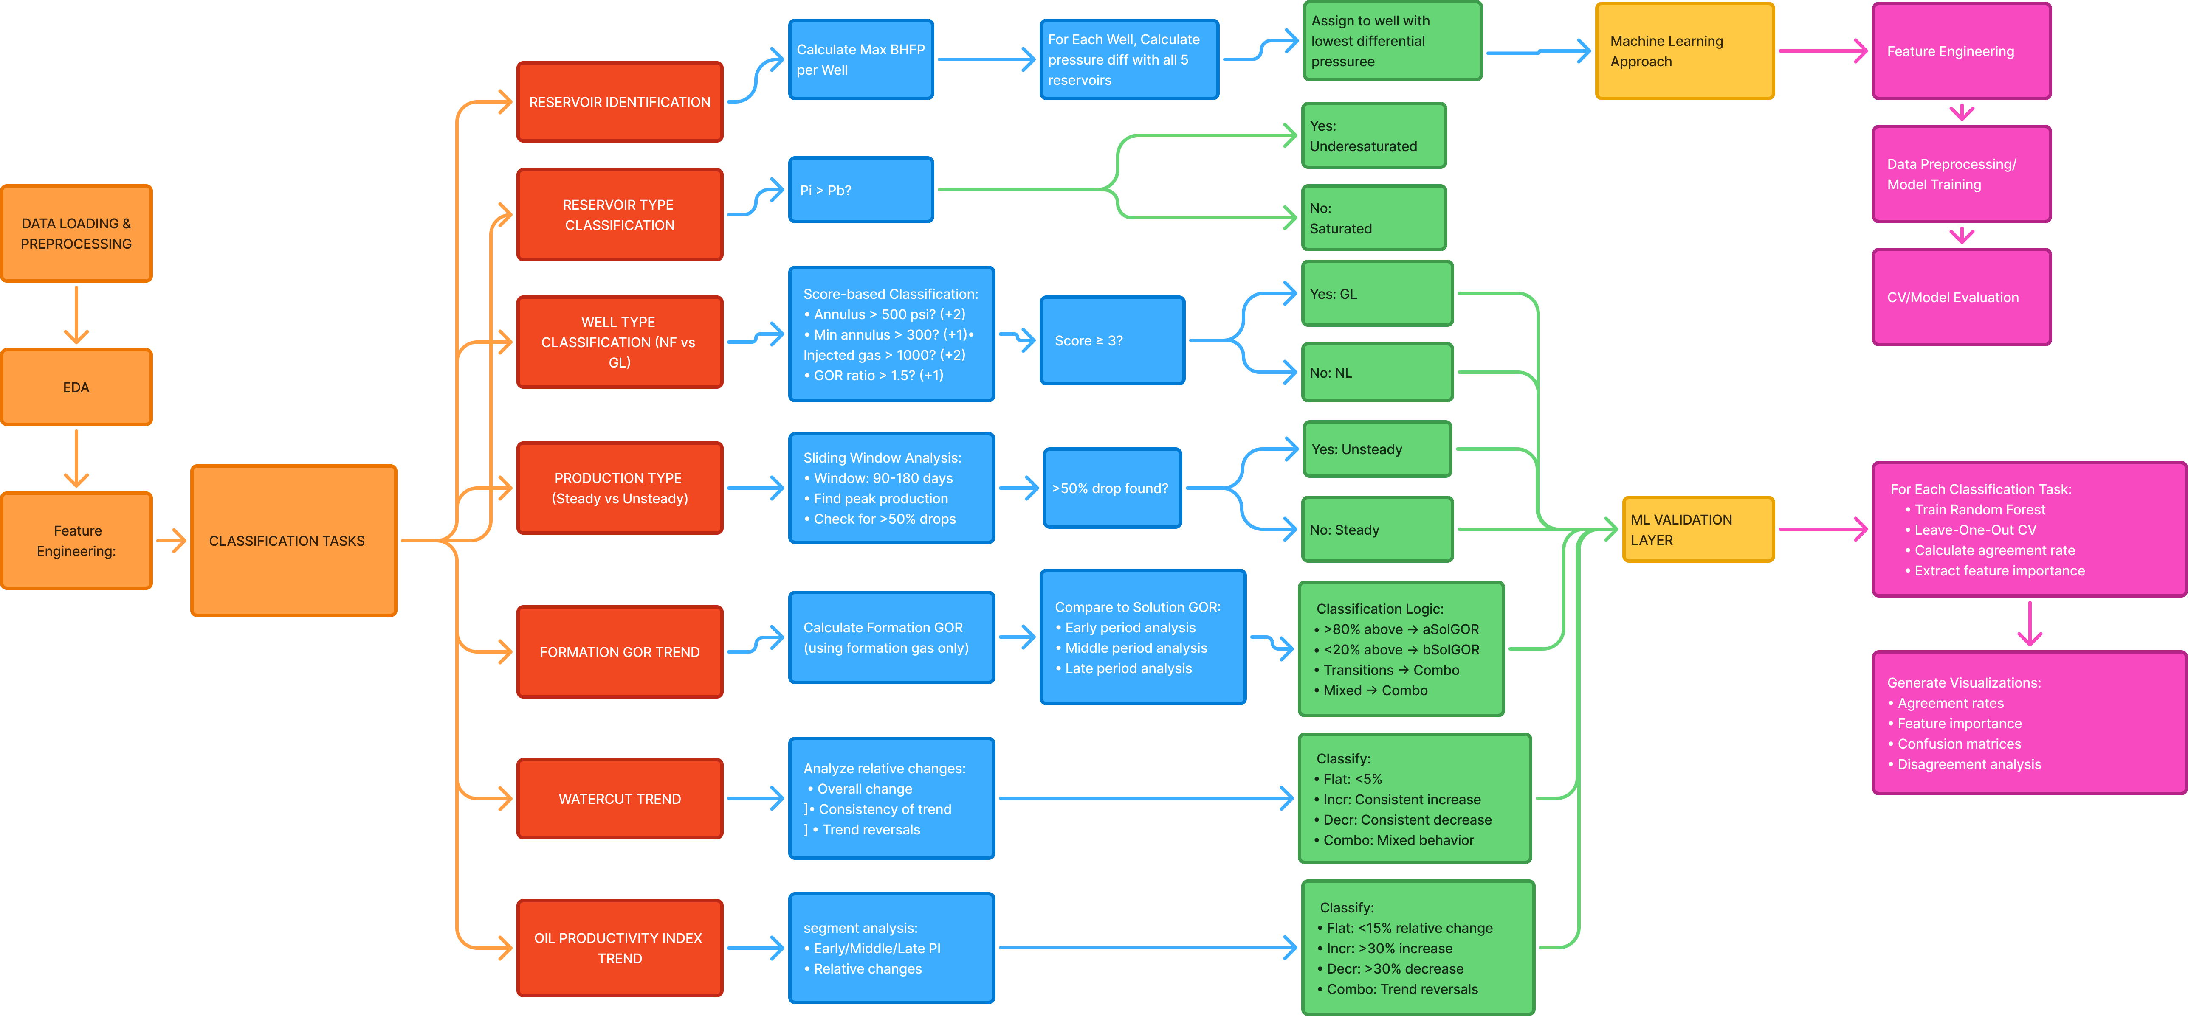
Problem Workflow
1
Workflow
2
4
3
4
5
6
Workflow

Slide 4
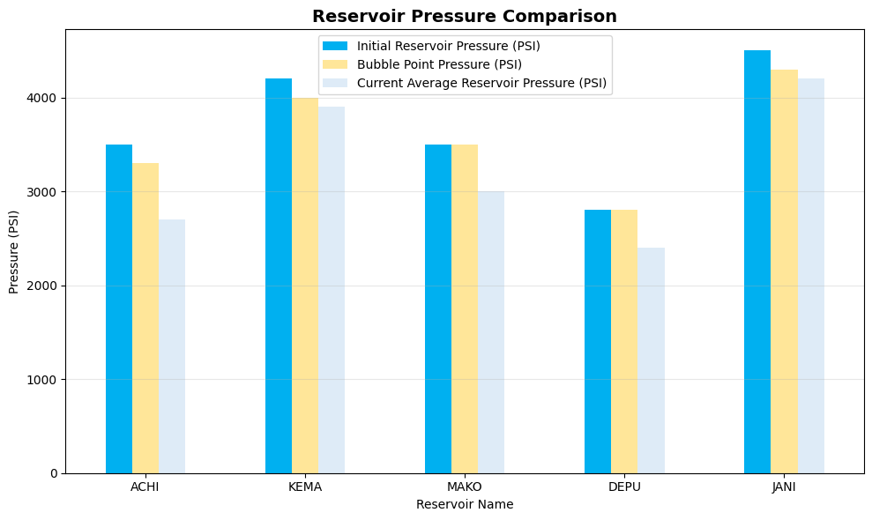
EDA - Field Overview
Reservoir Pressure comparison
Dataset
20 wells production history
Production date ranges from 2011-02-17 to 2016-08-12
5 reservoirs with distinct PVT properties
Cumulative Oil Prod (STB): 0.0 - 1129301.0
Cumulative Formation Gas Prod (MSCF): 0.0 - 1458660.0
Cumulative Total Gas Prod (MSCF): 0.0 - 1458660.0
Cumulative Water Prod (BBL): 0.0 - 1499262.0
7,955
Total Records
The chart compares initial, bubble point, and current reservoir pressures for all reservoirs. ACHI, KEMA, and JANI remain undersaturated, while MAKO and DEPU are now saturated, as their initial pressures are at bubble point levels.
13
Initial Parameters Tracked

Slide 5
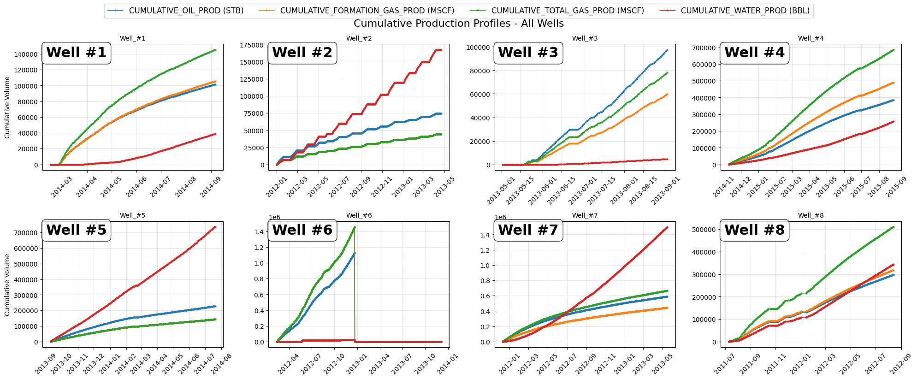
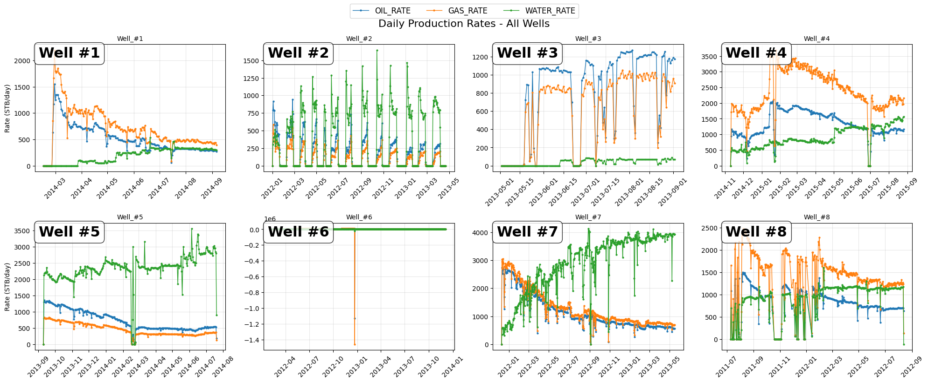
EDA - Production Profiles
Cumulative Production
This multi-well comparison shows cumulative oil, formation gas, total gas, and water production over time. Wells #2, #5, and #7 show significant water production (red line). Well #8 shows a notable gap between total gas (blue) and formation gas (orange), suggesting gas injection for artificial lift.
Daily Production Rates
This multi-well comparison shows daily oil, formation gas, total gas, and water production over time. e.g. Well #2 shows extreme volatility with spikes reaching 1500 STB/day, suggesting operational issues or frequent shut-ins. Well #1 show clear declining trends in oil production.

Slide 6
Methodology - Classification Framework
1
Workflow
2
3
4
1
3
1
5
Data Processing
Engineer domain-specific features
Apply petroleum engineering principles
Use threshold-based classification rules
Machine Learning cross-validation
Parameter | Approach | Output/Classification
Reservoir Assignment | Pressure differential analysis (≤200 psi criterion) | Match well BHFP to reservoir pressure≤200 psi differential
Reservoir Type | Compare initial pressure vs bubble point | Saturated / Undersaturated classification
Well Type (NF/GL) | Multi-indicator scoring | Identify Natural Flow (NF) vs Gas Lift (GL)
Production Stability | Detect >50% production drops in 3-6 month windows | Classify as Steady vs Unsteady
Formation GOR Trend | Segmented trend analysis | Categories: bSolGOR / aSolGOR / Combo
Watercut Trend | Time series decomposition | Trend analysis: Flat / Incr / Decr / Combo
PI Trend | Robust regression analysis | Trend analysis: Flat / Incr / Decr / Combo

Slide 7
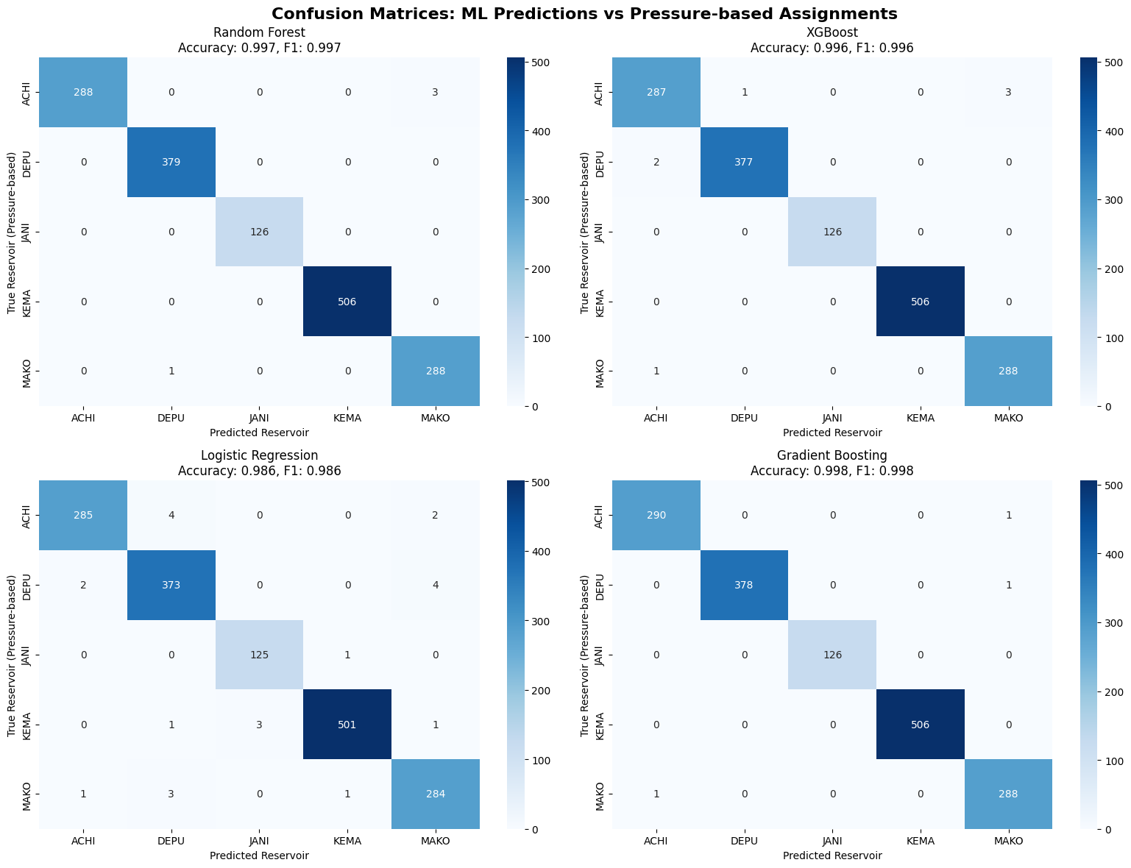
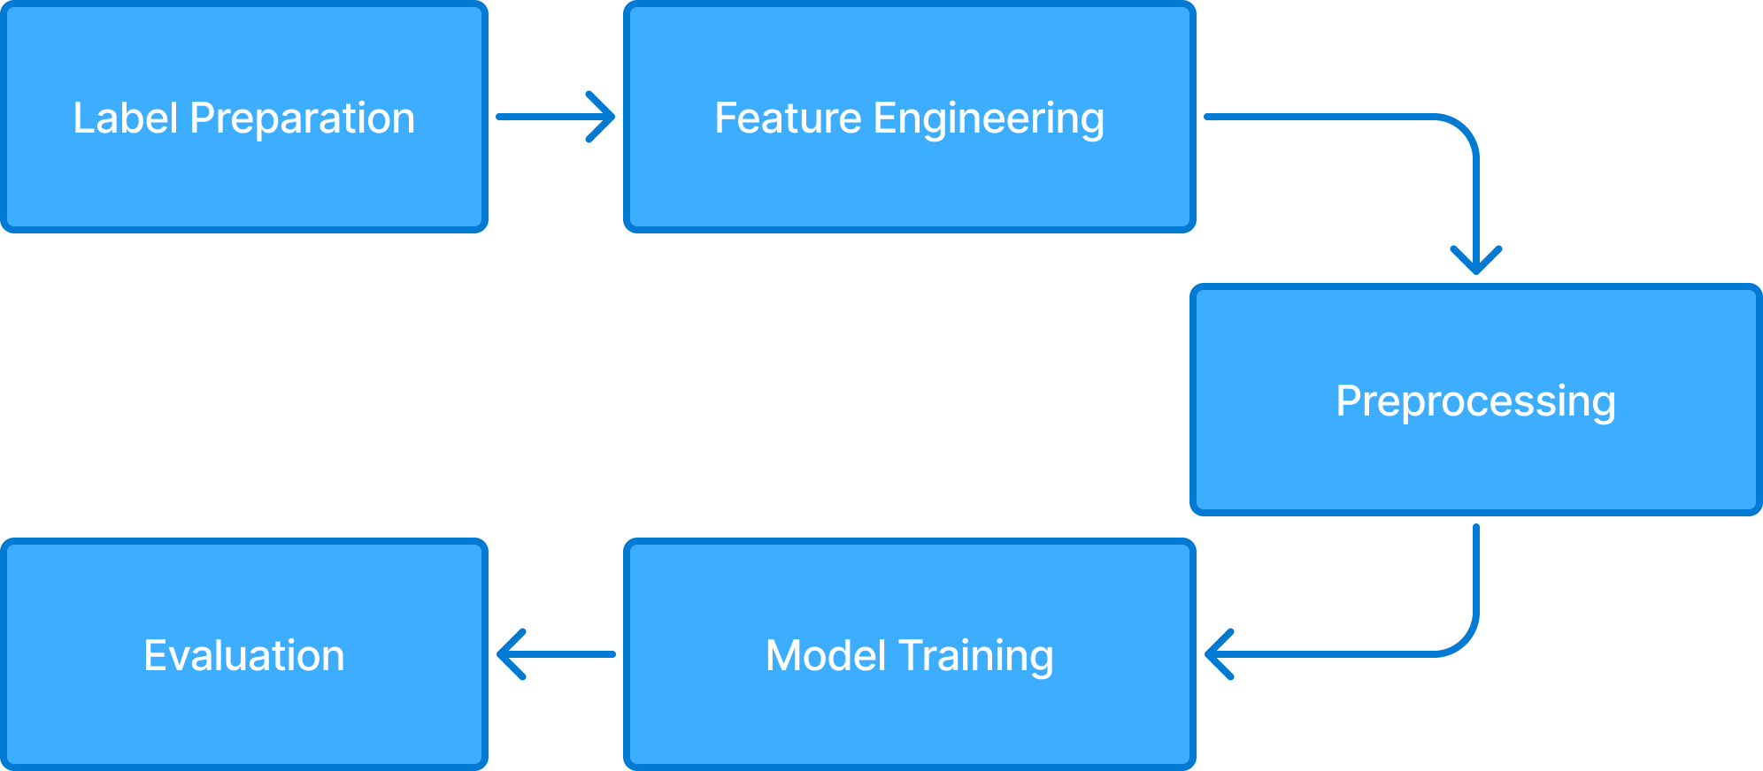
Methodology – ML-Driven Classification
Our Approach:
Algorithm | Accuracy | Precision | F1-Score
Random Forest | 0.9975 | 0.9975 | 0.9975
XGBoost | 0.9956 | 0.9956 | 0.9956
Logistic Regression | 0.9855 | 0.9856 | 0.9856
Gradient Boosting | 0.9981 | 0.9981 | 0.9981

Slide 8
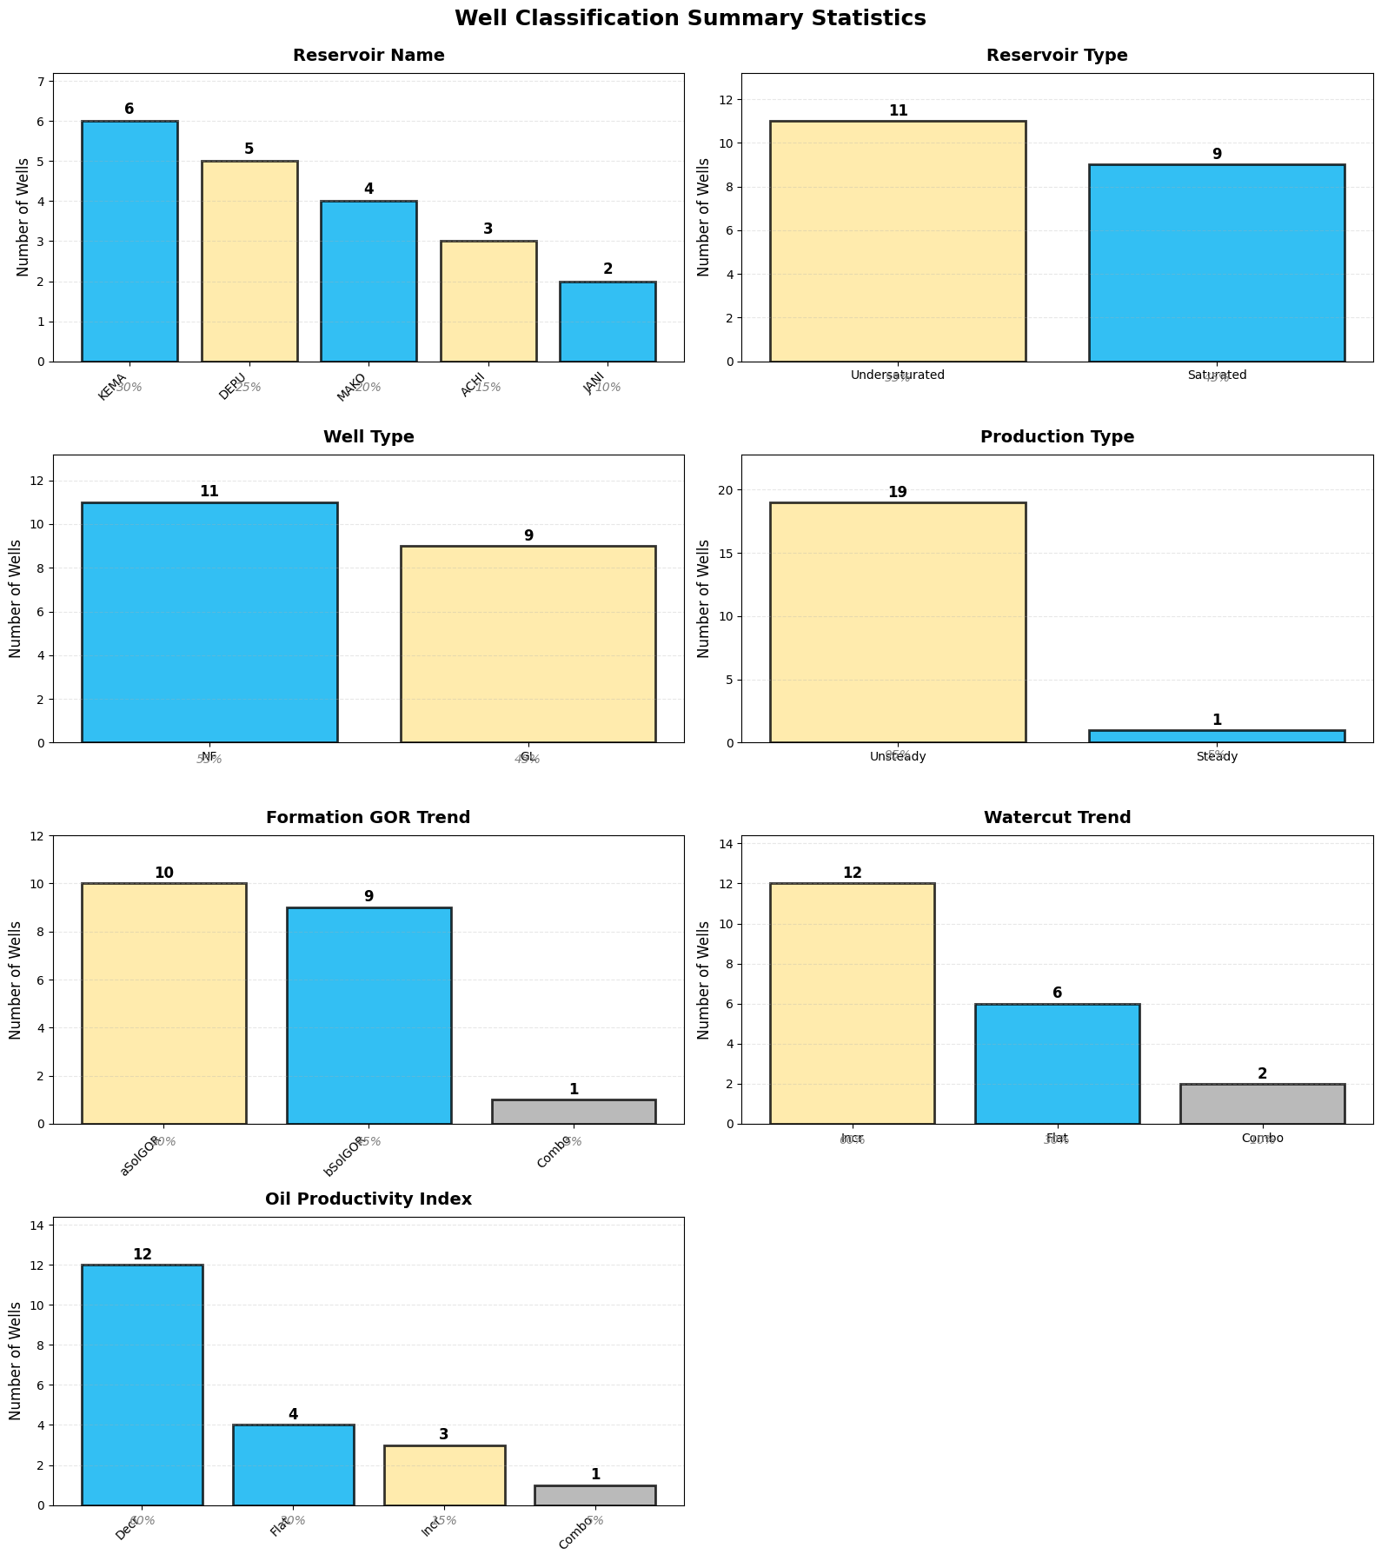
Results
10 wells above solution GOR (aSolGOR) vs 9 below (bSolGOR), with only 1 showing mixed behavior. 12 wells (60%) show increasing watercut, while only 6 maintain flat trends. This fits with the water breakthrough issues seen in the production profiles.
KEMA dominates with 6 wells, while JANI has only 2. Nearly balanced with 11 undersaturated vs 9 saturated wells, indicating different depletion stages across the field. 11 naturally flowing vs 9 gas lifted wells, a fairly healthy mix suggesting the field isn't overly depleted.

Slide 9
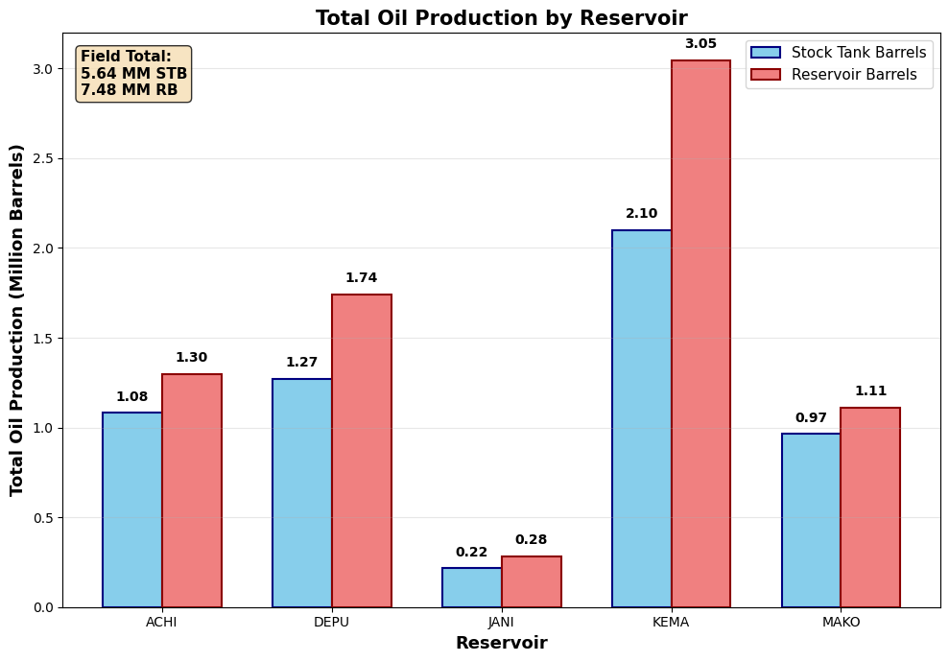
Results
Reservoir | Wells | Total Oil (Million STB) | Total Oil (Million RB) | FVF
ACHI | 3 | 1.08 | 1.30 | 1.20
DEPU | 5 | 1.27 | 1.74 | 1.37
JANI | 2 | 0.22 | 0.28 | 1.30
KEMA | 6 | 2.10 | 3.05 | 1.45
MAKO | 4 | 0.97 | 1.11 | 1.15
Total | 20 | 5.64 | 7.48
The estimate of the total oil produced (in reservoir barrels) from all 5 reservoirs is 7.48 Million

Slide 10
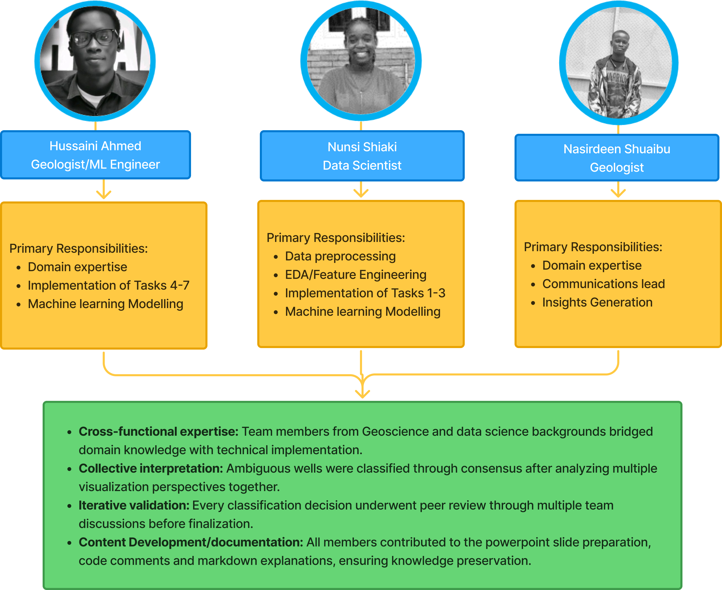
Contribution

