Slide 1
Docker

Slide 2
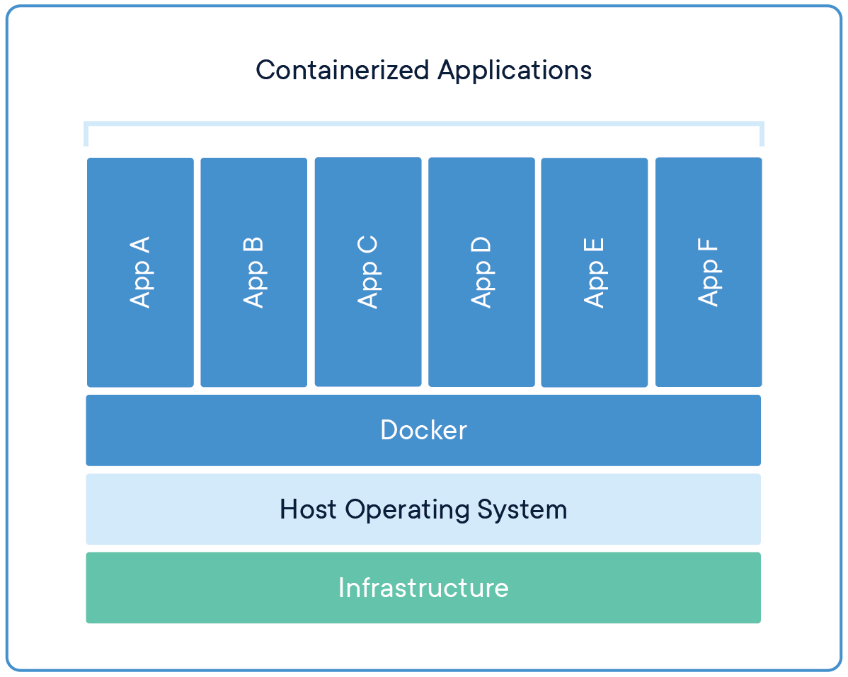
What is Docker ?
Containerization platform.
Creates, deploys, and manages isolated, lightweight "containers."
Containers package apps + dependencies for consistent execution.

Slide 3
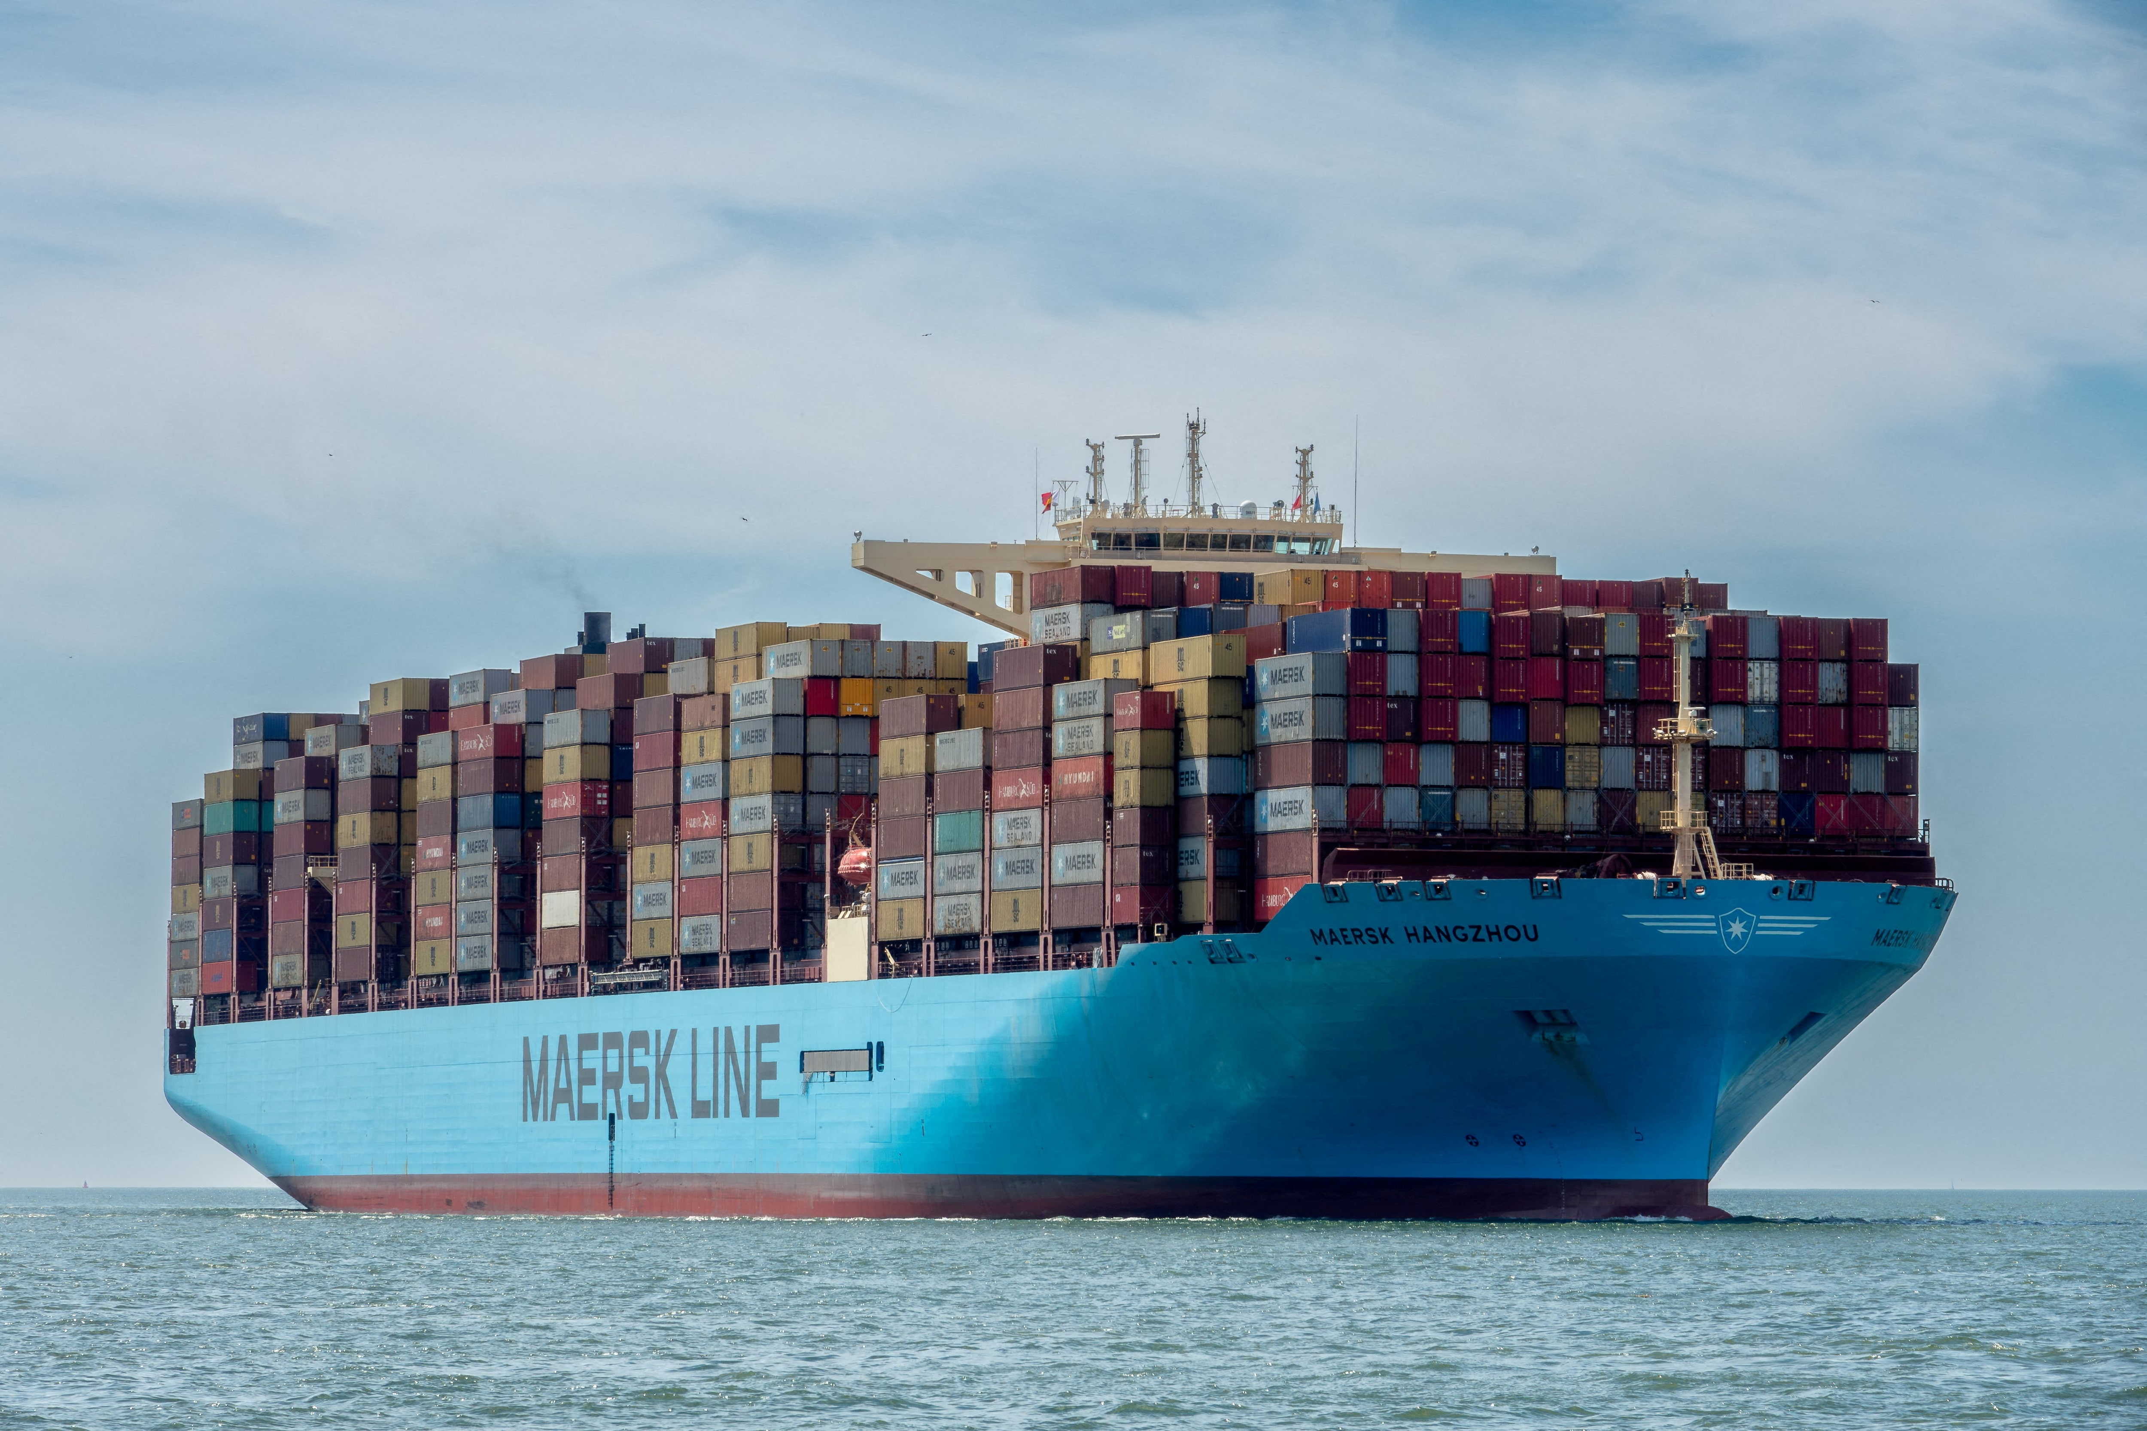
What is Docker ?
A tool to create lightweight, isolated environments ("mini computers") on your local machine.
Packages apps + dependencies into containers for consistency across environments.

Slide 4
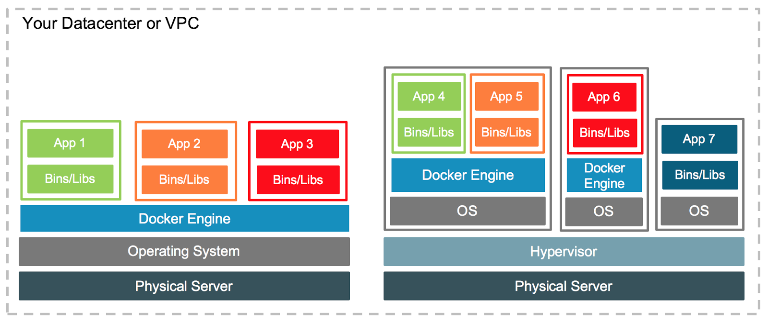
Containers vs. Virtual Machines
Containers:
Like mini computers: Share the host OS kernel (no full OS needed).
Lightweight: Fast startup, minimal resource usage.
VMs:
Full virtual machines: Emulate entire OS + hardware.
Heavy: Slower, higher resource consumption.

Slide 5
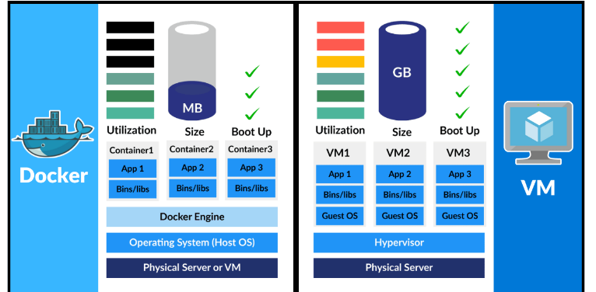

Slide 6
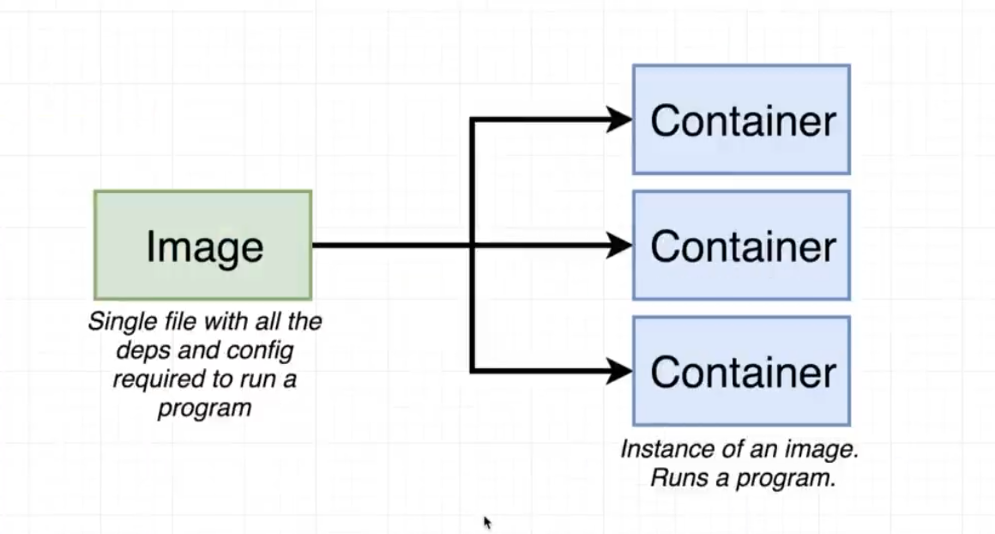
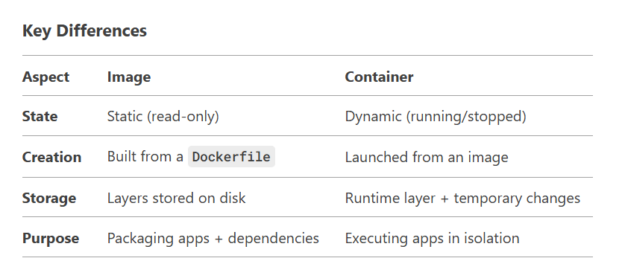
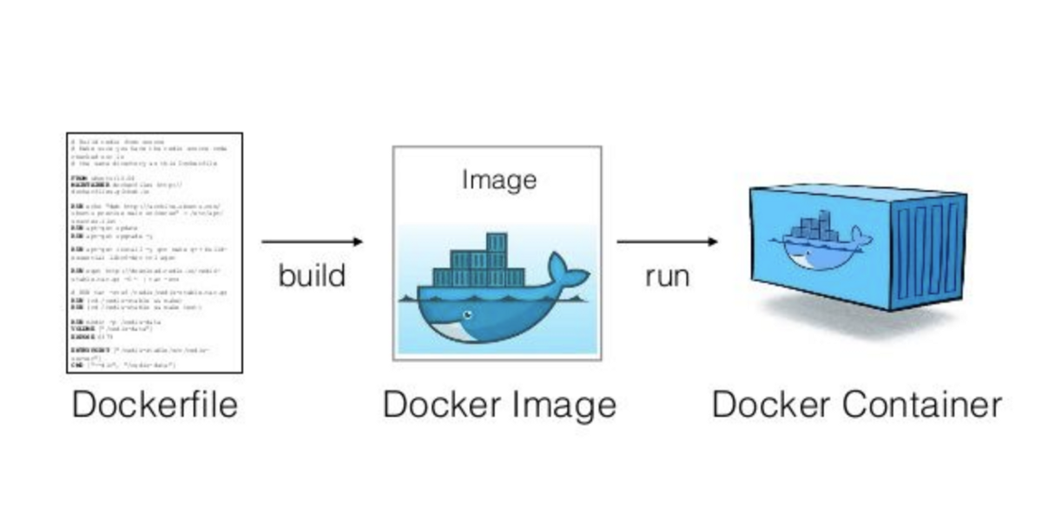
Key Differences

