Slide 1
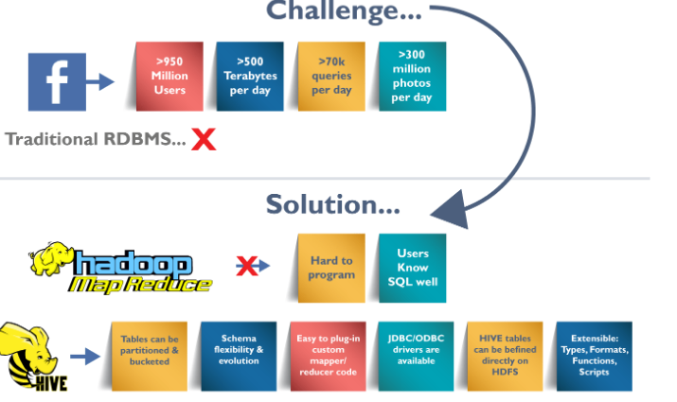
You (The User): Write SQL-like queries (HiveQL) instead of complex code. Hive’s "Translator": Converts your SQL-like commands into "MapReduce/Spark" jobs (the tools Hadoop uses). Works like a teacher turning your English essay into computer instructions. Metastore (Hive’s Notebook): Remembers where data is stored, table names, and column types (e.g., "age" is a number). Uses a database (like MySQL) to keep this info safe and organized. Hadoop (The Storage & Engine): Stores HUGE data files (in HDFS, Amazon S3, etc.). Runs the actual heavy-lifting tasks (like sorting or counting).
What’s Inside Hive?
Source :https://www.edureka.co/

Slide 2

HIVE in simple
Definition:
A tool for querying HUGE datasets stored in Hadoop (like a super-powered Excel for Big Data!).
Uses HiveQL (HQL), a SQL-like language.
Key Features:
Easy for SQL users.
Scales to petabytes of data.
Works with Hadoop (HDFS).
You speak "SQL" → Hive translates it to "Hadoop’s language" → Hadoop does the work → You get results!
SQL
Hadoop
Databank

Slide 3
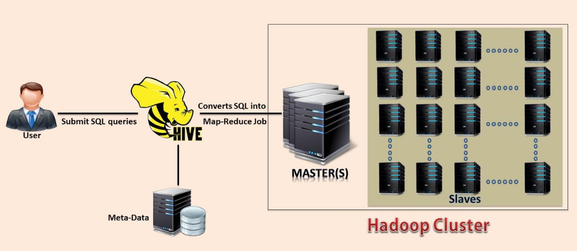
1. Not a Traditional Database Hive is not a relational database (like MySQL or Oracle). It’s not designed for operational transactions (e.g., real-time updates, banking systems). 2. Not Built for Real-Time Operations Not optimized for row-level operations: Inserts, updates, or deletes are slow and inefficient (even if supported in newer versions). Focus: Built for batch processing and large-scale analytics (e.g., data warehousing). 3. Not Suited for Interactive Queries High latency: Queries take time to execute due to: Translation of HiveQL to MapReduce/Tez/Spark jobs. Distributed processing on Hadoop clusters. Use tools like Apache Impala or Presto for low-latency queries. 4. Not Full SQL Compliance HiveQL ≠ Standard SQL: Limited support for subqueries, transactions, or advanced SQL features. Syntax and functions differ (e.g., date handling, joins). 5. Not a Replacement for OLTP Systems Use case mismatch: Ideal for OLAP (analytical workloads), not OLTP (transactional workloads). Example: Analyze terabytes of sales data, not process real-time orders.
What is NOT HIVE

Slide 4
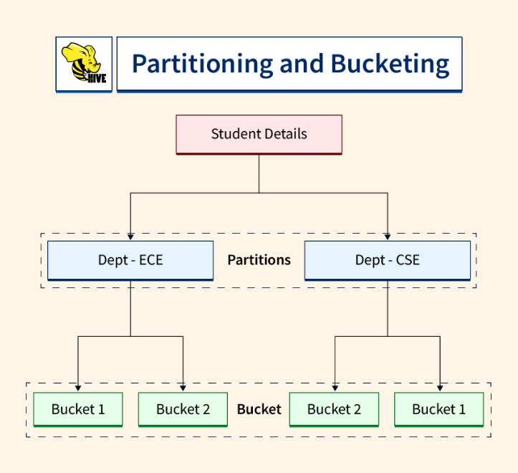
Partitioning vs Bucketing
Partitioning
Divides data into foders based on column values (e.g., date, country).
📂 Folders → year=2023 → month=01, month=02...
🚀 Speed: Skip scanning irrelevant data.
🎯 Efficiency: Queries like WHERE year=2023 read only the 2023 folder.
Bucketing
Splits data into fixed-size files (buckets) (e.g., user_id % 10).
🤝 Faster Joins: Bucketed tables join quickly (e.g., user tables with same buckets).
📊 Sampling: Easily test data (e.g., SELECT * FROM users TABLESAMPLE(BUCKET 1 OUT OF 10)).

Slide 5
Partitioning vs Bucketining
Azerbaijan
Partitionning
Naxçıvan
Qazax-Tovuz
Mərkəzi Aran
Bucketining
Babək
Ordubad,
Şahbuz
Göyçay
Kürdəmir
Ucar
Ağstafa
Gədəbəy
Qaza

Slide 6
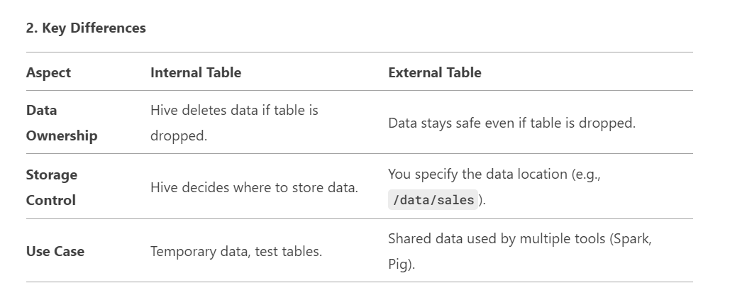
Internal Table vs External Table:
Internal Table (Managed Table):
🏠 Hive owns everything:
Manages both metadata (table structure) and data (files).
Example: Like storing your clothes in your own closet.
External Table:
📂 Hive only tracks metadata:
Manages metadata, but data is stored externally (e.g., HDFS, S3).
Example: Like tracking files in a shared Google Drive folder.

Slide 7
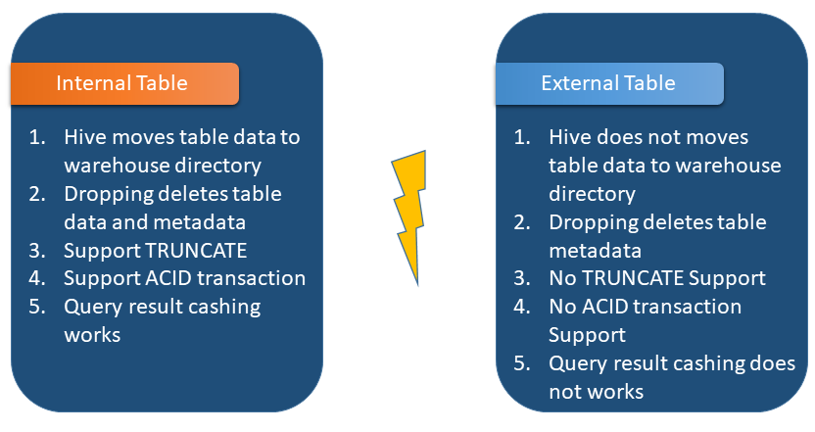
When Which table ?
Use Internal Tables If:
You want Hive to fully manage the data lifecycle.
Working with temporary/test data (e.g., staging tables).
Use External Tables If:
Data is shared across tools (Spark, Presto) or teams.
You don’t want data deleted accidentally (e.g., production data).
Internal Table = Hive is the owner (good for disposable data).
External Table = Hive is the librarian (tracks data owned by others).
Always use External Tables for critical/shared data!
Internal Table:
🗑️ Data deleted! Metadata + files removed from Hive’s storage.
External Table:
🔒 Data stays! Only metadata is deleted; files remain in /hdfs/data/sales.
Source:https://www.kamplato.kz/

Slide 8
Hive CREATE TABLE: Row Formatting
Property | What It Does | Example
ROW FORMAT DELIMITED | Defines how columns and nested data are split. | ROW FORMAT DELIMITED ...
FIELDS TERMINATED BY ',' | Columns are separated by commas (,). | "John",25,"USA"
COLLECTION ITEMS TERMINATED BY ':' | Array elements are split by colons (:). | "apple:banana:orange" → ["apple","banana","orange"]
**`MAP KEYS TERMINATED BY ' | '`** | Key-value pairs in maps are split by pipes (|). | `"name | John:age | 25"→{"name":"John","age":"25"}`
LINES TERMINATED BY '\n' | Rows are separated by newline characters. | (Default behavior for text files)
✅ Hive reads messy text files neatly.
✅ No coding needed to split columns, arrays, or maps.
❌ Wrong delimiters? Hive mixes up data (e.g., treats John,25:USA as 2 columns).
Icons: Use ✂️ (scissors) for delimiters, 📋 (clipboard) for examples.
Color-code delimiters: Red for ,, blue for :, green for |.
Animation: Reveal parsed data step-by-step (columns → arrays → maps).

