Slide 1
Infrastructure as Code (IaC)
Creating, destroying and configuring resources in a cloud or virtualization agnostic way with code.
No UI
No click
No manuel deployments
Standardization, do the same every time
Enables to use version control system
Tracks resources with state

Slide 2
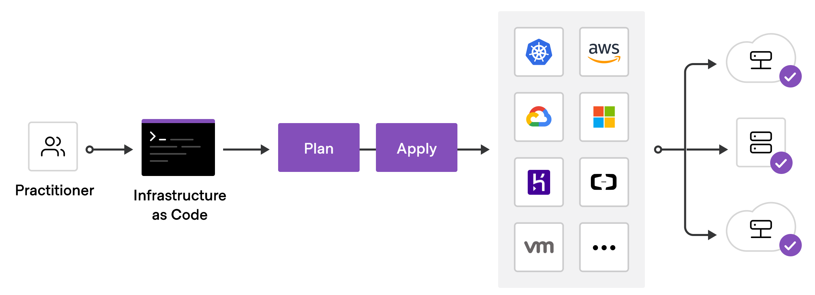
Terraform as IaC
https://developer.hashicorp.com/terraform/tutorials/aws-get-started/infrastructure-as-code

Slide 3
Terraform Providers
Hundreds of providers
AWS, Azure, Google Cloud, Oracle Cloud, Kubernetes, Docker, VMWare etc.
Recourses are VMs, networks, disks, load balancers etc.
Terraform language is declarative: Define desired state
Terraform automatically calculates dependencies of resources

Slide 4
Deploying Infrastructure with Terraform
Scope: Identify infrastructure of your project
Author: Write the configuration to define your infra
Initialize: Install the required Terraform providers
Plan: Preview the changes Terraform will make
Apply: Make the changes to your infrastructure
State file
Terraform keeps track real infrastructure in a state file
Terraform uses this file to what changes to make

