Slide 1

Predicting customers buying behavior
April 2023

Slide 2
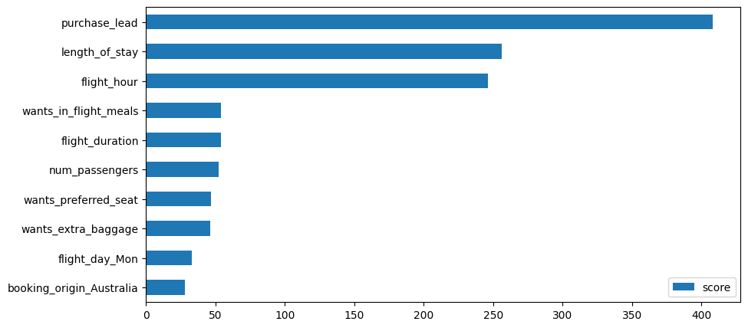
Predicting features contributing to customers buying behaviour
Top 3 features that contribute to customers buying behavior are :
Purchase_lead
Length_of_stay
Flight_hour
The model was trained using Random Forest and XGBoosting of which both performed equally well with an accuracy of 85%.

