Slide 1
Cyclistic Bike-Share Analysis — 2023
🚲
📊
Understanding Member and Casual Rider Behavior
Prepared By
Husnain Afzal
BS Data Science
Government College University Faisalabad

Slide 2
Business Problem
🎯
Cyclistic is a bike-sharing company that wants to increase the number of annual members. To achieve this goal, the company needs to understand how casual riders and annual members use its bikes differently.
Business Goal
Objective
Analyze riding behavior.
Compare members and casual riders.
Identify usage patterns.
Recommend strategies to increase memberships.
2

Slide 3
Project Workflow
CSV Files
➜
Excel
➜
MySQL
➜
Tableau
➜
Business
Recommendations
Tools Used
📗
🗄️
📊
Microsoft Excel
MySQL Workbench
Tableau Public
Data cleaning & preparation
Data querying & analysis
Interactive visualization
3

Slide 4
Dataset Overview
📁
🚲
🛠
📊
📅
Dataset
Total Rides
Cleaning
Visualization
Period
12 Monthly Files
5,714,805
Excel + SQL
Tableau
January–December 2023
The dataset contains one year of Cyclistic bike trips. Data was cleaned, validated, analyzed using SQL, and visualized in Tableau.
4

Slide 5
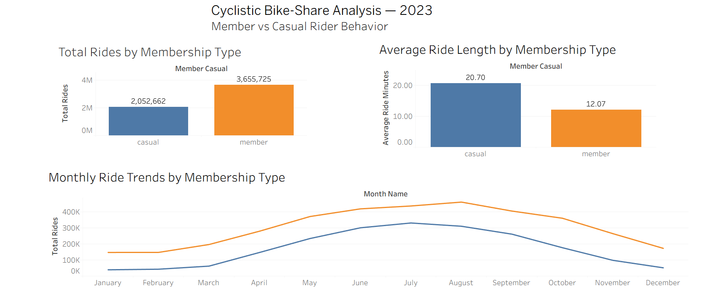
Overall Rider Behavior
Key Observations
Members completed significantly more rides.
Casual riders spent more time per ride.
Ride activity increased during summer.
Slide 5 — Rider Behavior Dashboard
Ride demand declined during winter.
5

Slide 6
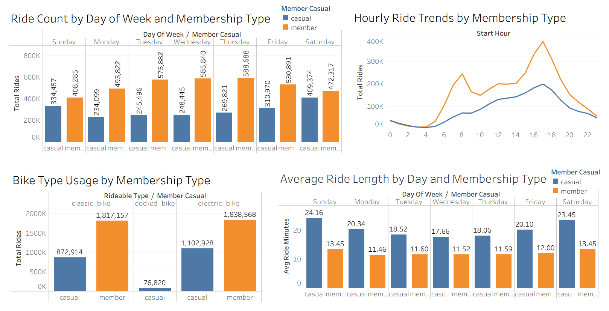
Detailed Rider Analysis
Insights
Members ride mostly on weekdays.
Casual riders ride more on weekends.
Evening hours show the highest ride activity.
Electric bikes are the most popular bike type.
Casual riders have longer average ride durations.
6

Slide 7
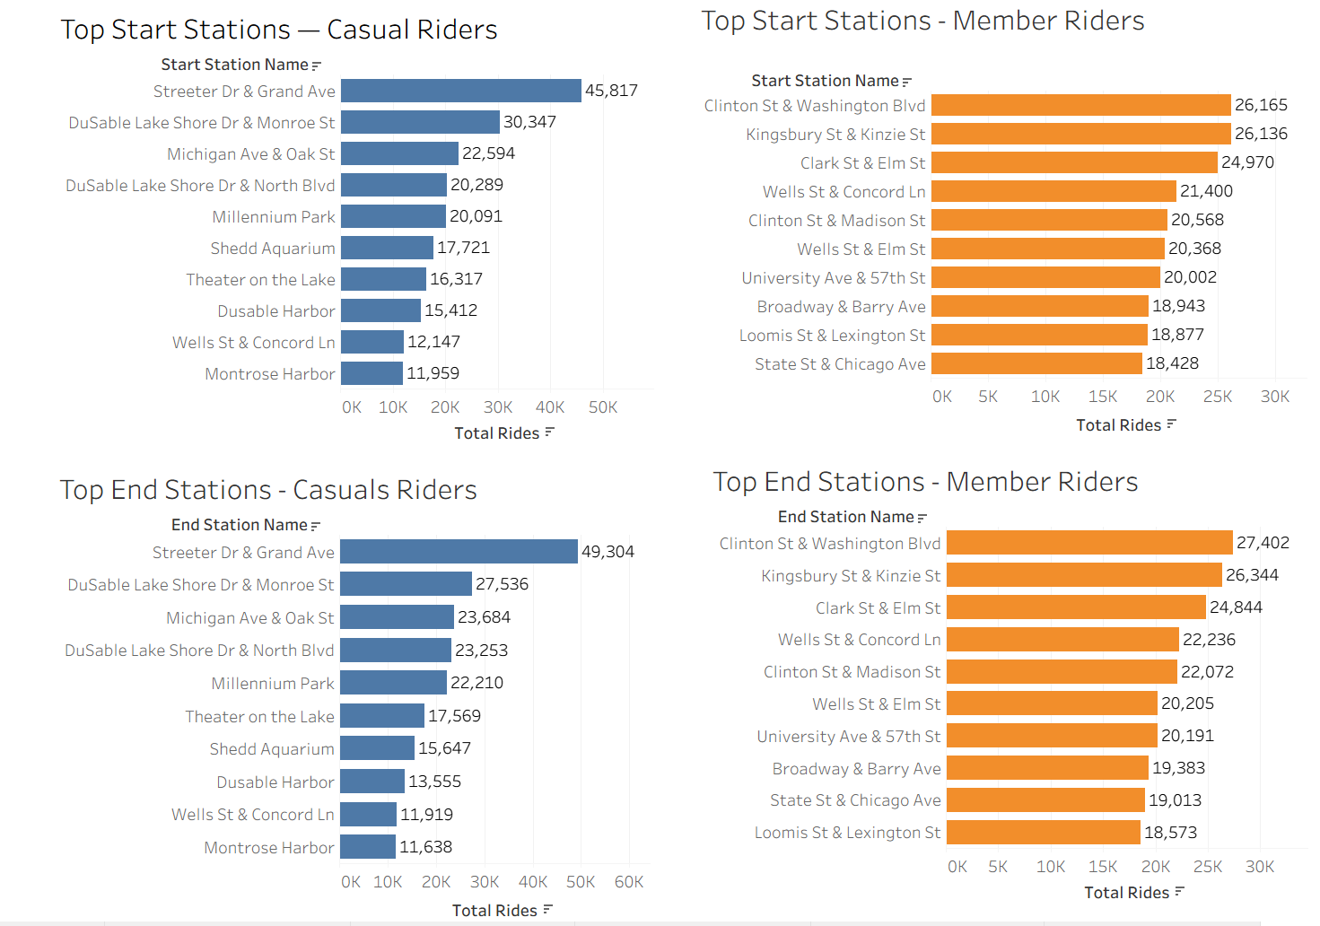
Station Analysis
Insights
Casual riders mostly start and end rides near tourist attractions.
Members frequently use business district stations.
Members have consistent commuting stations.
Casual riders travel between recreational locations.
7

Slide 8
Key Findings
3.66 Million
2.05 Million
12.07 Minutes
20.70 Minutes
Member Rides
Casual Rides
Member Average Ride
Casual Average Ride
Members ride more frequently while casual riders take longer trips.
8

Slide 9
Recommendations
🎯
Convert Frequent Casual Riders
🏖
Summer Campaigns
📍
Tourist Stations
Offer personalized membership discounts.
Launch seasonal membership promotions.
Promote memberships near popular attractions.
⚡
Electric Bikes
📱
Digital Marketing
Encourage electric bike memberships.
Target casual riders using online campaigns.
9

Slide 10
Conclusion
This analysis shows clear behavioral differences between annual members and casual riders. Members mainly use bikes for commuting, while casual riders use them for longer recreational trips. These insights can help Cyclistic design targeted marketing campaigns to convert casual riders into annual members.
10

Slide 11
Interactive Dashboard
📊
The complete interactive dashboard is available on Tableau Public.
View the Dashboard on Tableau Public
https://public.tableau.com/app/profile/husnain.afzal/viz/CyclisticBikeShareAnalysis2023
11

Slide 12
Thank You
Questions?
Husnain Afzal
BS Data Science
Government College University Faisalabad

