Slide 1
ESP32 Smart Home Automation System
Ultrasonic + DHT Sensors + Blynk IoT
Husnain – 1038 Umair -1076

Slide 2
Project Overview
- Smart home system using ESP32
- Control room light and temperature automatically
- Monitor temperature & humidity
- Remote control via Blynk app

Slide 3
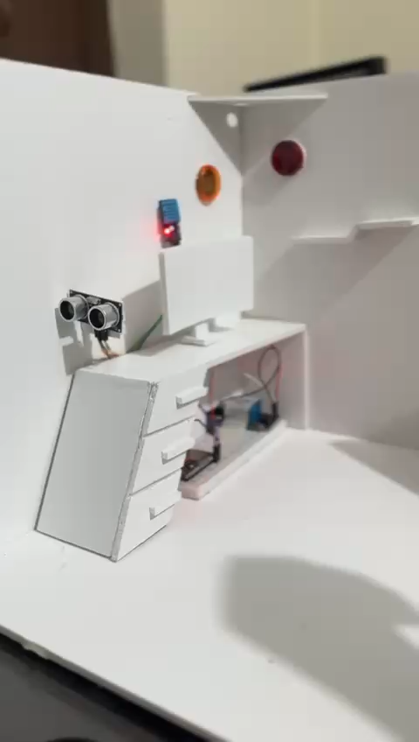
MOTION DETECTION

Slide 4
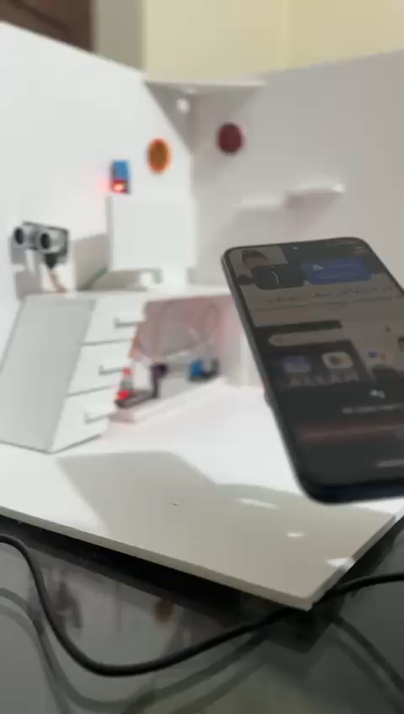
VOICE CONTROL HOME LIGHT

Slide 5
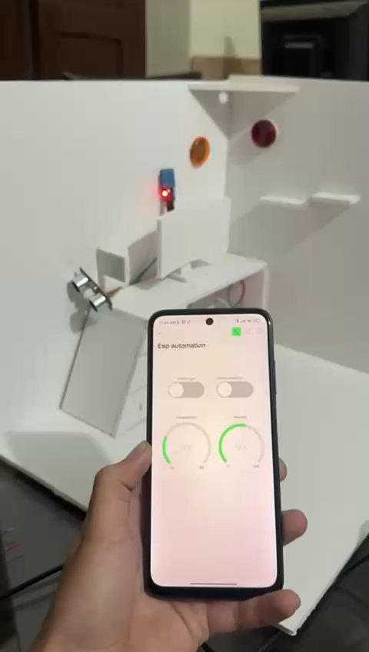
DHT READING

Slide 6
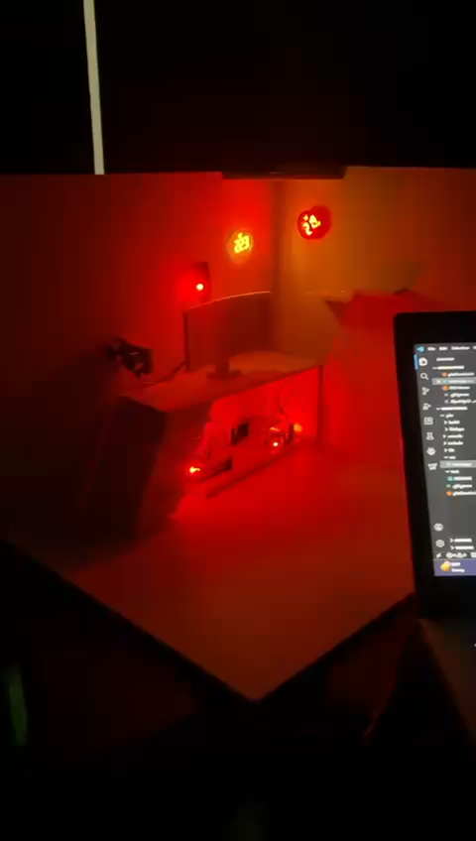
COMPLETE DESIGN

Slide 7
Components Used
- ESP32 Development Board
- DHT11 Sensor
- Ultrasonic Sensor
- Relay Modules
- Blynk IoT Platform
- Power Supply & Jumper Wires

Slide 8
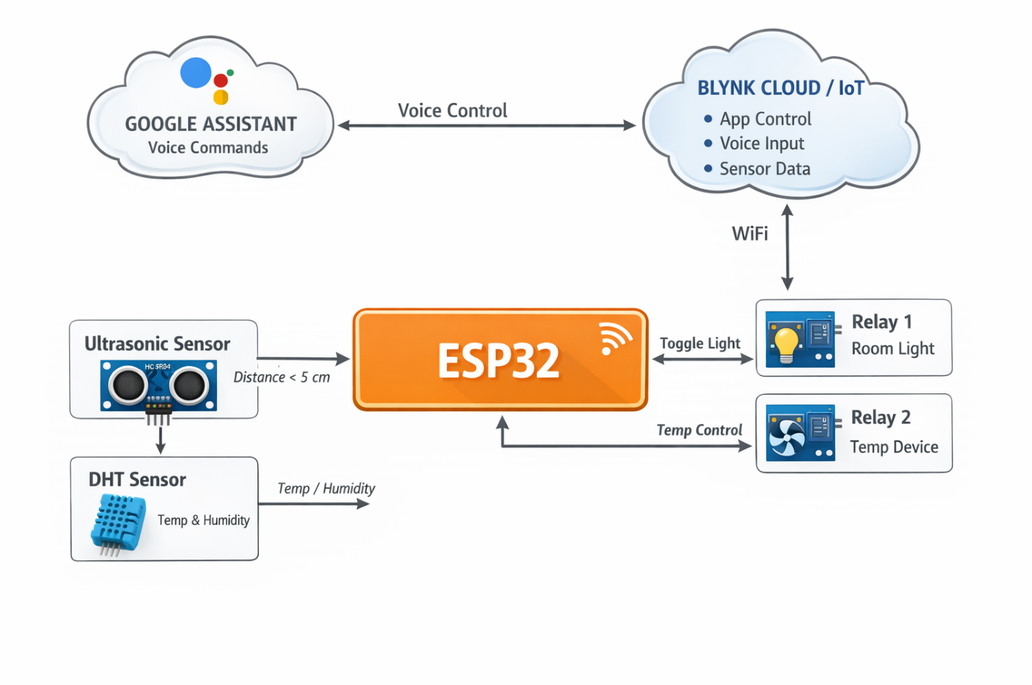
System Block Diagram

Slide 9
Working Principle
- ESP32 reads sensors continuously
- Ultrasonic sensor toggles room light automatically
- DHT sensor controls temperature relay
- Blynk app allows remote monitoring & control
- Detection lock prevents multiple triggers

Slide 10
WiFi & Blynk Connection
- ESP32 connects to home WiFi
- Blynk app linked with Auth Token
- Remote control of devices via smartphone
- Real-time updates on temperature & light status

Slide 11
Advantages
- Automation reduces manual effort
- Remote control from anywhere
- Energy-efficient with smart switching
- Simple & low-cost IoT solution

Slide 12
Applications
- Smart home lighting control
- Temperature regulation in rooms
- IoT-based monitoring & automation projects
- Educational and prototyping purposes

Slide 13
Conclusion
- ESP32 makes home automation easy & affordable
- Blynk app provides user-friendly control
- System can be expanded with more sensors & devices
- Future work: add more smart features

Slide 14
Thank You
Questions?
Email (mhusnainscoper123@gmail.com umairbuisness2005@gmail.com)

