Slide 1


Comparison Analysis of log-normal, Gamma-gamma and Exponentiated Weibull fading model for free space terrestrial link
MS Thesis Final Defense

Slide 2
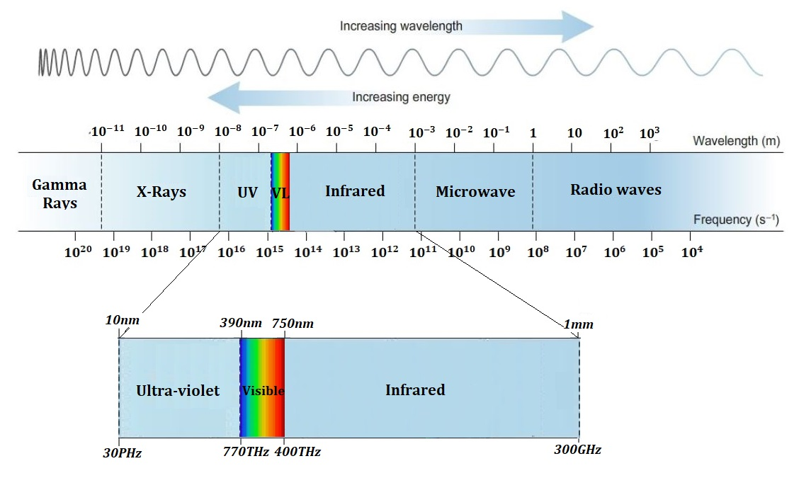
Introduction
The RF band
lies between 30 kHz and 300 GHz
licensed spectrum
Optical band
lies between 300 GHz and 30 PHz
license-free spectrum
Figure 1: Electromagnetic Spectrum

Slide 3

Advantages
Large Bandwidth
License-free spectrum
Low Power consumption
Reduced Antenna size
Robust channel security

Slide 4

Applications
Indoor Communication
Inter-chip communication in super-computers
The optical sensor-based communication
Wireless body-area-network (WBAN)
Visible Light Communication(VLC)
Passenger’s entertainment systems in vehicles
Light fidelity (Li-Fi) networks

Slide 5
Applications
Terrestrial Communication
In Metropolitan Area Network extension
Unmanned Aerial Vehicles(UAVs)
In Intelligent Transportation Systems (ITS)
Enterprise connectivity
Fibre back-up
Back-haul for cellular networks
Network disaster recovery

Slide 6
Applications
Satellite Communication
Inter-satellite communication
Satellite to ground station
Ground to Satellite communication
Satellite to Unmanned Aerial Vehicles(UAVs)
Deep space communication

Slide 7
Challenges
Adverse weather conditions: such as rain, snow sleet, fog, haze, smog and pollution which causes attenuations and scattering of the transmitted signal.
Pointing errors: pointing and misalignment loss due to building sways.
Atmospheric Turbulence: Random fluctuations in the refractive index, which causes the perturbation of the optical intensity as the signal propagate through the atmosphere.
Note: In this thesis we will focus only on Atmospheric Turbulence.

Slide 8
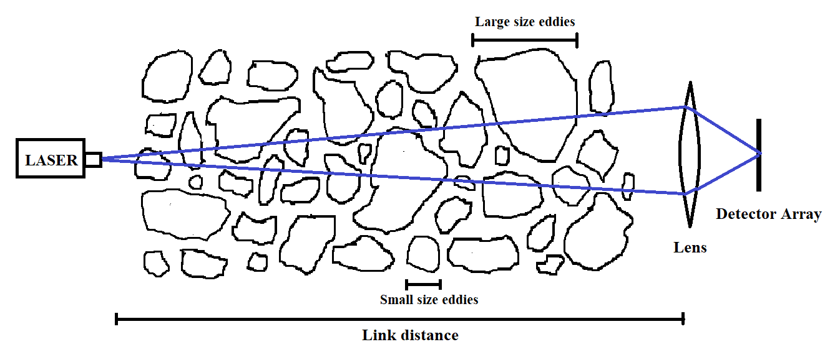
Atmospheric Turbulence
When the laser beam is propagating through these eddies then they will act like a prism or a lenses causing it to deflect, spread along the different paths.
Laser beam propagating through turbulent atmosphere

Slide 9
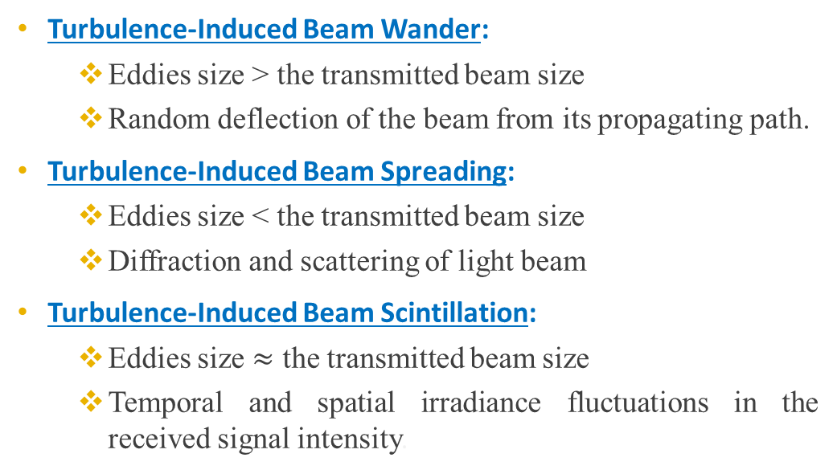
Atmospheric Turbulence
Effects
Turbulence-Induced Beam Wander:
Eddies size > the transmitted beam size
Random deflection of the beam from its propagating path.
Turbulence-Induced Beam Spreading:
Eddies size < the transmitted beam size
Diffraction and scattering of light beam
Turbulence-Induced Beam Scintillation:
Eddies size $≈$ the transmitted beam size
Temporal and spatial irradiance fluctuations in the received signal intensity.

Slide 10
Fading Models
Literature Review
In 1969, D.A. DeWolf experimentally investigates the light propagation through turbulent air and proposed the log-normal statistics to model irradiance fluctuation [40].
In 1974 T. Wangt and J.W. Strohbehn points out that the log-normal performs well in weak turbulence and does not fit with experimental data for strong turbulence [41].
In 1979 Parry and Puaey experimentally investigate the fluctuation in the light irradiance for various link distances [42]. They conclude that
For link distances L ≲ 200 m, irradiance fluctuations follow log-normal distribution.
For L = 500-700 m, P(I) described by K-distribution.
For intermediate values of link distances, the distributions of irradiance fluctuations was fell between log-normal and K-distribution.

Slide 11
Fading Models
Literature Review
In 1985 Andrews and Phillips introduced the I-K distributions as a generalization of K-distribution which is capable of described the statistics under all turbulence regimes[43].
In 1987 Churnside and Clifford introduces the log-normal Rician distribution to model the optical scintillation which is also known as Beckmann’s distributions [44].
All the above models are based on single-family of distribution but soon it was realized that the statistics of light irradiance could not be exactly described using a single family of distribution due to the non-stationary nature of the atmospheric turbulence.

Slide 12
Fading Models
Literature Review
In 2001 Al-Habash, Andrews and Phillips develop gamma-gamma(GG) model for the irradiance fluctuations based on doubly-stochastic theory of scintillation, in which both the small-scale and large-scale fluctuations are modeled by gamma distribution [45].
GG model is an accurate model for all turbulence regimes in case of point receiver but does not performs well under aperture averaging data [46].
In 2012, Barrios and Federico proposed Exponentiated Weibull distribution which shows an excellent fit to simulation and experimental data under all aperture averaging conditions as well as point aperture size under weak and moderate turbulence conditions [47].

Slide 13
Problem Statement
In this thesis we will compare the Gamma-gamma and Exponentiated Weibull Fading models and try to establish the accuracy of these models under various conditions of
Different operating wavelengths
Aperture sizes
Varying link distances

Slide 14
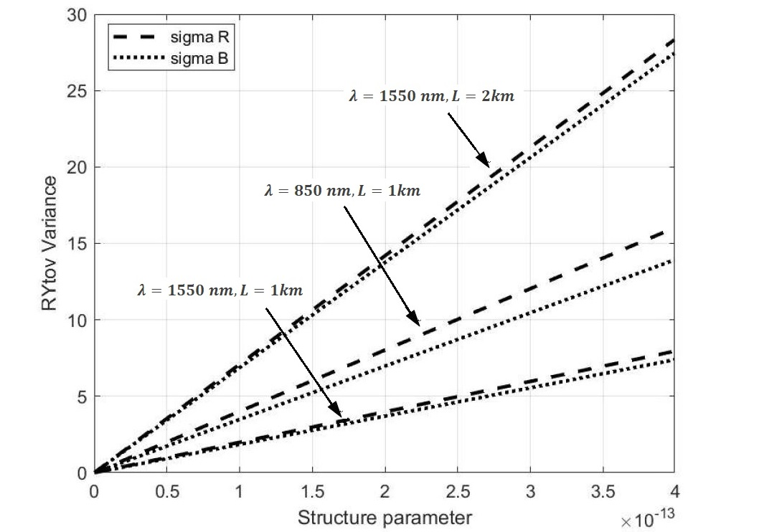
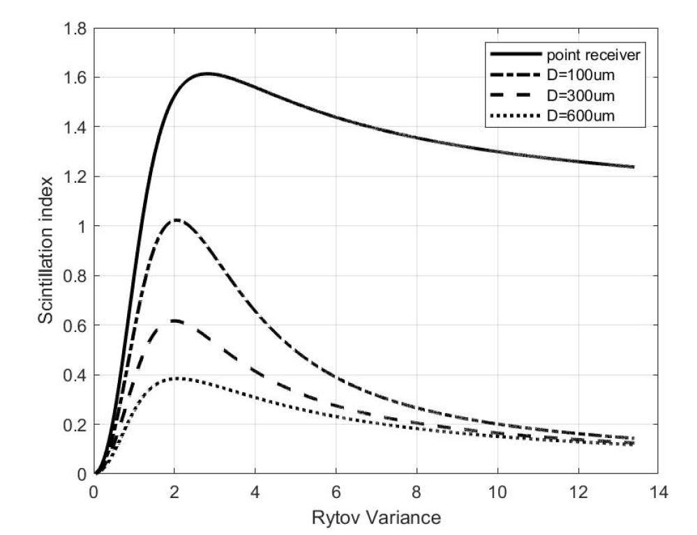
Parameters
Used in Fading Models
Rytov Variance
Scintillation index
Measure of strength of turbulence fluctuations.
Normalized variance of intensity fluctuations.

Slide 15
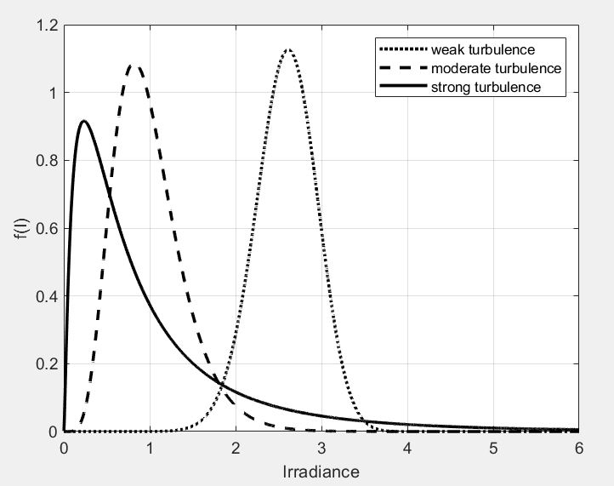

Exponentiated Weibull Distribution
Fading Model
Consider the Gaussian beam of mono-chromatic light of wavelength $1550 nm$ propagating through a link distance of $1 km.$
Note: All results were plotted by assuming the point receiver.
In case of weak turbulence regimes pdf curve looks like a parabola and for the increasing values of turbulence the peak of probability density is shifted towards left side and in case of strong turbulence its right tail is looks like a negative exponential.
Probability density function for the weak, moderate and strong turbulence regimes.
MS thesis Final Defense

Slide 16
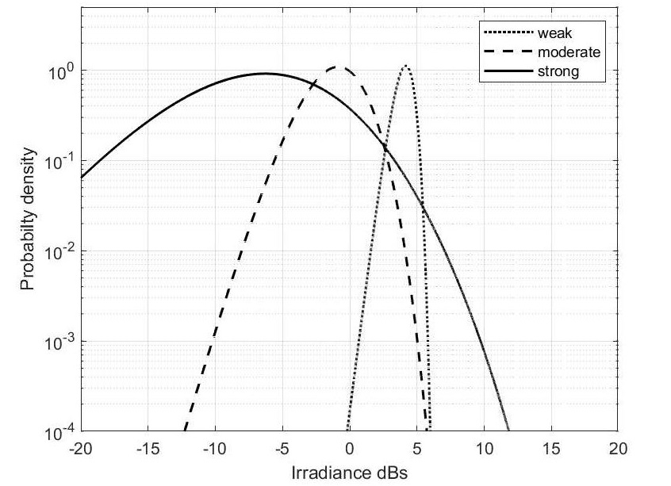
Exponentiated Weibull Distribution
Fading Model
The results are best shown on logarithmic scale where abscissa is the normalized irradiance measured in decibel.
Note: All results were plotted by assuming the point receiver.
On log-log scale the pdf of the irradiance looks like a upside down parabola which is physically correct; the tails of the parabola represent low probability events such as deep fades and peak surges.
Representation of Exponentiated Weibull Distribution on Log-log scale
MS thesis Final Defense

Slide 17
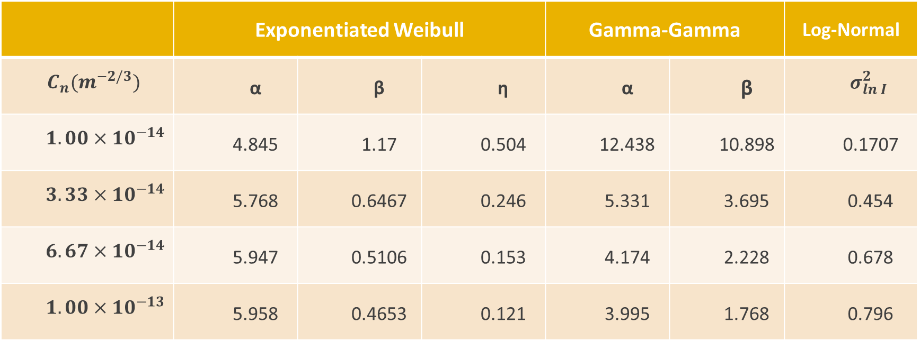
Comparison of Fading Models
PDF Parameters
 | Exponentiated Weibull |  |  | Gamma-Gamma |  | Log-Normal
$$C_{n}(m^{−2/3})$$ | α | β | η | α | β | $$σ_{ln I}^{2}$$
$$1.00×{10}^{−14}$$ | 4.845 | 1.17 | 0.504 | 12.438 | 10.898 | 0.1707
$$3.33×{10}^{−14}$$ | 5.768 | 0.6467 | 0.246 | 5.331 | 3.695 | 0.454
$$6.67×{10}^{−14}$$ | 5.947 | 0.5106 | 0.153 | 4.174 | 2.228 | 0.678
$$1.00×{10}^{−13}$$ | 5.958 | 0.4653 | 0.121 | 3.995 | 1.768 | 0.796
PDF parameters for Exponentiated Weibull, Gamma-gamma and Log-normal distribution
MS thesis Final Defense

Slide 18
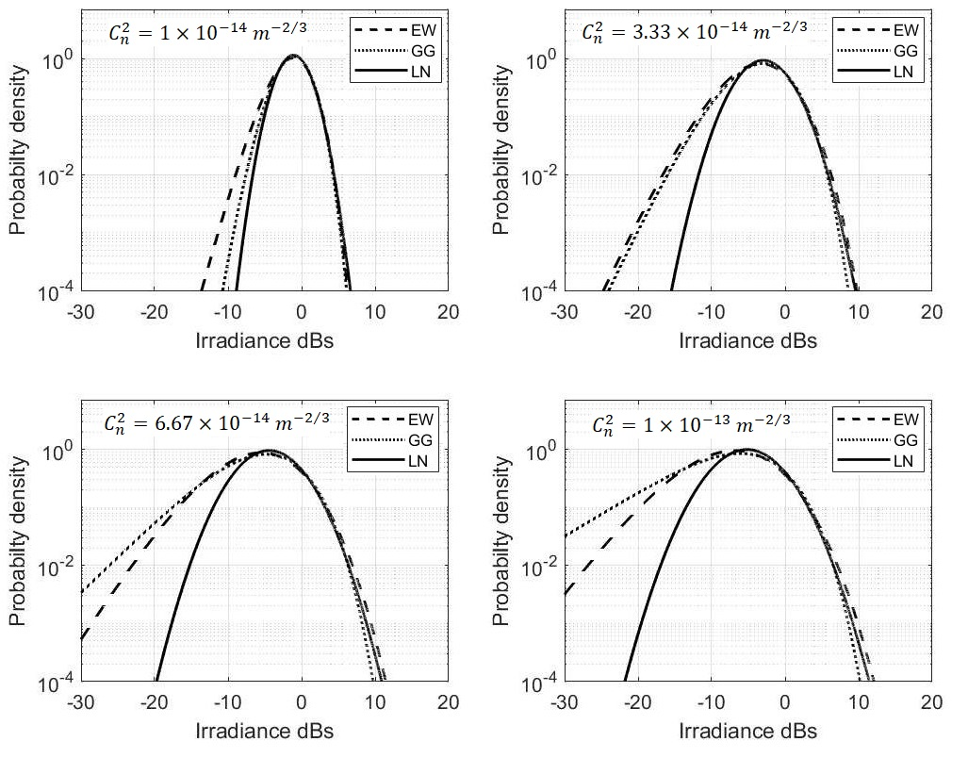
Comparison of Fading Models
Under Various Turbulence levels
It should be noted the Exponentiated Weibull and gamma-gamma models were very close on the other log-normal deviate from these curves and this deviation becomes large in case strong turbulence regimes specially the left tail that is why the log-normal is unable to explain the irradiance statistics in case of strong turbulence.
It is noted that from the weak to strong turbulence the variance of irradiance intensity increases.
Comparison of log-normal, gamma-gamma and Exponentiated Weibull fading models under various Turbulence regimes.
MS thesis Final Defense

Slide 19
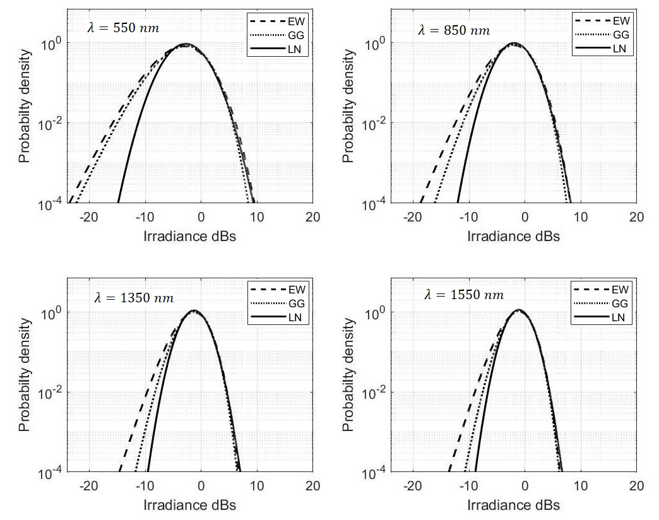

Comparison of Fading Models
Under Wavelength Diversity
Comparison is done for four operating wavelengths 550 nm, 850 nm, 1350 nm and 1550 nm. In order to compare the results all of the plots were created for fixed path length 1km and atmospheric structure parameter $C_{n}^{2}$ ${=10}^{−14}{ m}^{{−2}/3}$.
It is clear from the figure, with the increase of wavelength variance of irradiance intensity decreases which anticipated that higher wavelength is suitable for free space optical communication.
Comparison of log-normal, gamma-gamma and Exponentiated Weibull fading models under wavelength diversity.
MS thesis Final Defense

Slide 20
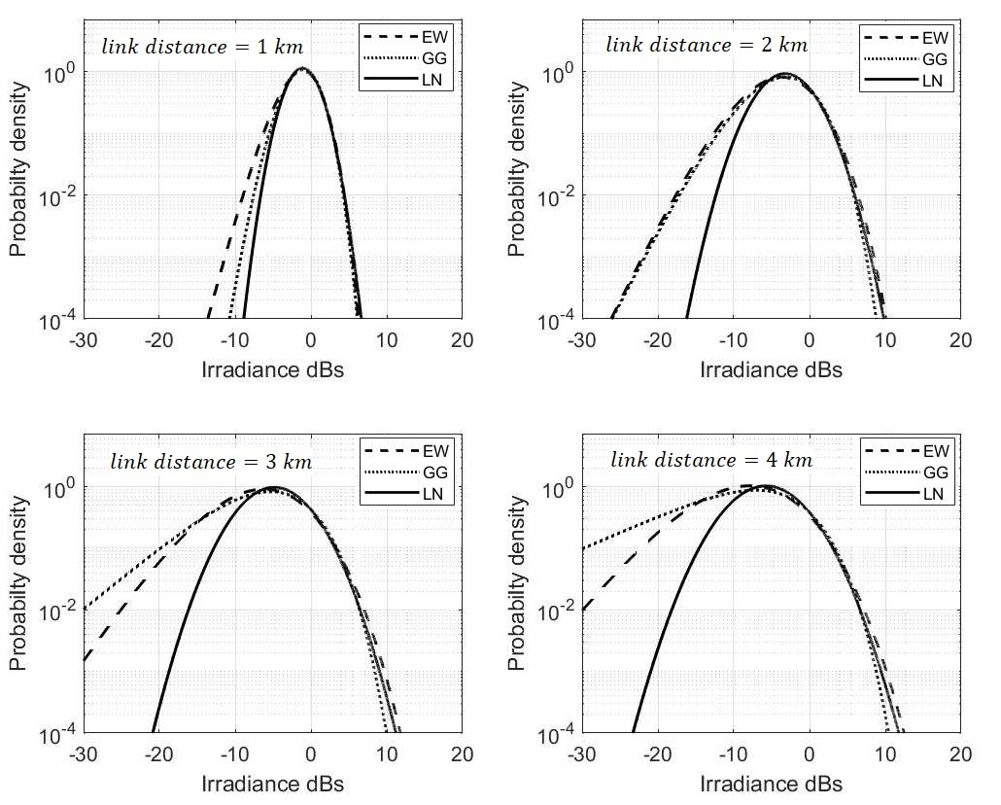

Comparison of Fading Models
Under Various link Distances
Comparison is done for four link distances (1-4 km). In order to compare the results all of the plots were created for fixed wavelength of 1550 nm and atmospheric structure parameter $C_{n}^{2}$ ${=10}^{−14}{ m}^{{−2}/3}$.
It is clear from the figure, with the increase of link distance variance of irradiance intensity increases which is according to the fact that longer link distance will suffer more signal fading.
Comparison of log-normal, gamma-gamma and Exponentiated Weibull fading models for various link distances.
MS thesis Final Defense

Slide 21
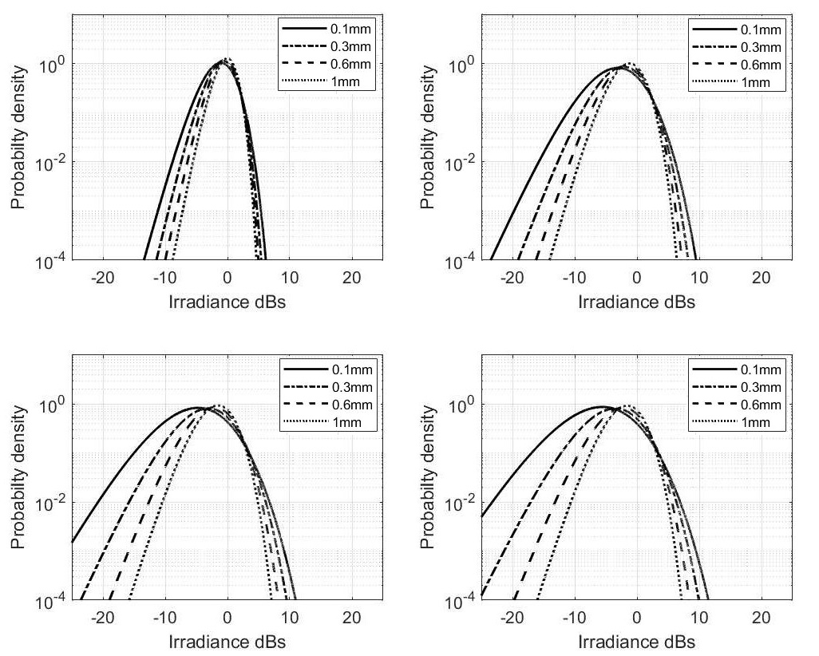

Exponentiated Weibull Distribution
Using Aperture Averaging
Comparison is done for four aperture diameters ($0.1mm$, $0.3mm$, $0.6mm$ and $1mm$). All of the plots were created for fixed wavelength of $1550nm$, link distance of $1km$ and atmospheric structure parameter $C_{n}^{2}$ ${=10}^{−14}{ m}^{{−2}/3}$.
It is clear from the figure, with the increase of aperture diameter variance of irradiance intensity decreases which anticipated that larger aperture diameter is less effected by the atmospheric turbulence.
Effect of Aperture Averaging
MS thesis Final Defense

Slide 22

Exponentiated Weibull Distribution
Comparison using Experimental Data
For completeness of this comparison study simulation results are compared with the experimental data which is extracted from Wayne et al’s paper [46].
The experiment was performed at Kennedy Space Centre, Florida.
Link distance is $980m$.
The transmitter end consists of a coherent solid-state continuous-wave laser of wavelength $532nm$.
Atmospheric Structure parameter ${(C}_{n})$ ranges from $5.00×{10}^{−14}$ $m^{−2/3}$ to $3.70×{10}^{−13}$ $m^{−2/3}$.
Aperture Diameter sizes vary from $4mm$ to $154mm$.
The data was collected on Oct 2, 2009 from 13:00 EST to 16:30 EST at the ISTEF laser range.
MS thesis Final Defense

Slide 23
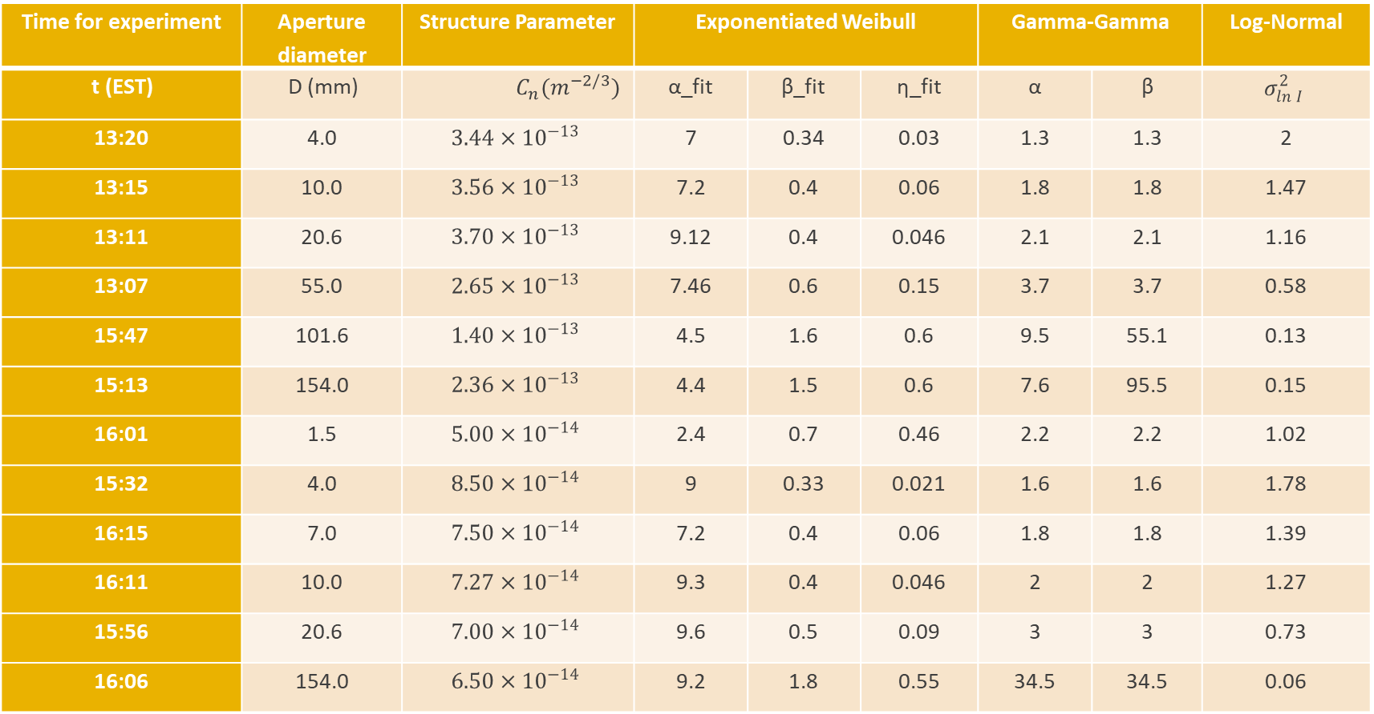
Time for experiment | Aperture diameter | Structure Parameter | Exponentiated Weibull |  |  | Gamma-Gamma |  | Log-Normal
t (EST) | D (mm) | $$C_{n}(m^{−2/3})$$ | α_fit | β_fit | η_fit | α | β | $$σ_{ln I}^{2}$$
13:20 | 4.0 | $$3.44×{10}^{−13}$$ | 7 | 0.34 | 0.03 | 1.3 | 1.3 | 2
13:15 | 10.0 | $$3.56×{10}^{−13}$$ | 7.2 | 0.4 | 0.06 | 1.8 | 1.8 | 1.47
13:11 | 20.6 | $$3.70×{10}^{−13}$$ | 9.12 | 0.4 | 0.046 | 2.1 | 2.1 | 1.16
13:07 | 55.0 | $$2.65×{10}^{−13}$$ | 7.46 | 0.6 | 0.15 | 3.7 | 3.7 | 0.58
15:47 | 101.6 | $$1.40×{10}^{−13}$$ | 4.5 | 1.6 | 0.6 | 9.5 | 55.1 | 0.13
15:13 | 154.0 | $$2.36×{10}^{−13}$$ | 4.4 | 1.5 | 0.6 | 7.6 | 95.5 | 0.15
16:01 | 1.5 | $$5.00×{10}^{−14}$$ | 2.4 | 0.7 | 0.46 | 2.2 | 2.2 | 1.02
15:32 | 4.0 | $$8.50×{10}^{−14}$$ | 9 | 0.33 | 0.021 | 1.6 | 1.6 | 1.78
16:15 | 7.0 | $$7.50×{10}^{−14}$$ | 7.2 | 0.4 | 0.06 | 1.8 | 1.8 | 1.39
16:11 | 10.0 | $$7.27×{10}^{−14}$$ | 9.3 | 0.4 | 0.046 | 2 | 2 | 1.27
15:56 | 20.6 | $$7.00×{10}^{−14}$$ | 9.6 | 0.5 | 0.09 | 3 | 3 | 0.73
16:06 | 154.0 | $$6.50×{10}^{−14}$$ | 9.2 | 1.8 | 0.55 | 34.5 | 34.5 | 0.06
MS thesis Final Defense

Slide 24
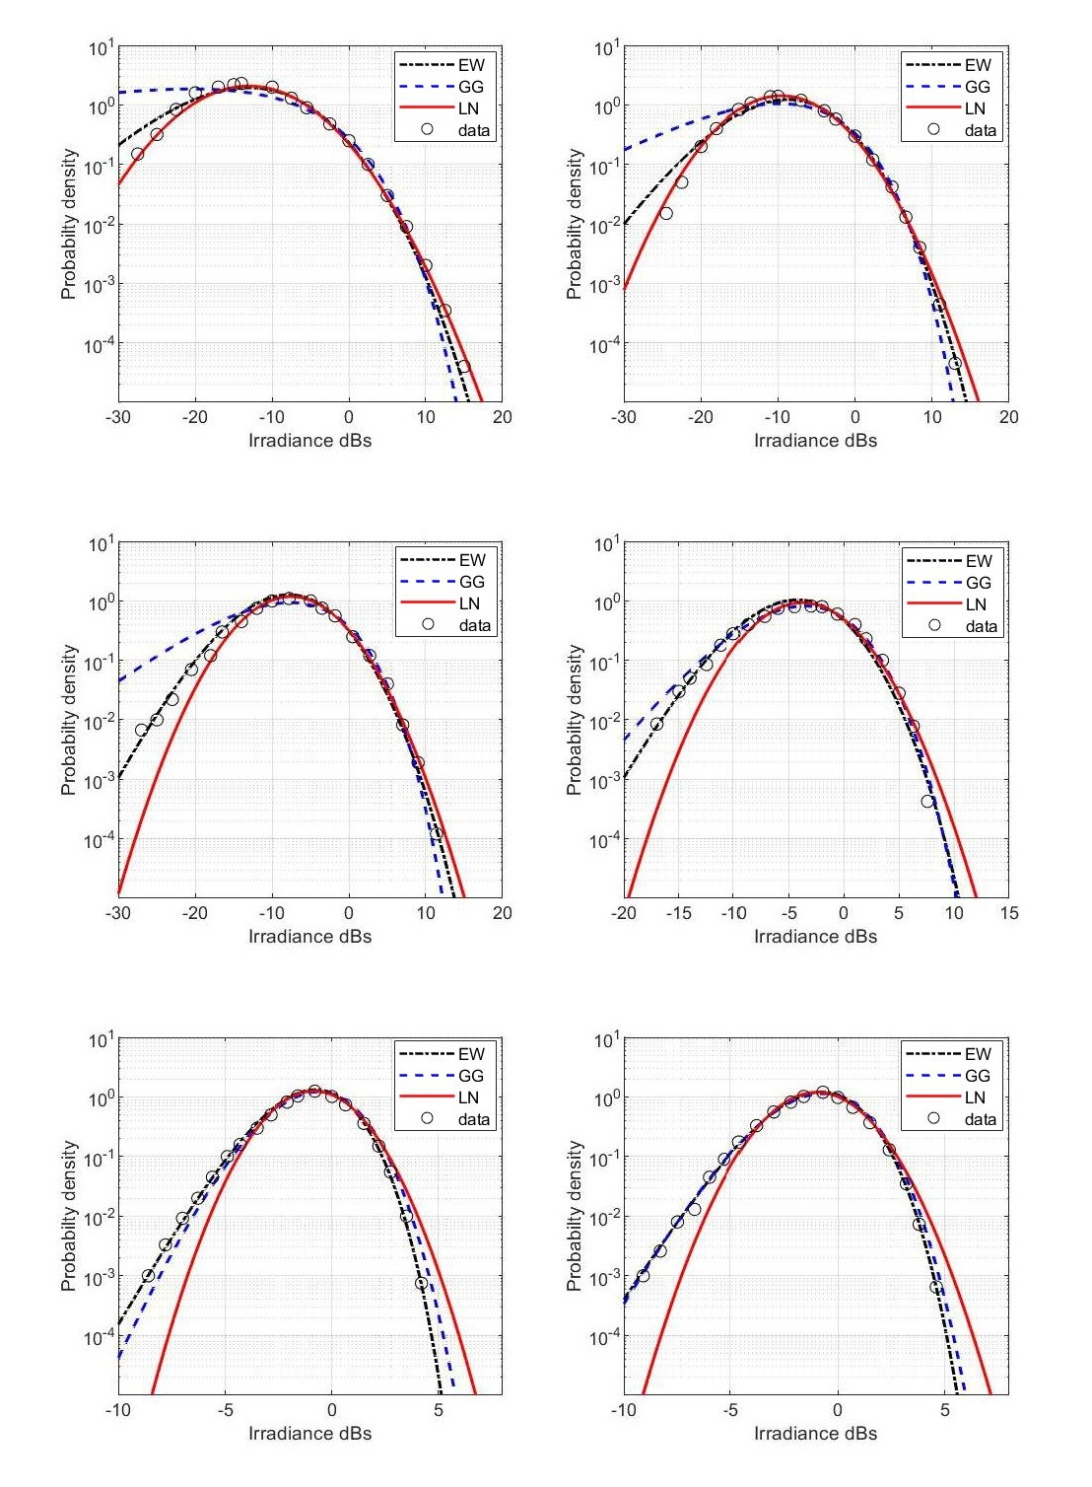
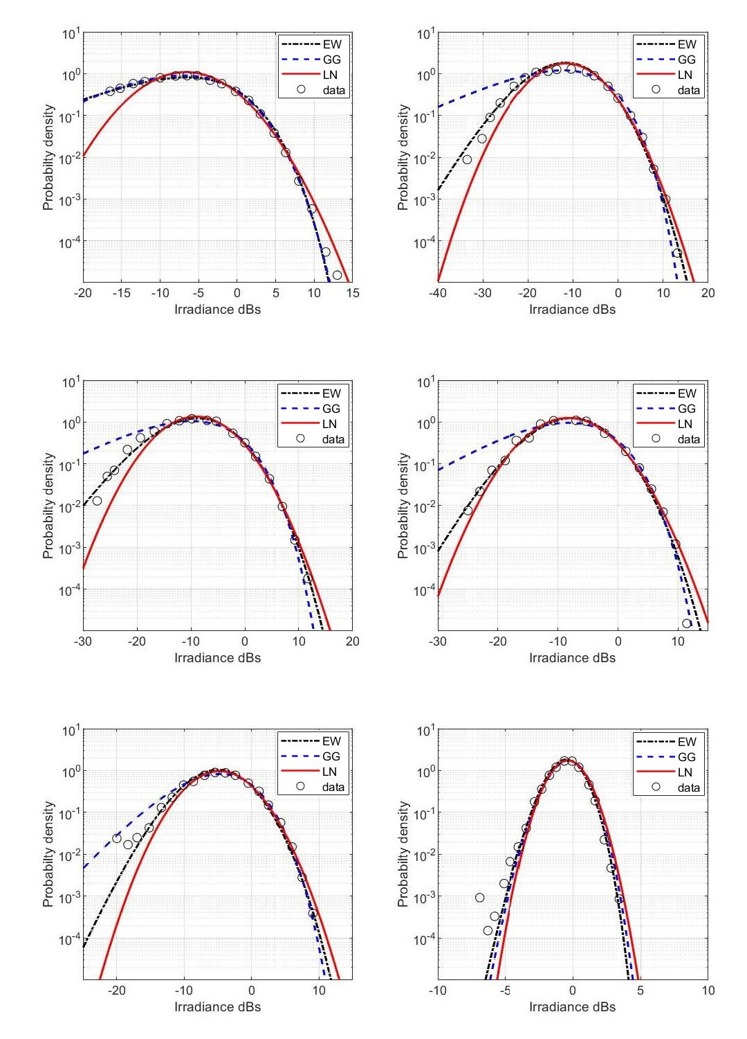
MS thesis Final Defense

Slide 25
Conclusion
The comparison of the results of Exponentiated Weibull fading model with the LN and GG models is done by assuming the same and varying conditions of turbulence level, wavelength, link distance. It has been observed that the Exponentiated Weibull and gamma-gamma models were very close, while, log-normal deviate from these curves and this deviation becomes large in case strong turbulence regimes specially the left tail that is why the log-normal is unable to explain the irradiance statistics in case of strong turbulence.
Moreover, the accuracy of log-normal, gamma-gamma and Exponentiated Weibull model is compared under varying conditions of link distance, wavelength and different aperture sizes. It has been observed that by increasing the link distance, decreasing wavelength and decreasing aperture size the variance of irradiance intensity increases and results in the reduced accuracy.
In the last section, the results of Exponentiated Weibull, log-normal and gamma-gamma fading are analyzed with the experimental data extracted from the Wayne et al’s paper [46]. The results show that the EW fading model presents the better fit for data under different aperture averaging conditions.
MS thesis Final Defense

Slide 26
Thank You
Husnain Shabbir
0332 7525600
l175177@lhr.nu.edu.pk

