Slide 1

Friendship

Slide 2


Why is friendship good?
Why is friendship good?
➤Life would be lonely, desolate
➤It is as necessary to the spirit as food is to the body
➤All cultures tell us of it and praise it
➤ Scriptures
➤Makes us laugh, listens to us, lends a hand, is fun, consoles

Slide 3

Best Friend
➤Tell anything about self, hopes, dreams, fears
➤ Keeps secrets
➤ Can say anything in conversation
➤Never lies, either to or for
➤ Really listens in conversation
➤Can always count on
➤Shares interest
➤Developed over time
➤ Lucky to have a few

Slide 4
Definition of friendship
What is a friend? --- We have chemistry! We enjoy each other's company.
We trust, understand, respect and appreciate each other.
We like how we feel when we're together. We are close even when we are apart.
We look forward to being together. We commit over some time.
We give to each other. We may not give in the same way but
what we give and what we receive is of great value to each of us.

Slide 5
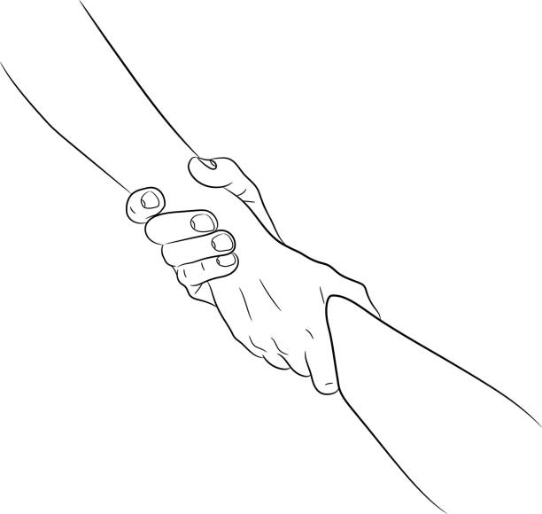
A strong friendship doesn't
need daily conversation,
doesn't always need
togetherness, as long as the
relationship lives in the
heart, true friends will
never part.

Slide 6





Fake friends
may want you to do well
but not better than them
Real friends
share your Joy and are happy
when you are happy

Slide 7

Thank you for watching
Creator: A.Fariza

