Slide 1

ONCOSCAN: AI Cancer Detection
Welcome to ONCO SCAN, an AI-powered solution for early and accurate cancer detection. Utilizing advanced image analysis to assist healthcare professionals in diagnosis and treatment planning.
GROUP#7 Husnain Haider Muhammad Abdullah Khan Alishba Shahzad Ruvaiba Shafqat Naima Fawad

Slide 2

Cancer Types:
ONCO SCAN provides AI-powered detection for eight different types of cancer, enabling comprehensive medical screening across multiple body systems.
Oral Cancer
Cervical Cancer
Brain Cancer
Blood Cancer
Detects oral abnormalities
Screens cervical tumors
Detects abnormalities in brain
Screens blood cancer
Breast Cancer
Colon Cancer
Lung Cancer
Skin Cancer
Detects abnormalities in breast
Screens colon tumors
Detects abnormalities in lung
Screens skin cancer

Slide 3

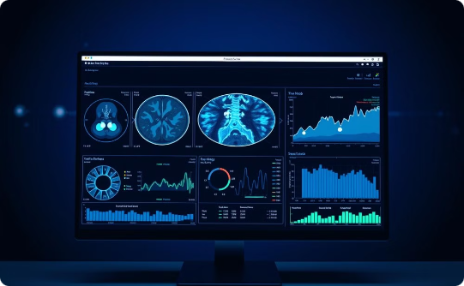

Model Functionality :
Tumor Classification
Image Analysis
Accuracy
Advanced AI algorithms classify tumors into benign or malignant categories, providing crucial diagnostic information for healthcare professionals.
Automated AI-driven system processes and analyzes medical images with sophisticated computer vision algorithms.
High-precision detection system delivers accurate diagnostic results, supported by advanced machine learning validation.
Our model enhances diagnostic capabilities through tumor classification.

Slide 4




Website Functionalities :
Precise Accuracy
Reducing Human Error
Speedy Diagnosis
Assisting Screening
Minimizes false positives/negatives.
Facilitates prompt treatment.
Optimizes screening programs.
Automates image analysis.
Key features designed for efficient and reliable cancer detection.

Slide 5




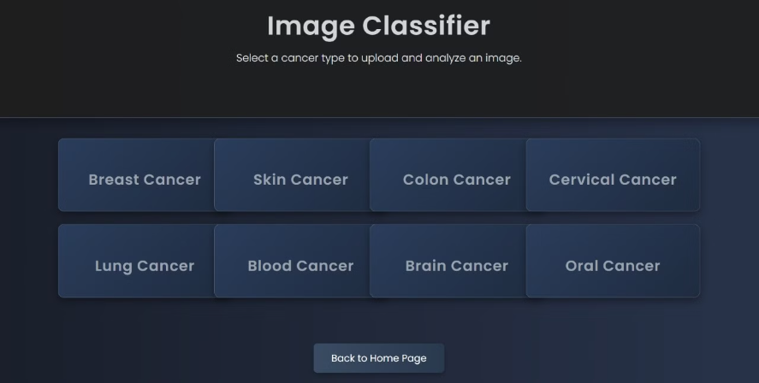
Image Classification Process :
Image Input
Upload medical images.
AI Analysis
AI performs image analysis.
Classification
Tumor classified as benign or malignant.
Results
Diagnosis results provided.
Step-by-step process of image analysis and diagnostic output.

Slide 6



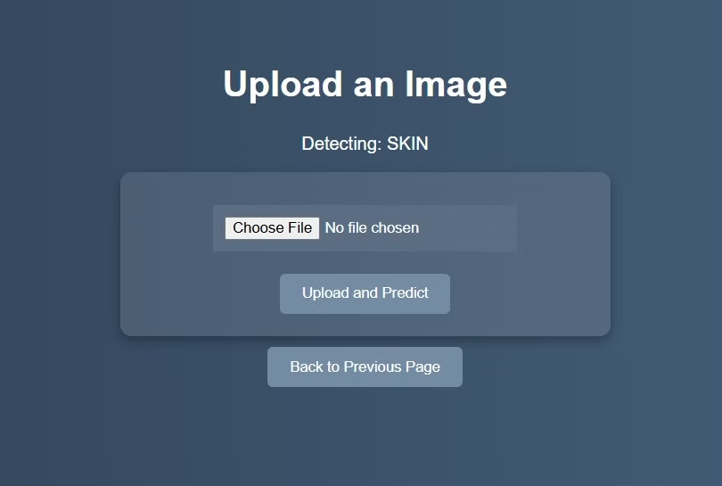
Image Insertion Interface :
2
Secure
Ensured data privacy.
User-Friendly
1
Simple upload process.
Compatibility
3
Supports various image formats.
The website's image insertion interface is designed for ease of use and data security.

Slide 7
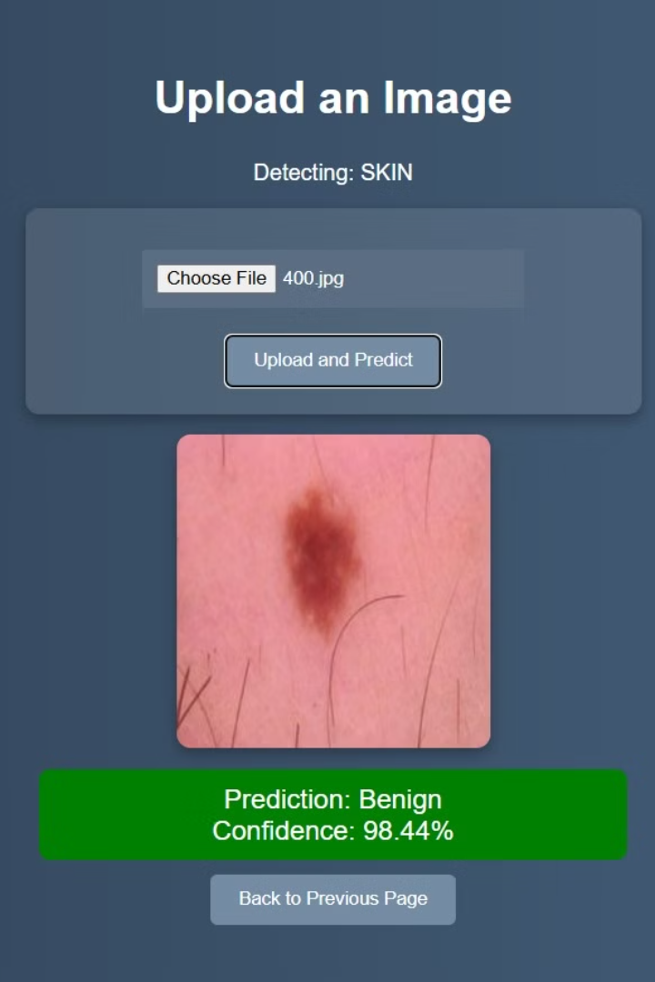
AI-Powered Image Detection :
High Sensitivity
Real-time Analysis
Detects subtle anomalies.
Provides quick results.
Improved Accuracy
Reduces false positives.
ONCOSCAN enhances cancer detection with AI.

Slide 8
Thank you!

