Slide 1
Data Mining project Q1-Autumn-21-22
Music genre classifier
29-12-2021
Felipe Castro, Théo Fuhrmann, Xavier Gordillo,
Javier Rivera, Armando Rodríguez, Hasnain Shafqat

Slide 2
Outline
Introduction
Preprocessing
Naive bayes
KNN
Decision trees
Support vector machines
Ensembles
Comparison
Conclusions

Slide 3
Introduction

Slide 4

Dataset
About: music features (danceability, energy, loudness, tempo, etc.)
Size: 50k samples and 18 columns
Dataset url: https://www.kaggle.com/vicsuperman/prediction-of-music-genre
Notes:
The dataset contains information about hospital utilization, formatted in such a way where information is aggregated on a weekly basis.

Slide 5
Goal
Classify a song among one of the following genres:
Classical
Electronic
Hip-hop
Rock
Dataset url: https://www.kaggle.com/vicsuperman/prediction-of-music-genre
Notes:
The dataset contains information about hospital utilization, formatted in such a way where information is aggregated on a weekly basis.

Slide 6
Preprocessing

Slide 7
Dataset simplification
Electronic, Anime
Jazz, Alternative
Country, Rap
Blues, Rock
Classical, Hip-Hop
Electronic, Rock
Classical, Hip-Hop

Slide 8
Treatment of missings
Feature | Encoded missing | # of missings
duration_ms | -1 | 1991
tempo | ‘?’ | 1953
Imputation with the mean per genre

Slide 9
Feature selection
instance_id: no correlation
obtained_date: no correlation
artist_name: to avoid overfitting
track_name: no correlation

Slide 10
Model preparation
Standardisation:
KNN: distance-based model
Naive Bayes: gaussian naive bayes needs a gaussian distribution
SVM: distance-based kernels
One-Hot-Encoding to every model except for the mixed naive bayes.

Slide 11
Naive Bayes

Slide 12
Naive Bayes
Mixed Data → Two different Approaches:
-Categorical Naive Bayes + Gaussian Naive Bayes
-Gaussian Naive Bayes with One Hot Encoding

Slide 13
Categorical Naive Bayes + Gaussian Naive Bayes
-Split categorical attributes from the numerical attributes.
-Apply Categorical Naive Bayes to the Categorical data
-Apply Gaussian Naive Bayes to the Numerical data
-Get the combined prediction

Slide 14
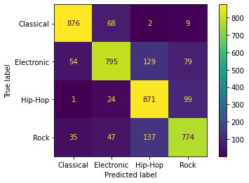
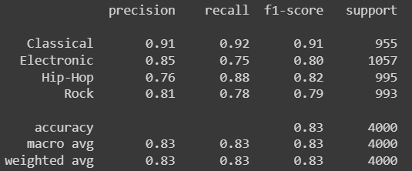
Categorical Naive Bayes + Gaussian Naive Bayes
Accuracy = 0.83

Slide 15
Gaussian Naive Bayes with One Hot Encoding
-Apply One Hot Encoding to the Categorical data
-Standardize all the data
-Apply Gaussian Naive Bayes

Slide 16
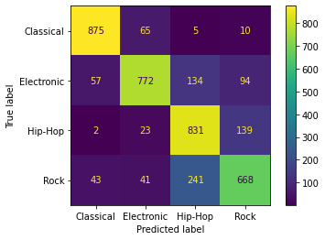
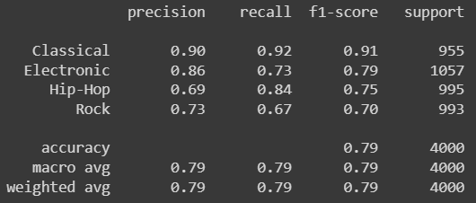
Categorical Naive Bayes + Gaussian Naive Bayes
Accuracy = 0.78
Notes:
Accuracy = 0.78

Slide 17
K-Nearest Neighbors
Notes:
Now we are going to talk about the K-Nearest Neighbors

Slide 18
K-Nearest Neighbors
One hot encoding
Normalize all the data
Default configuration results:
Validation accuracy: 65,306%
Test accuracy: 66,225%
True\Predicted | Classical | Electronic | Hip-Hop | Rock
Classical | 858 | 116 | 9 | 17
Electronic | 65 | 775 | 100 | 60
Hip-Hop | 7 | 98 | 526 | 369
Rock | 14 | 95 | 401 | 490
Notes:
What we start doing with this model was to apply one hot encoding and then normalize all the data as it works with distances. With the default configuration we obtain an accuracy of about 66% with the following confusion matrix where we can see some missclasifications specially in the rigth bottom part of it.

Slide 19
K-Nearest Neighbors: Tunning
One hot encoding
Normalize all the data
Default configuration results:
Validation accuracy: 65,306%
Test accuracy: 66,225%
Number of neighbors
Metric: Euclidean, Manhattan, Chebyshev, Minkowski
Weights: Uniform or Distance ponderation
True\Predicted | Classical | Electronic | Hip-Hop | Rock
Classical | 858 | 116 | 9 | 17
Electronic | 65 | 775 | 100 | 60
Hip-Hop | 7 | 98 | 526 | 369
Rock | 14 | 95 | 401 | 490
Notes:
To improve these results we did a grid search changing the number of neighbors, the metric used and the ponderation of the samples.

Slide 20
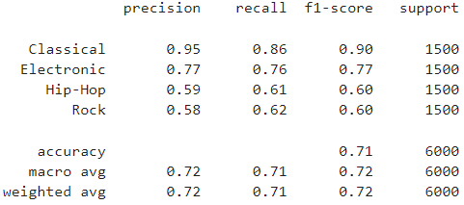
K-Nearest Neighbors: Tunning
Best parameters:
20 neighbors
Manhattan metric
Samples weighted by distance
Validation accuracy: 65,86%
Test accuracy: 71,23%
Notes:
With that we obtained the best results with 20 neighbors using manhatan metric and weighting the samples by distance. We obtained a test accuracy of 71% and taking a look to the classifcation report we can see that classical is obtaining the best results with 90% of the f1-score and hip and rock have major issues with the classification just obtaingin 60%

Slide 21
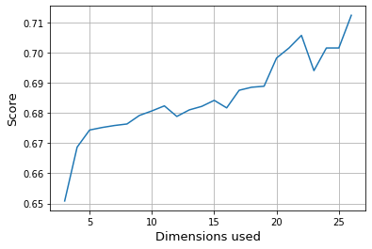
K-Nearest Neighbors with PCA
Notes:
To finalize with this model we tried to apply pca to reduce the dimensionality of the problem and obtain better results. However this didn’t work for us and we obtain the best accuracy using all the features. Meaning that all the features have an impact on the model.

Slide 22
Decision Trees

Slide 23
Decision Trees
Apply One Hot Encoding to the Categorical Data.
If we apply it with default parameters → Overfitting

Slide 24
Hyperparameter Tuning
-In order to avoid overfitting → Prune the Tree
-Hyperparameter Tuning:
-Criterion: Gini or Entropy
-Maximum Depth
-Minimum number of samples to be leaf
-Minimum number of samples to split a node
-Number of features to consider when looking for the best split

Slide 25
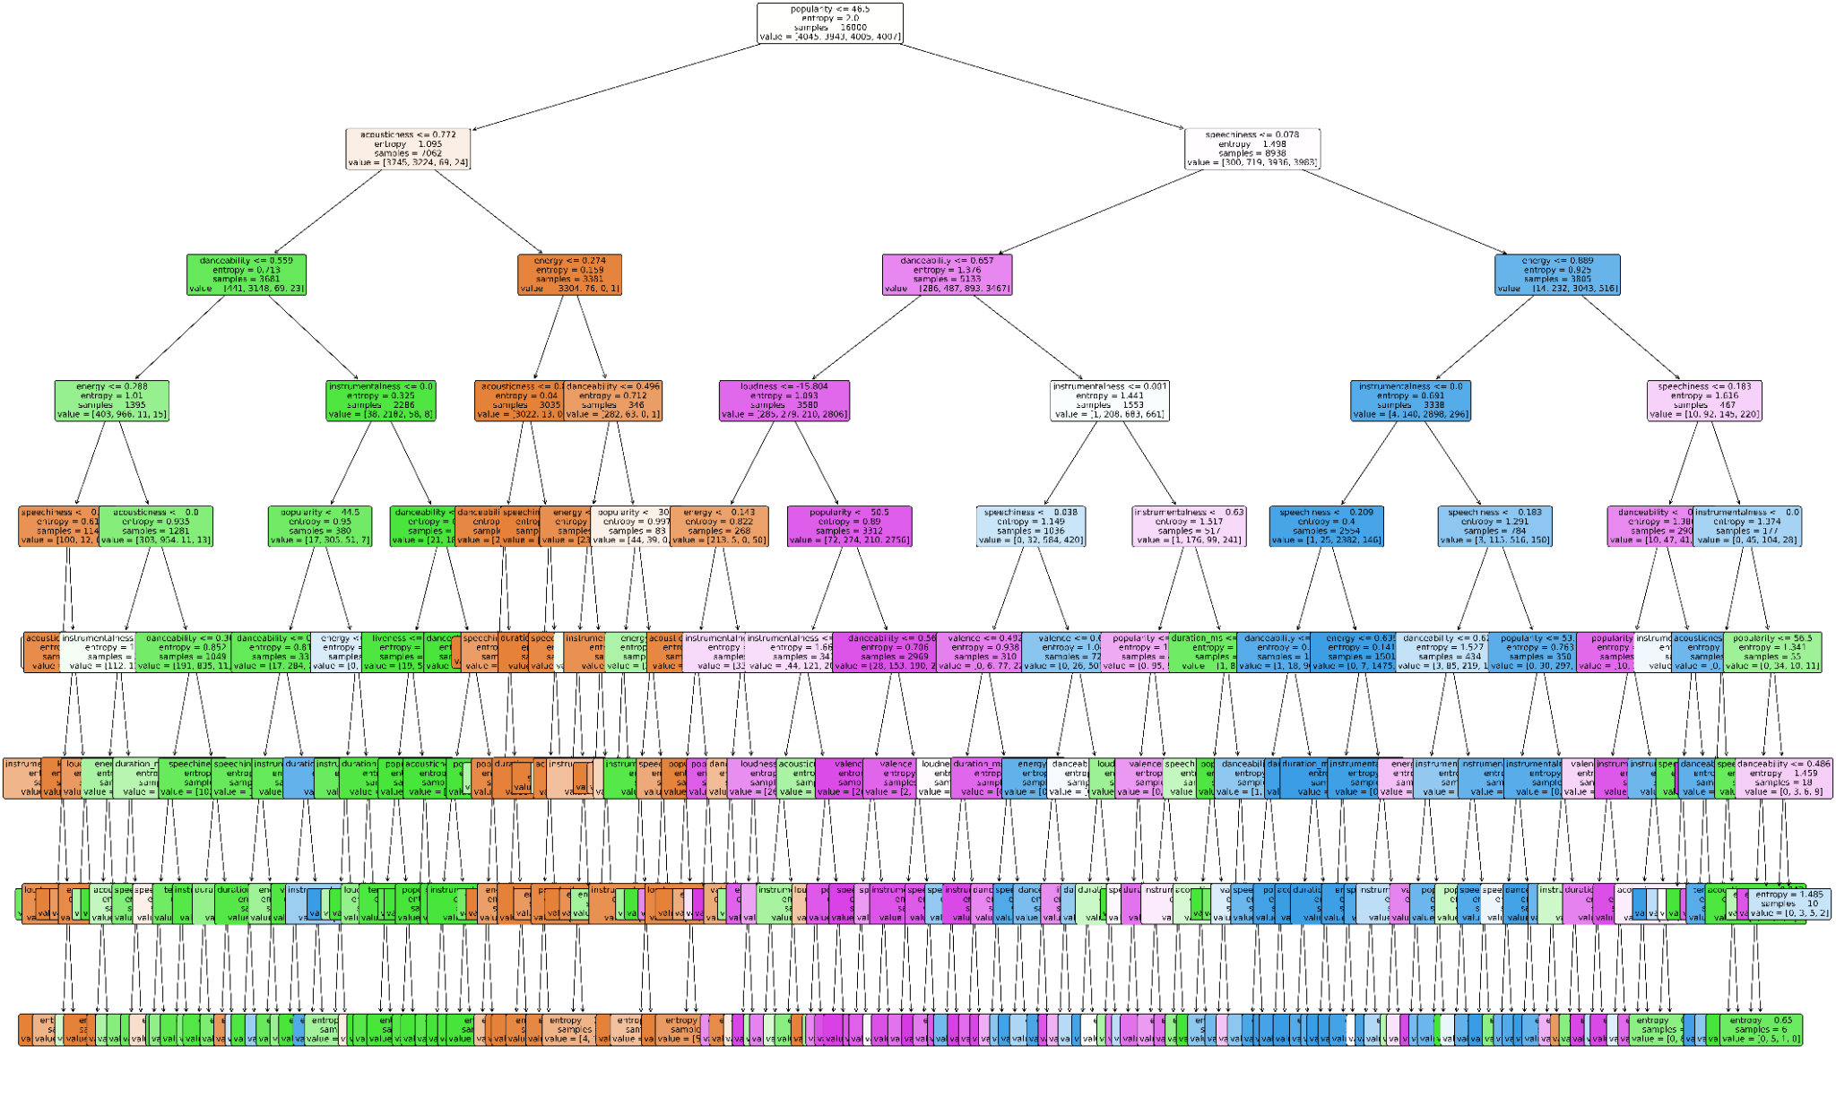
Understanding the decision tree
max_depth = 8
at most 8 decisions are made
Visual representation of the entire tree.
Notes:
Now we will try to gain a deeper understanding of the decision tree that we trained. We will take a look at its shape and the decisions that it makes in order to classify samples. In the figure we can see the visual representation of the tree. We can see that it has at most 8 levels, meaning a sample will go through at most 8 decisions before getting classified into one of the four classes. More decision levels yield better training results, but the testing results were worse since the model was getting overfit to the data.

Slide 26
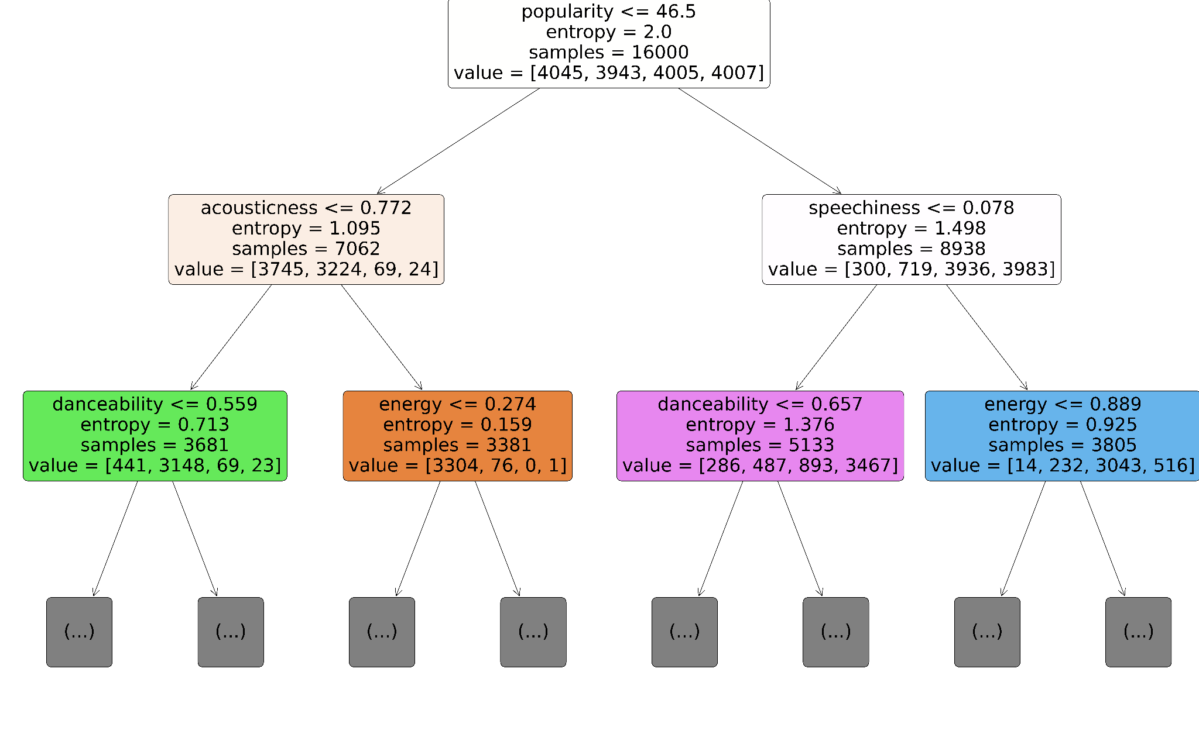
Analyzing the first decision levels
First three decision levels of the tree.
Notes:
In this figure we can see the first three decision levels of the tree. Now we will take a random sample from the testing dataset, belonging to a Rock song. We will see how the tree classifies the sample in the rock category

Slide 27
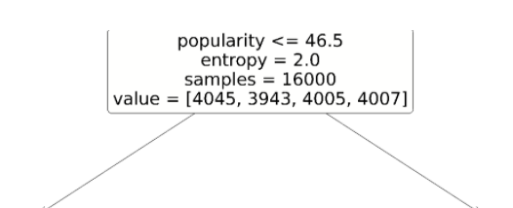
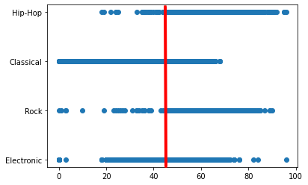
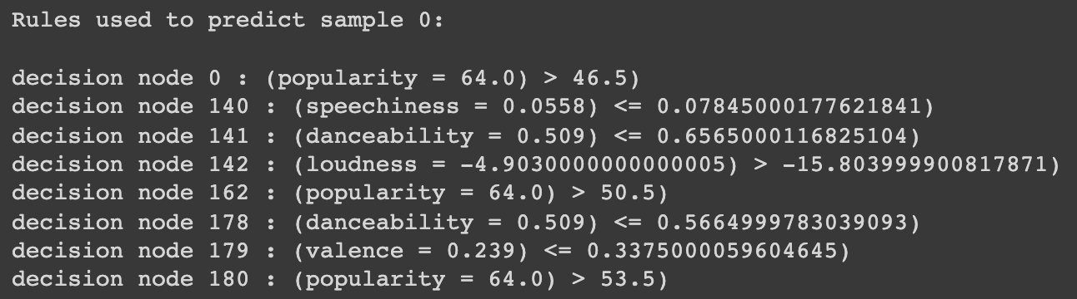
First decision level
Distribution of the popularity variable against the target classes
Notes:
In the first level, the tree looks at the popularity variable, determining a threshold of 46.5. When looking at the distribution of the popularity variable we can begin to see a clear separation between classes. Samples belonging to the rock and hip-hop genre will probably have a popularity above the threshold. This is the case of our sample, which belongs to the rock category.

Slide 28
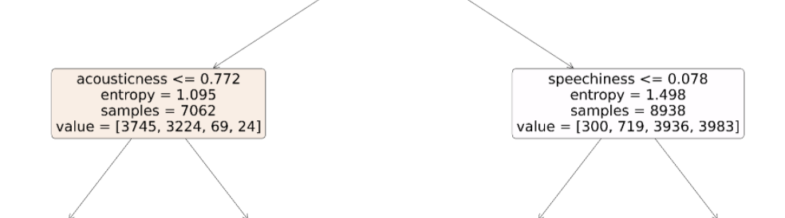
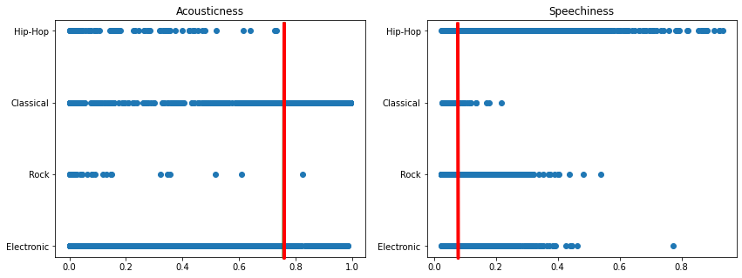
Second decision level
Distribution of the accousticness and spechiness variables against the target classes
Notes:
The same process is repeated for the subsequent nodes until we get to the leaves. Now we will look at the right node starting from the root, and ask our sample about the speechiness variable. By analyzing its value with respect to the threshold, we can determine that the next node will be the left child of the current node.

Slide 29
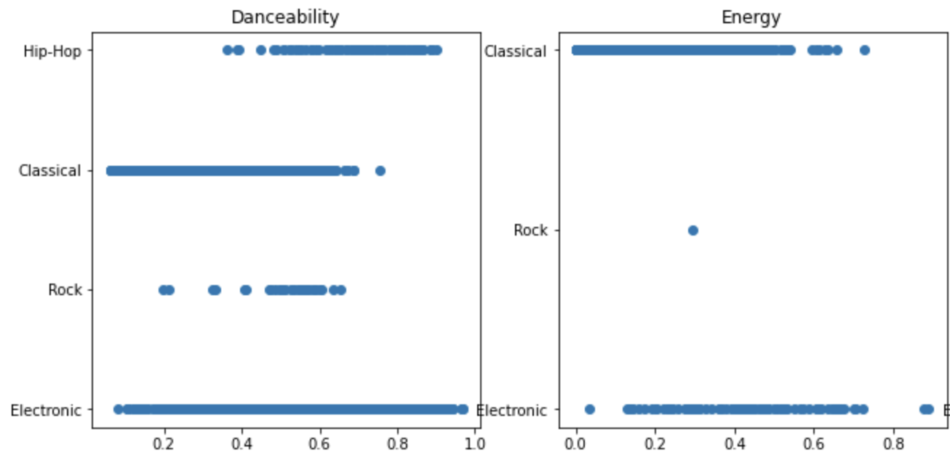
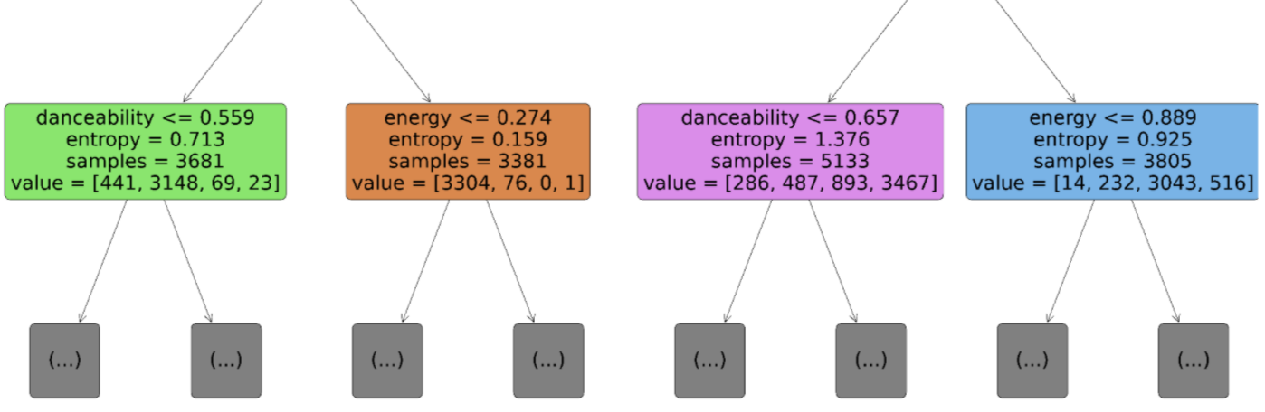
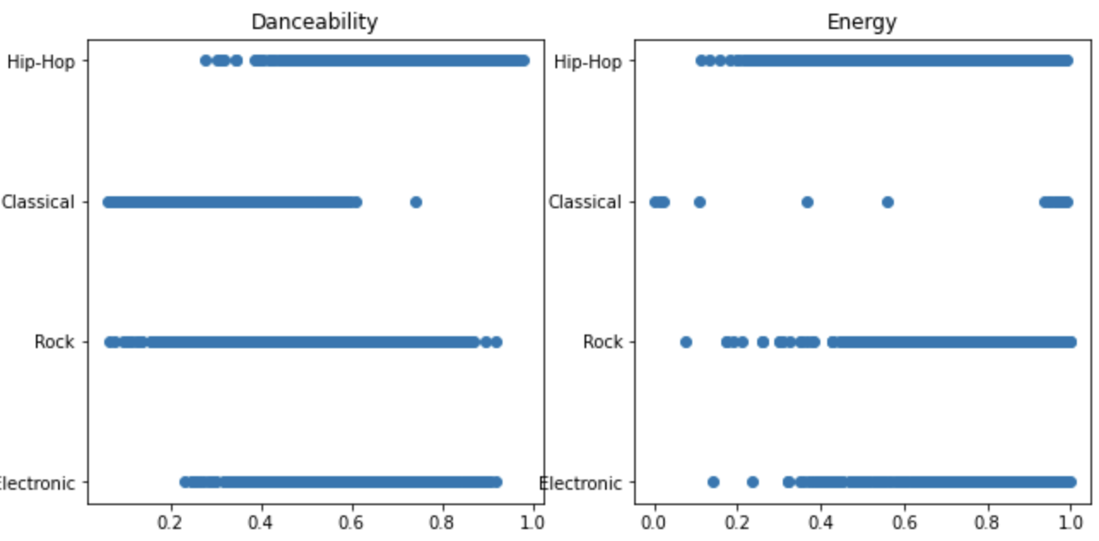
Third decision level
Distribution of the danceability and energy variables against the target classes
Notes:
Finally tree keeps asking questions to the sample’s features in order to determine its class. This process is repeated until we get to the leaves, where the class of the sample is determined.

Slide 30
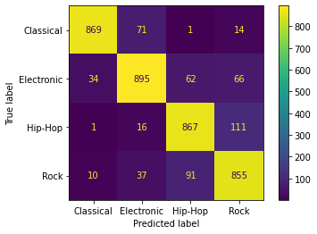
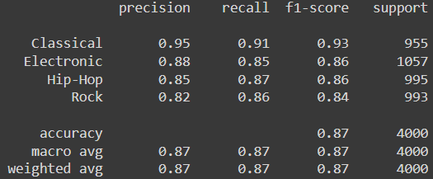
Hyperparameter Tuning
Best Configuration:
'criterion': 'entropy',
'max_depth': 8,
'min_samples_leaf': 6,
'min_samples_split': 15
Accuracy = 0.87

Slide 31
Support Vector Machines
Notes:
Now we are going to talk about the support vector machines

Slide 32
SVM with linear kernel
One hot encoding
Standardize all the data
Default configuration results:
Validation accuracy: 87,77%
Test accuracy: 87,92%
True\Predicted | Classical | Electronic | Hip-Hop | Rock
Classical | 2278 | 177 | 2 | 43
Electronic | 101 | 2123 | 131 | 145
Hip-Hop | 2 | 80 | 2150 | 268
Rock | 13 | 59 | 187 | 2241
Notes:
We will start talking about the SVM with the linear kernel. We firstly apply one hot encoding and then standarize all the data which is the correct thing to do using SVM’s. With the default configuration we obtain an accuracy of about 88% with the following confusion matrix where we can see a clear correct classified diagonal with many samples.

Slide 33
SVM with linear kernel: Tuning
One hot encoding
Standardize all the data
Default configuration results:
Validation accuracy: 87,77%
Test accuracy: 87,92%
C: Regularization parameter
True\Predicted | Classical | Electronic | Hip-Hop | Rock
Classical | 2278 | 177 | 2 | 43
Electronic | 101 | 2123 | 131 | 145
Hip-Hop | 2 | 80 | 2150 | 268
Rock | 13 | 59 | 187 | 2241
Notes:
To improve these results we did a grid search changing the value C which works as a regularization parameter

Slide 34
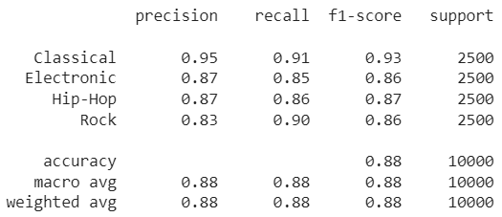
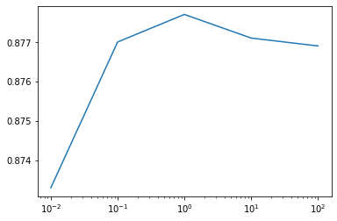
SVM with linear kernel: Tuning
Best parameter C = 1.0
Validation accuracy: 87,77%
Test accuracy: 87,92%
2954 supports (29,54%) with 966 slacked
Notes:
With that we obtained the best results with C equal to 1 (which is indeed the default value) so we obtain a test accuracy of about 88% and taking a look to the classifcation report we can see that all genres have a really good f1-scores. Moreover we obtained around 30% of supports with only 966 of them slacked which we consider a good result.

Slide 35
SVM with RBF kernel
Same preparation of the data (one hot + standardize)
Default configuration results:
Validation accuracy: 88,369%
Test accuracy: 88,39%
Notes:
Now we will talk about the SVM with the rbf kernel which is known to work better with low features. We apply the same preprcoessing, one hot encoding and then standarize all the data. With the default configuration we obtain an accuracy of about 88,4%.

Slide 36
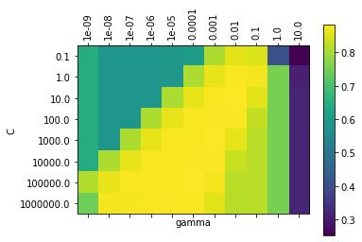
SVM with RBF kernel: Tuning
Same preparation of the data (one hot + standardize)
Default configuration results:
Validation accuracy: 88,369%
Test accuracy: 88,39%
C: Regularization parameter
Gamma: Coefficient of the kernel
Notes:
To improve these default results we did a grid search changing the value C and the parameter gamma, which is the coefficient of the kernel, and we obtain this green-yellow grid that shows us the validation accuracies modifiyng these parameters.

Slide 37

SVM with linear kernel: Tuning
Best parameters:
C = 10.0
Gamma = 0.01
Validation accuracy: 88,59%
Test accuracy: 88,62%
3040 supports (30,40%) with 883 slacked
Notes:
Overall the best results were obtained with C = 10 and gamma = 0.01 which increase the accuracy to 88.6%. We obtained around 30% of support with less slacked oned than before. In the classification report, again, we can see really good f1-scores. To conclude, using rbf kernel we could fit in a better way all our data.

Slide 38
Ensembles: Voting

Slide 39
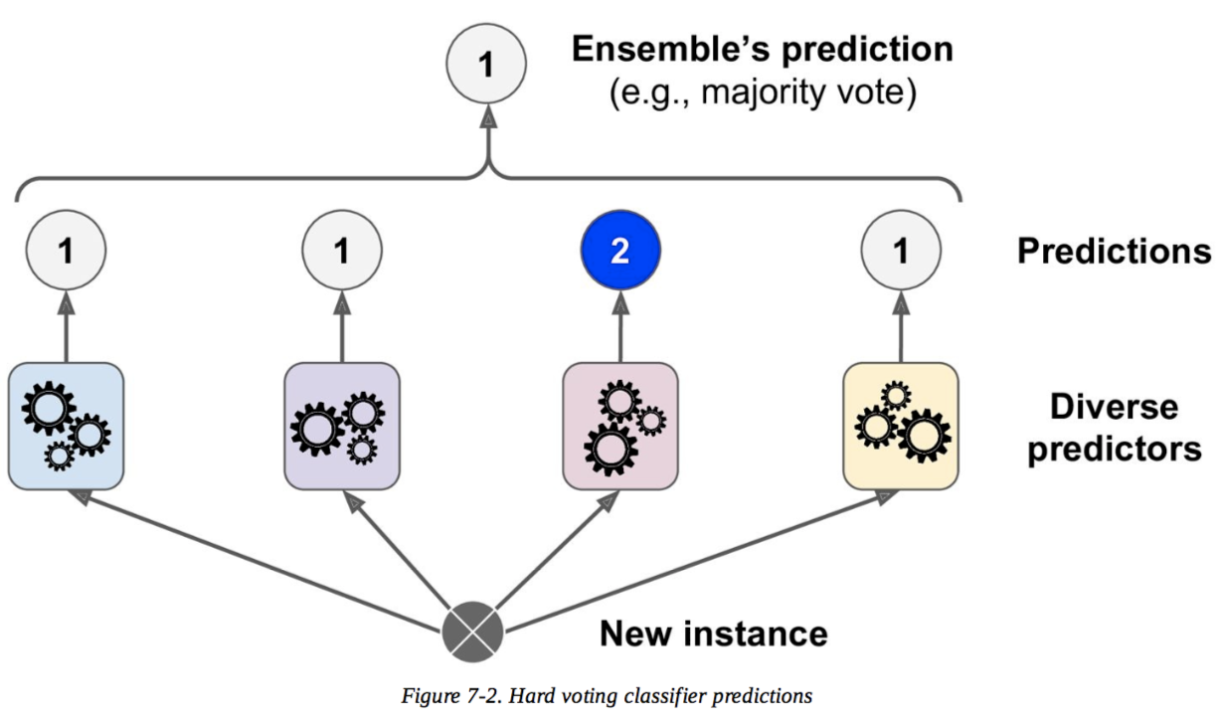
Voting: Hyperparameter Tuning
Classifiers:
Knn
Fine-tuned decision Tree
Base decision tree
Naive Bayes
Hyperparameter:
Type of voting

Slide 40
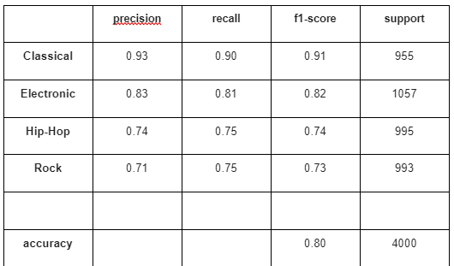
Soft Voting
Accuracy: 0.617 [Naive Bayes]
Accuracy: 0.710 [Knn]
Accuracy: 0.714 [Dec. Tree with param]
Accuracy: 0.769 [Dec. Tree]
Weights [1,2,2,2]

Slide 41
Ensembles: Bagging

Slide 42
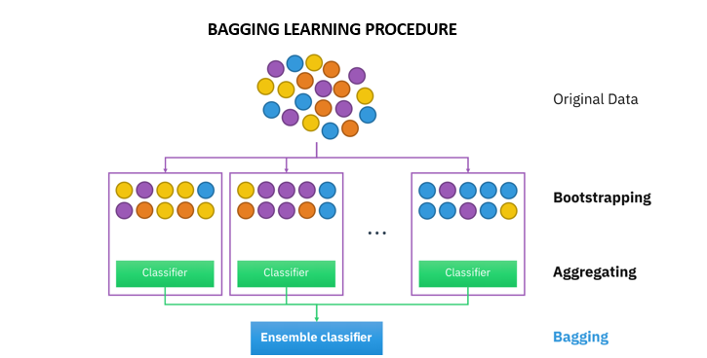
Bagging: Two approaches
Classifiers:
Knn
Decision Trees
Hyperparameter:
Number of estimators
How we will find it?
Grid Search

Slide 43
Bagging with Knn
Normalize all the data
Best number of estimators: 350
Accuracy obtained: 72.1%

Slide 44
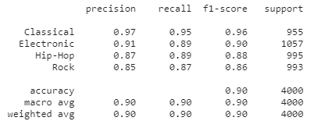
Bagging with decision trees
Best number of estimators: 315
Accuracy obtained: 89.9%
True\Predicted | Classical | Electronic | Hip-Hop | Rock
Classical | 903 | 46 | 1 | 5
Electronic | 17 | 940 | 42 | 58
Hip-Hop | 1 | 16 | 888 | 90
Rock | 10 | 30 | 91 | 862

Slide 45
Ensembles: Random Forest

Slide 46
Random Forest
Hyperparameter:
Number of estimators
Criterion
maximum depth
maximum features
How we will find it?
Grid Search

Slide 47
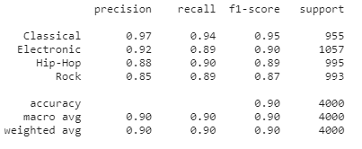
Random Forest: results
True\Predicted | Classical | Electronic | Hip-Hop | Rock
Classical | 893 | 55 | 1 | 6
Electronic | 18 | 939 | 39 | 61
Hip-Hop | 0 | 9 | 897 | 89
Rock | 8 | 19 | 83 | 883
Best parameters:
criterion : entropy
maximum depth : 90
maximum features : sqrt
number of estimators : 250
Accuracy obtained: 90.35 %

Slide 48
Ensembles: Boosting

Slide 49
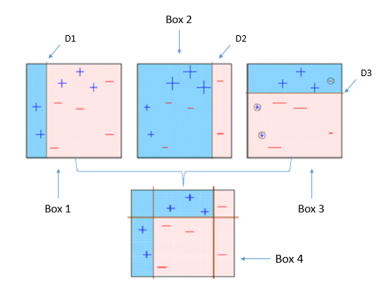
Boosting
Hyperparameter:
Estimator used
Base decision tree
Fine tuned decision tree
Naive bayes
Number of estimators
How we will find it?
Grid Search

Slide 50
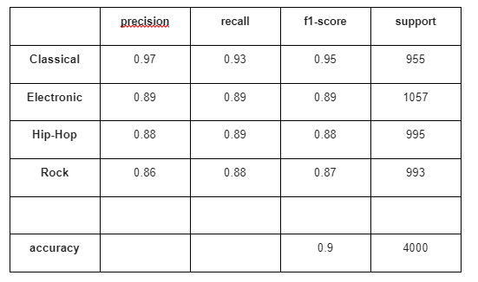
Boosting
Best parameters:
Fine-tuned decision tree:
Number of estimators: 200
Acuraccy: 0.89075
Base decision tree:
Number of estimators: 200
Acuraccy: 0.9015

Slide 51
General conclusions

Slide 52

General conclusions
Classifier | Test accuracy
Categorical Naive Bayes + Gaussian Naive Bayes | 83%
One Hot Encodig + Gaussian Naive Bayes | 78,6%
KNN | 71,23%
Decision trees | 87%
SVM linear | 87,92%
SVM RBF | 88,62%
Voting | 80%
Bagging | 89.9%
Random Forests | 90.35%
Boosting | 90%
Notes:
1:40 min: The following table gathers the accuracies that the models obtained for the testing data.
We can see that the KNN model performed the worst amongst all of them. We think that the problem is that the model couldn’t find a good metric to describe the distance between samples.
Then, the Naive Bayes model got slightly better results, with about 80% accuracy. These results are far from perfect, but we cannot expect the Naive Bayes model to perform much better with a dataset of this complexity.
Decision trees and Support Vector Machines performed much better. These more advanced models were able to to fit themselves to the dataset and get better results.
Finally, we performed experiments with ensembles, which, since they combine the results of the previous models, we expected to have the best results. Indeed, bagging models had the highest accuracies amongst all techniques used, being random forests the best of them.
We consider random forest to be the best model for our particular problem amongst all the models that we observed. Apart from having the best results, random forests are not particularly difficult to implement and interpret, and they require less preprocessing than some of the other models, since we do not need to normalize the data before applying the model.
Thank you for your attention

Slide 53
Data Mining project Q1-Autumn-21-22
Music genre classifier
29-12-2021
Felipe Castro, Théo Fuhrmann, Xavier Gordillo,
Javier Rivera, Armando Rodríguez, Hasnain Shafqat

