Slide 1
COMPANY
Crowd Strike
Stop Breaches

Slide 2

LOGO

Slide 3
TABLE OF CONTENTS
Introduction
Products
Marketing Mix
Reflection
Conclusion
Reference

Slide 4

INTRODUCTION
The world's leading AI-native cybersecurity platform
Crowd Strike secures everything, from endpoints to cloud
Single Agent, Total Protection
Real-time Threat Radar
AI-powered Defense
Proven Track Record
Trusted by Leaders

Slide 5
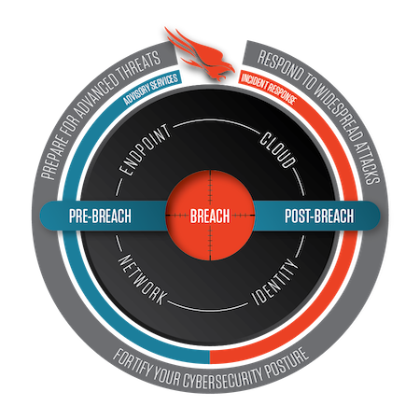
PRODUCTS
Crowd Strike Falcon – a unified platform
Endpoint security services
Cloud security services
Identity protection services
Network monitoring services

Slide 6
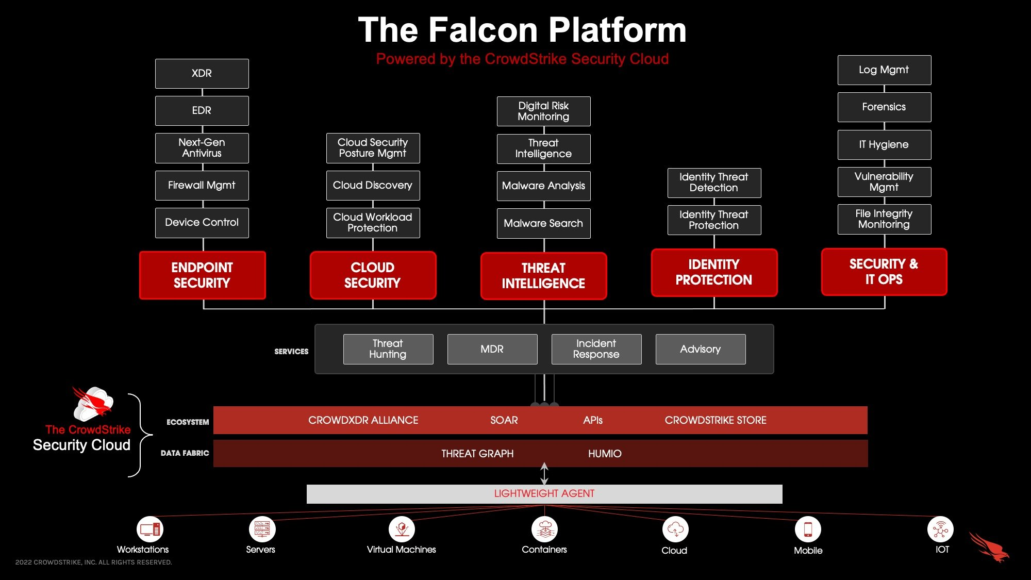
THE FALCON PLATFORM

Slide 7
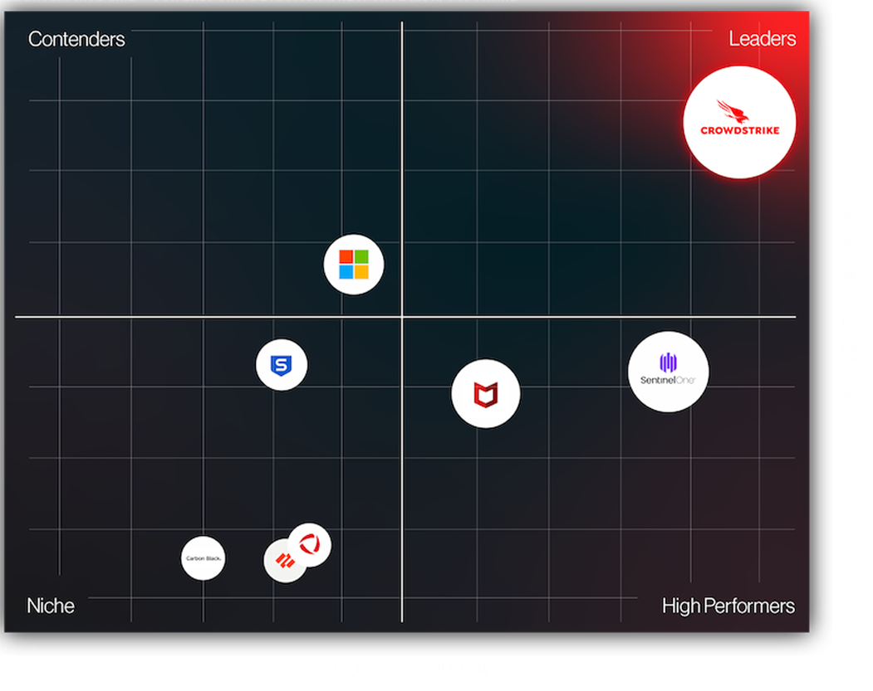
MARKETING MIX
Product
Crowd Strike Falcon - Cloud endpoint protection with threat intelligence.
Place
Cloud-based, accessible anywhere, deployable on various endpoints
Price
Subscription-based with tiered options for flexibility.
Promotion
Marketed through digital channels, events, and success stories. Emphasis on advanced features and threat detection capabilities

Slide 8
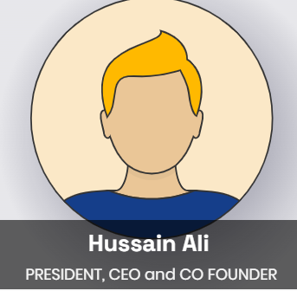
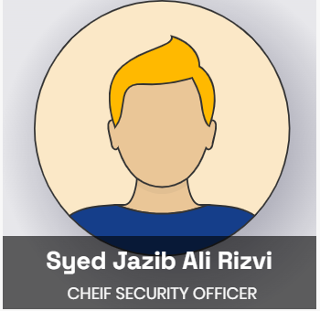
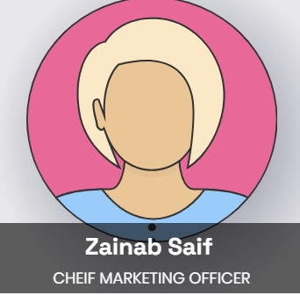
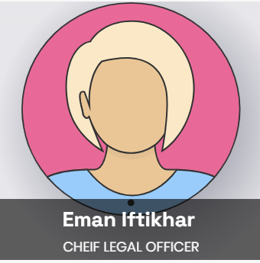
REFLECTIONS

Slide 9
REFLECTION 1
Position:
President, CEO, and Co-founder of Crowd Strike
Experience:
Over 30 years in Cyber security, with roles at McAfee and founding Found stone
Innovation:
Recognized for driving innovation in nascent technologies
Media Presence:
Featured in major publications and TV programs, authored best-selling security book
Education:
B.S. in Accounting from Seton Hall University, C.P.A. (inactive status)
Skills:
Expertise in security, incident response, and scaling organizations globally

Slide 10
REFLECTION 2
Roles:
Oversees all security aspects, including info security and physical security.
Founding Roles:
Founded security and incident response practices at CrowdStrike.
FBI Career:
Executive Assistant Director, led global criminal and cyber investigations.
Leadership Philosophy:
Advocates "One team. One Fight." for unity at CrowdStrike.
Engagements:
Lectures, serves on boards, keynote speaker at cybersecurity conferences.
Awards:
NACD Directorship 100, Federal 100 Award, SC Award for Security Executive of the Year.
Education:
B.B.A. (Hofstra), M.S. in Criminal Justice Administration (Virginia)

Slide 11
REFLECTION 3
Position:
Chief Marketing Officer at CrowdStrike
Experience:
Multiple-time CMO in enterprise software, cybersecurity specialist
Previous Roles:
Illumio (CMO, Board Member), Tenable (Led public offering), Amplitude (Led public offering), Tanium (Former CMO), Coverity (Former CMO)
Additional Roles:
Partner at Andreessen Horowitz, Board Member at Immersive Labs
Marketing Expertise:
20-year track record, known for bold storytelling and category dominance
Education:
MBA from Santa Clara University, B.S. in Business Administration from the University of San Francisco

Slide 12
REFLECTION 4
Position:
Chief Legal Officer at CrowdStrike.
Experience:
Over a decade in legal roles.
Achievements:
Led legal efforts for CrowdStrike's IPO.
Responsibilities:
Leads legal team covering commercial, compliance, corporate, employment, IP, and litigation.
Passion:
Supports employees in the mission to prevent breaches.
Previous Roles:
VP, Legal at CrowdStrike; Associate General Counsel at MobileIron, Inc.; IP Litigator at Farella Braun + Martel
Legal Practice:
Admitted in California.
Education:
J.D. from University of Pennsylvania Law School

Slide 13

CONCLUSION
Crowd Strike was founded in 2011 with a mission to “stop breaches”
Industry transformation through innovative products and services
Simplifying cyber security for enhanced protection

Slide 14
REFERENCES
https://www.crowdstrike.com/en-us/
https://www.crowdstrike.com/about-us/brand/
https://www.crowdstrike.com/blog/how-the-falcon-platform-modernizes-your-security-stack/
https://www.crowdstrike.com/blog/how-crowdstrike-protects-against-recent-cozy-bear-phishing-campaign/
https://www.crowdstrike.com/why-crowdstrike/crowdstrike-industry-validation/
https://2320957.wixsite.com/crowdstrike/blank-1

Slide 15
ANY QUESTION ?

Slide 16
THANK YOU
☺☺

