Slide 1
Importance of Cybersecurity in Telecommunication
Title:
Group Members: Hussain Ali Qureshi Syed Jazib Ali Rizvi

Slide 2
Outlines:
Introduction
Cyberattacks in the Telecom Sector
Impact of Cyberattacks
Role of Cybersecurity in the Telecom Sector
Pakistan and International Perspectives
Promoting Cybersecurity
Conclusion

Slide 3
Introduction

Slide 4
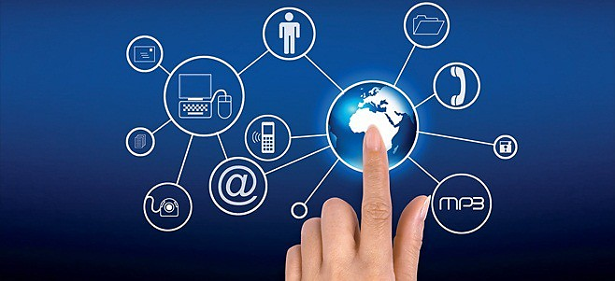
Telecommunication
Telecommunication is the transmission of information over significant distances by electronic means. It refers to all types of voice, data, and video transmission.
Notes:
Telecommunication is the transmission of information over significant distances by electronic means. It refers to all types of voice, data, and video transmission. Telecommunication networks are essential for modern communication and society, enabling people to stay connected and access information and services from anywhere in the world.
There are two main types of telecommunication networks: wired and wireless.
Wired networks: These networks use physical cables, such as copper wires or fiber optic cables, to transmit data. Wired networks are generally more reliable and have higher bandwidth than wireless networks, but they can be more expensive to deploy and maintain.
Wireless networks: These networks use radio waves to transmit data. Wireless networks are more flexible and less expensive to deploy than wired networks, but they can be less reliable and have lower bandwidth.

Slide 5
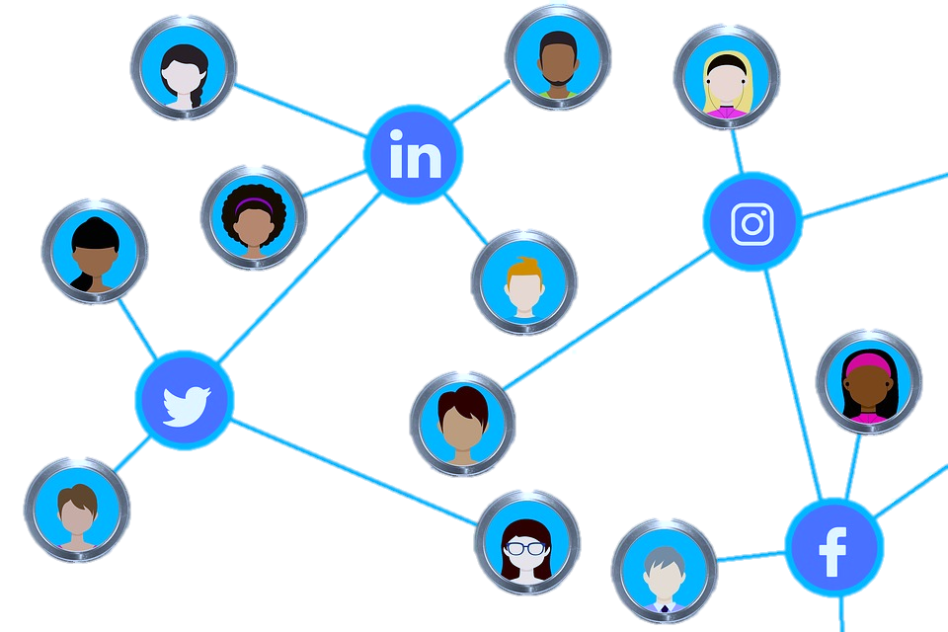
Means of Telecommunication
Telephone
Mobile phone
Internet
Social Media
Instant Messaging
Notes:
Internet: The internet is a global network of computers that allows people to communicate with each other and access information and services from anywhere in the world. The internet is used for a wide range of telecommunication activities, including:
Email: Email is a method of exchanging electronic messages between people.
Instant messaging: Instant messaging is a type of online communication that allows people to have real-time conversations with each other.
Video conferencing: Video conferencing is a type of online communication that allows people to see and hear each other in real time.
Voice over IP (VoIP): VoIP is a technology that allows people to make and receive phone calls over the internet.
Mobile phone: Mobile phones are wireless telephones that allow people to communicate with each other from anywhere in the world. Mobile phones can be used to make and receive phone calls, send and receive text messages, and access the internet.
Social media: Social media platforms such as Facebook, Twitter, and Instagram allow people to connect with each other and share information. Social media can also be used to communicate with businesses and organizations.

Slide 6
Telecom Stakeholders
Consumers
Telecom Operators
Telecom equipment vendors
Telecommunications infrastructure providers
Telecommunications regulatory bodies
Notes:
Telecommunications companies:
These companies provide telecommunications services to consumers and businesses. Examples of telecommunications companies include Telenor, Zong, Jazz, and Ufone.
Telecommunications equipment manufacturers:
These companies manufacture the equipment that is used by telecommunications companies to provide their services. Examples of telecommunications equipment manufacturers include Huawei, Nokia, and Ericsson.
Telecommunications infrastructure providers:
These companies build and maintain the infrastructure that is used by telecommunications companies to provide their services. Examples of telecommunications infrastructure providers include tower companies and fiber optic cable providers.
Telecommunications regulatory bodies:
These organizations are responsible for regulating the telecommunications sector and ensuring that telecommunications companies comply with the relevant laws and regulations. Examples of telecommunications regulatory bodies include the Pakistan Telecommunication Authority (PTA) and the Federal Communications Commission (FCC) in the United States.

Slide 7
Cybersecurity in Telecom Sector
Telecom companies hold a vast amount of sensitive customer data.
Telecom networks are critical infrastructure.
Telecom companies are increasingly interconnected.
Telecom companies are often seen as having large amounts of money.
Why is it IMPORTANT?
Notes:
Telecom companies hold a vast amount of sensitive customer data. This includes customer names, addresses, phone numbers, social security numbers, and billing information. This data is a valuable target for cybercriminals, who can use it to commit identity theft, fraud, and other crimes.
Telecom networks are critical infrastructure. Telecom networks are essential for communication, commerce, and public safety. A cyber attack on a telecom network could disrupt these services and cause significant damage.
Telecom companies are increasingly interconnected. Telecom companies often partner with each other to provide services to customers. This interconnectedness can make it easier for cybercriminals to spread an attack from one company to another.
Telecom companies are often seen as having large amounts of money. This makes them a target for ransomware attacks, where cybercriminals encrypt the company's data and demand a ransom payment to decrypt it.

Slide 8
Cyberattacks in the Telecom Sector

Slide 9
Types of Cyberattacks
Data Theft and Breaches
Distributed Denial of Service (DDoS) Attacks
Phishing Attacks
Man-in-the-middle (MitM) attacks
Malware attacks
SIM Card Cloning
Insider Threats
Notes:
TYPES:
Data breaches: involve the unauthorized access, theft, or exposure of sensitive data, such as customer information, financial data, or intellectual property. Data breaches can have a significant impact on telecom companies, as they can damage their reputation, lead to financial losses, and result in legal and regulatory penalties.
DDoS attacks: are designed to overwhelm a website or server with traffic, making it unavailable to legitimate users. DoS attacks can be used to extort money from telecom companies or to disrupt their services for political or other reasons.
MitM attacks: involve the attacker intercepting communication between two parties and impersonating one of the parties. This can be used to steal sensitive information, such as passwords or credit card numbers.
Malware attacks: involve the installation of malicious software on a device. This software can be used to steal data, damage the device, or disrupt services.
Phishing Attacks: Phishing attacks involve sending deceptive emails or messages to trick users into revealing sensitive information, such as login credentials. Telecom customers may receive phishing emails that appear to be from their service providers, leading to identity theft and fraud.

Slide 10
Successful Attacks
Telenor Email Spoofing (2017)
Several employees were exploited
Damage not publicly clarified
Vodafone ransomware attack (2020)
Service disruption in several countries
Estimated losses: millions of dollars
T-Mobile data breach (2021)
37 million customers
Estimated losses: millions of dollars
Notes:
Telenor Email Spoofing (2017): The attack took place on November 08 when a malicious email was received by employees from an apparently legitimate email address. The exact nature of the attack and the extent of damage to consumer data remains unclear. The subject line of the email was “confidential” and it contained a ‘word’ document as an attachment. The email informed the recipients that the attachment was a new policy guideline from Ministry of Information Technology [MOIT] regarding IT security. As soon as the recipient clicked on the attachment, the embedded trojan code automatically forwarded the email to contacts within Telenor using the recipient’s email address, numerous computers were infected. The victim’s social and email accounts were all compromised while the trojan was able to retrieve data from the computers, simultaneously installing a key-logger in the process.
Vodafone ransomware attack (2020): In December 2020, Vodafone suffered a ransomware attack that disrupted its services in several countries. The attackers encrypted Vodafone's data and demanded a ransom payment. Vodafone has not disclosed the amount of the ransom payment, but it is estimated to have been in the millions of dollars.
T-Mobile data breach (2021): In August 2021, T-Mobile suffered a data breach that affected over 47 million customers. The attackers were able to gain access to customer names, addresses, phone numbers, social security numbers, and dates of birth. T-Mobile has not disclosed the cost of the data breach, but it is estimated to have cost the company millions of dollars.

Slide 11
Impact of Cyberattacks

Slide 12
Impact of Cyberattacks
Disruption of Communication Services
Data Breaches and Privacy Concerns
Financial Losses and Reputation Damage
Notes:
A. Disruption of Communication Services
1. Service Outages: Cyberattacks, such as DDoS attacks, can overwhelm telecom networks, leading to service outages and rendering voice calls, data transmission, and internet services unavailable to customers.
2. Emergency Communications: Disruptions in communication services can hinder emergency response efforts, making it challenging for first responders and public safety agencies to coordinate during crises.
3. Loss of Connectivity: Customers and businesses may face interruptions in their ability to connect, causing inconvenience and potential financial losses.
B. Data Breaches and Privacy Concerns
1. Customer Data Exposure: Cyberattacks can result in the theft of customer data, including personal information, call records, and billing details, leading to privacy breaches and identity theft.
2. Regulatory Non-Compliance: Data breaches may violate data protection regulations and laws, resulting in legal consequences and fines for telecom companies.
3. Trust Erosion: Customer trust in telecom providers can erode when data breaches occur, impacting long-term customer relationships and brand reputation.
C. Financial Losses and Reputation Damage
1. Operational Costs: Cyberattacks necessitate significant expenditures on incident response, recovery, and cybersecurity improvements, increasing operational costs for telecom companies.
2. Reputation Damage: High-profile cyberattacks can damage the reputation of telecom companies, leading to customer churn and loss of market share.
3. Litigation and Fines: Data breaches and privacy violations can result in legal action and financial penalties, further exacerbating financial losses.
4. Insurance Premiums: The financial impact of cyberattacks can lead to increased insurance premiums, affecting the overall cost of doing business in the sector.
These impacts highlight the far-reaching consequences of cyberattacks on the telecom sector. To mitigate these risks, telecom companies must invest in robust cybersecurity measures, incident response plans, and data protection practices to safeguard communication services, customer data, and their reputations.

Slide 13
Cost of Cybercrime
The cost of cybercrime is high and growing. According to Cybersecurity Ventures, the global cost of cybercrime is expected to reach $10.5 trillion annually by 2025. This represents a significant increase from the $3 trillion estimated in 2015.
Data breaches
Denial-of-service (DoS) attacks
Man-in-the-middle (MitM) attacks:
Malware attacks:
$4.24 million
$200,000
$80,000
$2.6 million
Notes:
Data breaches: The average cost of a data breach in the United States is $4.24 million, according to IBM. This includes the cost of investigating the breach, notifying customers, and complying with regulations.
Denial-of-service (DoS) attacks: The average cost of a DoS attack is $200,000, according to Radware. This includes the cost of lost sales and productivity, as well as the cost of mitigating the attack.
Man-in-the-middle (MitM) attacks: The average cost of a man-in-the-middle (MitM) attack is also difficult to quantify, as it depends on the specific attack and the type of data that is stolen. However, a 2020 report by Verizon found that the median cost of a MitM attack is $80,000.
Malware attacks: The average cost of malware attacks varies depending on the type of malware and the size of the organization. However, a recent study by IBM found that the average cost of a malware attack is $2.6 million.

Slide 14
Role of Cybersecurity in Telecom Sector

Slide 15
Importance of Robust Cybersecurity Measures
Safeguarding Critical Infrastructure
Protection of Customer Data
Preserving Reputation and Trust
Cybersecurity during the modernization of Telecom
Prevention of nation-state Threats
Notes:
Protecting Critical Infrastructure: The Role of Cybersecurity: Telecom networks are critical infrastructure, essential for the functioning of society and the economy. A cyber attack on a telecom network could have a devastating impact, disrupting essential services and causing widespread chaos. Cybersecurity plays a vital role in protecting telecom networks from cyber attacks and ensuring the continuity of essential services.
Trust in Telecom: The Importance of Cybersecurity: Trust is essential for the telecom sector. Customers need to be confident that their data is secure and that their communications will not be intercepted. Cybersecurity helps to build trust by demonstrating that telecom companies are taking steps to protect their customers and their networks.
Cybersecurity for Telecom Transformation: The telecom sector is undergoing a rapid transformation, driven by new technologies such as 5G, cloud computing, and the Internet of Things (IoT). These new technologies offer new opportunities for telecom companies, but they also create new security challenges. Cybersecurity is essential for telecom companies to navigate this transformation and to deliver secure and reliable services to their customers.
Nation-State Threats: Protecting Telco Infrastructure: Nation-state actors are increasingly targeting telecom networks in cyber attacks. These attacks are often highly sophisticated and difficult to defend against. Telecom companies need to be aware of the nation-state threat and to implement robust cybersecurity measures to protect their networks.

Slide 16
Strategies for Defending Against Cyber Threats
Network Monitoring and Threat Detection
Multi-Layered Security
Employee Training
Incident Response Plans
Patch Management
User Authentication and Access Control
Data Encryption
Collaboration with Cybersecurity Experts
Notes:
Network Monitoring and Threat Detection: Implementing advanced threat detection systems and continuous network monitoring to identify and respond to potential threats in real-time.
Multi-Layered Security: Employing a multi-faceted approach to security, including firewalls, intrusion detection systems, encryption, and access controls.
Employee Training: Regularly training employees on cybersecurity best practices and raising awareness about potential threats, such as phishing and social engineering.
Incident Response Plans: Developing comprehensive incident response plans to mitigate the impact of cyberattacks, including steps for containment, eradication, and recovery.
Patch Management: Keeping software, hardware, and firmware up to date to address known vulnerabilities and reduce the attack surface.
Collaboration with Cybersecurity Experts: Engaging with cybersecurity experts and sharing threat intelligence to stay updated on emerging threats and vulnerabilities.
Secure Software Development: Ensuring that telecom software is developed with security in mind to prevent vulnerabilities from being introduced.
User Authentication and Access Control: Implementing strong user authentication methods and strict access control policies to limit access to critical systems and data.
Data Encryption: Encrypting sensitive data both in transit and at rest to protect it from unauthorized access.

Slide 17
Successful Defenses
AT&T MitM Attack (2019)
AT&T was able to detect the attack and prevent the attackers from stealing any money.
Deutsche Telekom (2020)
The attackers were able to encrypt some of Deutsche Telekom's data, but the company was able to restore the data from backups.
Verizon DDoS Attack (2021)
Verizon was able to mitigate the attack and keep its services running.
Notes:
In 2019, AT&T successfully defended against a man-in-the-middle attack that targeted its customers. The attackers were able to intercept traffic between AT&T customers and their banks, but AT&T was able to detect the attack and prevent the attackers from stealing any money.
In 2020, Deutsche Telekom successfully defended against a ransomware attack that targeted its network. The attackers were able to encrypt some of Deutsche Telekom's data, but the company was able to restore the data from backups and prevent the attackers from disrupting its services.
In 2021, Verizon successfully defended against a major DDoS attack that targeted its network. The attack was one of the largest DDoS attacks ever recorded, but Verizon was able to mitigate the attack and keep its services running.

Slide 18
Pakistan and International Perspective

Slide 19
Telecom Cybersecurity in the World
Market Size:
Expected to reach USD 3102.74 billion by 2030, growing at a CAGR of 6.2% in the forecast period (2023-2030).
Current Situation:
Cybercriminals are becoming more sophisticated and are targeting telecom companies with new and innovative methods.
Organizations:
The United Nations (UNO)
International Telecommunication Union (ITU)
Notes:
The ITU is a specialized agency of the United Nations responsible for telecommunications and information and communication technologies (ICTs). The ITU's Cybersecurity Framework provides guidance on how to improve cybersecurity in the telecom sector. It covers a wide range of topics, including risk management, security controls, and incident response.
The OECD is an intergovernmental economic organization with 38 member countries. The OECD's Guidelines for the Security of Information and Communication Technologies provide guidance on how to develop and implement cybersecurity policies and procedures for organizations of all sizes. They are particularly relevant for telecom companies, as they cover a wide range of issues that are specific to the telecom sector.
The United Nations General Assembly has passed a number of resolutions on cybersecurity, including Resolution 70/237 on "The role of the International Telecommunication Union in developing countries in the field of information and communication technologies" and Resolution 68/167 on "Developing culture of peace". These resolutions highlight the importance of cybersecurity for international peace and security.
All three organizations work together to promote cybersecurity in the telecom sector. They do this by developing policies and guidelines, providing training and resources, and sharing information about cyber threats and best practices.

Slide 20
Telecom Cybersecurity in Pakistan
Market Size:
Expected to reach USD 5.15 billion by 2028, growing at a CAGR of 3.28% in the forecast period (2023-2028).
Current Situation:
The government and telecom companies are investing in cybersecurity and developing new regulations to protect telecom networks.
Organizations:
Pakistan Telecommunication Authority (PTA)
National Telecom Security Operations Center (NTSOC)
Notes:
Telecom cybersecurity in Pakistan, as in many countries, is of paramount importance due to the critical role of the telecommunications sector in facilitating communication, digital services, and economic activities. Pakistan, like other nations, faces a range of cybersecurity challenges and works to implement measures to protect its telecommunications infrastructure, networks, and sensitive data.
Here are some key aspects of telecom cybersecurity in Pakistan:
Regulatory Framework: Pakistan has established a regulatory framework to govern and oversee the telecommunications sector. The Pakistan Telecommunication Authority (PTA) is the primary regulatory body responsible for ensuring the security, integrity, and reliability of telecom services.
National Response Center for Cyber Crimes (NR3C): The NR3C, a unit of the Federal Investigation Agency (FIA), plays a significant role in investigating and addressing cybercrimes, including those related to telecom networks and services.
Security Guidelines and Standards: The PTA has issued security guidelines and standards that telecom operators are expected to follow to protect their networks and customer data.
Data Protection and Privacy: Pakistan has data protection laws, including the Data Protection Act 2012, to safeguard the privacy of individuals and the security of their personal data, which includes data held by telecom companies.
Incident Response and Reporting: Telecom operators in Pakistan are required to have incident response plans in place to promptly detect and respond to cyber incidents. They must report any significant cybersecurity breaches to the PTA.
International Cooperation: Pakistan collaborates with international organizations and law enforcement agencies to combat cyber threats. This includes sharing threat intelligence and cooperating in cybercrime investigations.
Threat Landscape: Telecom companies in Pakistan face various cybersecurity threats, including DDoS attacks, phishing, malware, and insider threats. These can disrupt services and compromise customer data.
Collaboration with Telecom Operators: The PTA collaborates with telecom operators to improve cybersecurity practices, encourage employee training, and conduct security audits.
Public Awareness and Education: Efforts are made to raise public awareness about cybersecurity best practices and to educate users about the risks of cyber threats, including those targeting the telecom sector.
Secure Mobile Banking and Payments: Given the growth of mobile banking and digital payments in Pakistan, securing these services is a priority. Ensuring the protection of financial transactions is essential.
Protection of Critical Infrastructure: Critical telecom infrastructure, such as the national backbone network, is a key focus for protection against cyber threats.
Internet of Things (IoT): The proliferation of IoT devices in Pakistan requires a focus on securing these devices, as they can be entry points for cyberattacks.

Slide 21
Promoting Cybersecurity

Slide 22
A Collaborative Approach
Telecom companies can share information about cyber threats and best practices
Telecom companies can work together to develop coordinated responses to cyberattacks
Telecom companies and governments can invest in research and development to develop new cybersecurity technologies and solutions
Governments develop and implement cybersecurity policies and regulations
Raise awareness of cybersecurity risks
Notes:
A. Government Regulations and Policies 1. Legislation: Enactment and enforcement of cybersecurity-related laws and regulations at the national level, such as data protection and privacy laws. 2. Regulatory Authorities: Establishment of regulatory bodies responsible for overseeing cybersecurity compliance and ensuring that telecom companies and other organizations adhere to security standards. 3. Incident Reporting Requirements: Mandating that organizations report cybersecurity incidents to the appropriate authorities, enabling a coordinated response and threat intelligence sharing. 4. National Cybersecurity Strategies: Formulation of national strategies to guide the development and implementation of cybersecurity measures at the state level. 5. Critical Infrastructure Protection: Special regulations and standards for safeguarding critical infrastructure sectors, including the telecom sector. 6. Cross-Border Collaboration: Engagement in international cooperation and information sharing to address transnational cyber threats.
B. Industry Best Practices and Standards 1. Security Frameworks: Adoption of internationally recognized cybersecurity frameworks like NIST Cybersecurity Framework, ISO 27001, and CIS Critical Security Controls. 2. Security Certification: Encouragement of industry-specific security certifications to ensure that organizations meet specific cybersecurity standards. 3. Secure Software Development: Promoting secure coding practices and secure development lifecycles to minimize software vulnerabilities. 4. Vendor and Supply Chain Security: Implementation of supply chain security measures, ensuring that products and services are free from vulnerabilities. 5. Threat Intelligence Sharing: Collaboration among industry stakeholders for sharing threat intelligence and best practices. 6. Multi-Factor Authentication: Encouragement of multi-factor authentication for enhancing access security. 7. Penetration Testing and Security Audits: Regular security testing and audits to identify vulnerabilities and weaknesses. 8. Access Control and Identity Management: Strong access controls, identity and access management systems, and privilege management.
C. Public Awareness and Education Initiatives 1. Cybersecurity Awareness Campaigns: Launching national and sector-specific campaigns to educate the public and organizations about cybersecurity best practices and risks. 2. School Programs: Integrating cybersecurity education into school curricula to raise awareness among the younger generation. 3. Workshops and Training: Offering workshops, training sessions, and webinars to enhance cybersecurity knowledge and skills among the public and industry professionals. 4. Cyber Hygiene: Promoting basic cybersecurity hygiene, including strong password practices, software updates, and email security. 5. Media and Information Dissemination: Engaging with media to provide cybersecurity news, updates, and tips to the public. 6. Public-Private Partnerships: Collaborating with private sector organizations to deliver cybersecurity education and awareness initiatives.

Slide 23
Conclusion

Slide 24
Cybersecurity Is Essential for Telecom
Cybersecurity is essential for protecting customer privacy.
Cybersecurity is essential for protecting telecom networks.
Cybersecurity is essential for maintaining trust and reputation.
Telecom stakeholders should make cybersecurity a top priority.

Slide 25

Questions?

Slide 26
Contribution
Both members contributed to the presentation on “Importance of Cybersecurity in Telecommunication.”
Hussain Ali highlighted the importance of cybersecurity for protecting customer data, national infrastructure, and telecom companies.
Syed Jazib Ali Rizvi highlighted the role of cybersecurity in protecting critical infrastructure, defending against nation-state threats, and securing customer data.

