Slide 1

The Current State of Cybersecurity in Pakistan

Slide 2
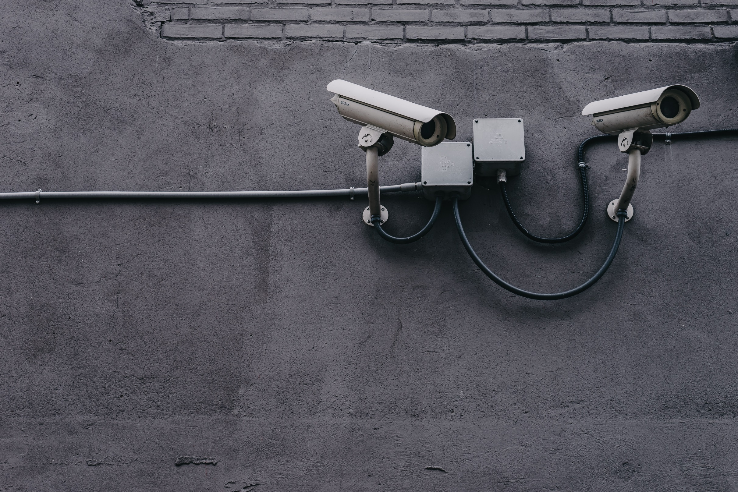
Table of Content
Table of Content
Introduction
Current Status
Recent Attacks
How It Is Happening
The Impact of Recent Attackss
Initiatives Being Taken
Conclusion

Slide 3
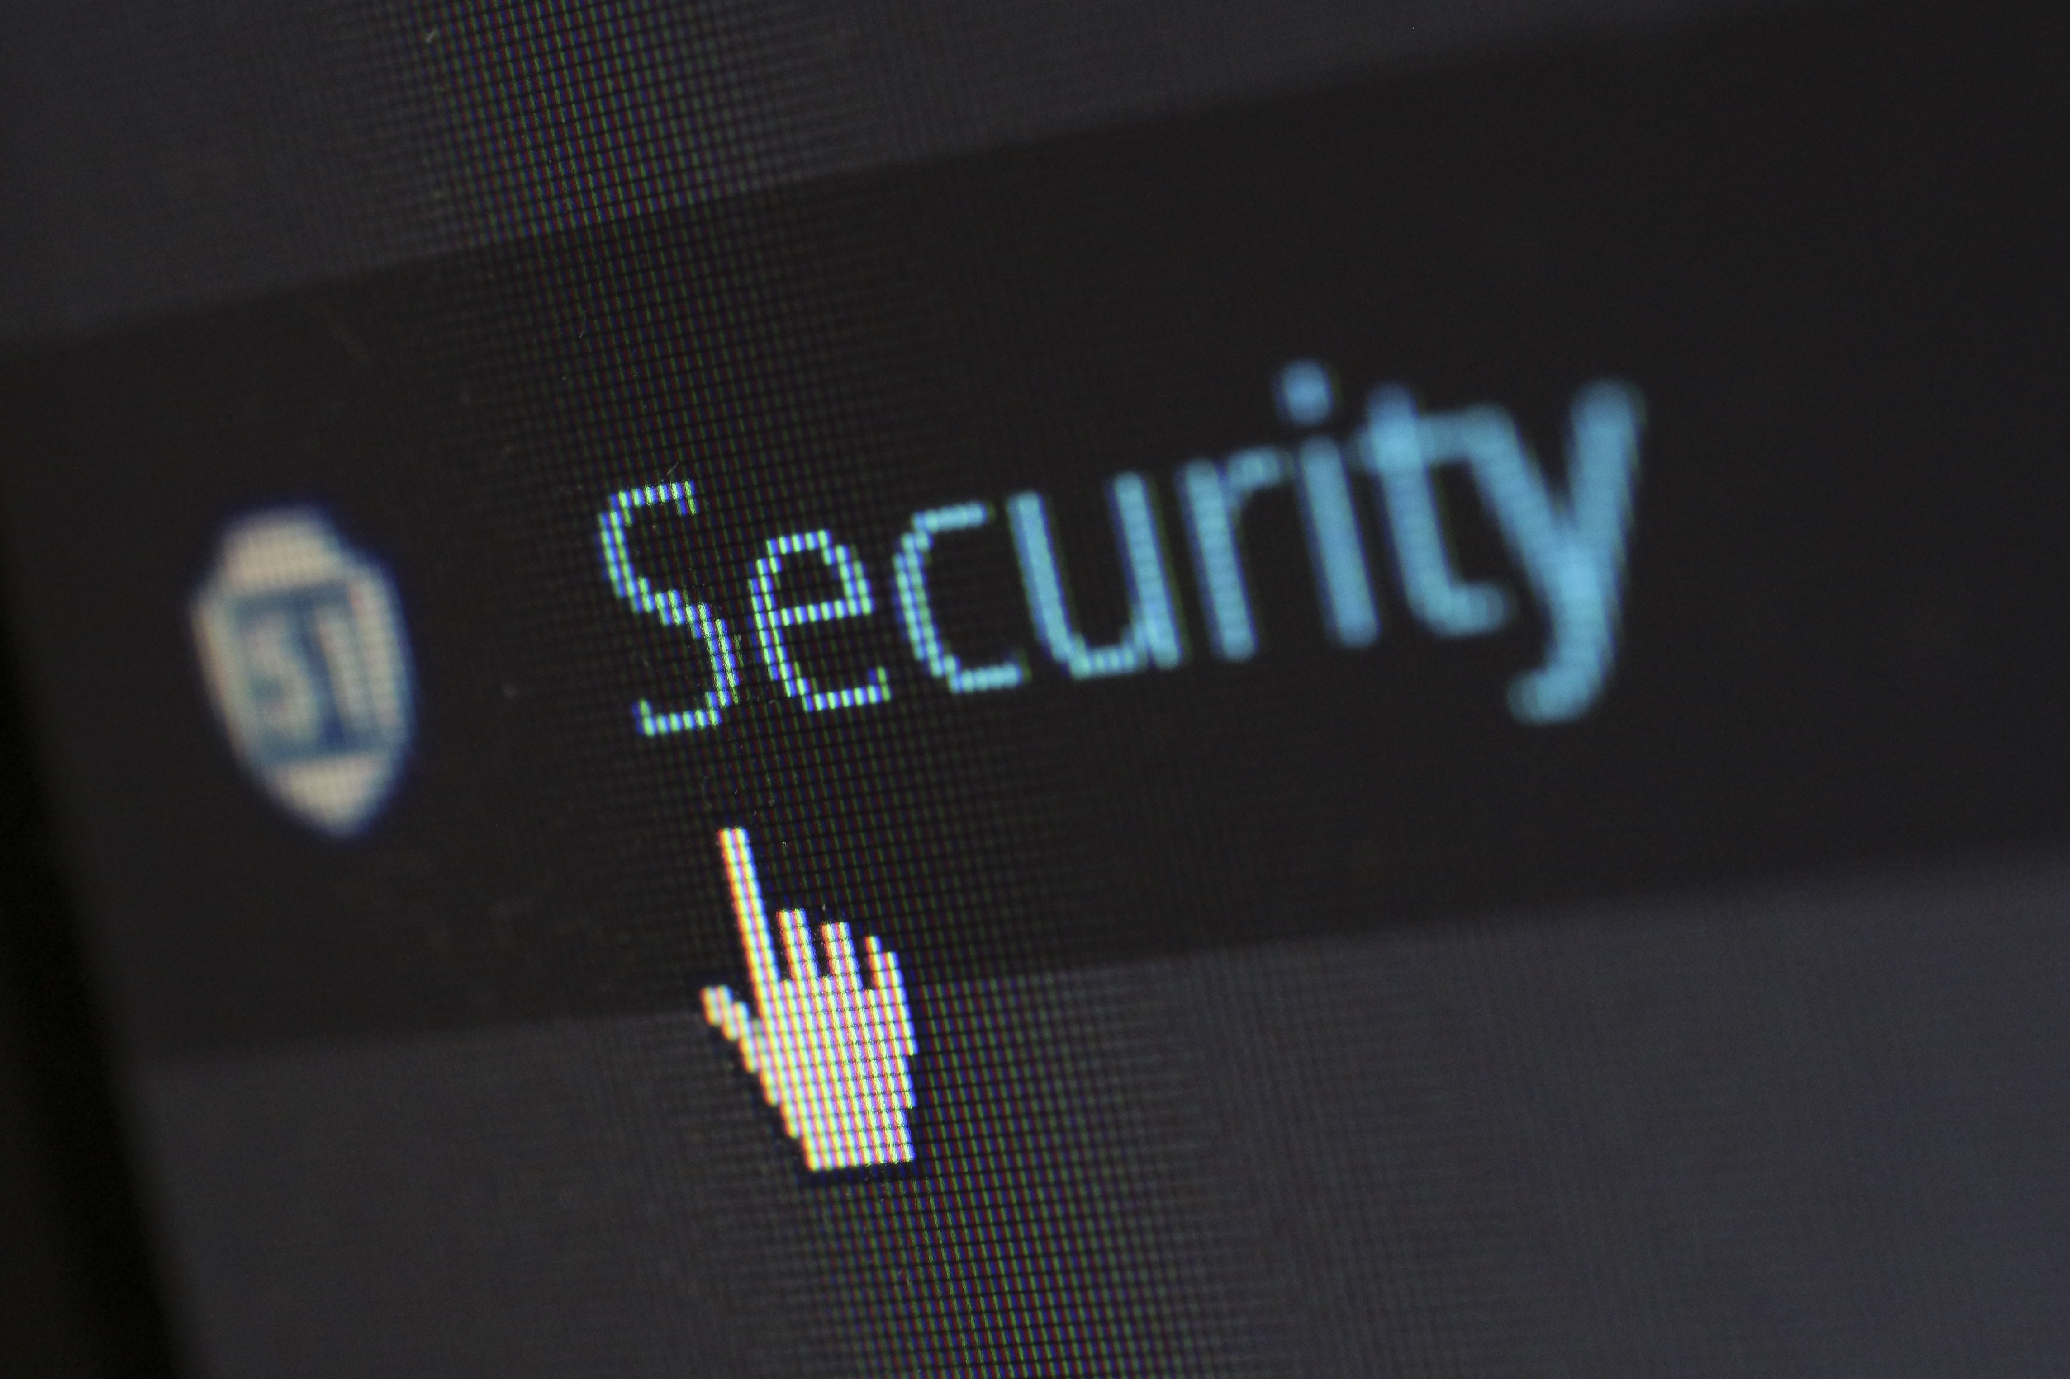
Introduction n
With a rapid increase in the use of digital technology in Pakistan, the growth of cyber security has skyrocketed. | Hence it important that we are aware of our cyber surroundings. | Cyber crime lurks in the cyber world of Pakistan and we have to be careful against it | In this presentation we will talk about the current state of Cyber Security in Pakistan

Slide 4
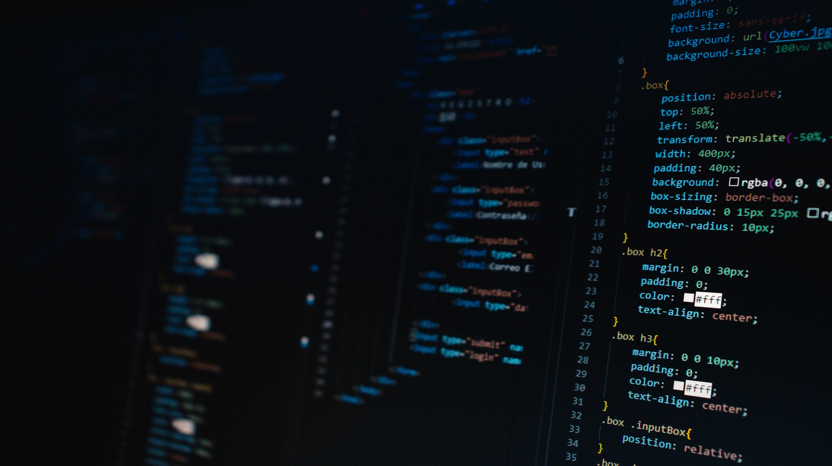
Current State
Pakistan has seen a rise in Cyber attacks that target Individuals and organizations which leads to unprecedented damage
This is recent that many universities and organizations are coming forward to give awareness to people about possible cyber crimes
This is only recently that Pakistani Universities have started to offer Cyber security programs
Take back to a couple of years Pakistan had Zero awareness about Cyber crimes and their impacts.
Pakistan has greatly improved its cyber security domain by implementing laws and regulations to address cyber crimes s Cyber security

Slide 5

Recent Attacks in Pakistan
NADRA attack in 2021
Attack on the Banking Sector
Biometric records and citizen data were reportedly exposed.
The incident raised concerns because it occurred after the launch of biometric verification services.
The exact technical details were not publicly clear.
Large-scale data exposure concerns highlighted gaps in Pakistan’s cybersecurity readiness.
Multiple banking-sector incidents have involved compromised payment cards and customer trust issues.
Some banks restricted or suspended international card payments as a precautionary response.
These incidents highlighted the need for stronger monitoring, fraud prevention, and customer awareness.

Slide 6

How Is It Happening?
The most obvious reason for the amount of cyber attacks happening on in Pakistan is due to the fact that our people have little to no awareness
Pakistan has one of the weakest IT infrastructure in the world. Considering this it is also obvious that Pakistan also has a weak cyber domain. Cyber criminals make use of it and commit cyber crimes
Social engineering is also a huge factor because humans are the weakest link in cyber security. We easily fall victim to scams .
In Pakistan we don’t pay much attention to Cyber law. It isn’t the case that these law don’t exist but rather that they are not implemented.

Slide 7

Impact of These Attacks
Financial loss is one of the most visible impacts of cyberattacks.
Businesses may face stolen funds, disrupted operations, recovery costs, and legal expenses.
Data breaches can expose sensitive information and create privacy risks.
Many cyberattacks disrupt availability by interrupting services and daily operations.
State-sponsored attacks can also create national security risks by targeting government and military systems.

Slide 8

Initiatives Being Taken
Here are a few steps that Pakistan can take to strengthen its cybersecurity:
Develop a National Cybersecurity Strategy
Increase Awareness
Enhance Collaboration
Build Cybersecurity Capabilities
Enhance Cybersecurity Education and Training
The government can take the following actions:
Establish a National Cybersecurity Agency
Develop Incident Response Capabilities
Improve Information Sharing
Invest in Research and Development
Establish Cybersecurity Standards
Develop Cyber Laws and Regulations

Slide 9
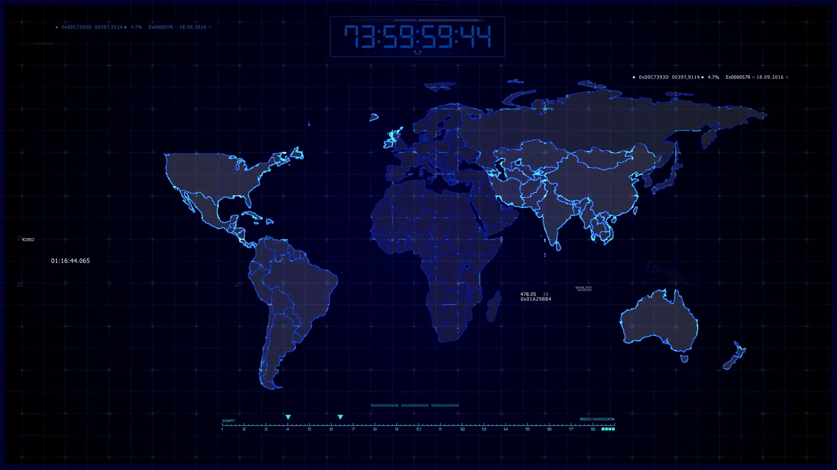
Conclusion
Cybersecurity remains a major concern for individuals, businesses, and the government in Pakistan.
The National Cybersecurity Policy 2021 and the creation of national cybersecurity institutions show that progress is being made.
Pakistan can continue strengthening its cybersecurity posture through awareness, education, stronger laws, better incident response, and investment in secure digital infrastructure.
A safer digital environment can support Pakistan’s growing digital economy.

Slide 10


Slide 11

Group Members
Group Members
Syed Qalb e Abbas
Syed Jazib Ali Rizvi
Syed Qammar Abbas
Shehroze Sameer
Hussain Ali
Syed Qalb e Abbas
Syed Jazib Ali Rizvi
Syed Qammar Abbas
Shehroze Sameer
Hussain Ali

