Slide 1

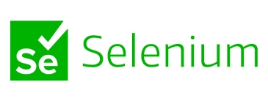
Software Testing with Selenium

Slide 2
Group Members
1.Hussain Ali(232095)
2.Shehroze Sameer(232091)
3.Syed Jazib Ali (232145)
4.Qalb e Abbass (232133)

Slide 3
Table of Contents
Project Description
Importance of Non-Functional Testing
Selenium Overview
Testing Methodology
Test Case Design
Working of Selenium
Results and Analysis
Selenium vs Other Testing Tools
Conclusion and Recommendations

Slide 4
Project Description
Assessing Student Portal
Evaluating Wikipedia Search
This project aims to assess the performance and reliability of the university's student portal login page under stress conditions.
The project also evaluates the effectiveness of Wikipedia's search engine through automated testing using Selenium.

Slide 5
Importance of Non-Functional Testing
1
Smooth User Experience
2
Stability and Reliability
3
Preventing Crashes
Non-functional testing ensures everything works as it should, assessing load handling, response times, and resource usage.
Stability and reliability testing prevents downtime and system malfunctions, ensuring consistent functioning even under pressure.
Stress testing the login page helps determine if it can accommodate heavy traffic without crashing.

Slide 6

Selenium for Web Automation
Cross-Browser Compatibility
Automation of Repetitive Tasks
Selenium's toolkit, including Grid, IDE, and WebDriver, allows for effective test automation on various platforms and browsers.
Selenium simplifies web application testing by automating monotonous operations, saving time and effort.
Multilingual Support
Selenium supports multiple programming languages, making it a versatile tool for web application automation testing.

Slide 7

Testing Methodology
Load Testing
Stress Testing
Assessing the system's ability to handle heavy traffic and user loads.
Pushing the system to its limits to identify potential weaknesses and vulnerabilities.
1
2
3
Performance Testing
Evaluating the system's response times, resource utilization, and overall efficiency.

Slide 8



Test Case Design
Login Page Validation
Wikipedia Search Validation
Dashboard Verification
Verify the functionality and usability of the login page.
Ensure the search engine provides accurate and relevant results.
Confirm successful login and redirection to the homepage/dashboard.

Slide 9
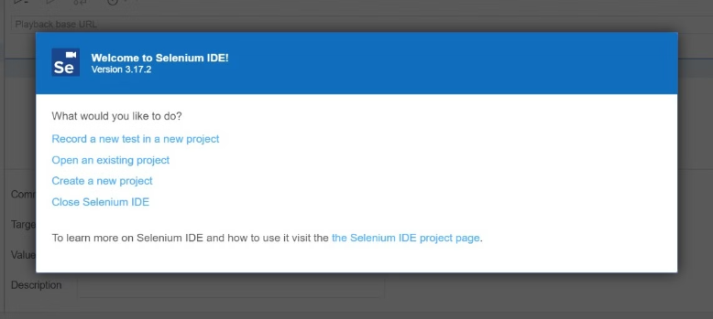
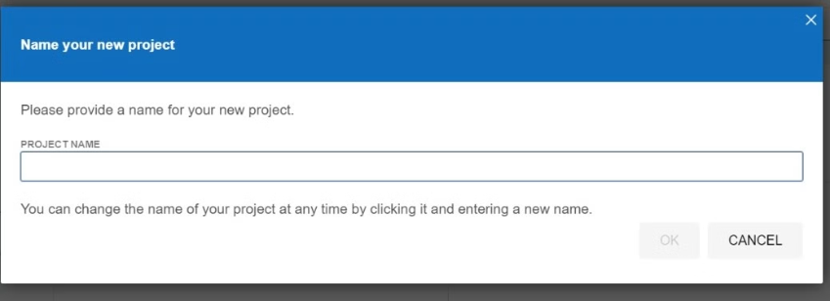
Working of Selenium
1.Click on record a new test in a new project

Slide 10
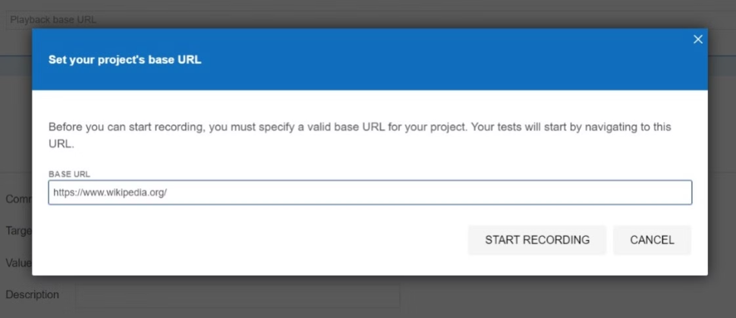
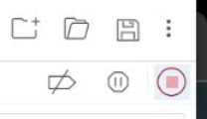
Working of Selenium
2.Then give the URL of the website you want to test( here in our case we have taken "Wikipedia" as an example)
3.Click on start recording then perform your required test.
Then stop the recording and name the test.

Slide 11
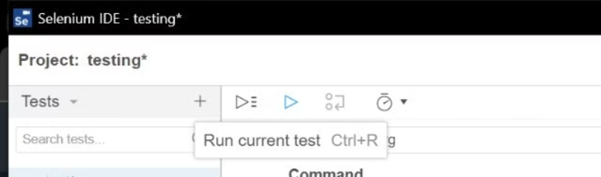
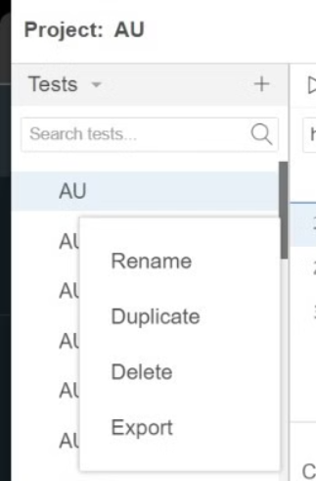
Working of Selenium
4.Click on "Run Current Test" , then Selenium will automate what we have just performed.
By doing this we can test the search engine of Wikipedia.

Slide 12
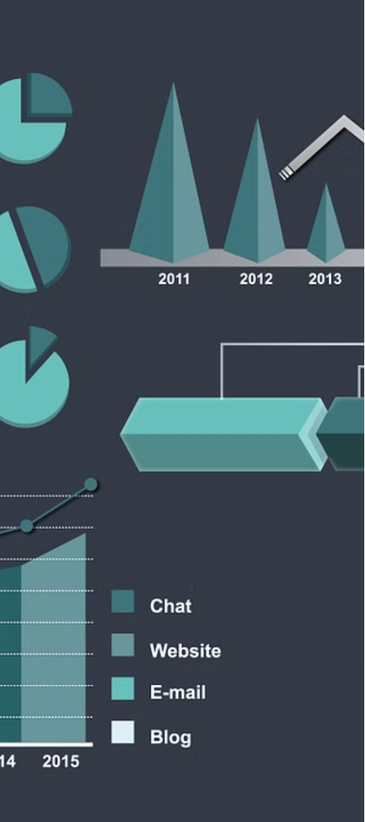



Results and Analysis
Data Collection
Collect and analyze test results to identify any discrepancies
or issues.
Bottleneck Identification
Pinpoint any performance bottlenecks or functional problems in the systems.
Issue Resolution
Recommend solutions and improvements based on
the testing findings.

Slide 13
Selenium vs Other Testing Tools
Tool | Best For | Selenium Comparison
Selenium | Web browser automation | Best fit for web UI testing and browser-based workflows
JMeter | Load and performance testing | Better than Selenium for real load/stress testing
Postman | API testing | Better for API testing; Selenium is for browser UI testing
Cypress | Modern web app testing | Easier setup, but mainly JavaScript-focused
Playwright | Cross-browser automation | More modern automation features, but Selenium has wider legacy use
Katalon Studio | Low-code test automation | Easier for beginners, but less flexible than Selenium

Slide 14


Conclusion and Recommendations
Project Summary
Future Considerations
The testing process provided valuable insights into the functionality and usability of the Air University login page and the Wikipedia search engine.
Future testing could focus on further optimizing performance and refining user experience based on the recommendations provided.

Slide 15
Thank You ☺

