Slide 1


AVIONICS BASE NETWORK
Inspired By PAC Kamra

Slide 2
Project Details
Course: Computer Networks Lab
Code: CS260L
Instructor: Mohsin Sarfraz
Date: 15th December, 2024

Slide 3
Team Members
Hussain Ali (232095)
Ahmad Ali (232147)

Slide 4
Table of Contents
Project Introduction
Network Design Objectives
Network Topology Overview
Topology Diagram
IP Allocation Table
VLAN Assignment Scheme
Router Configuration
Switch Configuration
Security Features
Testing and Validation
Team Contributions
Conclusion

Slide 5
Project Introduction
Simulating the network architecture for a military aviation base.
Based on operational needs of facilities like PAF Base Minhas, Kamra.
Goals: Scalable, secure, robust networking for aviation and military departments.

Slide 6
Objectives
Establish a secure and scalable network.
Ensure inter-departmental communication.
Simulate redundancy for mission-critical systems.
Provide centralized services (DNS, FTP, Mail).

Slide 7
Design Overview
PAC HQ Core Infrastructure: Firewall, Main Router, Distribution Switch.
Factory Locations: AMF, APF, ARF, MRF with distinct departmental divisions.
Connectivity: Point-to-point links between HQ and factories using Serial Communication.

Slide 8
Network Topology
Hierarchical Network Topology
Connectivity Design:
- Star topology: Within HQ and factories for departmental connections
- Point-to-Point Links: Efficient interconnectivity between HQ and factories using OSPF.

Slide 9
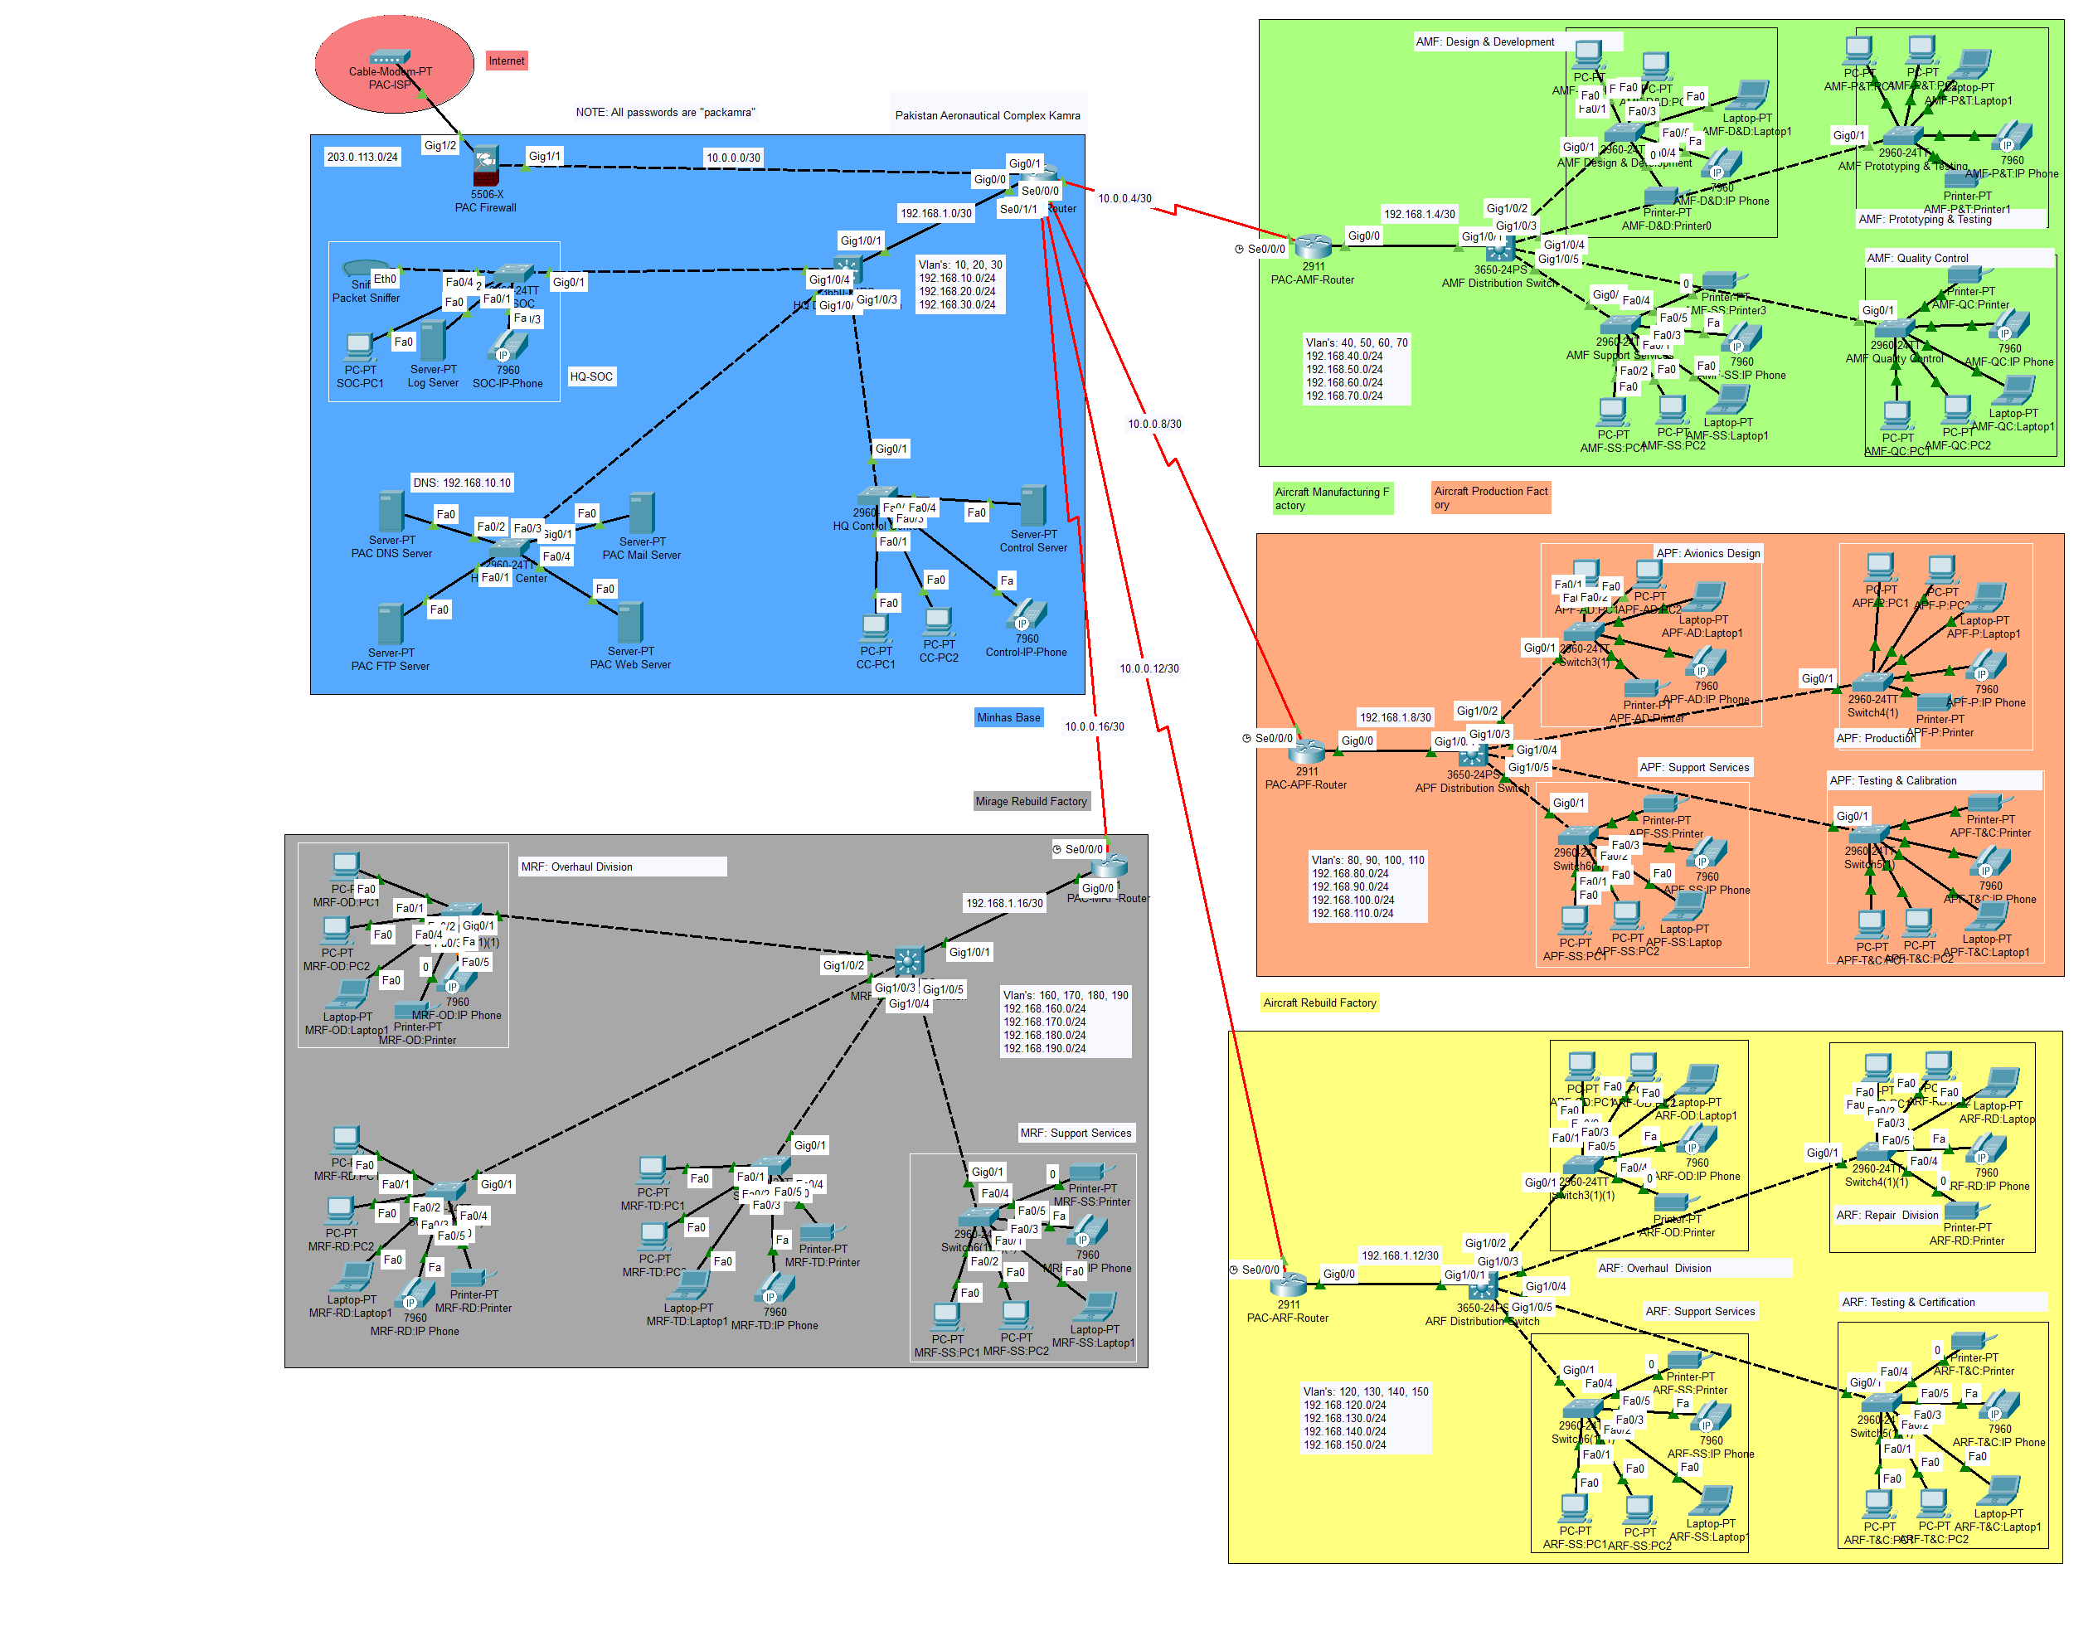

Slide 10
IP Allocation Scheme
Class C private addresses are used for VLANs, with a /24 subnet mask to accommodate up to 254 devices per VLAN.
Class A private IP addresses are used for point-to-point links, with a /30 subnet mask for efficient use of IP addresses (2 usable IPs per subnet).

Slide 11
VLAN IP Allocation
Location | VLAN | Subnet | IP Range | Devices/Subnets
PAC HQ - Data Center | VLAN 10 | 192.168.10.0/24 | 192.168.10.1 - 192.168.10.254 | DNS, FTP, Web, and Mail Servers
PAC HQ - Control Center | VLAN 20 | 192.168.20.0/24 | 192.168.20.1 - 192.168.20.254 | Control Center Devices
PAC HQ - SOC | VLAN 30 | 192.168.30.0/24 | 192.168.30.1 - 192.168.30.254 | SOC Devices
AMF - Design | VLAN 40 | 192.168.40.0/24 | 192.168.40.1 - 192.168.40.254 | PCs, IP Phones, Printers
AMF - Prototyping | VLAN 50 | 192.168.50.0/24 | 192.168.50.1 - 192.168.50.254 | PCs, IP Phones, Printers
AMF - Quality Control | VLAN 60 | 192.168.60.0/24 | 192.168.60.1 - 192.168.60.254 | PCs, IP Phones, Printers
AMF - Support Services | VLAN 70 | 192.168.70.0/24 | 192.168.70.1 - 192.168.70.254 | PCs, IP Phones, Printers
ARF - Overhaul | VLAN 80 | 192.168.80.0/24 | 192.168.80.1 - 192.168.80.254 | PCs, IP Phones, Printers
ARF - Repair | VLAN 90 | 192.168.90.0/24 | 192.168.90.1 - 192.168.90.254 | PCs, IP Phones, Printers
ARF - Testing | VLAN 100 | 192.168.100.0/24 | 192.168.100.1 - 192.168.100.254 | PCs, IP Phones, Printers
ARF - Support | VLAN 110 | 192.168.110.0/24 | 192.168.110.1 - 192.168.110.254 | PCs, IP Phones, Printers
APF - Avionics Design | VLAN 120 | 192.168.120.0/24 | 192.168.120.1 - 192.168.120.254 | PCs, IP Phones, Printers
APF - Production | VLAN 130 | 192.168.130.0/24 | 192.168.130.1 - 192.168.130.254 | PCs, IP Phones, Printers
APF - Testing/Calibration | VLAN 140 | 192.168.140.0/24 | 192.168.140.1 - 192.168.140.254 | PCs, IP Phones, Printers
APF - Support Services | VLAN 150 | 192.168.150.0/24 | 192.168.150.1 - 192.168.150.254 | PCs, IP Phones, Printers
MRF - Overhaul | VLAN 160 | 192.168.160.0/24 | 192.168.160.1 - 192.168.160.254 | PCs, IP Phones, Printers
MRF - Repair | VLAN 170 | 192.168.170.0/24 | 192.168.170.1 - 192.168.170.254 | PCs, IP Phones, Printers
MRF - Testing | VLAN 180 | 192.168.180.0/24 | 192.168.180.1 - 192.168.180.254 | PCs, IP Phones, Printers
MRF - Support | VLAN 190 | 192.168.190.0/24 | 192.168.190.1 - 192.168.190.254 | PCs, IP Phones, Printers

Slide 12
P2P IP Allocation
Link | Source IP | Destination IP | Subnet | Devices/Usage
ISP -> PAC-FW (Firewall) | 203.0.113.x | 203.0.113.1 | 203.0.113.0/30 | Internet to Firewall connection
PAC-FW (Firewall) -> PAC-MR (Main Router) | 10.0.0.2 | 10.0.0.1 | 10.0.0.0/30 | Firewall to Main Router connection
PAC-MR (Main Router) -> PAC-AMF (Aircraft Manufacturing Factory) | 10.0.0.5 | 10.0.0.6 | 10.0.0.4/30 | Main Router to Aircraft Manufacturing Factory connection
PAC-MR (Main Router) -> PAC-APF (Avionics Production Factory) | 10.0.0.9 | 10.0.0.10 | 10.0.0.8/30 | Main Router to Avionics Production Factory connection
PAC-MR (Main Router) -> PAC-ARF (Aircraft Rebuild Factory) | 10.0.0.13 | 10.0.0.14 | 10.0.0.12/30 | Main Router to Aircraft Rebuild Factory connection
PAC-MR (Main Router) -> PAC-MRF (Mirage Rebuild Factory) | 10.0.0.17 | 10.0.0.18 | 10.0.0.16/30 | Main Router to Mirage Rebuild Factory connection
PAC Main Router -> PAC Distribution Switch | 192.168.1.1 | 192.168.1.2 | 192.168.1.0/30 | Main Router to Distribution Switch connection
PAC Aircraft Manufacturing Factory -> PAC Distribution Switch | 192.168.1.5 | 192.168.1.6 | 192.168.1.4/30 | Aircraft Manufacturing Factory to Distribution Switch connection
PAC Avionics Production Factory -> PAC Distribution Switch | 192.168.1.9 | 192.168.1.10 | 192.168.1.8/30 | Avionics Production Factory to Distribution Switch connection
PAC Aircraft Rebuild Factory -> PAC Distribution Switch | 192.168.1.13 | 192.168.1.14 | 192.168.1.12/30 | Aircraft Rebuild Factory to Distribution Switch connection
PAC Mirage Rebuild Factory -> PAC Distribution Switch | 192.168.1.17 | 192.168.1.18 | 192.168.1.16/30 | Mirage Rebuild Factory to Distribution Switch connection

Slide 13
Router’s Configuration
Basic Security Configurations
Dynamic Routing using OSPF Protocol
Firewall Integration using ACL
NAT Configuration on Main Router
Default Route to Main Router/ISP

Slide 14
L3 Switch Configuration
Basic Security Configurations
VLAN Configuration
Inter-VLAN Routing
Trunk Ports
Default Route to Main/Factory Router

Slide 15
Security Features
Firewall Policies: Restrict access between VLANs and external networks.
Access Control Lists (ACLs): Restrict factory to factory communication.
Security Recommendations:
Firewalls, IPS, strong authentication, and encryption.
Regular audits and updates.

Slide 16
Testing and Validation
Ping Tests: Verified inter-device connectivity.
Service Verification:
DNS, FTP, Web, and Mail services tested for redundancy and availability.

Slide 17
Conclusion
Successfully modeled a secure, scalable network for military aviation needs.
Ensured redundancy, efficient communication, and high availability.
Future improvements: Advanced security and routing techniques.

Slide 18
References
Pakistan Aeronautical Complex (PAC) Official Website — https://www.pac.org.pk/
PAF Base Minhas — https://en.wikipedia.org/wiki/PAF_Base_Minhas
Cisco Packet Tracer Documentation
Cisco Networking Academy: Routing and Switching Concepts
Cisco Network Security Guidelines
Computer Networks Lab Course Material, CS260L

Slide 19


THANK YOU!

