Slide 1
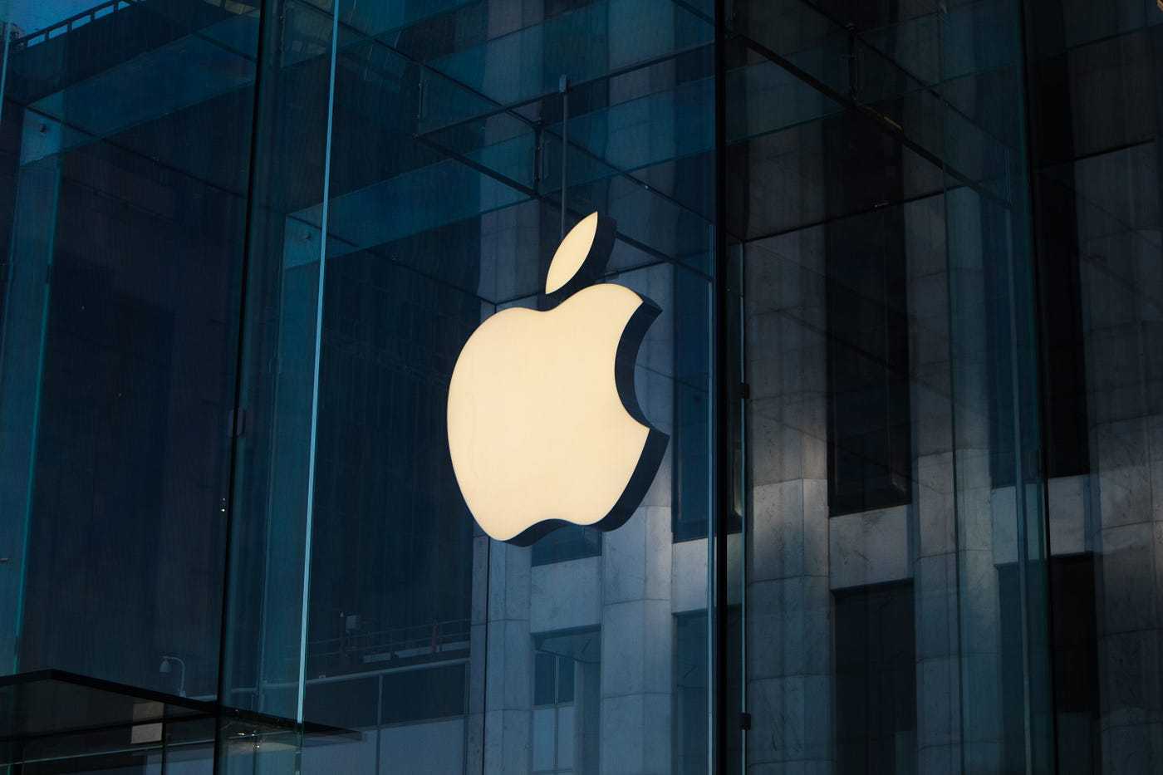

Topic:
Business Intelligence and Management Integration in Apple Inc.

Slide 2

03
Process Analysis
TABLE OF CONTENTS
Topic:
Business Intelligence and Management Integration in Apple Inc.
01
02
Organizational
Overview
Key Business Processes

Slide 3
TABLE OF CONTENTS
04
Business Intelligence
Tools and Emerging
Technologies
Topic:
TABLE OF CONTENTS
Business Intelligence and Management Integration in Apple Inc.
06
01
02
03
Integration of Technical and Management Skills
Organizational
Overview
Key Business Processes
Process Analysis
05
Management Concepts Application

Slide 4
08
Recommendations
TABLE OF CONTENTS
TABLE OF CONTENTS
07
04
05
06
Business Intelligence
Tools and Emerging
Technologies
Integration of Technical and Management Skills
Management Concepts Application
BI Dashboard
09
Final Deliverables

Slide 5
ORGANIZATIONAL OVERVIEW
01
TABLE OF CONTENTS
Company Overview : Founded in 1976 Headquarters Cupertino, California by Steve Jobs, Steve Wozniak, and Ronald Wayne. Current CEO: Tim Cook.
Leading technology company specializing in consumer electronics, software, and online services. First product Apple I. Iconic launches are Macintosh (PC) (1984), iPhone (2007).
07
08
09
BI Dashboard
Recommendations
Final Deliverables
Key Products and Services : iPhones, MacBooks, iPads, Apple watch,
Apple Music, and App Store. Annual Revenue (2023): $394 billion.
Market Cap: Largest publicly traded company globally.

Slide 6
ORGANIZATIONAL OVERVIEW
Key Business Processes
01
Company Overview : Founded in 1976 Headquarters Cupertino, California by Steve Jobs, Steve Wozniak, and Ronald Wayne. Current CEO: Tim Cook.
Leading technology company specializing in consumer electronics, software, and online services. First product Apple I. Iconic launches are Macintosh (PC) (1984), iPhone (2007).
Key Products and Services : iPhones, MacBooks, iPads, Apple watch,
Apple Music, and App Store. Annual Revenue (2023): $394 billion.
Market Cap: Largest publicly traded company globally.

Slide 7
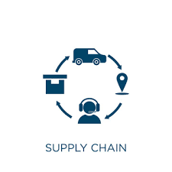
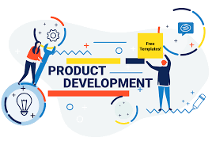

ORGANIZATIONAL OVERVIEW
01
Key Business Processes
Company Overview : Founded in 1976 Headquarters Cupertino, California by Steve Jobs, Steve Wozniak, and Ronald Wayne. Current CEO: Tim Cook.
Leading technology company specializing in consumer electronics, software, and online services. First product Apple I. Iconic launches are Macintosh (PC) (1984), iPhone (2007).
v
Apple’s supply chain is highly efficient, relying on strategic partnerships and just-in-time manufacturing.
Mapped Process: Supplier sourcing, Manufacturing coordination, Logistics , Retail distribution.
Key Products and Services : iPhones, MacBooks, iPads, Apple watch,
Apple Music, and App Store. Annual Revenue (2023): $394 billion.
Market Cap: Largest publicly traded company globally.
Supply Chain Management:
Apple’s product development emphasizes innovation, user-centric design, and cutting-edge technology. It follows iterative cycles of prototyping, testing, and refining to ensure excellence. Sustainability is integrated by using recycled materials and energy-efficient processes. This approach consistently sets industry benchmarks and enhances customer satisfaction..
Apple’s marketing and branding focus on simplicity, innovation, and premium quality, building strong customer
Product Development:
Marketing and Branding:

Slide 8
Key Business Processes
v
Apple’s supply chain is highly efficient, relying on strategic partnerships and just-in-time manufacturing.
Mapped Process: Supplier sourcing, Manufacturing coordination, Logistics , Retail distribution.
Supply Chain Management:
Marketing and Branding:
Apple’s marketing and branding focus on simplicity, innovation, and premium quality, building strong customer
Apple’s product development emphasizes innovation, user-centric design, and cutting-edge technology. It follows iterative cycles of prototyping, testing, and refining to ensure excellence. Sustainability is integrated by using recycled materials and energy-efficient processes. This approach consistently sets industry benchmarks and enhances customer satisfaction..
Product Development:

Slide 9
Key Business Processes
v
Apple’s product development emphasizes innovation, user-centric design, and cutting-edge technology. It follows iterative cycles of prototyping, testing, and refining to ensure excellence. Sustainability is integrated by using recycled materials and energy-efficient processes. This approach consistently sets industry benchmarks and enhances customer satisfaction..
Marketing and Branding:
Apple’s marketing and branding focus on simplicity, innovation, and premium quality, building strong customer
Product Development:
Apple’s supply chain is highly efficient, relying on strategic partnerships and just-in-time manufacturing.
Mapped Process: Supplier sourcing, Manufacturing coordination, Logistics , Retail distribution.
Supply Chain Management:

Slide 10
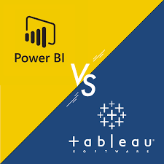
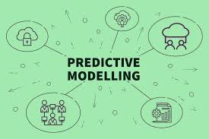

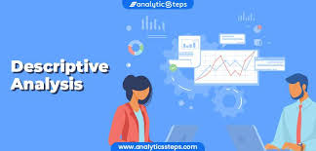
Business Intelligence Tools
Tableau and Power BI:
Dashboards tracking global sales, inventory, and performance KPIs.
Process Analysis
Business Process Mapping :
Visual representation of the supply chain
and Product development lifecycle.
Detailed supply chain process:
Procurement → Assembly → Distribution → Retail/Online
Sales.
Product development cycle:
Ideation → Prototyping → Testing → Launch.
Challenges Identified :
Intense competition from rivals like Samsung and Google.
Complex global supply chains prone to disruptions. High competition in the technology sector.
Dependence on external suppliers for components.
v
Predictive Modeling:
Predictive modeling helps Apple forecast demand and personalize experiences, ensuring smarter decisions and market leadership.
.
Descriptive Analytics:
Descriptive analytics helps Apple analyze past performance to identify trends, improve operations, and enhance customer satisfaction.

Slide 11
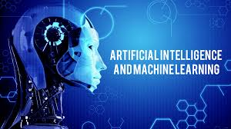
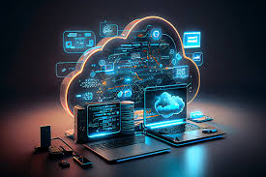
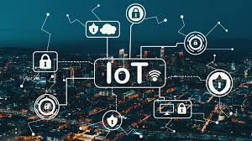
Emerging Technologies
AI and Machine Learning:
Personalized recommendations in App Store and Apple Music.
Business Intelligence Tools
Tableau and Power BI:
Predictive Modeling:
Dashboards tracking global sales, inventory, and performance KPIs.
Predictive modeling helps Apple forecast demand and personalize experiences, ensuring smarter decisions and market leadership.
.
Cloud Computing:
Enhancing data security and reliability for iCloud.
Descriptive Analytics:
Descriptive analytics helps Apple analyze past performance to identify trends, improve operations, and enhance customer satisfaction.
IoT:
Seamless connectivity across Apple devices using AirDrop and HomeKit.

Slide 12
Management Concepts Application
Emerging Technologies
Strategic Planning:
SWOT Analysis:
Strengths: Strong brand equity, innovation.
Weaknesses: High product prices.
Opportunities: Expansion in developing markets
Threats: Market saturation, supply chain risks.
Porter’s Five Forces : Bargaining power of suppliers: High
due to reliance on unique components.
Leadership and Decision Making:
Collaborative decision-making led by Tim Cook.
Focus on diversity and cross-functional teams.
AI and Machine Learning:
Cloud Computing:
Personalized recommendations in App Store and Apple Music.
Enhancing data security and reliability for iCloud.
IoT:
Seamless connectivity across Apple devices using AirDrop and HomeKit.

Slide 13
Management Concepts Application
Integration of Technical and Management Skills
Strategic Planning:
SWOT Analysis:
Strengths: Strong brand equity, innovation.
Weaknesses: High product prices.
Opportunities: Expansion in developing markets
Threats: Market saturation, supply chain risks.
Porter’s Five Forces : Bargaining power of suppliers: High
due to reliance on unique components.
Leadership and Decision Making:
Collaborative decision-making led by Tim Cook.
Focus on diversity and cross-functional teams.
Fusion of Management Theories and Technical
Expertise :
Gantt charts for timeline adherence in launches like iPhone and
Apple Vision Pro.
Integrating Lean Management principles for efficiency.
Applying Maslow’s Hierarchy to motivate teams.
Risk Management :
Developing contingency plans for supply chain risks using
scenario planning to counter chip shortages. Risk matrix
addressing cybersecurity threats.

Slide 14
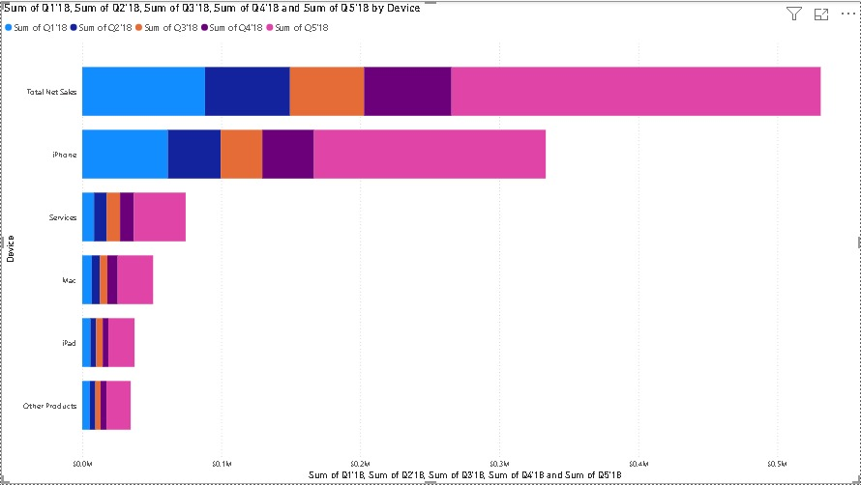
BI Dashboard (Example Visualization)
Management Concepts Application
Integration of Technical and Management Skills
Strategic Planning:
SWOT Analysis:
Strengths: Strong brand equity, innovation.
Weaknesses: High product prices.
Opportunities: Expansion in developing markets
Threats: Market saturation, supply chain risks.
Porter’s Five Forces : Bargaining power of suppliers: High
due to reliance on unique components.
Leadership and Decision Making:
Collaborative decision-making led by Tim Cook.
Focus on diversity and cross-functional teams.
Fusion of Management Theories and Technical
Expertise :
Gantt charts for timeline adherence in launches like iPhone and
Apple Vision Pro.
Integrating Lean Management principles for efficiency.
Applying Maslow’s Hierarchy to motivate teams.
Risk Management :
Developing contingency plans for supply chain risks using
scenario planning to counter chip shortages. Risk matrix
addressing cybersecurity threats.

Slide 15
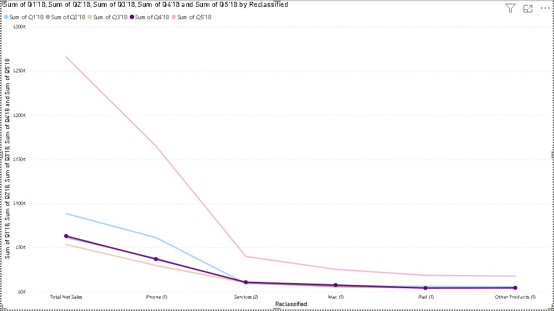
BI Dashboard (Example Visualization)
BI Dashboard (Example Visualization)
Integration of Technical and Management Skills
Insights Presented:
Sales performance by region.
Customer satisfaction trends.
Supply chain efficiency metrics.
Fusion of Management Theories and Technical
Expertise :
Gantt charts for timeline adherence in launches like iPhone and
Apple Vision Pro.
Integrating Lean Management principles for efficiency.
Applying Maslow’s Hierarchy to motivate teams.
Risk Management :
Developing contingency plans for supply chain risks using
scenario planning to counter chip shortages. Risk matrix
addressing cybersecurity threats.

Slide 16
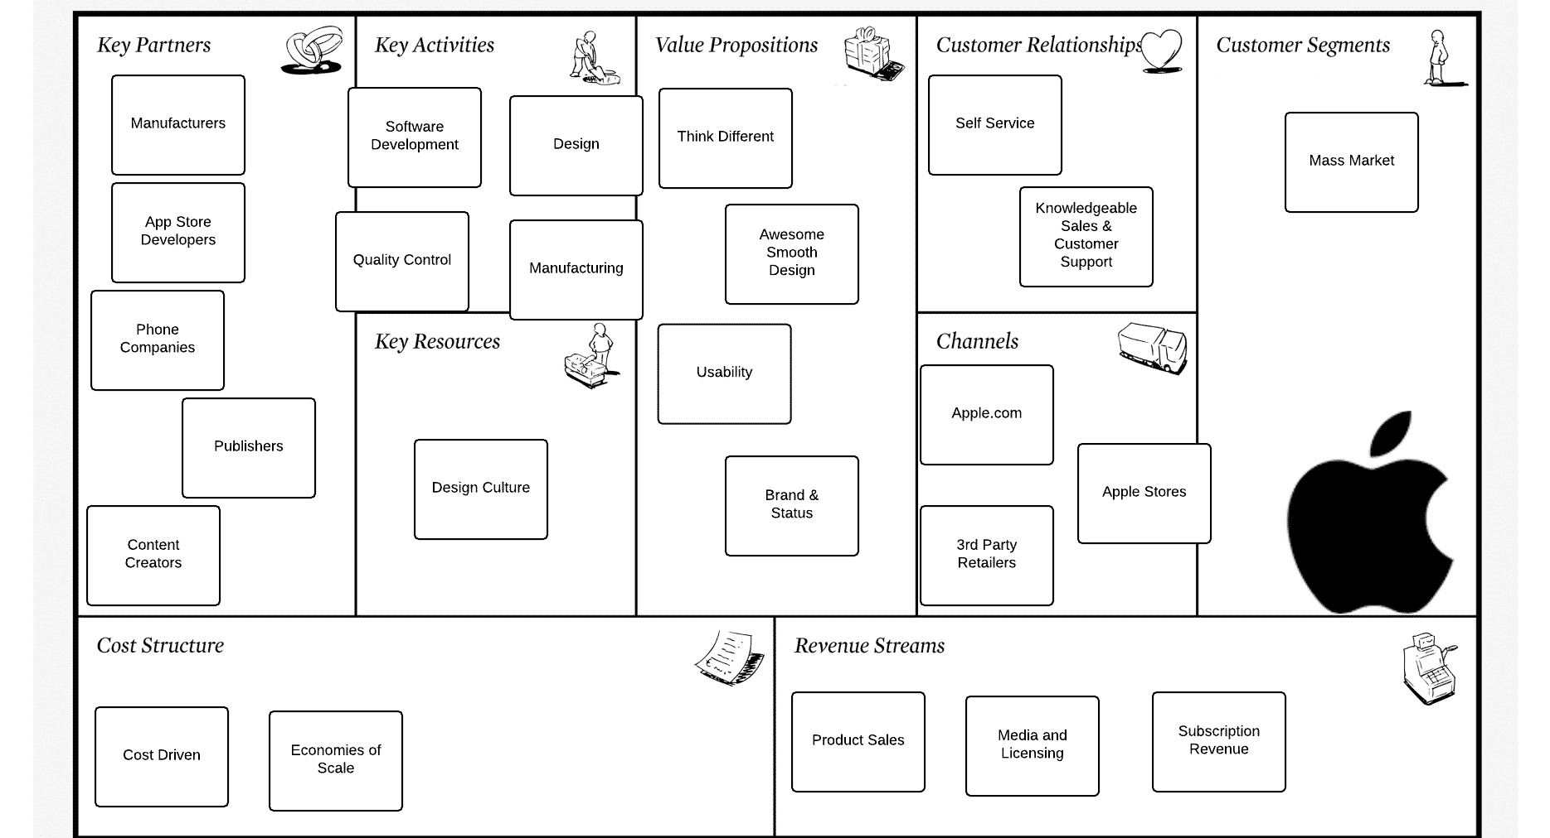
BUSINESS PROCESS MODEL
BI Dashboard (Example Visualization)
Insights Presented:
Sales performance by region.
Customer satisfaction trends.
Supply chain efficiency metrics.

Slide 17
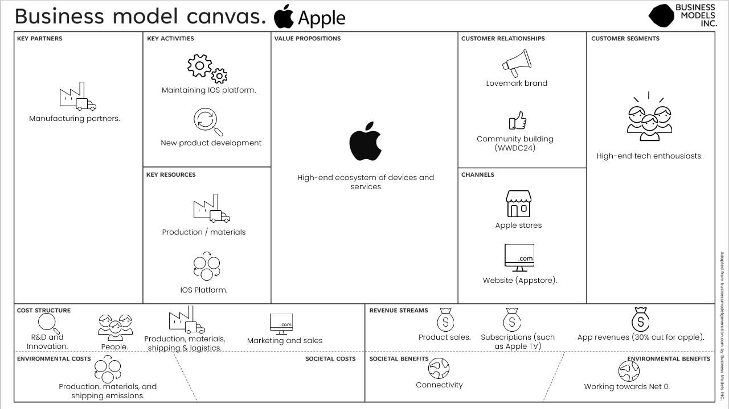
BUSINESS PROCESS MODEL
BUSINESS PROCESS MODEL
BI Dashboard (Example Visualization)

Slide 18
Recommendations
BUSINESS PROCESS MODEL
Improving Supply Chain Resilience:
Diversify suppliers and use predictive analytics for risk mitigation. Onshoring production facilities and multi-supplier strategies.
Enhancing Product Development:
Integrate more AI-driven tools in R&D.
Optimizing Decision-Making:
Broaden the use of BI tools for real-time insights.

Slide 19
Conclusion: Driving Innovation Through Intelligence
Recommendations
Apple’s Strength:
A leader in blending innovation with strategic management, ensuring sustained growth.
Key Insights:
Business intelligence and emerging technologies are pivotal to Apple’s efficiency and decision-making.
Strong leadership and strategic planning drive its market success.
Recommendations:
Diversify supply chains, enhance AI and IoT integration, and leverage predictive analytics for personalization.
Final Note:
Apple’s success showcases how innovation and management excellence transform challenges into opportunities,
shaping the future.
Improving Supply Chain Resilience:
Diversify suppliers and use predictive analytics for risk mitigation. Onshoring production facilities and multi-supplier strategies.
Enhancing Product Development:
Integrate more AI-driven tools in R&D.
Optimizing Decision-Making:
Broaden the use of BI tools for real-time insights.

Slide 20
Question And Answers?
Let’s Explore the Future of Apple Together.
Conclusion: Driving Innovation Through Intelligence
Apple’s Strength:
A leader in blending innovation with strategic management, ensuring sustained growth.
Key Insights:
Business intelligence and emerging technologies are pivotal to Apple’s efficiency and decision-making.
Strong leadership and strategic planning drive its market success.
Recommendations:
Diversify supply chains, enhance AI and IoT integration, and leverage predictive analytics for personalization.
Final Note:
Apple’s success showcases how innovation and management excellence transform challenges into opportunities,
shaping the future.

Slide 21
Conclusion: Driving Innovation Through Intelligence
Apple’s Strength:
A leader in blending innovation with strategic management, ensuring sustained growth.
Key Insights:
Business intelligence and emerging technologies are pivotal to Apple’s efficiency and decision-making.
Strong leadership and strategic planning drive its market success.
Recommendations:
Diversify supply chains, enhance AI and IoT integration, and leverage predictive analytics for personalization.
Final Note:
Apple’s success showcases how innovation and management excellence transform challenges into opportunities,
shaping the future.
Question And Answers?
Let’s Explore the Future of Apple Together.

