Slide 1
Partial Derivatives of Vector Valued Functions & Vector Derivatives
Multivariable Calculus
MA-105
Group #2
Chapter #12, 13 & 15

Slide 2
Introduction
Multivariable Calculus studies functions with multiple variables. These functions appear in fields like physics, engineering, 3D modeling, and cybersecurity.
In this presentation, we will explore:
• How vector-valued functions behave
• How partial and vector derivatives describe changes
• How gradient, divergence, and curl reveal spatial behavior
Understanding these tools helps model and predict complex systems — from fluid flow to dynamic threats in cyberspace.

Slide 3
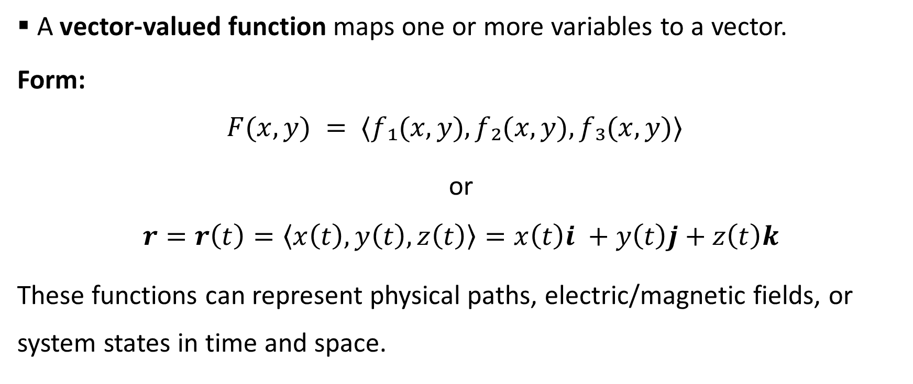
Vector-Valued Function – Definition
A vector-valued function maps one or more variables to a vector.
Form:
$$F(x, y) = ⟨f₁(x, y), f₂(x, y), f₃(x, y)⟩$$
or
$$r=r\left(t\right)=\left\langle x\left(t\right),y\left(t\right),z\left(t\right)\right\rangle =x\left(t\right)i +y\left(t\right)j+z\left(t\right)k$$
These functions can represent physical paths, electric/magnetic fields, or system states in time and space.

Slide 4
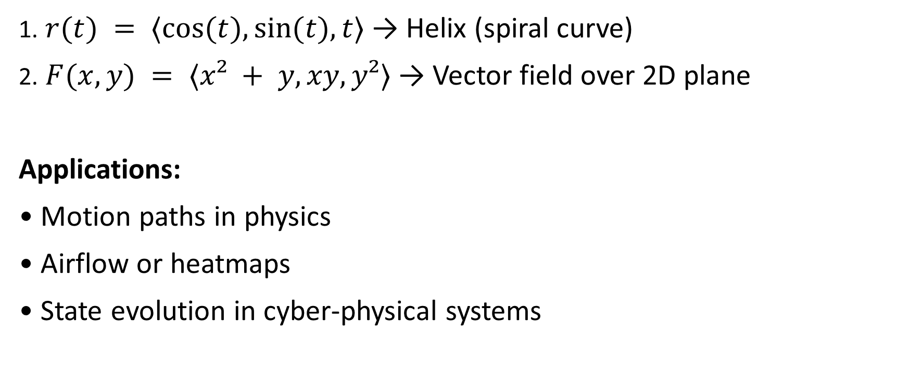
Vector-Valued Function – Examples
1. $r(t) = ⟨cos⁡(t), sin⁡(t), t⟩$→ Helix (spiral curve)
2. $F(x, y) = ⟨x² + y, xy, y²⟩$→ Vector field over 2D plane
Applications:
• Motion paths in physics
• Airflow or heatmaps
• State evolution in cyber-physical systems

Slide 5
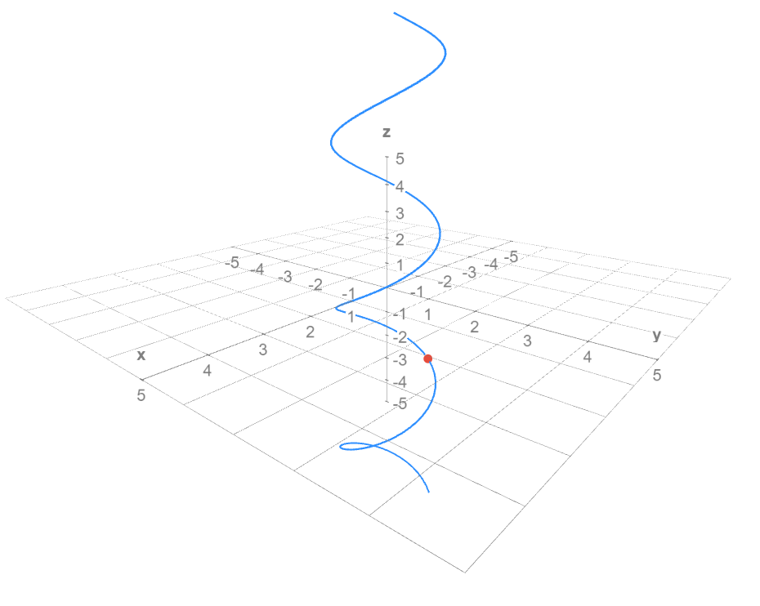
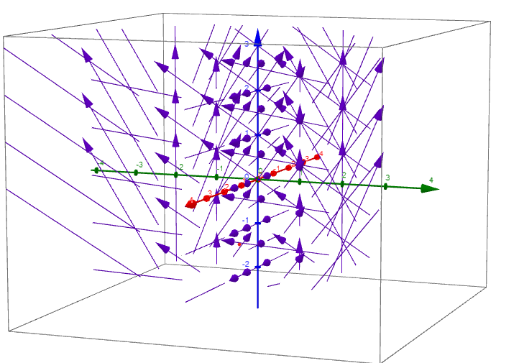
Vector-Valued Function - Visualization

Slide 6
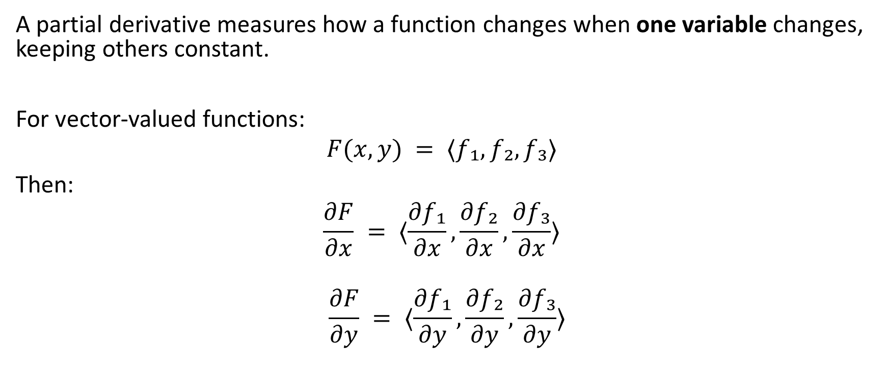
Partial Derivatives - Definition
A partial derivative measures how a function changes when one variable changes, keeping others constant.
For vector-valued functions:
$$F(x, y) = ⟨f₁, f₂, f₃⟩$$
Then:
$$\frac{∂F}{∂x} = ⟨\frac{∂f₁}{∂x},\frac{∂f₂}{∂x},\frac{∂f₃}{∂x}⟩$$
$$\frac{∂F}{∂y} = ⟨\frac{∂f₁}{∂y},\frac{∂f₂}{∂y},\frac{∂f₃}{∂y}⟩$$

Slide 7
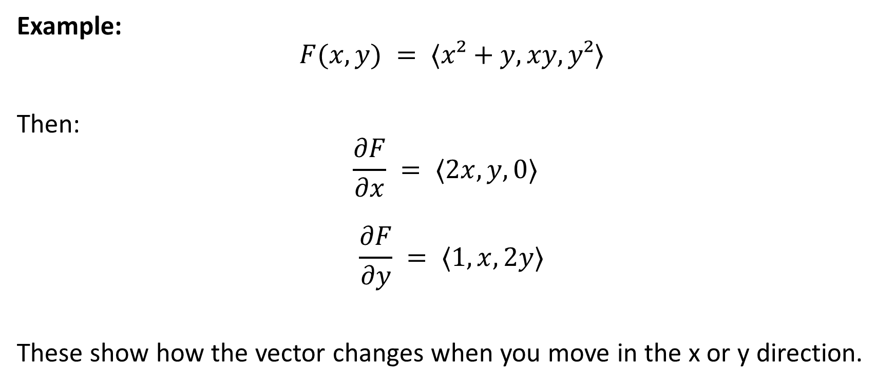
Partial Derivatives - Example
Example:
$$F(x, y) = ⟨x²+y, xy, y²⟩$$
Then:
$$\frac{∂F}{∂x} = ⟨2x, y, 0⟩$$
$$\frac{∂F}{∂y} = ⟨1, x, 2y⟩$$
These show how the vector changes when you move in the x or y direction.

Slide 8
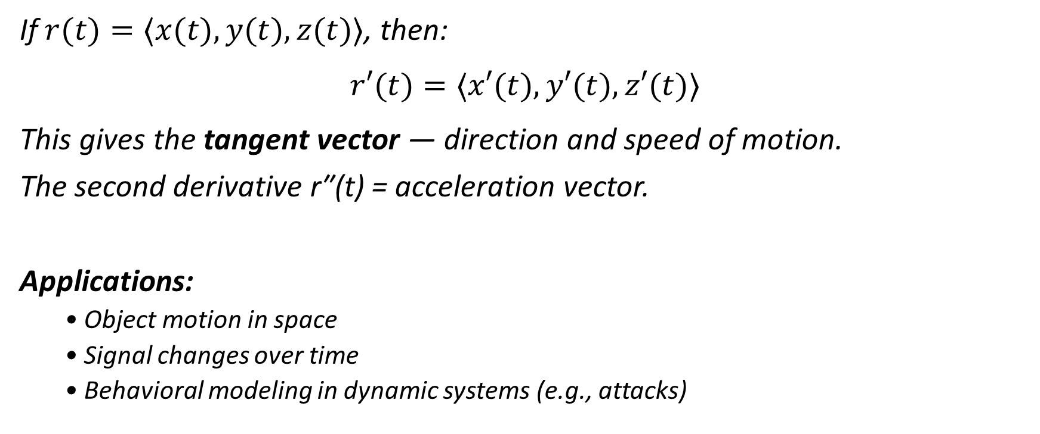
The Vector Derivative
If $r(t)=⟨x(t), y(t), z(t)⟩$, then:
$$r′(t)=⟨x′(t), y′(t), z′(t)⟩$$
This gives the tangent vector — direction and speed of motion.
The second derivative r″(t) = acceleration vector.
Applications:
• Object motion in space
• Signal changes over time
• Behavioral modeling in dynamic systems (e.g., attacks)

Slide 9

Del Operator ∇
The del operator ∇ is used to define a key operation:
$$∇ = ⟨\frac{∂}{∂x},\frac{∂}{∂y},\frac{∂}{∂z}⟩$$
It is the base for:
• Gradient: ∇ g
• Divergence: ∇ · F
• Curl: ∇ × F

Slide 10
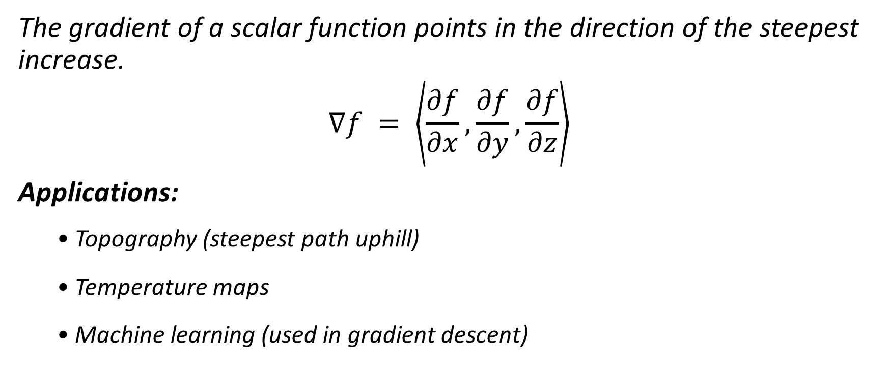
Gradient (∇g)
The gradient of a scalar function points in the direction of the steepest increase.
$$∇f = \left\langle \frac{∂f}{∂x},\frac{∂f}{∂y},\frac{∂f}{∂z}\right\rangle$$
Applications:
• Topography (steepest path uphill)
• Temperature maps
• Machine learning (used in gradient descent)

Slide 11

Gradient (∇g) - Example
If
$$f(x, y) = x² + y²$$
Then:
$$∇f = ⟨2x, 2y⟩$$
At point (1,2):
$∇f = ⟨2, 4⟩$→ points outward from origin
Used in ML to update weights in threat detection models.

Slide 12
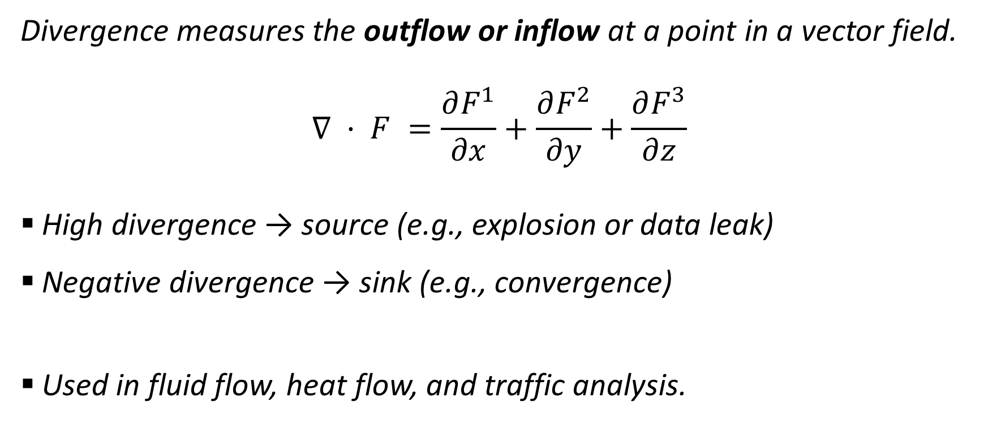
Divergence (∇·F)
Divergence measures the outflow or inflow at a point in a vector field.
$$∇ · F =\frac{∂F^{1}}{∂x}+\frac{∂F^{2}}{∂y}+\frac{∂F^{3}}{∂z}$$
High divergence → source (e.g., explosion or data leak)
Negative divergence → sink (e.g., convergence)
Used in fluid flow, heat flow, and traffic analysis.

Slide 13
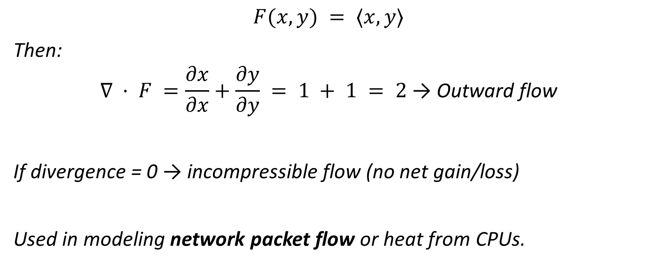
Divergence (∇·F) - Example
$$F(x, y) = ⟨x, y⟩$$
Then:
$$∇ · F =\frac{∂x}{∂x}+\frac{∂y}{∂y} = 1 + 1 = 2 \text{→ }\text{Outward} \text{flow}$$
If divergence = 0 → incompressible flow (no net gain/loss)
Used in modeling network packet flow or heat from CPUs.

Slide 14
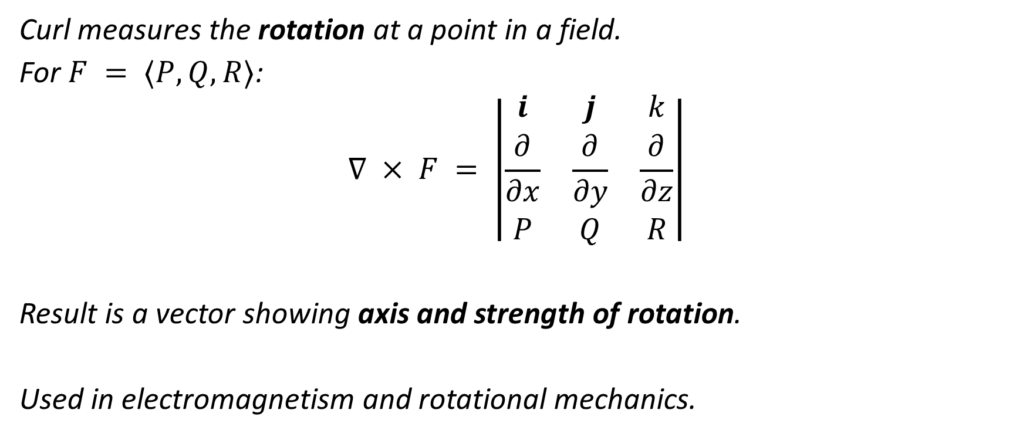
Curl (∇×F)
Curl measures the rotation at a point in a field.
For $F = ⟨P, Q, R⟩$:
$$∇ × F = \left|\begin{matrix}i & j & k \\ \frac{∂}{∂x} & \frac{∂}{∂y} & \frac{∂}{∂z} \\ P & Q & R\end{matrix}\right|$$
Result is a vector showing axis and strength of rotation.
Used in electromagnetism and rotational mechanics.

Slide 15
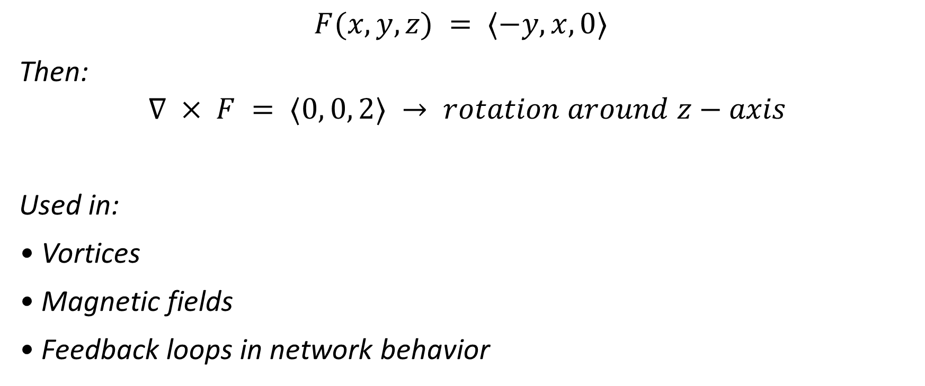
Curl (∇×F) - Example
$$F(x, y, z) = ⟨−y, x, 0⟩$$
Then:
$$∇ × F = ⟨0, 0, 2⟩ → rotation around z−axis$$
Used in:
• Vortices
• Magnetic fields
• Feedback loops in network behavior

Slide 16
Summary Table
Concept | Symbol | Input | Output | Interpretation
Gradient | ∇f | Scalar | Vector | Max rate of increase
Divergence | ∇·F | Vector | Scalar | Spread of field
Curl | ∇×F | Vector | Vector | Local rotation

Slide 17
Relevance to Cybersecurity
These mathematical tools also aid in cybersecurity:
• Vector Fields → System state or network activity
• Gradients → Risk change rates or ML optimization
• Divergence → Detecting data leaks or system load
• Curl → Identifying circular patterns (botnet activity)
They’re especially relevant in signal analysis, AI training, and behavioral modeling.

Slide 18
Discussion Time We welcome your questions!
Thank You

