Slide 1
John the ripper
Cracking Password Hash in Kali Linux
Academic lab demonstration using dummy hashes only

Slide 2
Table of Contents
Benefits of Kali Linux
Overview of John the Ripper
Understanding Password Hashes
Process of Using John the Ripper
Cracking a password
Johnny, a GUI for John
Mitigation Against Hash Cracking Risks

Slide 3
Benefits of Kali Linux
Provides a wide range of pre-installed cybersecurity tools.
Kali Linux is designed to adhere to security standards and best practices.
Kali Linux is based on Debian and provides a high degree of customization.
Kali Linux is specifically built for security testing and assessment.

Slide 4
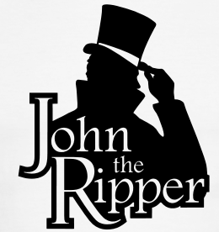
Introducing John the Ripper
John the Ripper is a password cracking tool.
Powerful Tool: Used by security pros to unmask hidden passwords.
Variety of Algorithms: Supports various algorithms and techniques.
Multiple Attack Methods: From brute force attack to rainbow tables.
Customization: Allow complex cracking sessions with specific rules and wordlists.
This Photo by Unknown Author is licensed under CC BY

Slide 5
Reasons to Use John the Ripper
Works with Unix, Windows & Kerberos
Also compatible with LDAP, MySQL & MD4 with the addition of extra modules
Popular password cracking tool
Preferred by pentesters
Accessible on multiple platforms
Auto-detects password hash types
Can crack multi-encrypted formats

Slide 6
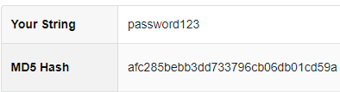
Understanding Password Hashes
It is a transformed representation of a plain text password
Hash functions are designed to convert password into hashes
Every password is converted into a hash that is stored on a server
This process makes storing a password safer
But as we will say later on that this can be cracked

Slide 7
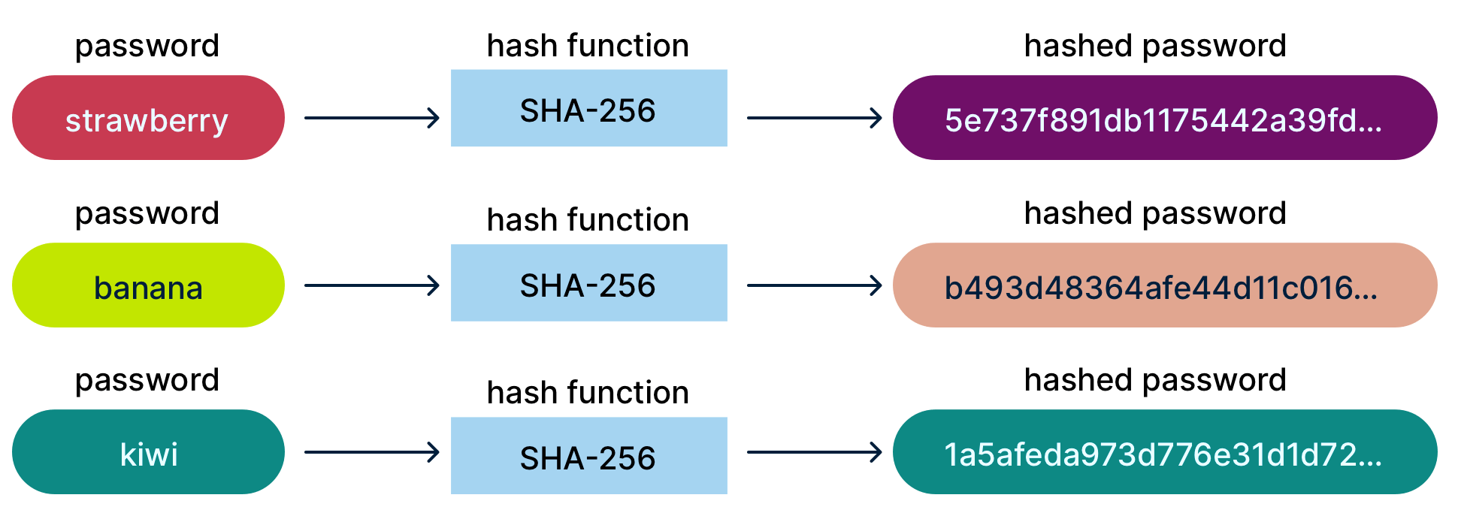

Slide 8
Process of Using John the Ripper
Generating a Hash
Creating a wordlist
Executing John the Ripper
First, we will create a password hash
Then, we will create a wordlist that is suitable for the target password
Finally, we will use John to test whether the password can be recovered.

Slide 9
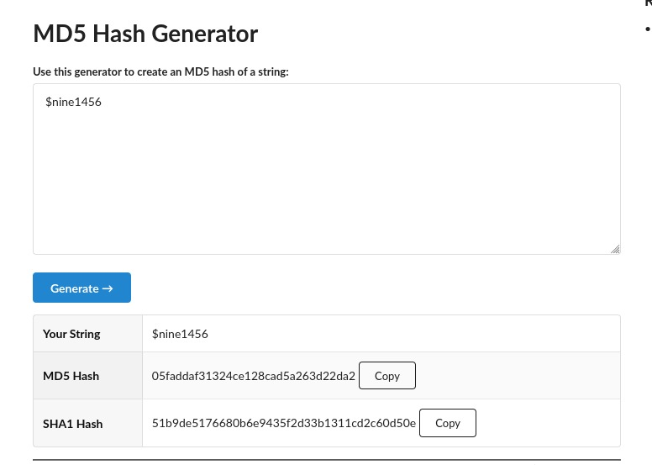

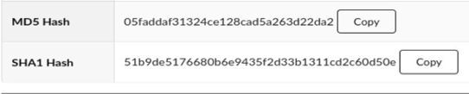
Generating a Hash
We need to create a password hash that we will crack later on.
We will generate an MD5 hash because it is fast to test in a beginner-level lab environment.
John supports many hash formats depending on the installed version and available modules. MD5 is used here only for a quick lab demonstration.
We save this hash in a text file for John to process.
Dummy Password
Generated Hash

Slide 10
Creating a Wordlist
To create a wordlist we will use cupp -i, which can be installed by the following command:
Now, we will use cupp –i to generate a wordlist.
CUPP asks the user questions related to the target and then generates a wordlist that contains possible password combinations.
Creating a good wordlist is essential as it helps in cracking the password faster.
There are other wordlist generators like crunch and cewl etc.
sudo apt update
sudo apt install cupp

Slide 11
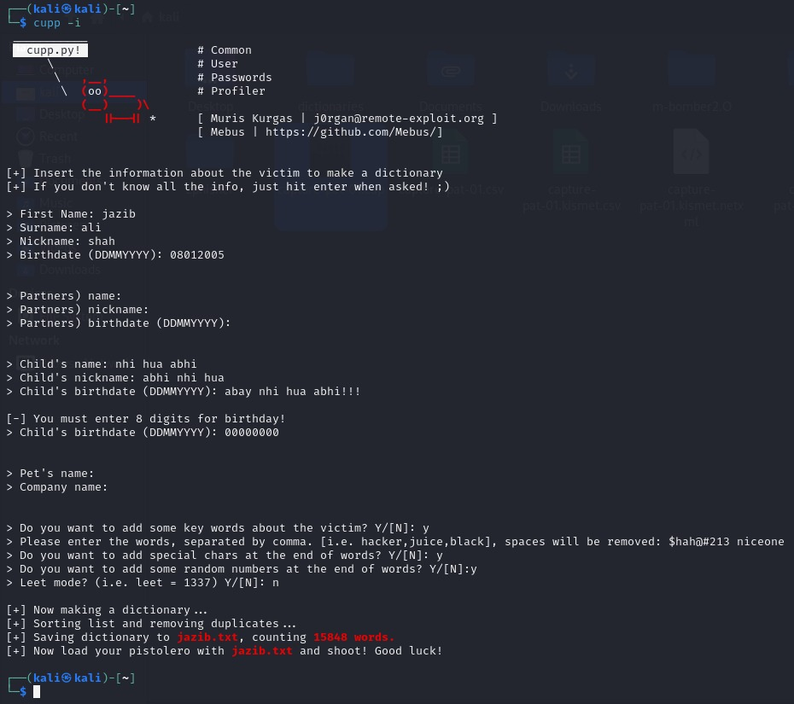
Visual representation
Target’s Information
Generated Wordlist

Slide 12
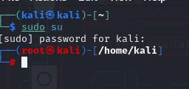
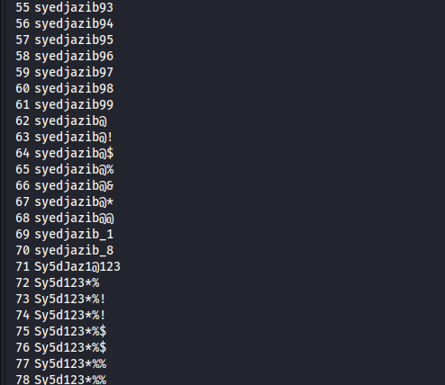
Execution of John the Ripper
First, we need to enter root by:
The basic syntax of John is:
The syntax comprises of 3 things:
The wordlist
The format of the hash password
The hash password itself stored in a text file.
This what our wordlist looks like:

Slide 13
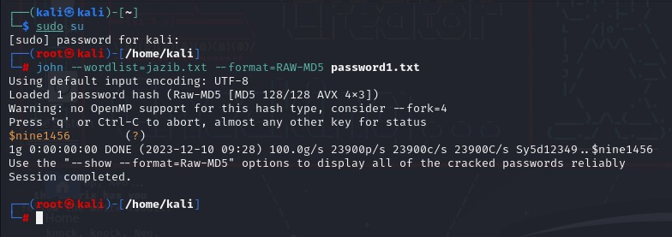
John's Command Syntax
Following the syntax we will be cracking our dummy password hash.
The first input is the wordlist, which was generated using CUPP for this lab.
The second input is the hash format. In this demo, the format is Raw-MD5.
The final input is the text file that contains the password hash.

Slide 14
Cracking Process
John compares candidate passwords from the wordlist against the target hash and reports a match if found.
After finding the match it will display the matched password in highlighted output to highlight it.
Larger wordlists take more time, so a short lab wordlist was used for demonstration.
Keep the hash file and wordlist path correct when running John.
Our password

Slide 15
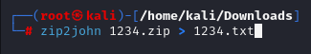
Cracking ZIP and PDF Hashes
ZIP and PDF password recovery follows a similar workflow after converting the protected file into a John-readable hash.
We just need to convert that password into a text hash.
As we can see in the given picture, zip2john is what converts the zip password into a text file by using the > redirection operator.

Slide 16

Introducing Johnny GUI
Johnny basically does the same work but it also provides a menu like interface which makes it much more user friendly.
There is little difference in purpose between these two tools.
They are made by the same developers
Johnny is much easier to use because it is a GUI and John is a command line interface.

Slide 17
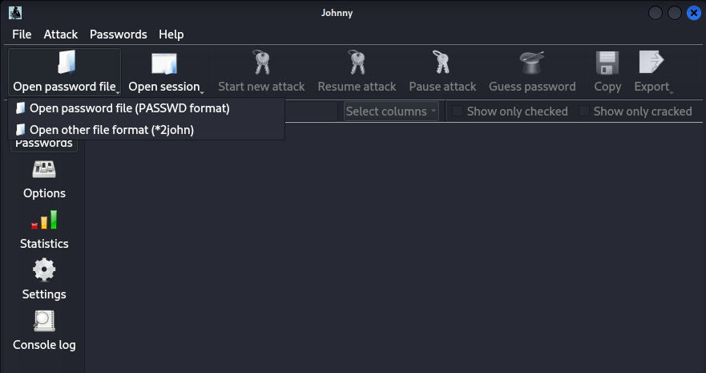
Johnny in Action
First search johnny in the search box to open the interface of johnny, which will look like this.
We can see how it provides an interface for the user by giving a menu.
Click on “Open password file” and select the hash text file.

Slide 18
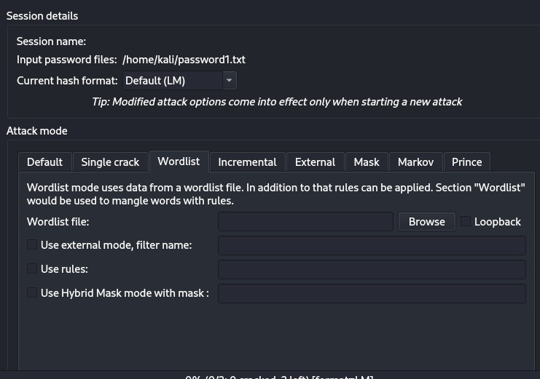
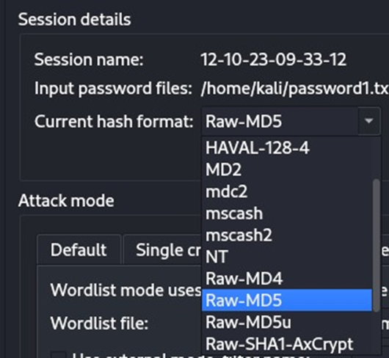
Johnny in Action
Then we go to options and select the wordlist by clicking on browse.
After selecting the wordlist we select the format of the hash.
Here

Slide 19

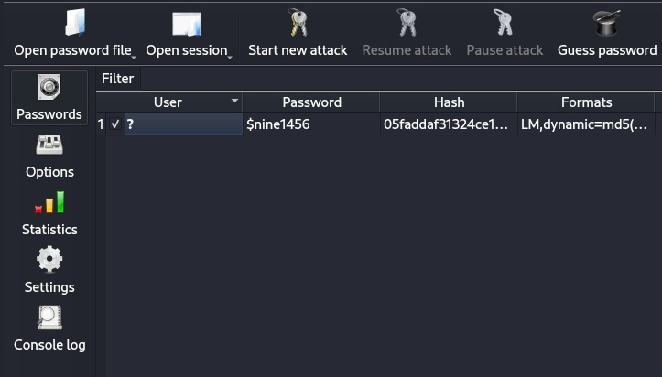
Johnny in Action
Our hash password format is MD-5 so we select that and then start the attack
After starting the attack johnny does the same thing and matches the wordlist keywords with the hash and gives the password as an output.
Which will look like this:
Here, is the cracked password.

Slide 20
Mitigating Hash Cracking Risks
Hash cracking is a defensive lesson: weak passwords and weak storage choices create real risk.
Strong passwords: Use long passphrases and avoid names, birthdays, phone numbers, and common words.
Avoid MD5/SHA-1: Do not use outdated hashing algorithms for password storage.
Salt every hash: Use a unique salt per password to reduce precomputed and rainbow-table attacks.
Use adaptive hashing: Prefer bcrypt, scrypt, Argon2, or PBKDF2 for password storage.
Enable MFA: Reduce the impact if a password is guessed, reused, or cracked.
Rate-limit attempts: Use lockout, throttling, monitoring, and alerts for suspicious login attempts.
Key message: cracking tools help security teams test password strength before attackers exploit weak credentials.

Slide 21
Key Takeaways
Password hashes can still be cracked when users choose weak or predictable passwords.
Wordlists make cracking faster by testing likely password candidates first.
MD5 is suitable only for simple lab demos, not secure password storage.
Salted adaptive hashing and MFA significantly reduce password compromise risk.
Tools like John the Ripper should only be used for authorized auditing and education.
Educational use only: dummy hashes, controlled lab, authorized testing.

Slide 22

Thank you! Any Questions?
References:
https://www.nist.gov/blogs/manufacturing-innovation-blog/5-questions-ask-your-cybersecurity-professional
https://www.expressvpn.com/blog/salt-hash-password-protection/
https://www.kali.org/
https://www.google.com/

