Slide 1
RELATIONS AND THEIR PROPERTIES
Discrete Structures
MA-216
Group #3
Chapter #9

Slide 2
Table of Contents
Relations (Muhammad Sameer)
Representing Relations (Shahzaib Ali)
Properties of Relations (Haseeb Khan)
Combining Relations (Ubaidullah)
Applications of Relations (Hussain Ali)
Database and Relations (Malik Hassan Awan)
Relations and Matrices (Hussain Ali)
Relations and Digraphs (Umair Aamir)

Slide 3
Cartesian Product
Definition:
An ordered n-tuple (a₁, a₂, ..., a_{n}) is the ordered collection that has a₁ as its first element, a₂ as its second element..., and a_{n} as its nth element.
Ordered 2-tuples are called ordered pairs.
(a, b) = (c, d) if and only if a = c and b = d
(a, b) ≠ (b, a) unless a = b
Example:
Let A = {1, 2, 3} and B = {x, y, z}
A × B = { (1, x), (1, y), (1, z), (2, x), (2, y), (2, z), (3, x), (3, y), (3, z) }

Slide 4
Relations
Definition:
A binary relation R from A to B is a subset of the Cartesian product
A × B.
Notation:
xRy means (x, y) ∈ R --- read as x is related to y under R
xRy means (x, y) ∉ R
Example:
Let A = {1, 2, 3} and B = {x, y, z} R = { (1, x), (2, y), (3, z) }

Slide 5
Relations
Example:
Consider two sets:
Set S represents a set of students: S = {Alice, Bob, Charlie}
Set C represents a set of courses: C = {Math, English, History}
Now, let's define a relation R that represents the enrollment of students in courses:
R = { (Alice, Math), (Bob, English), (Charlie, History), (Alice, History) }

Slide 6
Representing relations
Consider the relation
R = { (a, 2), (b, 1), (b, 2), (c, 3), (d, 2) }
on sets
A = {a, b, c, d} and B = {1, 2, 3, 4}
R | 1 | 2 | 3 | 4
a |  | x
b | x | x
c |  |  |  | x
d |  | x
 |  | 1 | 2 | 3 | 4
a |  | 0 | 1 | 0 | 0
b |  | 1 | 1 | 0 | 0
c |  | 0 | 0 | 0 | 1
d |  | 0 | 1 | 0 | 0
a
b 1
c 2
d 3
Arrow
Table
Matrix

Slide 7
Functions as Relations
A function is a special type of relation between two sets where each element in the domain is associated with exactly one element in the codomain.
Example:
Let A = {a, b, c} and B = {1, 2, 3}
A relation R = { (a, 1), (b, 2), (c, 3), (a, 2) } is not a function because a maps to two values.
A function f = { (a, 1), (b, 2), (c, 3) } maps every element of A to exactly one element of B.

Slide 8
Relations on a Set
Definition:
A relation R on a set A is a relation from A to A, that is, a subset of A×A.
Example:
Let A = {1, 2, 3, 4}, and R = { (a, b) | a, b ∈ A ∧ a + b is even }
R = { (1,1), (1,3), (2,2), (2,4), (3,3), (4,4) }
1
1
R | 1 | 2 | 3 | 4
1 | x |  | x
2 |  | x |  | x
3 |  |  | x
4 |  |  |  | x
 |  | 1 | 2 | 3 | 4
1 |  | 1 | 0 | 1 | 0
2 |  | 0 | 1 | 0 | 1
3 |  | 0 | 0 | 1 | 0
4 |  | 0 | 0 | 0 | 1
2
2
3
3
4
4

Slide 9
Properties of Relations
1. Reflexive:
A relation R on a set A is reflexive if (a, a) belongs to R for every a in A.
Example:
A = {1, 2, 3}
R = { (1, 1), (2, 2), (3, 3) }

Slide 10
Properties of Relations
2. Symmetric:
A relation R on a set A is symmetric if, for every (a, b) in R, (b, a) also belongs to R.
Example:
A = {1, 2, 3}
R = { (1, 2), (2, 1), (2, 3), (3, 2), (3, 3) }

Slide 11
Properties of Relations
3. Antisymmetric:
A relation R on a set A is antisymmetric if, for every (a, b) belong to R, and (b, a) belong to R, then a = b.
Example:
A = {1, 2, 3}
R = { (1, 2), (2, 3), (1, 1), (2, 2), (3, 3) }
Note: Antisymmetric is not the opposite of symmetric, a relation can be both.

Slide 12
Properties of Relations
4. Asymmetric:
A relation R on a set A is called asymmetric if (a, b) ∈ R → (b, a) ∉ R.
Example:
A = {1, 2, 3}
R = { (1, 2), (2, 3), (1, 3) }

Slide 13
Properties of Relations
5. Transitive:
A relation R on a set A is transitive if, for every (a, b) and (b, c) in R, (a, c) also belongs to R.
Example:
A = {1, 2, 3}
R = { (1, 2), (2, 3), (1, 3), (3, 3) }
Note: A set with one ordered pair is Transitive.

Slide 14
Equivalence Relations
Definition:
An equivalence relation on a set A satisfies three properties: reflexivity, symmetry, and transitivity.
Example:
Let A = {1, 2, 3} and
R = { (1,1), (2,2), (3,3), (1,2), (2,1), (1,3), (3,1), (2,3), (3,2) }
This relates every element to every other element, so it is reflexive, symmetric, and transitive.

Slide 15
Partial Order Relations
Definition:
A partial order on a set A is a relation that is reflexive, antisymmetric, and transitive
Example:
Let A = {1, 2, 3} and
R = { (1,1), (2,2), (3,3), (1,2), (2,3), (1,3) }
The pair (1,3) is included to satisfy transitivity because 1 is related to 2 and 2 is related to 3.

Slide 16
Combining Relations
Let R = { (1, 2), (2, 3), (3, 4) } and S = { (2, 3), (3, 4), (4, 5) }
1. Union:
R ∪ S = { (1, 2) ,(2, 3) ,(3, 4) ,(4, 5) }
2. Intersection:
R ∩ S = { (2, 3), (3, 4) }
3. Difference:
R − S = { (1, 2) }
4. Exclusive OR:
R ⊕ S = { (1, 2), (4, 5) } R ⊕ S = R ∪ S − R ∩ S

Slide 17
Composite Relations
Definition:
Let R be a relation from a set A to a set B, and S be a relation from B to a set C. The composition of R and S, denoted by S o R, is the relation consisting of ordered pairs (a, c), whenever (a, b) ∈ R and (b, c) ∈ S.
Example:
R = {(1, x), (1, z), (2, w), (3, x), (3, z)}, and
S = {(x,0), (y,0), (w,1), (w,2), (z,1)}, then
S o R = {(1,0), (1,1), (2,1), (2,2), (3,0), (3,1)}
S o R
R
S
A
B
c

Slide 18
Powers of Relations
Definition:
Let R be a relation on the set A. The powers R^{n}, n = 1, 2, 3,… are defined recursively by:
R¹ = R,
R^{n+1} = R^{n} o R, for n ≥ 1
So:
R² = RoR,
R³ = R²oR = (RoR) o R
. . .

Slide 19
n-ary Relations
Definition:
An n-ary relation on sets A1​,A2​,…,An​ is a subset of the Cartesian product A1​×A2​×…×An​. It consists of all possible n-tuples whose elements come from the respective sets A1​,A2​,…,An​.
Example:
Let's consider three sets A, B, and C as follows:
A = {1, 2}, B = {x, y}, C = {red, blue}
The n-ary relation R is defined as the set of all 3-tuples (a, b, c)
R = { (1, x, red), (1, y, blue), (2, x, red), (2, y, blue) }

Slide 20
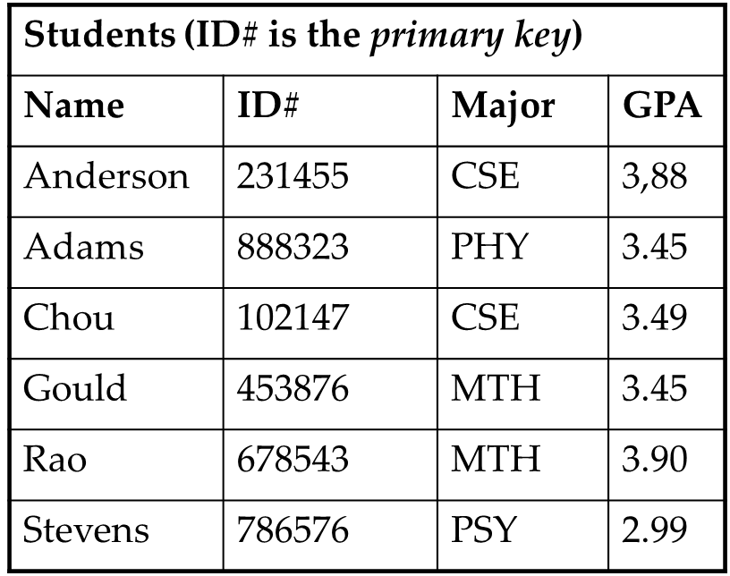
Databases and Relations
Field
Record

Slide 21
Databases and Relations
Record: an n-tuple of fields, for example (Name, ID#, Major, GPA).
Relational database: a collection of records represented as a relation.
Example: student database
{ (Anderson, 231455, CSE, 3.88),
(Adams, 888323, PHY, 3.45),
(Chou, 102147, CSE, 3.49),
(Gould, 453876, MTH, 3.45),
(Rao, 678543, MTH, 3.90),
(Stevens, 786576, PSY, 2.99) }

Slide 22
Primary Key
A primary key uniquely identifies each row in a relation.
Its value should not repeat for different records.
Example: StudentID uniquely identifies each student.
Student information
StudentID | FirstName | LastName | Age | Gender
232992 | Abdullah | Haroon | 19 | Male
232164 | Dua | Khan | 18 | Female
232137 | Abdullah | Sohail | 11 | Male

Slide 23
Composite Key
A composite key uses two or more columns together to uniquely identify a record.
Example: In an enrolment table, (StudentID, CourseID) can uniquely identify one enrolment.
Student information
StudentID | FirstName | LastName | Age | Gender
232992 | Abdullah | Haroon | 19 | Male
232164 | Dua | Khan | 18 | Female
232137 | Abdullah | Sohail | 11 | Male

Slide 24
Primary and Composite Keys
OrderID | CustomerID | ProductID | OrderDate | Quantity | TotalAmount
1 | 101 | 201 | 2022-01-15 | 2 | 150.00
2 | 102 | 202 | 2022-01-16 | 1 | 75.00
3 | 103 | 201 | 2022-01-17 | 3 | 225.00
4 | 101 | 203 | 2022-01-18 | 4 | 300.00
5 | 103 | 202 | 2022-01-19 | 2 | 150.00

Slide 25
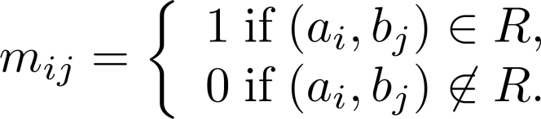
Relations and Matrices
A binary relation R can be represented by a matrix. The rows correspond to elements of A, and the columns correspond to elements of B.
The relation R is represented by the matrix
M_{R} = [m_{ij}], where
Example:
A relation R = { (1, 2), (2, 3), (3, 1) }
can be represented as:​
 |  |  | 1 | 2 | 3
 | 1 |  | 0 | 1 | 0
M_{R} = | 2 |  | 0 | 0 | 1
 | 3 |  | 1 | 0 | 0

Slide 26

Properties of Relations Using Matrices
Reflexive:
All the elements on the principal diagonal of M_{R} are equal to 1
Example:
A relation R = { (1, 1), (2, 2), (3, 3) } in matrix form is: ​
 |  |  | 1 | 2 | 3
 | 1 |  | 1 | 0 | 0
M_{R} = | 2 |  | 0 | 1 | 0
 | 3 |  | 0 | 0 | 1

Slide 27
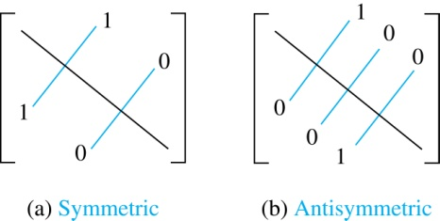
Properties of Relations Using Matrices
Symmetric:
R is a symmetric relation, if and only if m_{ij} = 1 whenever m_{ji} = 1
Antisymmetric:
R is an antisymmetric relation, if and only if m_{ij} = 0 or m_{ji} = 0 when i ≠ j
 |  |  | 1 | 2 | 3
 | 1 |  | 0 | 1 | 1
M_{sym} = | 2 |  | 1 | 0 | 0
 | 3 |  | 1 | 0 | 1
 |  |  | 1 | 2 | 3
 | 1 |  | 0 | 1 | 0
M_{anti} = | 2 |  | 0 | 1 | 1
 | 3 |  | 1 | 0 | 0
Example:

Slide 28
Properties of Relations Using Matrices
Join Operation (Union):
The join of two relations R_{1​} and R₂​, denoted as R₁​ ∨ R₂​, is the union of the relations.
R₁ ​∨ R₂ ​= M_{R1}​ ​∪ M_{R2}​​
Meet Operation (Intersection):
The meet of two relations R_{1​} and R_{2​}, denoted as R_{1​} ∧ R_{2​}, is the intersection of the relations.
R₁​ ∧ R₂ ​= M_{R1}​ ​∩ M_{R2}​​

Slide 29
Properties of Relations Using Matrices
Example:
Consider two relations R₁​ and R₂​ using 3x3 matrices:
>> Join >>
>> Meet >>
 |  | 1 | 0 | 1
R₁ = |  | 0 | 1 | 0
 |  | 1 | 0 | 1
 |  | 1 | 1 | 1
R₁​ ∨ R₂ = |  | 1 | 1 | 1
 |  | 1 | 1 | 1
 |  | 0 | 1 | 0
R₂ = |  | 1 | 0 | 1
 |  | 0 | 1 | 0
 |  | 0 | 0 | 0
R₁​ ∧ R₂ = |  | 0 | 0 | 0
 |  | 0 | 0 | 0

Slide 30

Properties of Relations Using Matrices
Composition Operation:
The composition R₁​ ∘ R₂​ is obtained by performing Boolean Product between matrices​​.
R₁​ ∘ R₂​ = M_{R1}​​ × M_{R2}​​
Example:
Find the Boolean product of A and B, where

Slide 31
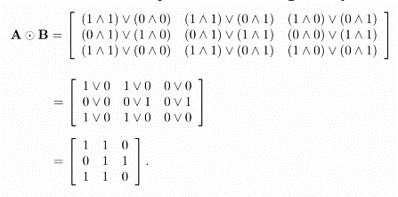
Properties of Relations Using Matrices

Slide 32


Properties of Relations Using Matrices
Power of Relation Matrix:
The composition of a relation R with itself n times (denoted as R^{n}) is obtained by performing the composition operation n times.

Slide 33
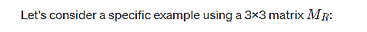


Properties of Relations Using Matrices
Example:

Slide 34
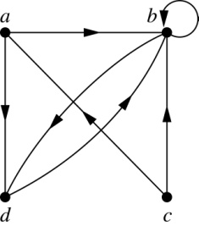
Relations and Digraphs
Digraph:
A digraph, short for directed graph, is a type of graph that is made up of nodes (or vertices) and directed edges (or arcs) between those nodes.
Examples:
Consider a relation R = { (a, b), (a, d), (b, b), (b, d), (c, a), (c, b), (d, b) }

Slide 35
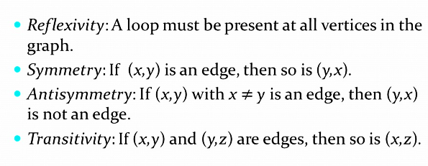
Relations and Digraphs

Slide 36
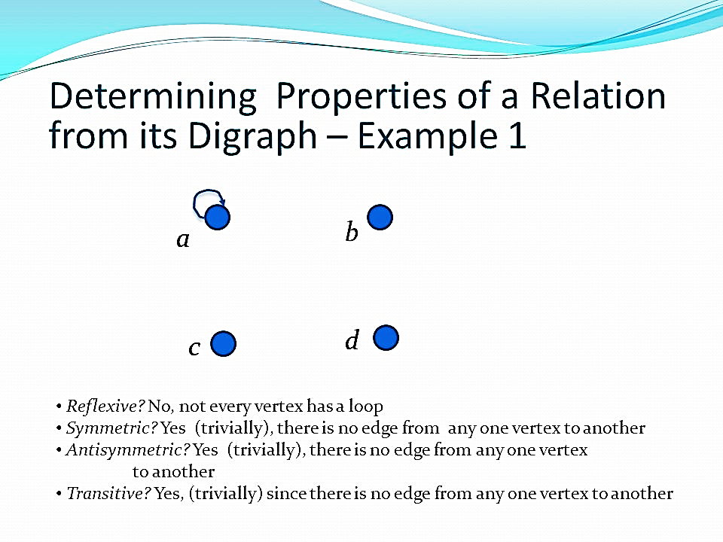
Relations and Digraphs
Reflexive
Symmetric
Antisymmetric
Transitive

Slide 37
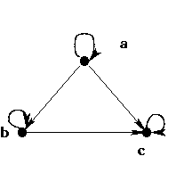
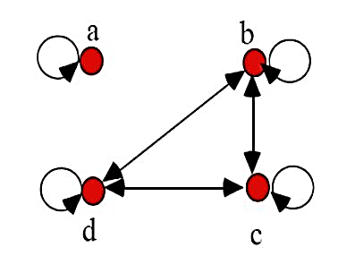
Relations and Digraphs

Slide 38
Key Takeaways
Relations describe connections between elements of sets.
Properties such as reflexive, symmetric, antisymmetric, and transitive classify relations.
Equivalence relations group similar elements; partial orders model hierarchy and ranking.
Relations are applied in databases through records, fields, primary keys, and composite keys.
Matrices and digraphs provide visual and computational ways to analyse relations.
31/12/2023
39

Slide 39
Why Relations Matter in Computer Science
Relations help model connections between objects in computing.
Databases: records, tables, keys, and entity relationships
Access Control: users, roles, permissions, and resources
Networks and Graphs: devices, links, nodes, edges, routes, and reachability
Program Logic: rules, conditions, comparisons, and system behaviour
Relations provide a foundation for understanding databases, cybersecurity, networking, and software systems.
31/12/2023
39
Notes:
This slide connects our topic with real computer science applications. Relations are used whenever we need to describe a connection between two objects. For example, in databases, a relation can represent a table or a link between records. In access control, relations can show which user is allowed to access which resource. In networks and graphs, relations help represent connections between devices or nodes. So, relations are important because they give us a formal way to model, analyse, and understand systems.

Slide 40
Discussion Time
Thank You

