Slide 1
John the Ripper
Cracking Password Hashes in Kali Linux
Academic lab demonstration using dummy hashes only

Slide 2
Table of Contents
Benefits of Kali Linux
Overview of John the Ripper
Understanding Password Hashes
Process of Using John the Ripper
Cracking a Dummy Password
Johnny GUI for John
Mitigation Against Hash Cracking Risks

Slide 3
Benefits of Kali Linux
Provides a wide range of pre-installed cybersecurity tools.
Kali Linux is designed to adhere to security standards and best practices.
Kali Linux is based on Debian and provides a high degree of customization.
Kali Linux is specifically built for security testing and assessment.

Slide 4
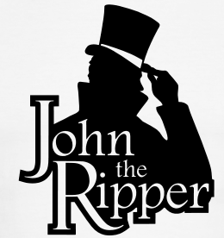
Introducing John the Ripper
John the Ripper is a password auditing and recovery tool.
Powerful Tool: Used by security professionals to test password strength.
Variety of Algorithms: Supports many hash formats and cracking modes.
Multiple Attack Methods: Supports wordlists, rules, masks, and incremental cracking.
Customization: Allows controlled cracking sessions with selected rules and wordlists.
This Photo by Unknown Author is licensed under CC BY

Slide 5
Reasons to Use John the Ripper
Works with Unix, Windows & Kerberos
Also compatible with LDAP, MySQL & MD4 with the addition of extra modules
Popular password cracking tool
Preferred by pentesters
Accessible on multiple platforms
Auto-detects password hash types
Can crack multi-encrypted formats

Slide 6
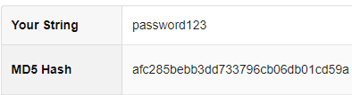
Understanding Password Hashes
Password hashes are transformed values created from plaintext passwords.
Systems store hashes instead of plaintext credentials.
Hashing improves storage security, but it does not make weak passwords safe.
If attackers obtain hashes, predictable passwords may still be recovered.

Slide 7
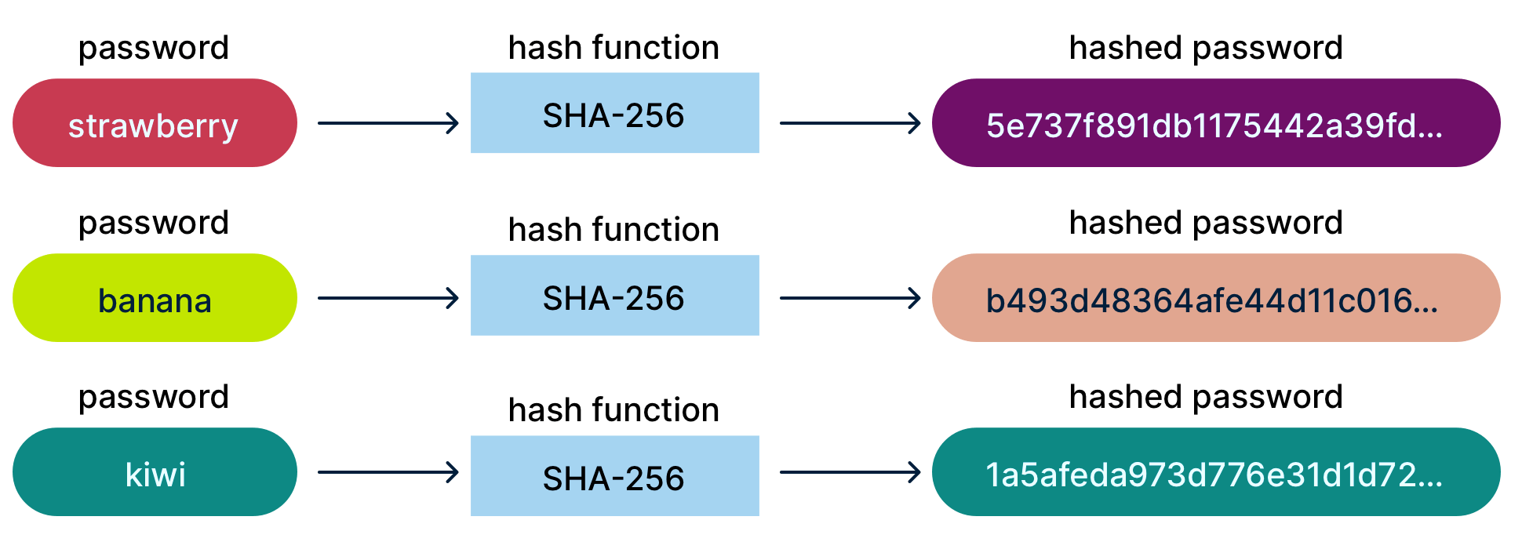

Slide 8
Process of Using John the Ripper
Generating a Hash
Creating a wordlist
Executing John the Ripper
First, we create a dummy password hash
Then, we will create a wordlist that is suitable for the target password
Finally, we use John to test whether the dummy password can be recovered.

Slide 9
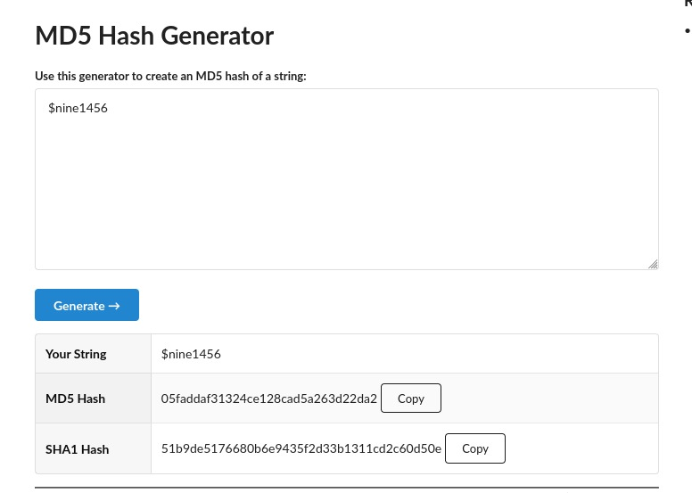

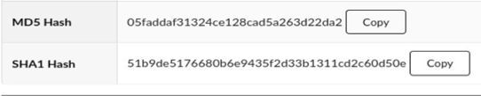
Generating a Hash
We need to create a password hash that we will crack later on.
We will generate an MD5 hash because it is fast to test in a beginner-level lab environment.
John supports many hash formats depending on the installed version and available modules. MD5 is used here only for a quick lab demonstration.
We save this hash in a text file for John to process.
Dummy Password
Generated Hash

Slide 10
Creating a Wordlist
To create a custom wordlist, we used CUPP. It can be installed with the following commands:
Then, we run cupp -i to generate a wordlist.
CUPP asks the user questions related to the target and then generates a wordlist that contains possible password combinations.
A relevant wordlist helps John test likely password candidates faster.
Other wordlist tools include Crunch and CeWL.
sudo apt update
sudo apt install cupp

Slide 11
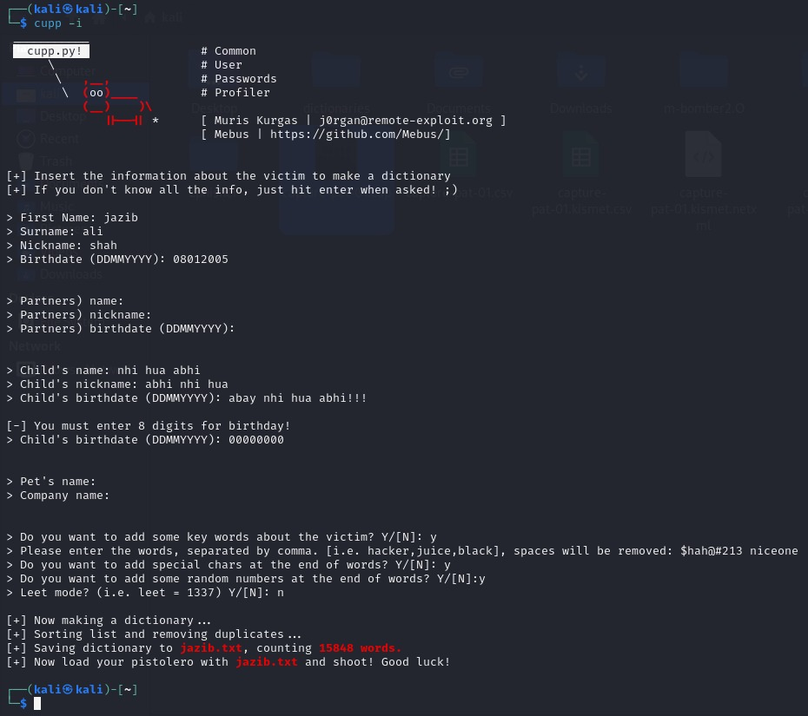
Visual representation
Target’s Information
Generated Wordlist

Slide 12
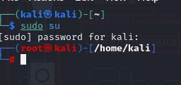
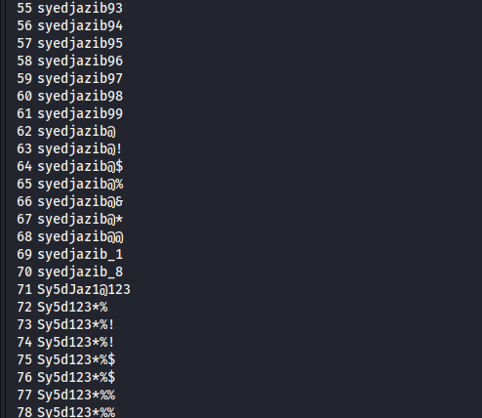
Execution of John the Ripper
Generated wordlist preview:
Demo setup: wordlist + hash file + selected format.

Slide 13
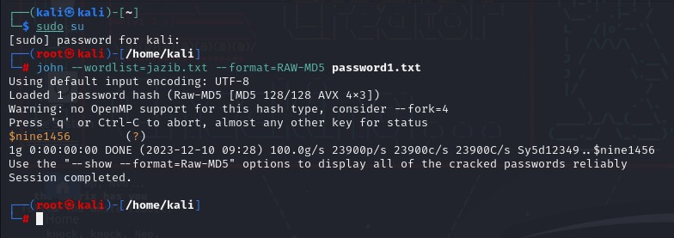
John's Command Syntax
Following the syntax we will be cracking our dummy password hash.
The first input is the wordlist, which was generated using CUPP for this lab.
The second input is the hash format. In this demo, the format is Raw-MD5.
The final input is the text file that contains the password hash.

Slide 14
Cracking Process
John compares candidate passwords from the wordlist against the target hash and reports a match if found.
After finding a match, John can display the recovered dummy password using john --show.
Larger wordlists take more time, so a short lab wordlist was used for demonstration.
The hash file path, wordlist path, and hash format must be correct when running John.
Our password

Slide 15
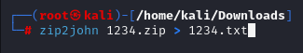
Cracking ZIP and PDF Hashes
ZIP and PDF password recovery follows a similar workflow after converting the protected file into a John-readable hash.
The protected file is converted into a John-readable hash using helper tools such as zip2john or pdf2john.
For example, zip2john extracts a ZIP hash and the > redirection operator redirects the output into a text file.

Slide 16

Introducing Johnny GUI
Johnny provides a graphical interface for John the Ripper.
It helps users configure attacks through menus instead of only using commands.
John is primarily command-line based, while Johnny is GUI-based.
Both are useful for authorized password auditing and lab demonstrations.

Slide 17
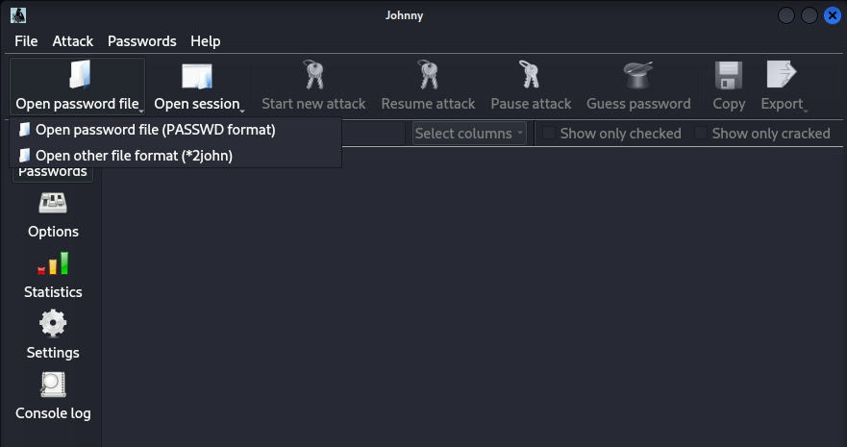
Johnny in Action
Search for Johnny in Kali Linux to open the interface.
Johnny provides menus for loading password files and selecting options.
Click on “Open password file” and select the hash text file.

Slide 18
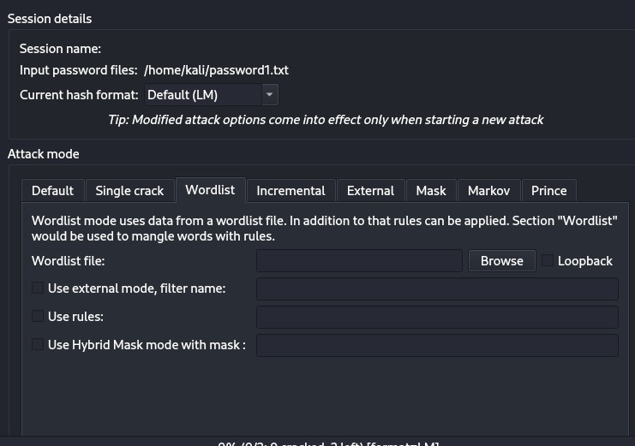
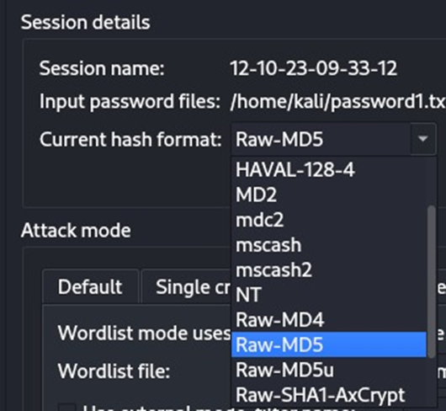
Johnny in Action
Go to Options and select the wordlist by clicking Browse.
After selecting the wordlist, choose the correct hash format.
Here

Slide 19

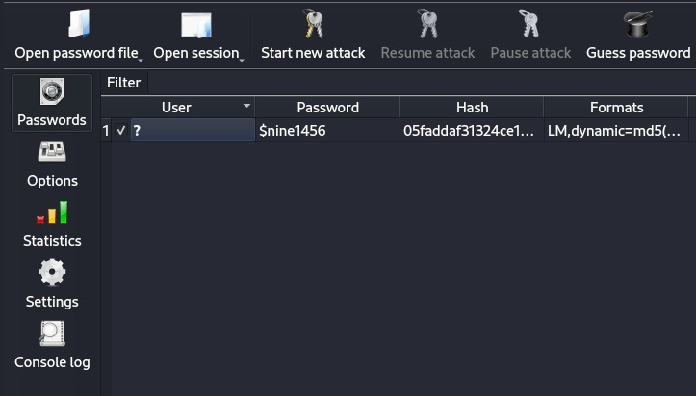
Johnny in Action
Our password hash format is MD5, so we select the matching format and start the attack.
Johnny tests wordlist candidates against the hash and shows the recovered dummy password if a match is found.
The result appears in the output area.
Here, is the cracked password.

Slide 20
Mitigating Hash Cracking Risks
Defensive controls reduce the likelihood and impact of password-hash compromise.
Strong passwords: Use long passphrases and avoid names, birthdays, phone numbers, and common words.
Avoid MD5/SHA-1: Do not use outdated hashing algorithms for password storage.
Salt every hash: Use a unique salt per password to reduce precomputed and rainbow-table attacks.
Use adaptive hashing: Prefer bcrypt, scrypt, Argon2, or PBKDF2 for password storage.
Enable MFA: Reduce the impact if a password is guessed, reused, or cracked.
Rate-limit attempts: Use lockout, throttling, monitoring, and alerts for suspicious login attempts.
Key message: cracking tools help security teams test password strength before attackers exploit weak credentials.

Slide 21
Key Takeaways
Password hashes can still be cracked when users choose weak or predictable passwords.
Wordlists make cracking faster by testing likely password candidates first.
MD5 is suitable only for simple lab demos, not secure password storage.
Salted adaptive hashing and MFA significantly reduce password compromise risk.
Tools like John the Ripper should only be used for authorized auditing and education.
Educational use only: dummy hashes, controlled lab, authorized testing.

Slide 22

Thank you! Any Questions?
References:
John the Ripper: https://www.openwall.com/john/
Kali Tools - John: https://www.kali.org/tools/john/
OWASP Password Storage Cheat Sheet:
https://cheatsheetseries.owasp.org/cheatsheets/Password_Storage_Cheat_Sheet.html
NIST Digital Identity Guidelines SP 800-63B: https://pages.nist.gov/800-63-3/sp800-63b.html

