Slide 1
Statistics for Data Science
Hussain Alsalman

Slide 2
Agenda
Introduction about Data & Statistics (20 mins)
Data Exploratory using statistical techniques ()
Data Preprocessing
Linear Regression

Slide 3
Introduction about Data & Statistics

Slide 4
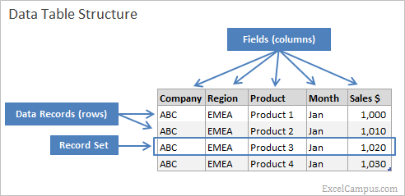
What are the types of data?
Structured data
Data that has pre-defined format. We mainly refer to the data that can be stored in tabular format.

Slide 5
Structured Data
Advantages:
Universally understood
The factual nature of structured data allows users of all skill levels to understand the meanings and relationships behind the data itself.
Transferable to data tools
Many data tools thrive on structured data, making it easier for you to analyze.
Easily digestible for data programs
Machine learning algorithms can easily crawl structured data fields, allowing for simplified data querying and manipulation.
Space savings
Historically, businesses store data in structures to keep the space required at a minimum.

Slide 6
Structured Data..(continued)
Disadvantages:
Storage inflexibility
Your structured data is generally stored in data warehouses or relational databases, both of which have very stringent structures. If you need to change your data needs, the likelihood is you’ll have to update all of your structured data.
Limited use cases
Pre-defined, structured data can only be used for its intended purpose, which causes some inflexibility.

Slide 7
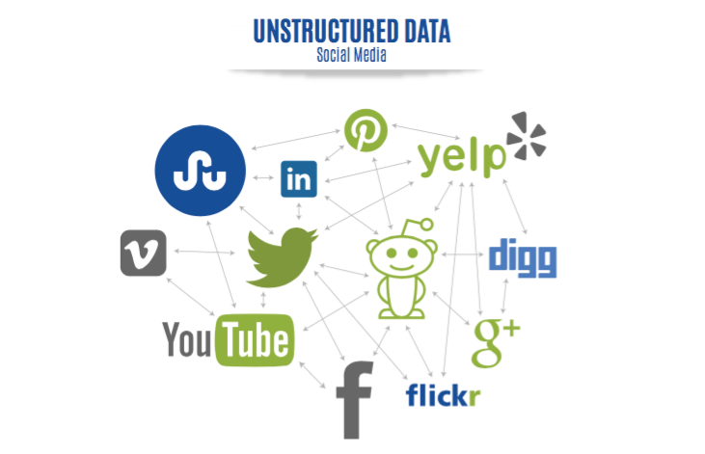
What are the types of data? ..(continued)
Unstructured data
Those include everything else, from texts on websites and social media to uploaded videos and music.

Slide 8
Unstructured Data
Advantages:
Wider use cases
Without any pre-definition, unstructured data can be used for more than one intended purpose.
Flexible formatting
Unstructured data can be stored in a variety of formats.
Easy storage
Because of the onset of unstructured data – due to modern demands and the internet – storage for this type of data is now easier and cheaper.
More data, more insights
Although harder to analyze, your organization most likely has more unstructured data than structured. This data could hold brilliant insights that could amplify your competitiveness.

Slide 9
Unstructured Data..(continued)
Disadvantages:
Difficult to prepare and analyze
Unless you have an experienced team of data scientists, unstructured data will remain inaccessible. Your average business user will not be able to understand its undefined format or draw value from it.
It requires specific data tools
Most data tools, such as Excel, can’t handle unstructured data. This means your business will have to search for a specific data management tool to manipulate the data.

Slide 10
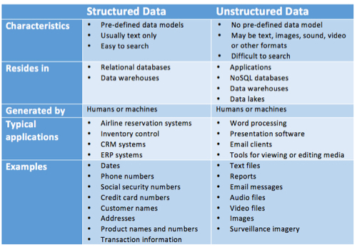
Structured vs Unstructured Summary

Slide 11
Dealing with unstructured data is beyond the scope of this lecture So we will focus on Structure data tonight

Slide 12
Introduction to Statistics
Before we start, we need to mention that Statistics is divided mainly into two parts.
Descriptive Statistics (Lecture Focus)
This branch focuses on describing the Data without making and conclusions
Inferential Statistics
This branch is all about making conclusions. It takes sample from the population and try to make statistical tests to generalize the idea.

Slide 13
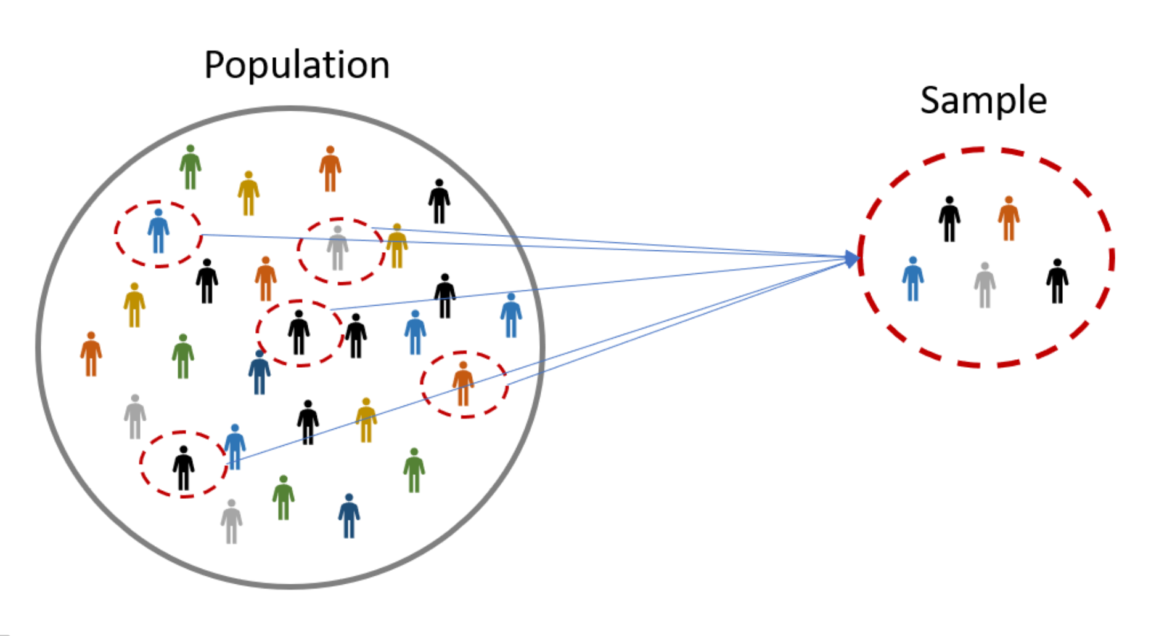
Random Sampling and Sample Bias
Sample
A sample is a subset of data from a larger data set; statisticians call this larger data set the population
Random sampling
Random Sampling is a process in which each available member of the population being sampled has an equal chance of being chosen for the sample at each draw

Slide 14
Sample Bias
Bias
Statistical bias refers to measurement or sampling errors that are systematic and produced by the measurement or sampling process. An important distinction should be made between errors due to random chance and errors due to bias

Slide 15
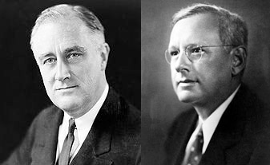
Sample Bias.. (continued)
The story of Franklin Roosevelt and Alf Landon election race in 1936
Notes:
The classic example is the Literary Digest poll of 1936 that predicted a victory of Alf Landon over Franklin Roosevelt. The Literary Digest, a leading periodical of the day, polled its entire subscriber base plus additional lists of individuals, a total of over 10 million people, and predicted a landslide victory for Landon. George Gallup, founder of the Gallup Poll, conducted biweekly polls of just 2,000 people and accurately predicted a Roosevelt victory. The difference lay in the selection of those polled. The Literary Digest opted for quantity, paying little attention to the method of selection. They ended up polling those with relatively high socioeconomic status (their own subscribers, plus those who, by virtue of owning luxuries like telephones and automobiles, appeared in marketers’ lists). The result was sample bias; that is, the sample was different in some meaningful and nonrandom way from the larger population it was meant to represent. The term nonrandom is important—hardly any sample, including random samples, will be exactly representative of the population. Sample bias occurs when the difference is meaningful, and it can be expected to continue for other samples drawn in the same way as the first.

Slide 16
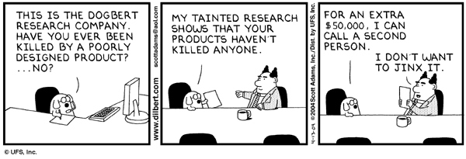
Sample Bias

Slide 17
Probability
It is numerical representation of how likely for an event to occur.
Basic rules

Slide 18
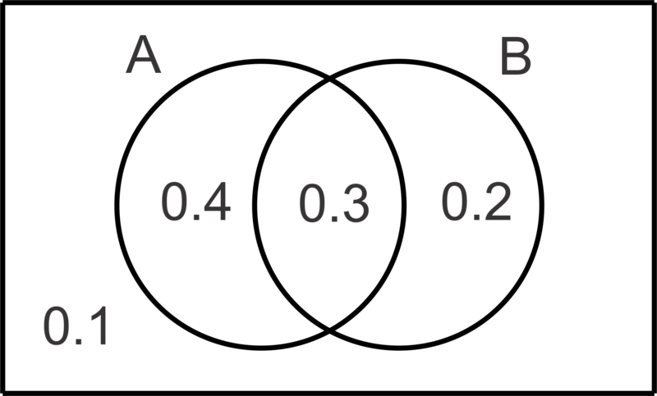

Slide 19
Bayes Theorm
$$P(A|B)=\frac{P(B|A)*P(A)}{P(B)}$$

Slide 20
Two schools of thoughts
Frequentist interpretation: hands-on exercise probability of a random event denotes the relative frequency of occurrence of an experiment’s outcome, when the experiment is repeated indefinitely.
Law of large numbers
Bayesian interpretation: hands-on exercise includes expert knowledge as well as experimental data to produce probabilities. The expert knowledge is represented by some (subjective).

Slide 21
Data Exploratory using statistical techniques

Slide 22
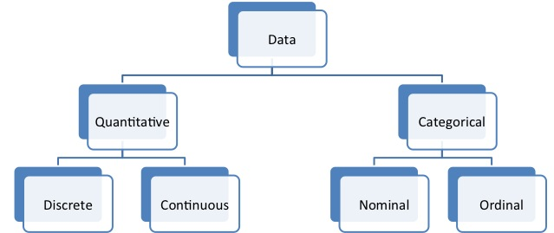
Types of Data

Slide 23
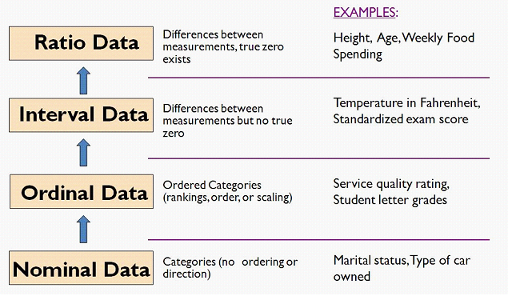
Are all data equal?

Slide 24
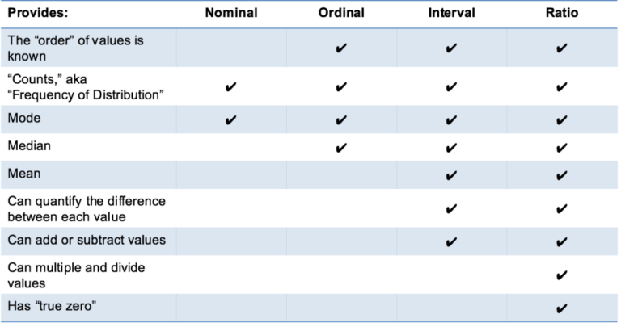
Are all data equal?

Slide 25
Categorical Data
In many cases especially in classification problem this is usually our target variable.
We can describe categorical data by
Counts
Percentages
However, they are very useful in analytic tasks such as
Grouping
Filtering

Slide 26

M&M samples Hands-on exercise

Slide 27
Quantitative Data
Those are exact variables and open doors for many statistical analysis. We can describe quantitative data by
Measure of centrality Hands-on exercise
Mean
Median
Mode
Measure of Variability Hands-on exercise
Range
Interquartile Range (IQR)
Standard Deviation
Variance

Slide 28
Quantitative Data..(continued)
Shape Hands-on exercise
Kurtosis
Skewness
Normal Curve or Bell Curve
Outliers

Slide 29
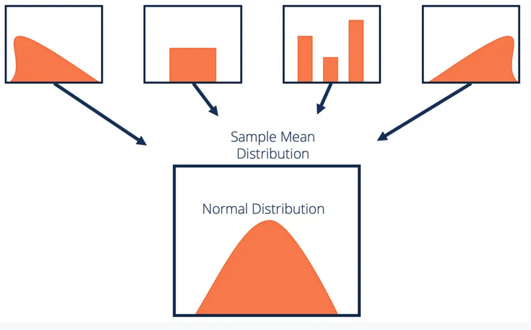
Centeral Limit Theorm
if you have a population with mean μ and standard deviation σ and take sufficiently large random samples from the population with replacement , then the distribution of the sample means will be approximately normally distributed

Slide 30
More Statistical concepts
How do we measure the relationship between variables?
We use covariance (not common) or correlation (most common)
Correlation vs Covariance

Slide 31
Covariance : $Cov(x,y)=\frac{∑(X−\overline{X})(Y−\overline{Y})}{N}$
Correlation : $r=\frac{1}{n−1}∑(\frac{X−\overline{X}}{s_{x}})(\frac{Y−\overline{Y}}{s_{y}})$
Correlation Types

Slide 32
Data Preprocessing
Why do we preprocess data?
Fields that are obsolete or redundant
Missing values
Outliers
Data in a form not suitable for the machine learning models;
Values not consistent with policy or common sense.

Slide 33
Common Tasks in Data preprocessing
Data cleaning
Handling missing data
Identify misclassificaitons
Graphically identify outliers
Transformation data to work better with ML models
Normalize the data
Hands-on exercise

Slide 34
Data Preprocessing Continuation
Graphical Methods to identify outliers
Normalizing data
Min–max normalization
Transformation to achieve normality
Hands-on exercise
:::::: {.rows}

Slide 35
Other considerations - Data Preprocessing
Categorical variables : we create dummy variables for categorical variables that are Nominal
Example: How to encode Maritul Status? given that we have 4 categories {Married, Single, Divorced, Seperated}

Slide 36
CustomerID | Income | Marital Status
10001 | 40000 | Married
10002 | 63000 | Single

Slide 37
Other considerations - Data Preprocessing
We simply create dummy variables for n-1 of all the classes for the categorical variable.

Slide 38
CustomerID | Income | Single | Married | Divorced
10001 | 40000 | 0 | 1 | 0
10002 | 63000 | 1 | 0 | 0

Slide 39
Other considerations - Data Preprocessing
Categorical variables : we can substitute classes with numerical for variables that are Ordinal
Example

Slide 40
Class | value
strongly disagree | 1
disagree | 2
neutral | 3
agree | 4
strongly agree | 5

Slide 41
Other considerations - Data Preprocessing
Binning Numerical Variables : Some algorithms prefer categorical variables therefore, we need to perform binning
Equal width binning
Equal frequency binning
Binning by clustering
Binning based on predictive value
note:
1 & 3, does not consider the target variable.
1 can be easily influenced by outliers
2 has an assumption that every class is equally likely ( most of the time unrealistic )
3 & 4 are usually preferred.

Slide 42
Other considerations - Data Preprocessing
Removing Variables That Are Not Useful
Unary or almost unary
Reasoning :
having fixed or almost fixed variable does not help explain the variability in the target variable.

Slide 43
Other considerations - Data Preprocessing
Variables That Should Probably Not Be Removed
Variables with 90% or more missing data
Variables that are strongly correlated
Reasoning :
Before deleting the whole variable with a lot of missing data, we need to investigate if there is a pattern in the missingness of those variables. We might create a flag variable that is useful.
if two variables are correlated some analyst just remove one of the variables, however, this might lead to lost of important information. It is best to use principle component analysis instead.

Slide 44
Try at Home excercise
What can you tell about this dataset
Try making histograms of continuous data
Is there a relationship between TB and TR
what is the average of total rooms?
Do you suspect outliers?
Example US Households data.
- MHV : median house value - MI : median income - HMA : housing median age - TR : total rooms - TB : total bedrooms - P : populatio - H : households - LAT : latitude - LON : longitude

Slide 45
Linear Regression

Slide 46
Interactive Session

