Slide 1

Topic: Introduction to Thermodynamics
Lecture - 1
Disclaimer:
The study materials/presentations are solely meant for academic purposes and they can be reused, reproduced, modified, and distributed by others for academic purposes only with proper acknowledgements.

Slide 2
Course Objectives:
CO1 → To learn the basics of Fluid Mechanics
CO2 → To learn the basics of Hydraulic machines
CO3 → To learn the basics of Thermodynamics
CO4 → To learn the basics of Power Plant Engineering
Topics to be covered:
Preliminary concepts, Energy and first law, 2nd law of thermodynamics, Entropy, Exergy, Vapor power and Gas power systems, Refrigeration and Heat Pumps

Slide 3
References and acknowledgement:
  Fundamentals of Engineering Thermodynamics – Michael J. Moran, Howard N. Shapiro, Daisie D. Boettner, and Margaret B. Bailey (Wiley)
  Fundamentals of Thermodynamics – C. Borgnakke, and Richard E. Sonntag (Wiley)

Slide 4
  The scope of thermodynamics was to deal with the capacity of hot objects to produce work.
  Today the scope is much larger to include using fossil fuels more effectively, developing renewable energy technologies, and more fuel-efficient means of transportation, etc.
  Thermodynamics is a branch of both Science and Engineering.
  The scientist is normally interested in the physical and chemical behavior of fixed quantities of matter at rest.
  Engineers are generally interested in studying systems and how they interact with their surroundings.
  To facilitate this, thermodynamics has been extended to the study of systems through which matter flows.

Slide 5
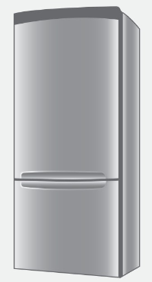
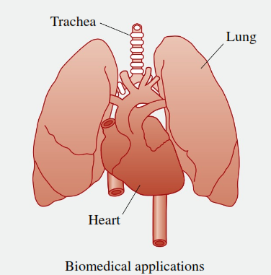
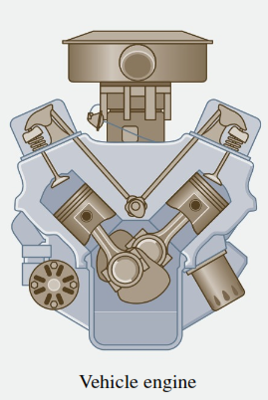
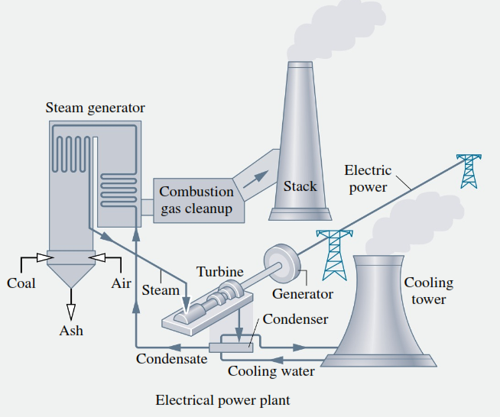
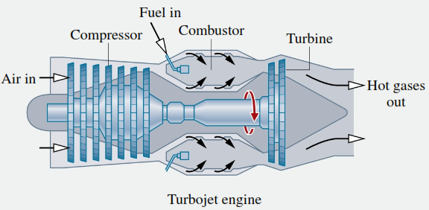
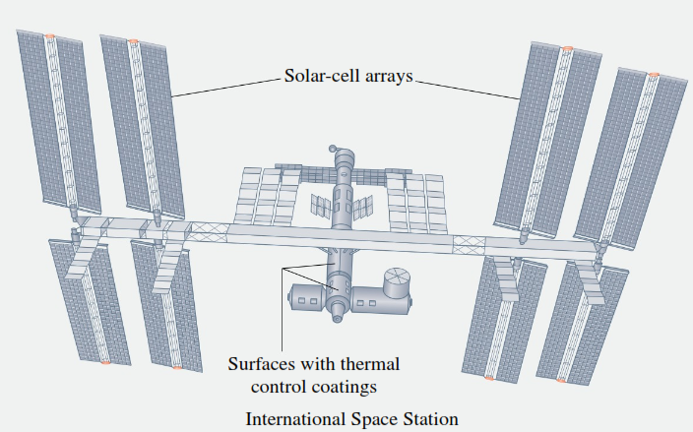
  Engineering applications of thermodynamics include surface and air transportation, space flight, electricity generation and transmission, heating and cooling, and biomedical application.

Slide 6
  Let us introduce some of the fundamental concepts and definitions.
  Defining Systems:
  The initial step in any thermodynamic / engineering analysis is to describe precisely what is being studied.
  In thermodynamics the term “system” is used to identify the subject of the analysis.
  The system is whatever we want to study. It may be as simple as a free body or as complex as an entire chemical refinery.
  It can be a fixed quantity of matter or something flowing through it.
  The composition of the matter inside the system may be fixed or may be changing through chemical or nuclear reactions.

Slide 7
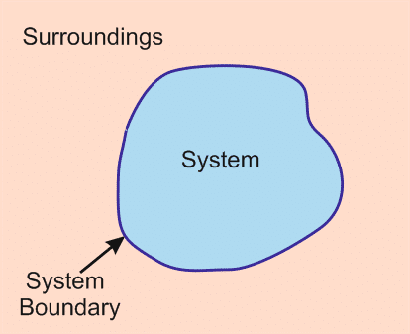
  The shape or volume of the system being analyzed is not necessarily constant, as when a gas in a cylinder is compressed by a piston or a balloon is inflated.
  Everything external to the system is considered to be part of the system’s surroundings.
  The system is distinguished from its surroundings by a specified boundary, which may be at rest or in motion.
  Two basic kinds of systems are there. These are referred to, respectively, as closed systems and control volumes.

Slide 8
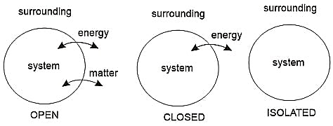
  A closed system refers to a fixed quantity of matter, whereas a control volume is a region of space through which mass may flow.
  A closed system always contains the same matter. There can be no transfer of mass across its boundary. The term control mass is sometimes used in place of closed system.
  A special type of closed system that does not interact in any way (neither mass nor energy) with its surroundings is called an isolated system.

Slide 9
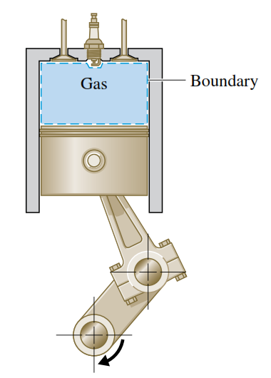
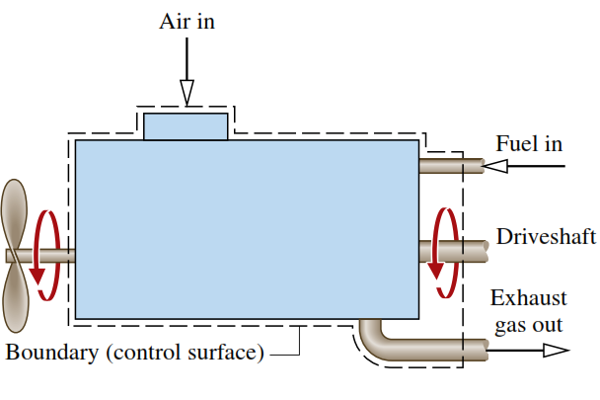
  An example of a closed system is a gas in a piston–cylinder assembly.
  In the picture of piston-cylinder assembly, when the valves are closed, we can consider the gas to be a closed system.
  The term open system is used interchangeably with control volume.
  When the terms control mass and control volume are used, the system boundary is often referred to as a control surface.
  A diagram of an engine is shown. The dashed line defines a control volume that surrounds the engine.

Slide 10
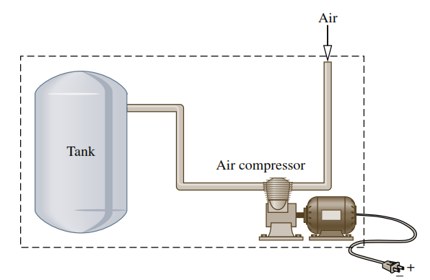
  The choice of a system boundary depends on the convenience it offers in the subsequent analysis.
  In general, the choice of system boundary is governed by two considerations:
    (1) what is known about a possible system, particularly at its boundaries, and
    (2) the objective of the analysis.
1
    Case 1: Electric power, Air inflow is known and objective is to calculate the time to reach a specified pressure
    Case 2: Air inflow and outflow is known, and objective is to determine electric power input
2
  There are two different viewpoints to study the system.

Slide 11
  Macroscopic and Microscopic views of thermodynamics
  The macroscopic approach to thermodynamics is concerned with the gross or overall behavior. This is sometimes called classical thermodynamics.
  The structure of matter at the molecular, atomic, and subatomic levels is not directly involved in this approach.
  The microscopic approach to thermodynamics, known as statistical thermodynamics, is concerned directly with the structure of matter.
  The system is characterized by statistical means, the average behavior of the particles making up a system and relate this information to the observed macroscopic behavior.
  Classical thermodynamics provides a direct approach for analysis and requires far fewer mathematical complications, therefore adopted for a wide range of engineering applications.

